Slide 1


November 2017
Viewing Trends Overview

Slide 2

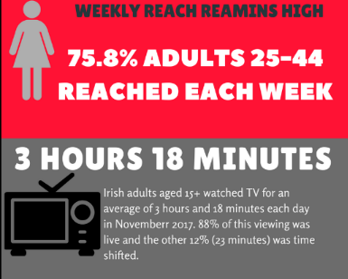
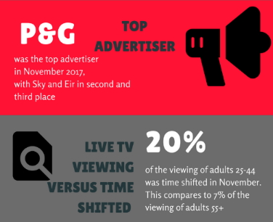
Total Viewing-November 2017

Slide 3
Average Minutes viewed daily
November 2017
19% of Ads25-44 viewing was time-shifted in November, compared to just 7% for Adults 55+

Slide 4
TV Viewing Live v Time shift Year on Year

Slide 5
Weekly reach of TAM Ireland Commercial Channels

Slide 6
Commercial Impacts November 2017

Slide 7
Top 10 Advertisers November 2017
1: P&G
2: Sky
3: Eir
4: Vodafone Ireland
05: Hyundai Ireland
10: Toyota
07: Lidl
08: Aldi
09: Reckitt Benckiser
06: Diageo

