Slide 1

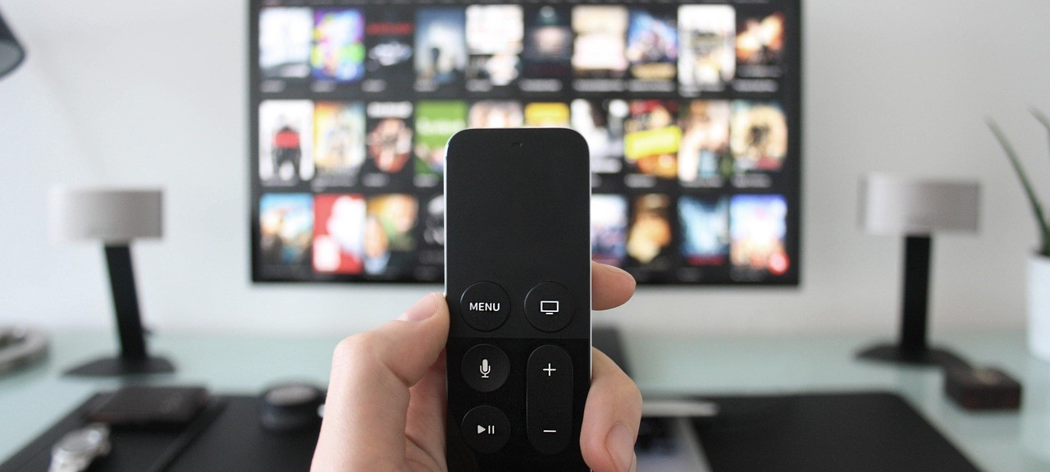
March 2018
Viewing Trends Overview

Slide 2

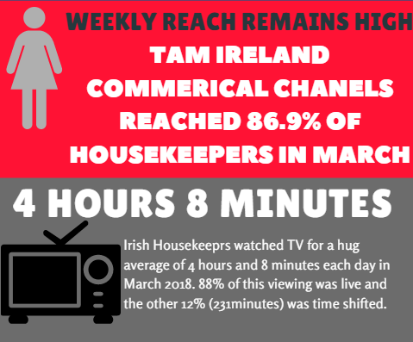

Total Viewing-March 2018

Slide 3
Average Minutes viewed daily
March 2018
Adults 55+ have by far the lowest time shifted viewing % at just 8%
In comparison 20% of Ads 25-44 viewing is time-shifted

Slide 4
TV Viewing Live v Time shift Year on Year
All audiences registered a slight increase in time shifted viewing year on year.

Slide 5
Weekly reach of TAM Ireland Commercial Channels

Slide 6
Commercial Impacts March 2018

Slide 7
Top 10 Advertisers March 2018
1: Procter & Gamble
2: Sky Ireland
3: Eir
4: McDonalds
05: L’Oréal
10: Mars Ireland
07: Aldi
08: Reckitt Benckiser
09: Virgin Media
06: Diageo

Slide 8
Top Programmes March 2018
RTE News: Six One
6 Nations Live England V Ireland
Live Nissan Super Sunday
Room To Improve
RTE News: Nine O'clock
Dancing With The Stars
The Late Late Show
6 Nations Live Trophy Lift
6 Nations Live Ireland V Scotland
Coronation Street
Live Monday Night Football: C Palace V Man Utd
The Simpsons
Live Premier League: Man Utd V Liverpool
Live: Munster V Toulon
6 Nations Prematch England V Ireland

Slide 9
Top Programmes March 2018
The Great Celebrity Bake Off
The Middle
GAA Beo
Classic Premier League
Gogglebox
The Big Bang Theory
Location, Location, Location
Young Sheldon
Henry Danger
Teen Mom OG
The Thundermans
Friends
Rugbaí-Croabh na hEorpa
Cluichí na Bliana 2016
Cuimhní Órga Spóirt - Iomáint
Rugbaí Beo Pro 14 2017-2018
Darts 2018
UEFA Champions League Mag.
Allianz National Football
Premier League Highlights

