Slide 1










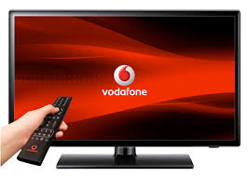








In a decade of disruption, TV set viewing is resilient
HOURS OF TV VIEWED ON A TV SET PER DAY
72%
Internet access
89%
Internet access*
Source: BARB, 2007-2017, individuals. TV set viewing within 7 days of broadcast. *Ipsos Tech tracker Q4 2017
Notes:
BVOD viewing TV on other devices adds an additional 9.22 mins per day bringing the total to 3.04 hrs per day

