Slide 1


#pv2019

Slide 2
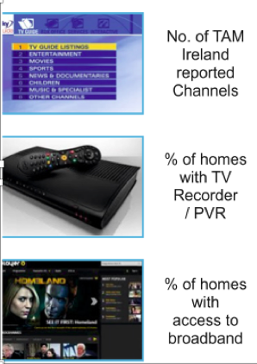
2008
2013
2018
20
33
52
5
53
60
63
82
89

Slide 3
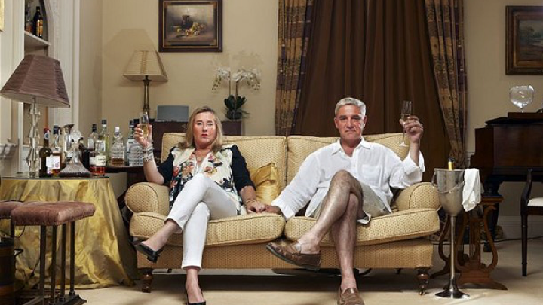
Reality Check
New Media
New media has grown total media time and occasions
TV is robust and is the key battleground for disruptors and incumbents
In Ireland 84% of all video viewing time across all devices remains with broadcaster channels – massively counter to initial forecasts

Slide 4
Old & New – not old v’s new
Consumers adopt new media alongside old & they co- exist – even for “millennials”
Digital & AI is proving most revolutionary lower down the marketing funnel
The “old” rules of brand building still apply

Slide 5

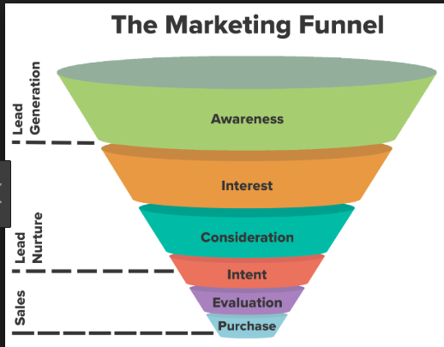
Television’s Forte
Digital’s Forte

Slide 6
TV has high daily, weekly and monthly reach
Total TV in Ireland reaches:
65.6%
86.3%
96.3%
of the population
in a day
of the population
in a week
of the population
in a month
Notes:
TV has the greatest reach of all media. No other form of advertising can build scale as quickly and powerfully as TV.

Slide 7










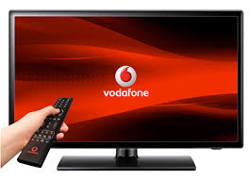








In a decade of disruption, viewing to TV on a TV Set remains very strong
MINS OF TV VIEWED ON A TV SET PER DAY
89%
Internet access*
63%
Internet access*
Notes:
BVOD viewing TV on other devices adds an additional 9.22 mins per day bringing the total to 3.04 hrs per day

Slide 8
And viewing to broadcaster generated content is impressively resilient
MINS OF BROADCASTER CONTENT VIEWED PER DAY
63%
Internet access*
89%
Internet access*
Notes:
BVOD viewing TV on other devices adds an additional 9.22 mins per day bringing the total to 3.04 hrs per day

Slide 9
Our Video Day - % of mins viewed x format
2 hr 40 mins
per day

Slide 10
Our Video Day - incremental Weekly Reach build x format

Slide 11
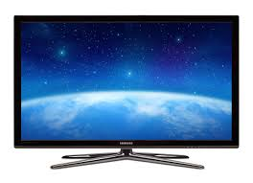
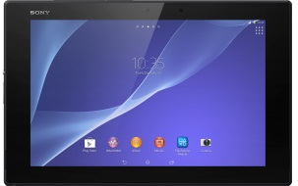
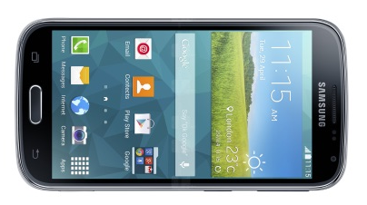
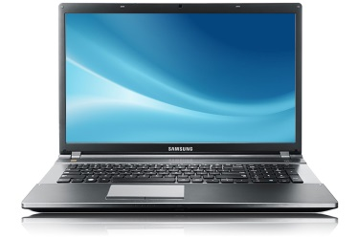
Our Video Day - % of minutes viewed x device
15-24 years
25-44 years
45+ years
57%
82%
94%
5%
2%
1%
23%
9%
3%
15%
7%
3%
Source: TAM A/V Data Solution 2018
Notes:
Device ownership is mainstream

Slide 12
TV is at the heart of a growing video world
All TV is video but not all video is TV.
TV is premium programmes in a premium context.

Slide 13
If live TV didn’t exist we’d have to invent it
Technology changes quickly but human needs do not.
Why do people love live TV?
Content
Convenience
Conversation

Slide 14
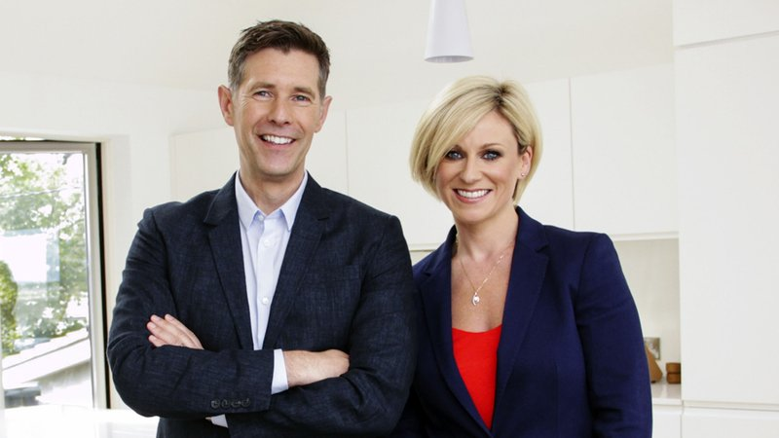
TV sparks conversation
Social media has become the digital water cooler.
Local, Irish made entertainment and factual programmes consistently feature in weekly Social TV Top 10
Room to Improve on March 25th had over 8,500 comments on Twitter/Facebook during the one hour live broadcast
Notes:
.
There is no doubt that in Ireland, watching TV has always been a social experience. Even before the arrival of the internet people would gather around to tune in with their friends and families, discussing what they were viewing. While “watercooler moments” (where those significant moments in TV broadcasting are discussed the next day in the workplace or home) still exist, they have altered slightly. The conversations still happen; however, many of them have moved online. In many ways, social media has become the digital water cooler. Engager analyse social engagement in terms of likes, comments, shares, and retweets across Facebook and Twitter.

Slide 15
It’s not all about brand building
TV is great at activation too.
Here’s a sneak peak into our latest research – hot off the presses this morning

Slide 16
Web Response - Travel
Pearson's correlation coefficient
0.917
Coefficient of determination
0.840
p-value
0

Slide 17
Establishment Survey
Increased to 9350 households per annum – the largest household random probability sample in the country
Donated over 15k to charity

Slide 18
TAM Ireland Activities
Panel increasing – 1000 reporting homes daily
One of the most representative panels in the world

Slide 19

Upcoming Events
THE TAMI's-Ireland TV Planning Awards
Ireland's first TV Planning awards, designed to recognise and celebrate inspired uses of TV.
March 28th 2019
Best use of TV and …..
Best use of innovation
Best ongoing use of TV
Best Newcomer
€100k worth of airtime to the grand prix winner!
CLOSING DATE EXTENDED TO FEB 15TH

Slide 20


Upcoming Events
TV TRAINING 2019
A workshop designed to give participants a grounding in the essentials of AV planning and buying.
February 13th 2019 – booked out
May 22nd 2019
COMING SOON
TAMI Award Winners Showcase 19th September 2019
The TAM Long Lunch-October 2019

