Slide 1
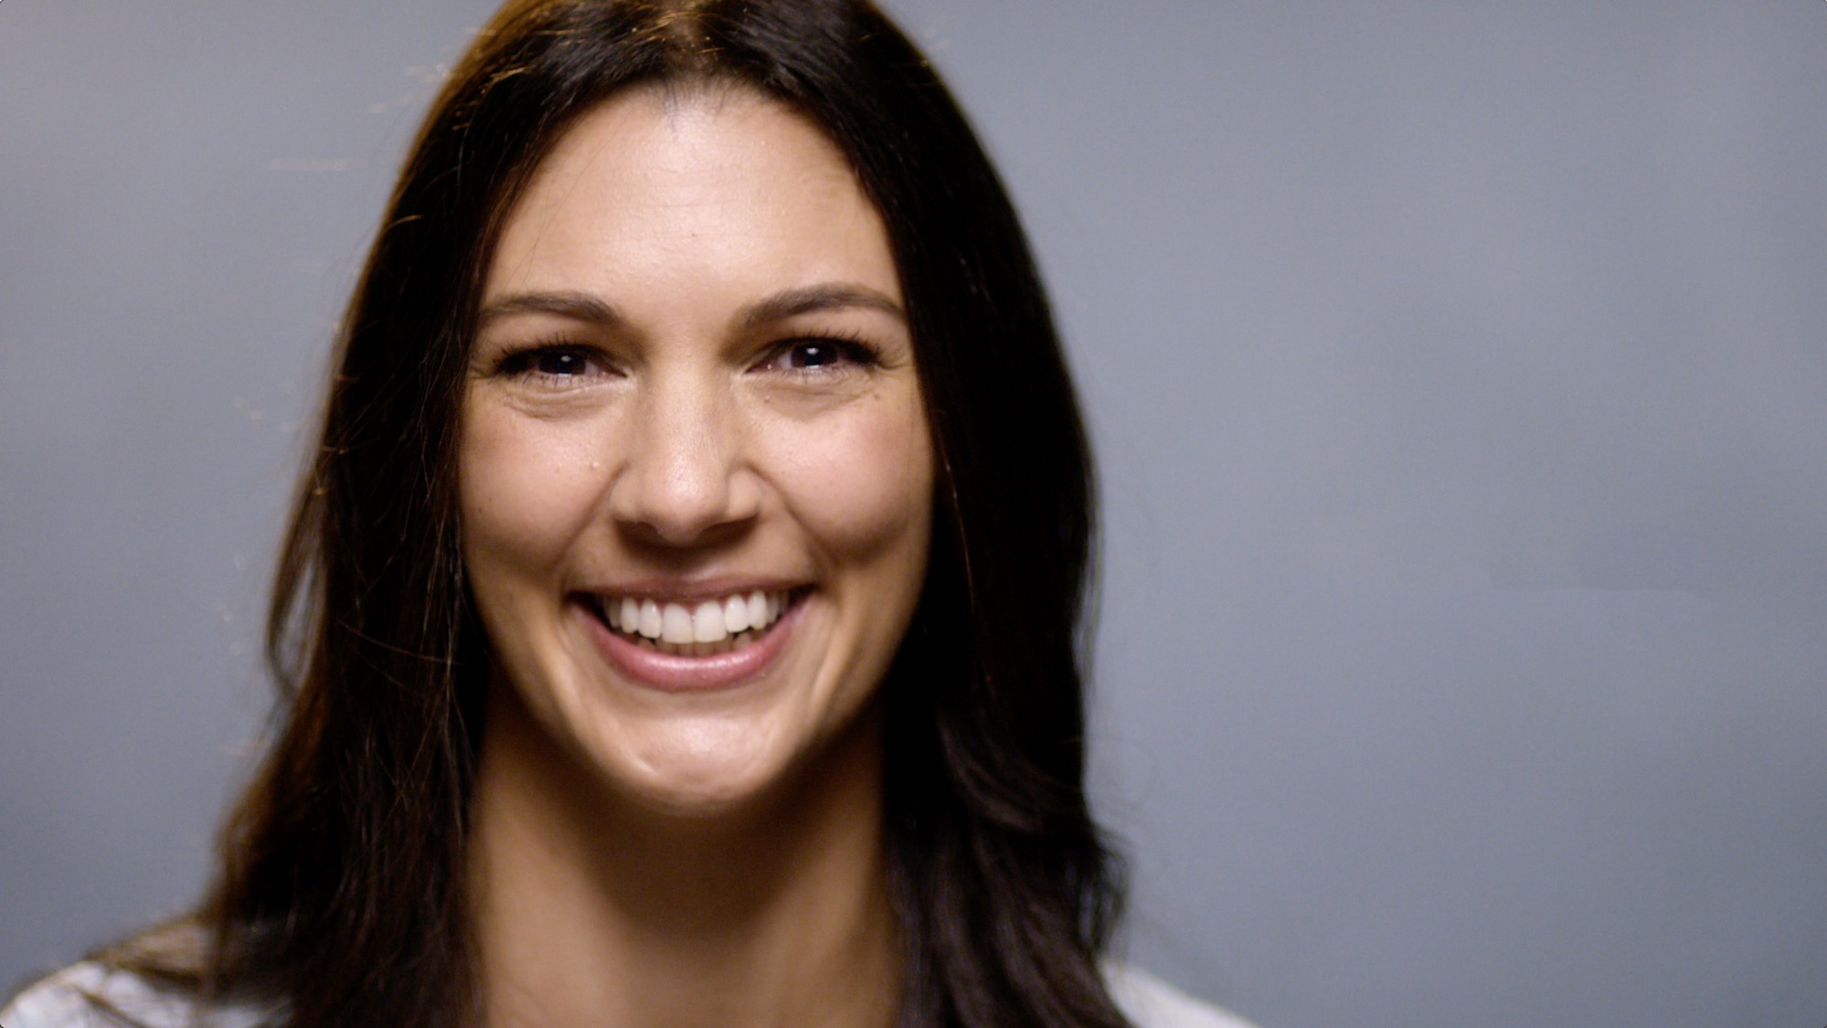

The role of TV for Vhi
29 January 2019

Slide 2

When it comes to
media effectiveness
What the industry thought
1 | TV | 48.9
2 | Online Video | 41.6
3 | Social Media | 41.3
4 | OOH | 39.6
5 | Cinema | 39.1
6 | Radio | 38.9
7 | Newspapers | 36.3
8 | DM | 36.3
9 | Online Display | 35.5
10 | Magazines | 35.1
Weighted attribute scores: targeting, ROI, emotional response, brand salience, reach, frequency, noticeability, media cost, production cost, environment, short-term sales response & measurement
Re-evaluating Media – Ebiquity 2018

Slide 3
When it comes to
media effectiveness
What the industry thought |  |  |  | What the evidence says
1 | TV | 48.9 |  | 1 | TV | 107.1
2 | Online Video | 41.6 |  | 2 | Radio | 103.2
3 | Social Media | 41.3 |  | 3 | Press | 87.8
4 | OOH | 39.6 |  | 4 | Mags | 79.5
5 | Cinema | 39.1 |  | 5 | OOH | 71.7
6 | Radio | 38.9 |  | 6 | DM | 67.0
7 | Newspapers | 36.3 |  | 7 | Social | 65.8
8 | DM | 36.3 |  | 8 | Cinema | 61.4
9 | Online Display | 35.5 |  | 9 | Online Video | 57.6
10 | Magazines | 35.1 |  | 10 | Online Display | 50
Weighted attribute scores: targeting, ROI, emotional response, brand salience, reach, frequency, noticeability, media cost, production cost, environment, short-term sales response & measurement
Re-evaluating Media – Ebiquity 2018

Slide 4


Vhi Mixed Marketing Modelling
(August 2014 – April 2017)
VHI

Slide 5


Slide 6
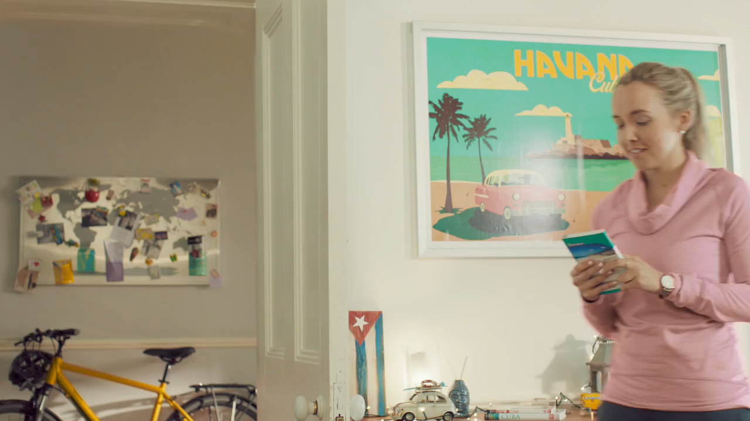
Vhi Testimonial TVC
VHI

Slide 7

Emotional effects build over years
Source: The pursuit of effectiveness, Les Binet & Peter Field

Slide 8
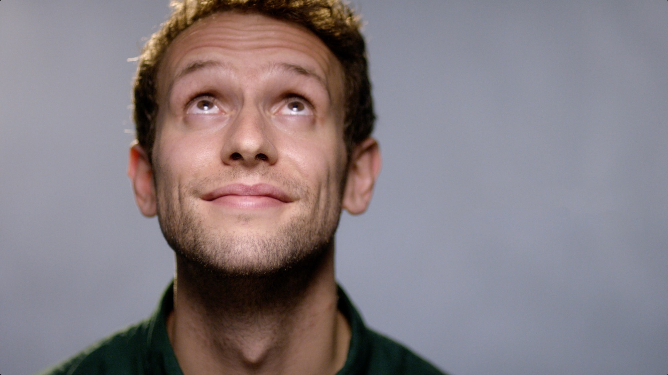
Getting the balance
right
VHI

Slide 9

When brand building is easy, up-weight activation
Role of emotions in purchase decision
Source: IPA Databank, 1998-2016 for-profit cases

Slide 10

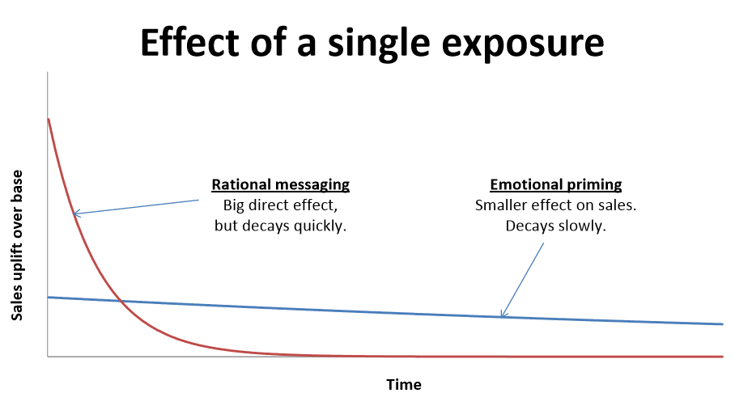
We can see the effect of a single exposure
Source: The Long and short of it, Les Binet and Peter Field

Slide 11
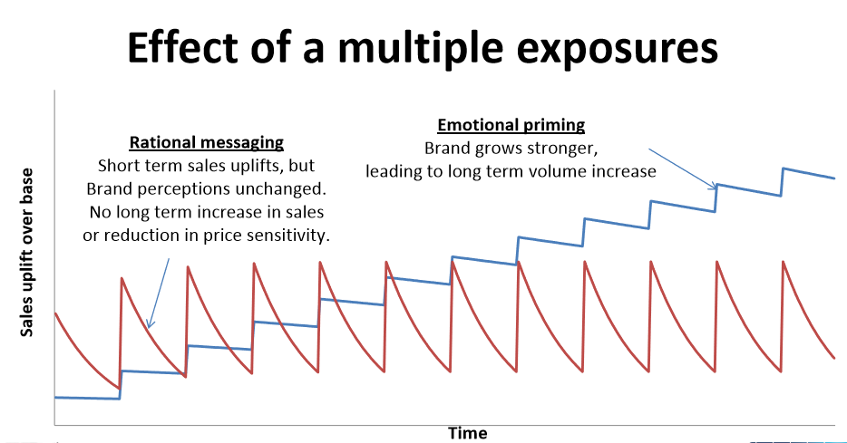
And the effect of multiple exposures
Source: The Long and short of it, Les Binet and Peter Field

Slide 12

Vhi has seen these effects in our business results
0.1% increase in SOM
7 PP increase in new business from benefit led activation
Younger cohorts sales increase by 5 PP
First time in 20 years
41% in 2016, versus 34% in 2017
35% to 40%, one year ahead of target
Brand imagery has improved on 20/21 criteria
TV consistently performed in top 10% for awareness of all TV ads
10 have increased by more than 5 PP
Noticeable incline began in line with new comms

Slide 13
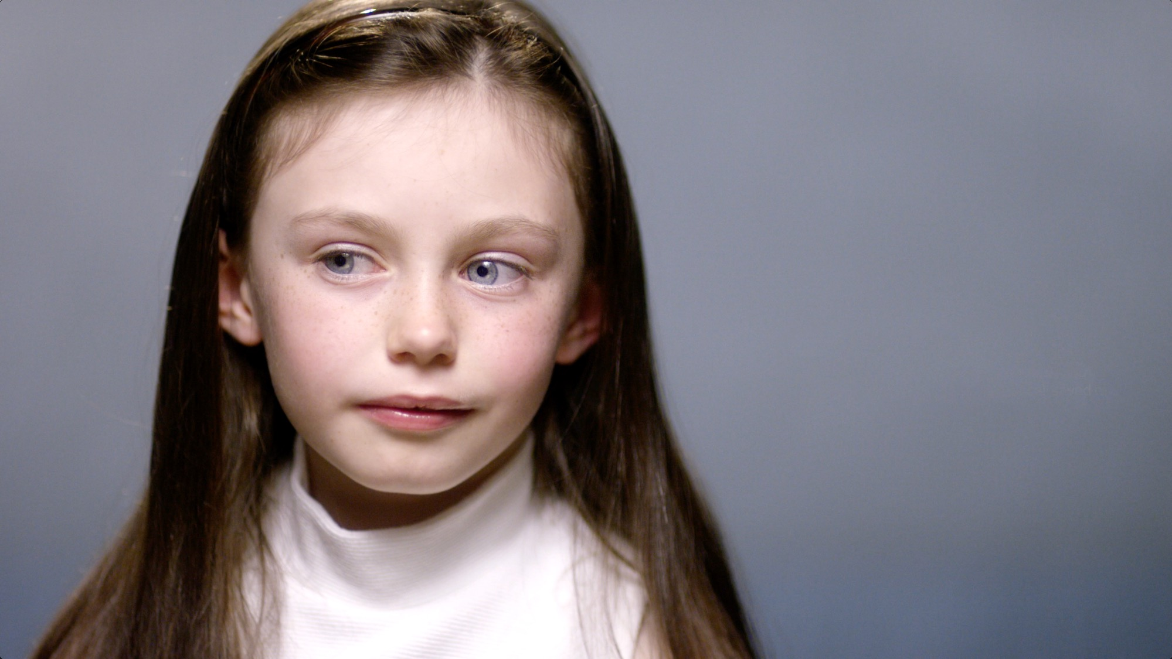
Using multiple media channels
VHI

Slide 14
Keep in mind that using multiple media channels is more effective than using one media channel alone
Sources: Jasper Snyder and Manuel Garcia-Garcia, Journal of Advertising

Slide 15
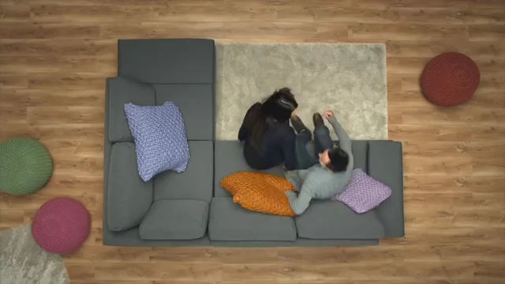
Vhi Fertility TVC
VHI

Slide 16

Strategy
Spark the conversation
Engage in the Issues
Get support (from Vhi)

Slide 17
Vhi Advertising Reach Overview – Prompted Awareness
(June 2018)
VHI

Slide 18
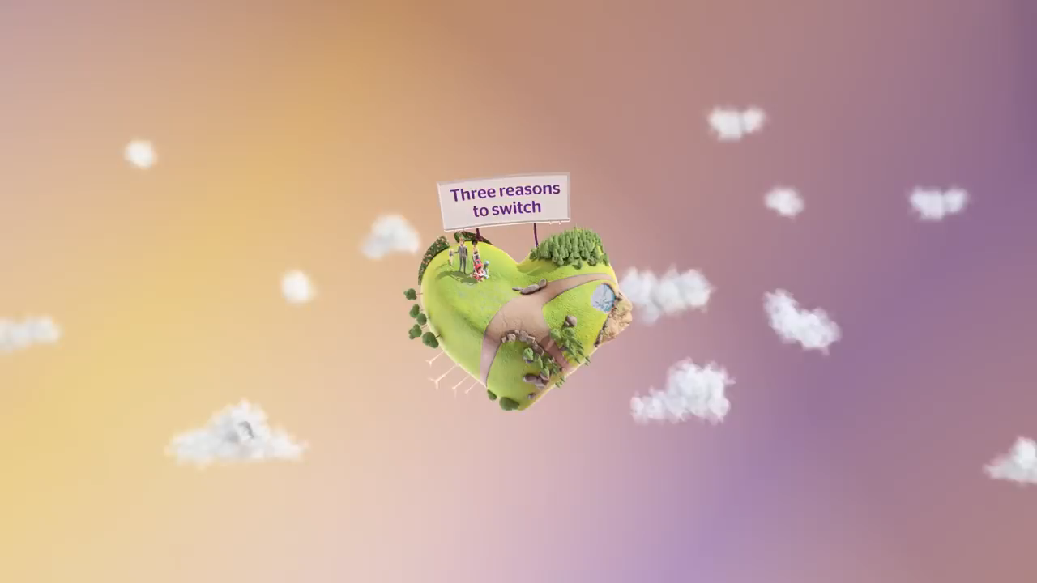
Vhi 25% off TVC
VHI

Slide 19
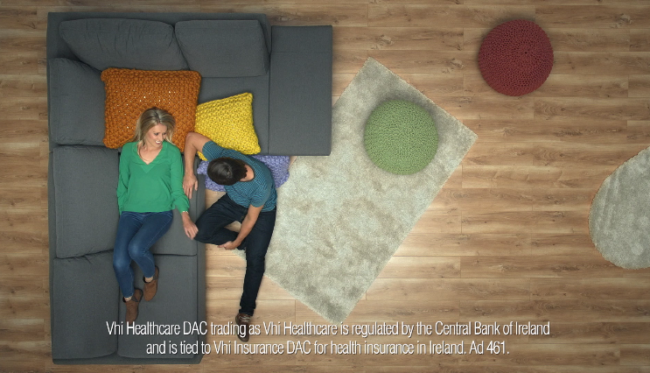
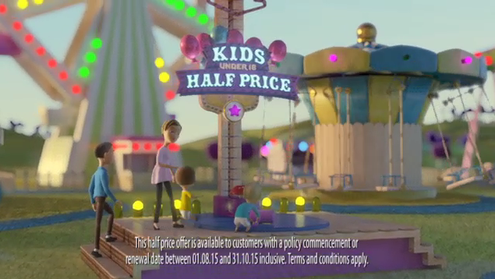
TV & VOD effectiveness by creative
Volume uplift per 100 GRPs (August 2014 – April 2017)
VHI

Slide 20
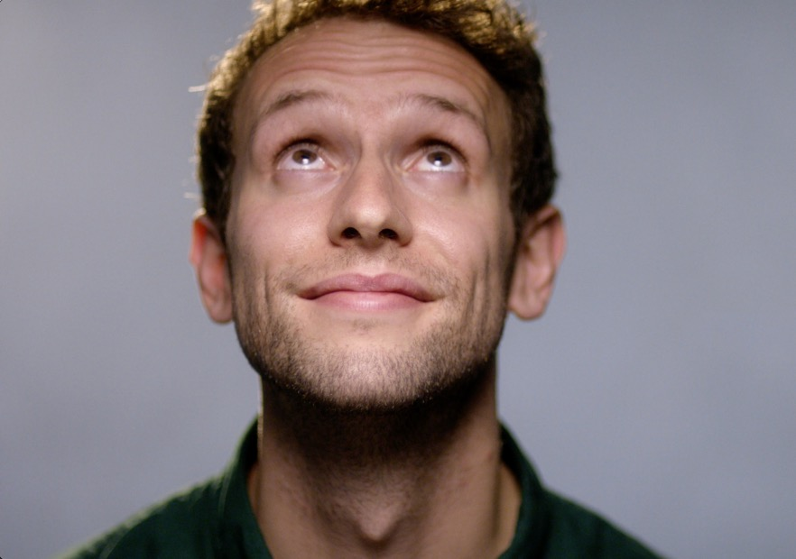

Recap
Right balance between emotional and tactical
Right media mix
Purpose for each medium
Creative and Media working together to develop an efficient and clever response
It has to all make sense!
VHI

Slide 21

Thank you

