Slide 1


The Age of Television

Slide 2
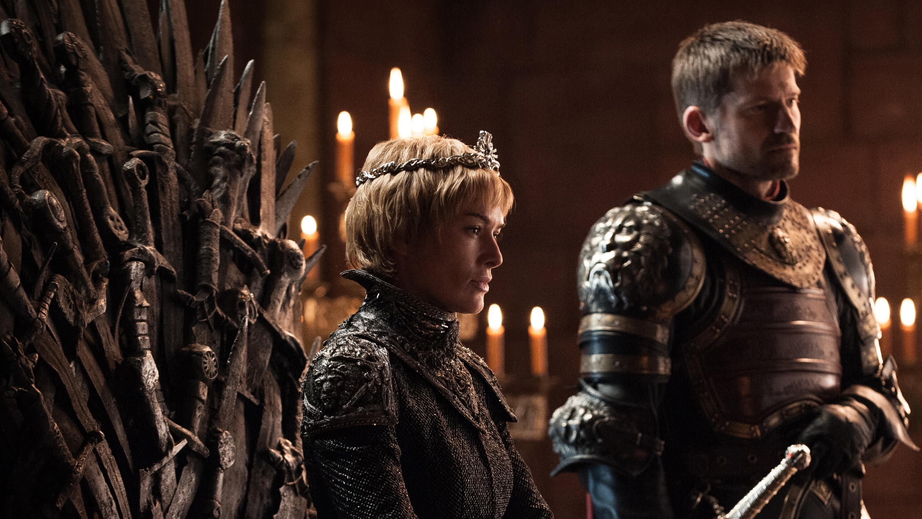
We are in a platinum age of TV
Greater choice & control
Quality of programming never better
Irish broadcasters invested in approx. €80 million on original content in 2018
Source: The Age of Television, 2018, MTM/Thinkbox. IHS Markit, Ofcom, 2018
Notes:
From a consumer point of view, we now have more choice in terms of what we view than ever before. There are more platforms, more device options, more places we can watch TV, both in and out of the home.
We’ve got more control over what we watch: we can pause, rewind, record, catch-up.
TV is much better quality. Most of us watch in HD, with 4K now an option and 8K coming soon and TV screen sizes keep increasing every year.
Finally, the quality of content broadcasters are putting out has never been stronger. You look at shows on Channel 4 such as The Handmaid’s Tale, Westworld, Game Thrones or Sharp Objects on Sky. These are huge budget, high-action dramas that you used only to find in the cinema, but you can now access them every day on your TV set. The UK spends £53 per person on original content and £123 on all content – which is the highest in the world.

Slide 3


TV accounts for 79% of our video day
Adults 25-44
Source: TAM Ireland A/V Data Solution All households, All devices x format
Notes:
Stand Alone is a large bucket including Netflix, Amazon Prime, Now TV, and gaming.

Slide 4


We needed to understand broad video viewing
Partnered with MTM/B&A
Camera glasses x 30
Depth interviews x 30
Behavioural science
1,200online survey
Data collation / future predictions

Slide 5








There are 8 need states which drive video viewing
8% ESCAPE
9% EXPERIENCE
8% INDULGE
15% IN TOUCH
3% DO
15% COMFORT
19% DISTRACT
22% UNWIND
Source: The Age of Television, 2018, B&A/TAM Ireland
Notes:
In the latest study, we found the same six need states but there were also two new ones that came through – do and distract
The study sized these eight need states in terms of the time audiences spend meeting each one with video content.
We found that the largest proportion of time spent watching videos is to satisfy the need to unwind, then the need for a distraction, followed by the need for comfort.

Slide 6
Needs are driven by both internal & external factors
CONTENT
8% ESCAPE
9% EXPERIENCE
8% INDULGE
15% IN TOUCH
PERSONAL
3% DO
15% COMFORT
SOCIAL
19% DISTRACT
22% UNWIND
CONTEXT
Source: The Age of Television, 2018, B&A/TAM Ireland
Notes:
The role of content and context differ across each need state, with content is particularly important for escape and experience.
In contrast, the need to unwind is far more likely to be driven by context – such as the need to wind down after work.
The need states also differ in terms of being personally or socially driven. For example, the need for comfort is driven by a desire to spend time with others, while the need for a distraction is more personal.

Slide 7
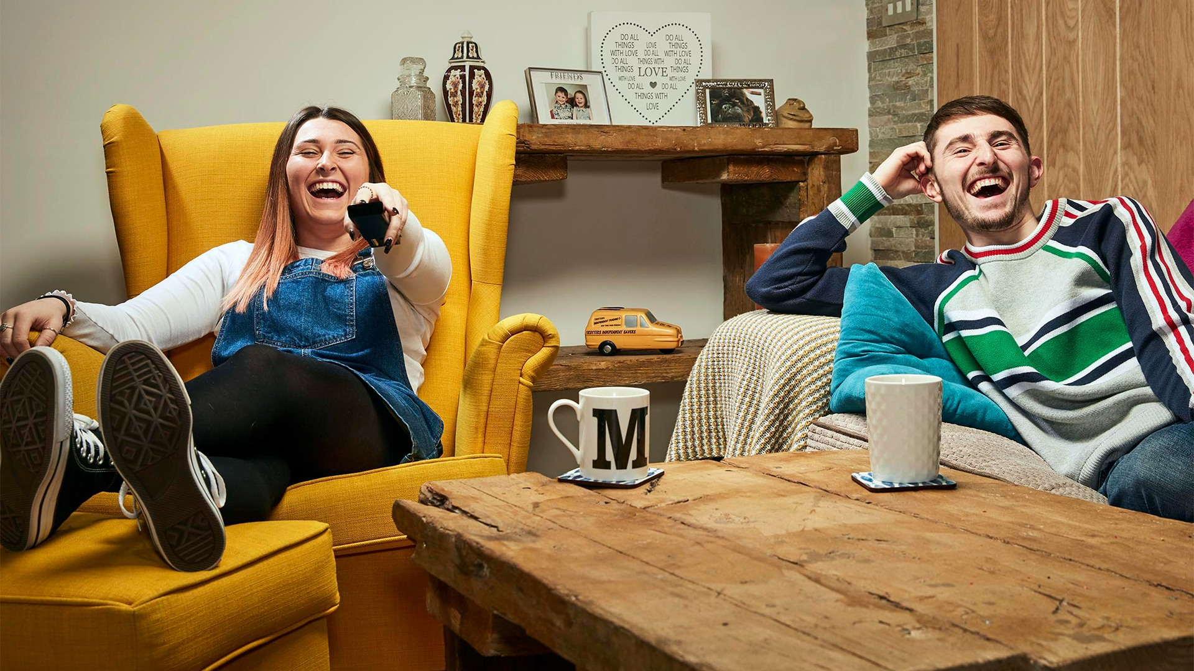
A closer look at the need states…
Notes:
Let’s have a look at the need states in a bit more detail

Slide 8
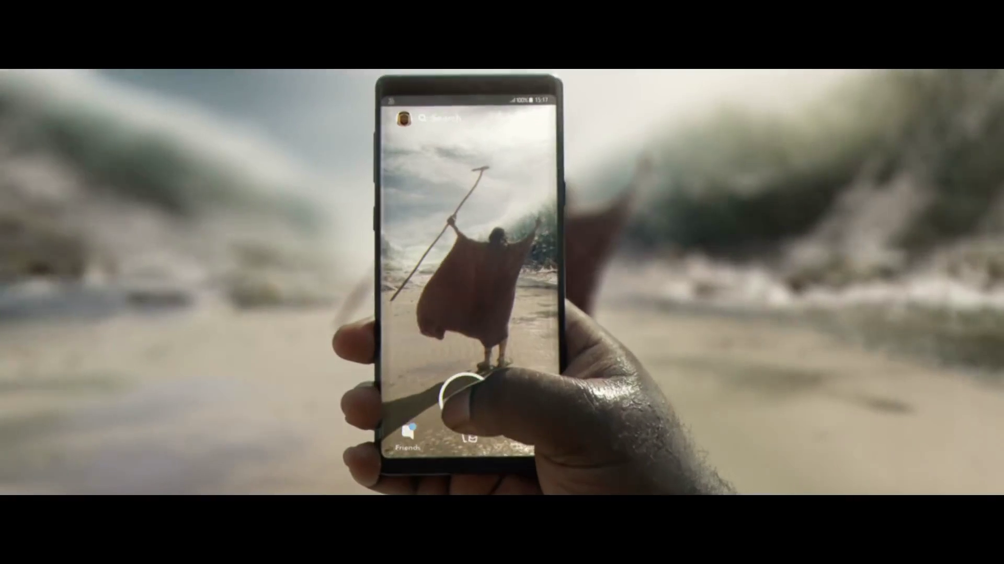
Online video facilitates ‘doing’ & is a key means of distraction
Notes:
Let’s start by looking at one of the new need states - DO

Slide 9

Viewing for practical tasks, or to distract ourselves, has high online video usage
ONLINE VIDEO
Source: The Age of Television, 2018, B&A/TAM Ireland
Notes:
We observed the role of online platforms when it comes to delivering against the need for distraction or useful information.
When audiences want practical information from video, they are most likely to turn to online platforms – more than half of the time spent in the ‘do’ need state is with online services like YouTube.

Slide 10
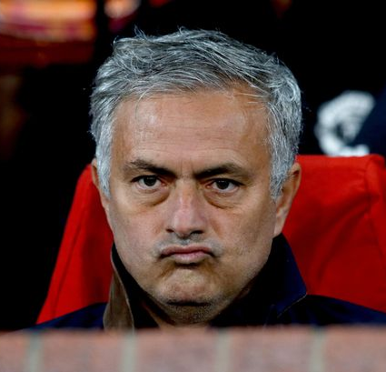


Do with José Mourinho
Need for practical info / tutorials
Often short-form content on YouTube
Production quality less important
Devices key
Notes:
Let’s imagine Jose Mourinho in the DO need state. He recently got sacked as the manager of Man United.
Hopefully now he is spending his free time watching videos of how to play attacking football and how to handle mega stars.
Perhaps if he had been doing that all along, he wouldn’t be looking for another job now.
You can see a summary of the key elements of the DO need state

Slide 11



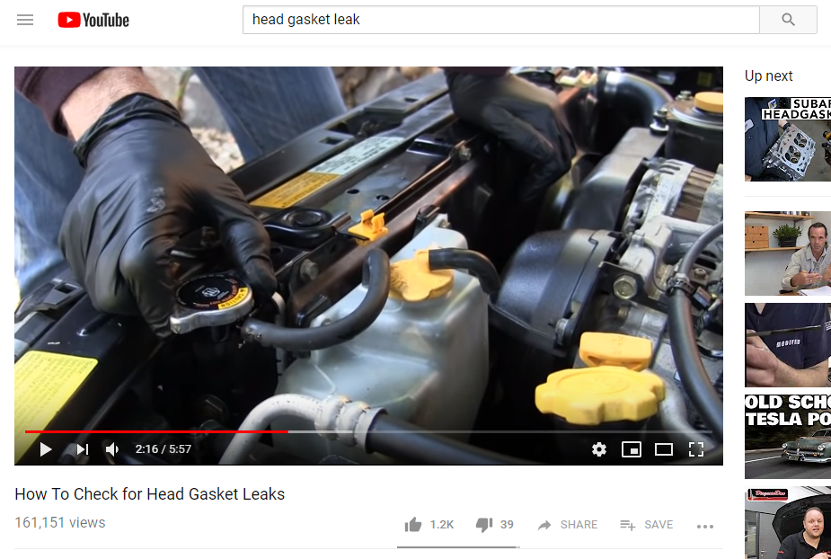
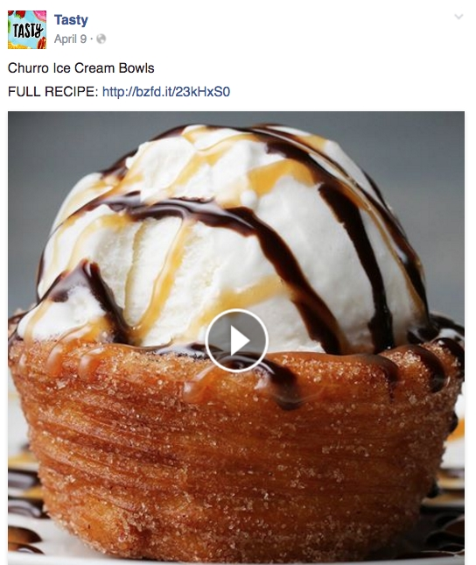
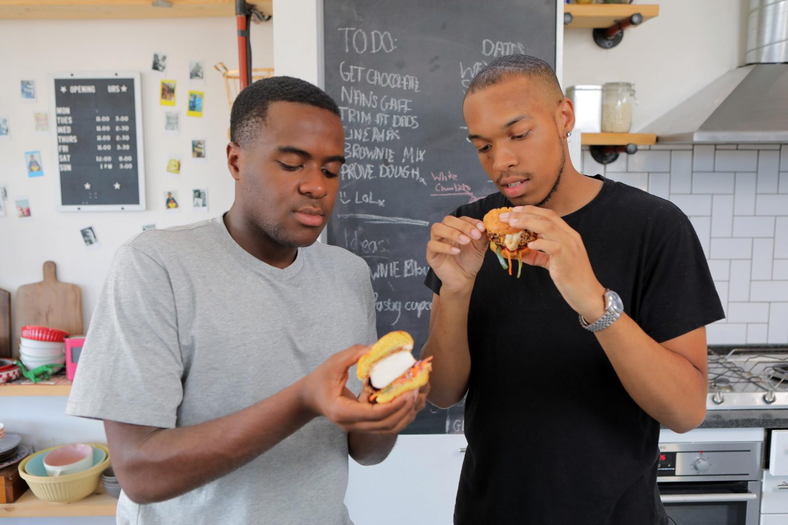


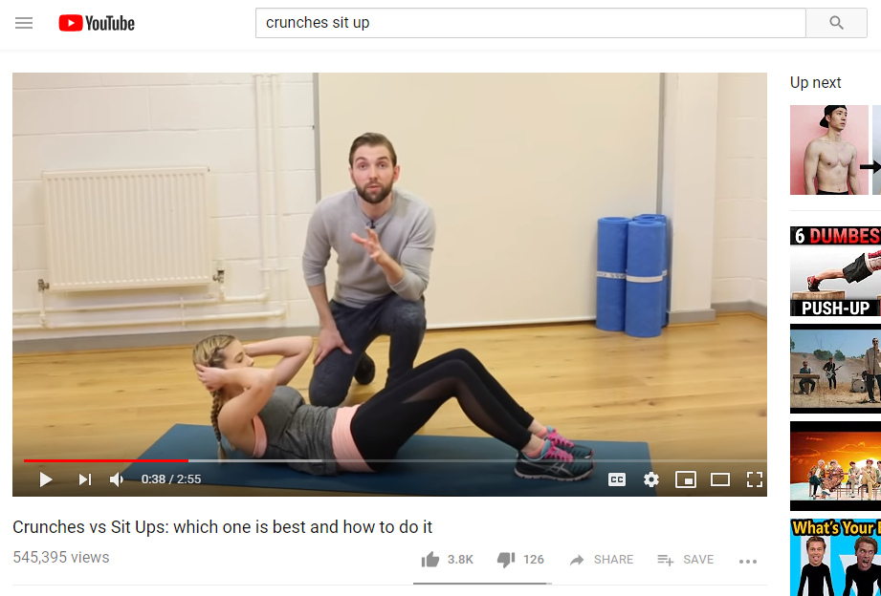
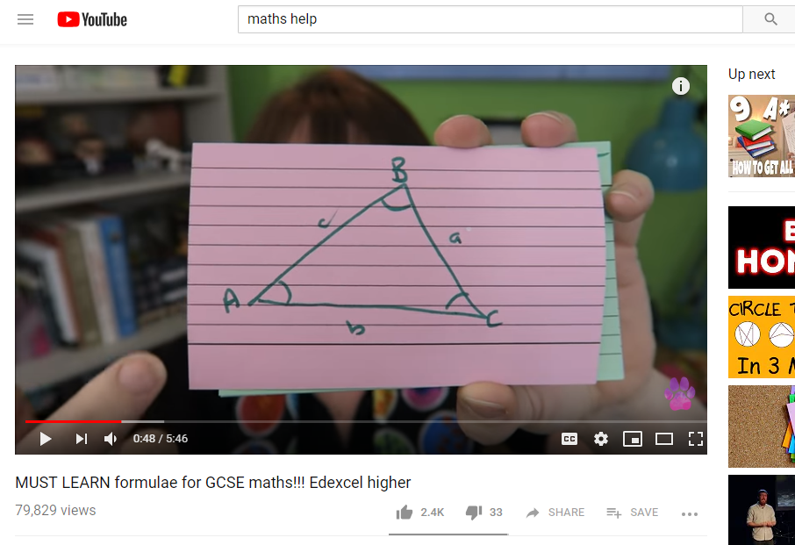
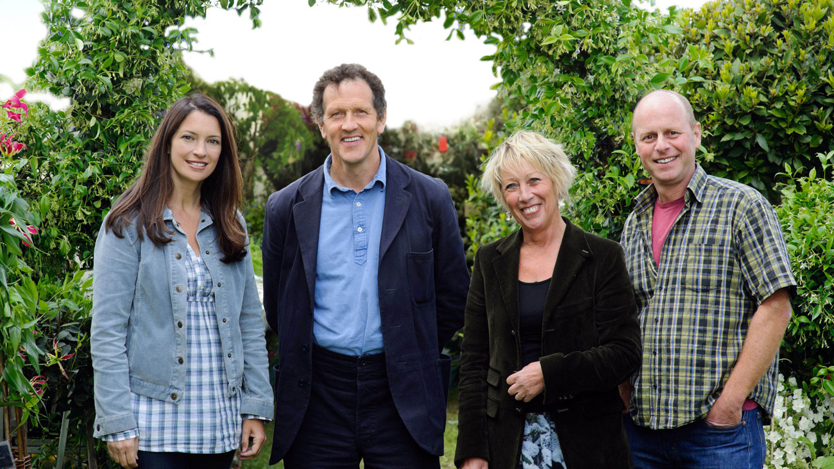
Do
3% of viewing time
The need to find useful information that can be practically applied to any area of life
15% online video
66% watched on device
61% how-to/DIY videos
Served by instructional/ how-to videos:
Source: The Age of Television, 2018, B&A/TAM Ireland
Notes:
Content focuses on instructional and ‘how-to’ videos covering a huge variety of everyday tasks - from changing a tyre/doing a sit-up/following a recipe/help with coursework.
Channel subscriptions & personalised recommendations are less relevant, as users are task focused and goal-orientated. Whether searching on YouTube, they’ll click on the most relevant looking video and production values are much less important.
In the past, we might have turned to information sources such as reference books, instruction manuals and cookbooks. Often these days, these have been replaced by online video.
TV can deliver in the DO need state, but it tends to be secondary and in addition to another need being served, rather than the primary motivation for viewing.

Slide 12
Distract with Leo Varadkar
Needs some light distraction
Theresa May/Boris Johnson memes
Instant gratification at fingertips
Short-form content
Notes:
Let’s imagine Leo Veradkar in the distract need state. He certainly needs some light distraction at the moment. Perhaps he’s is checking out memes of Theresa May or Boris Johnson or to put a smile of his face.
Video provides instant gratification when people want to fill time or have a brief distraction from what they’re doing and this can apply across a wide range of situations.
Examples from our respondents included waiting for your partner to come out of the shower in the morning, commuting, taking a break from work, waiting for the Xbox to load, waiting for a TV show to start etc

Slide 13



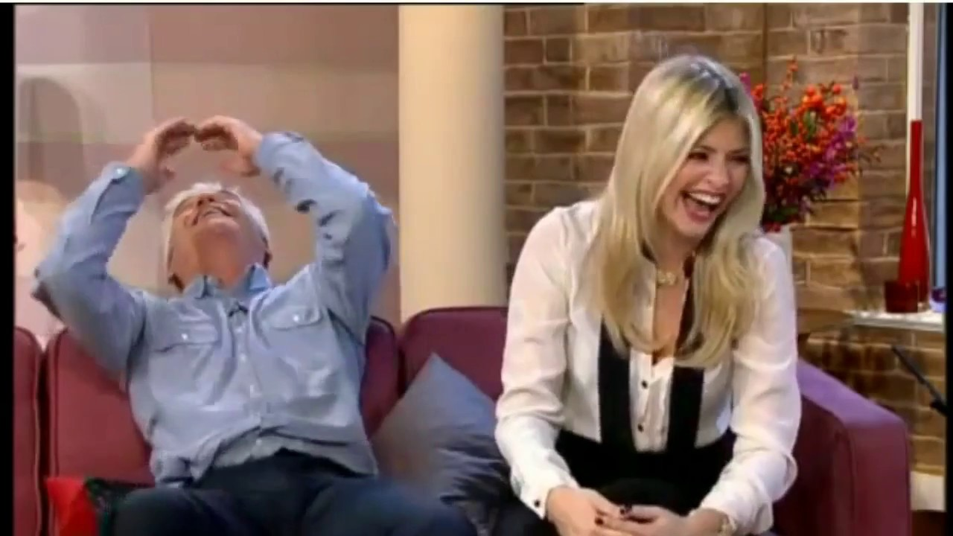

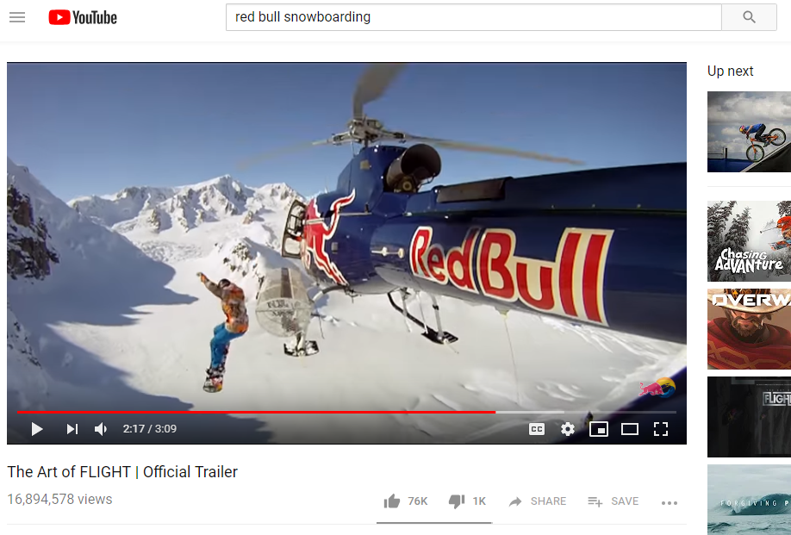
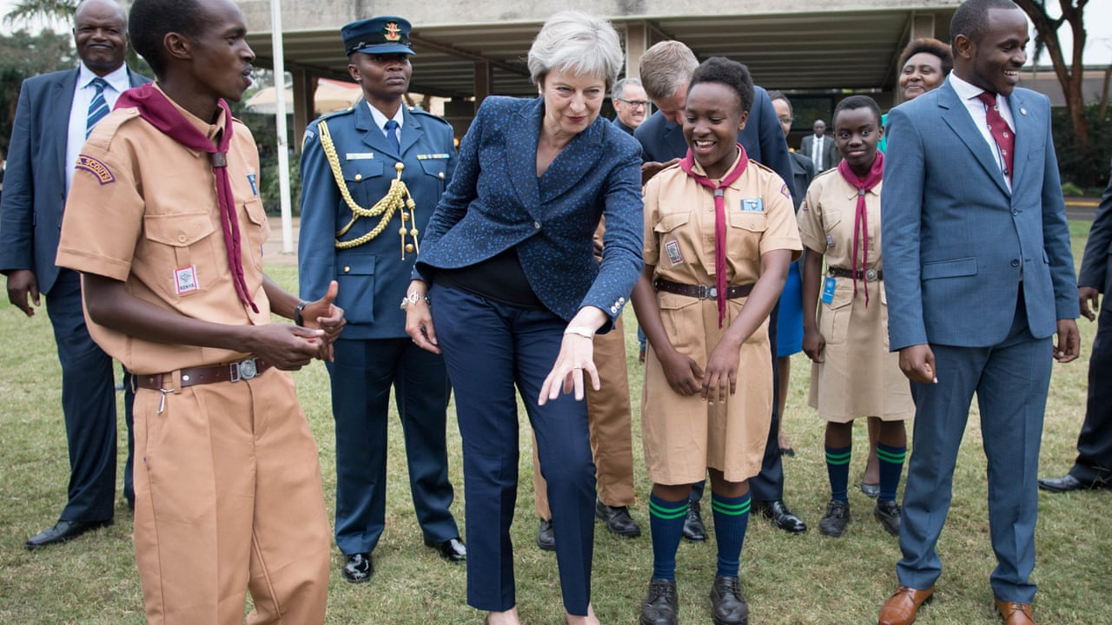

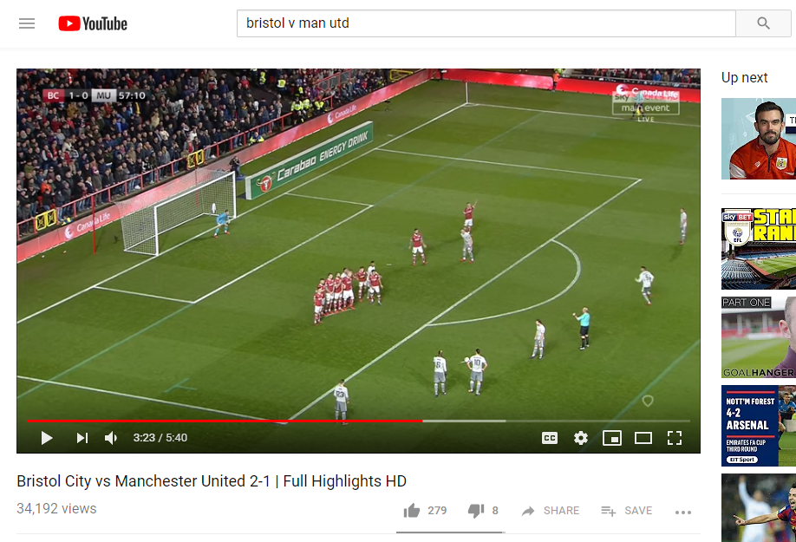
Distract
19% of viewing time
The need for instant gratification to fill time, counter boredom or provide a short break from other tasks
49% 16-34 profile
8% online video
48% watched on device
Served by entertaining or informing content:
Source: The Age of Television, 2018, B&A/TAM Ireland
Notes:
In the distract need state viewers are often looking to lighten their mood or put a smile on their face.
Online video content will typically be shorter videos informed by the personal tastes and interests of users
Consumption skews more towards afternoon than other needs, indicating that this is a time of day when distraction is needed.

Slide 14
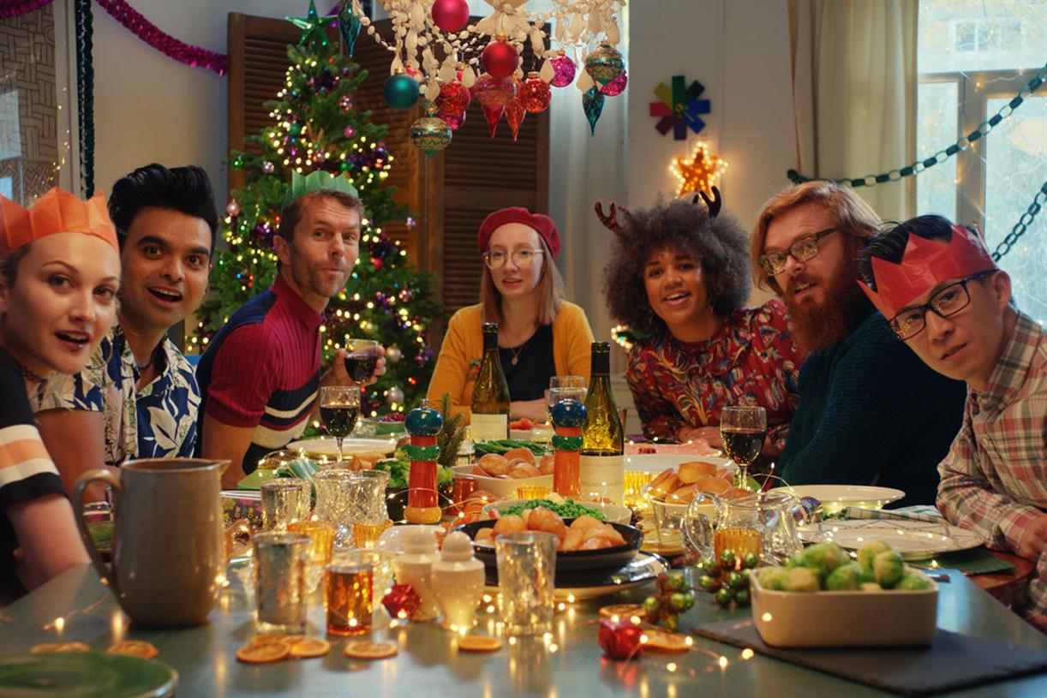
The need to indulge spans all forms of video, including VOD
Notes:
The next need state is indulge, which spans all forms of video including VOD

Slide 15
Indulge is well served by all video platforms
COMFORT
UNWIND
DISTRACT
DO
INDULGE
IN TOUCH
ESCAPE
EXPERIENCE
Source: The Age of Television, 2018, B&A/TAM Ireland

Slide 16
Indulge with Majella
Too much time with Daniel wants to focus on her interests
‘My time’
Personal viewing: docs, reality & niche content
‘Communities of interest’
Notes:
Majella spends a lot of time with Daniel, they live together and present together. And it’s fair to say, that Daniel can’t be easy to live with.
Sometimes it just all gets too much for Majella and she wants to forget Daniel and focus on herself for a bit by watching Striking Out on catch up
For all age groups, viewing is more likely to be alone – this is ‘my time’ and they’re engaged, relaxed and happy.
This need state can either be about pursuing individual hobbies and passions – from history or wildlife documentaries to gaming or make-up videos – or indulging guilty pleasures, for example reality TV or looking at cute videos of puppies!
The growth of online video has meant that personal interests can now be more easily indulged. It doesn’t have to be a strong personal passion because access is easier, whereas before you had to actively search out content on websites or in books and magazines. Whilst online video is a replacement for these sources to a degree, most people previously did nothing because it required effort – it’s now much easier to have a range of interests.
Online video has also amplified what behavioural economists describe as ‘communities of interest’ – basically weird stuff! This focuses on a wide range of areas where people derive satisfaction and pleasure and which can often cater to unusual and niche personal preferences - from spot squeezing to unboxing to joint cracking!

Slide 17




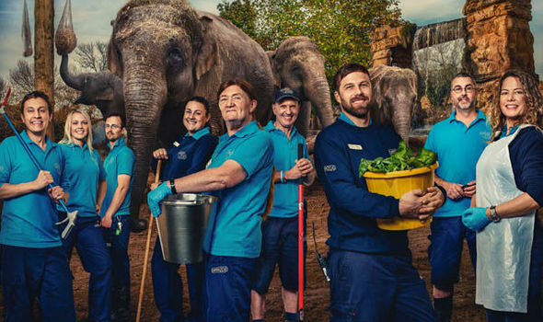

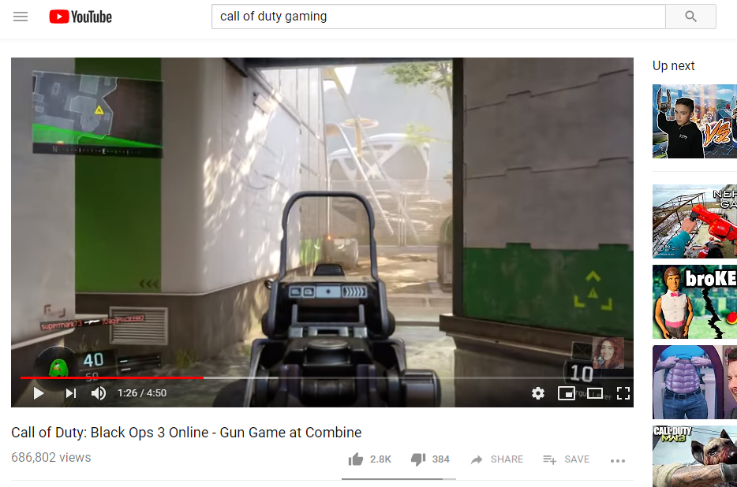
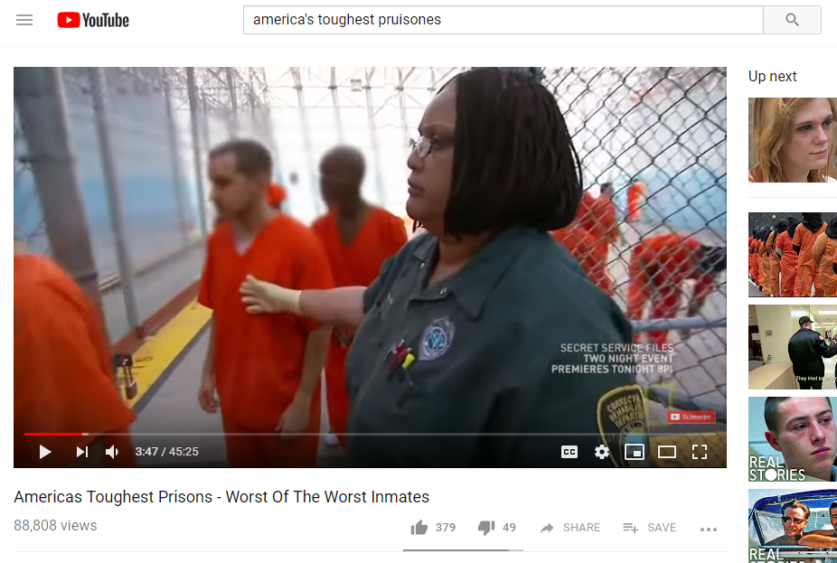
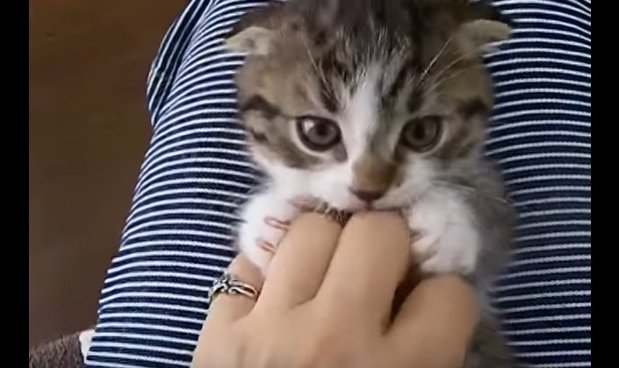
Indulge
8% of viewing time
The need to pursue personal interests, hobbies and fulfil guilty pleasures
28% 16-34 profile
10% online video
55% solo viewing
Served by content relating to hobbies and interests:
Source: The Age of Television, 2018, B&A/TAM Ireland
Notes:
For all age groups, viewing is more likely to be alone – this is ‘my time’ and they’re engaged, relaxed and happy.
This need state can either be about pursuing individual hobbies and passions or indulging guilty pleasures like a trashy TV show
The growth of online video has meant that personal interests can now be more easily indulged.
Online video has also amplified what behavioural economists describe as ‘communities of interest’. This focuses on a wide range of areas where people derive satisfaction and pleasure and which can often cater to unusual and niche personal preferences - from spot squeezing to unboxing to joint cracking!

Slide 18

Escaping into content drives on-demand viewing
ON-DEMAND
Source: The Age of Television, 2018, B&A/TAM Ireland
Notes:
Another need state is ESCAPE – this is all about escaping with your favourite content that you really do not want to miss.
On-demand viewing - from subscription services and broadcasters - performs particularly well for this need state
Collectively, around a third (32%) of time spent in the escape need state is with playback TV, broadcaster VOD or subscription on demand.

Slide 19

Broadcaster TV content fulfils the most prevalent human needs
Notes:
Four need states still to look at

Slide 20
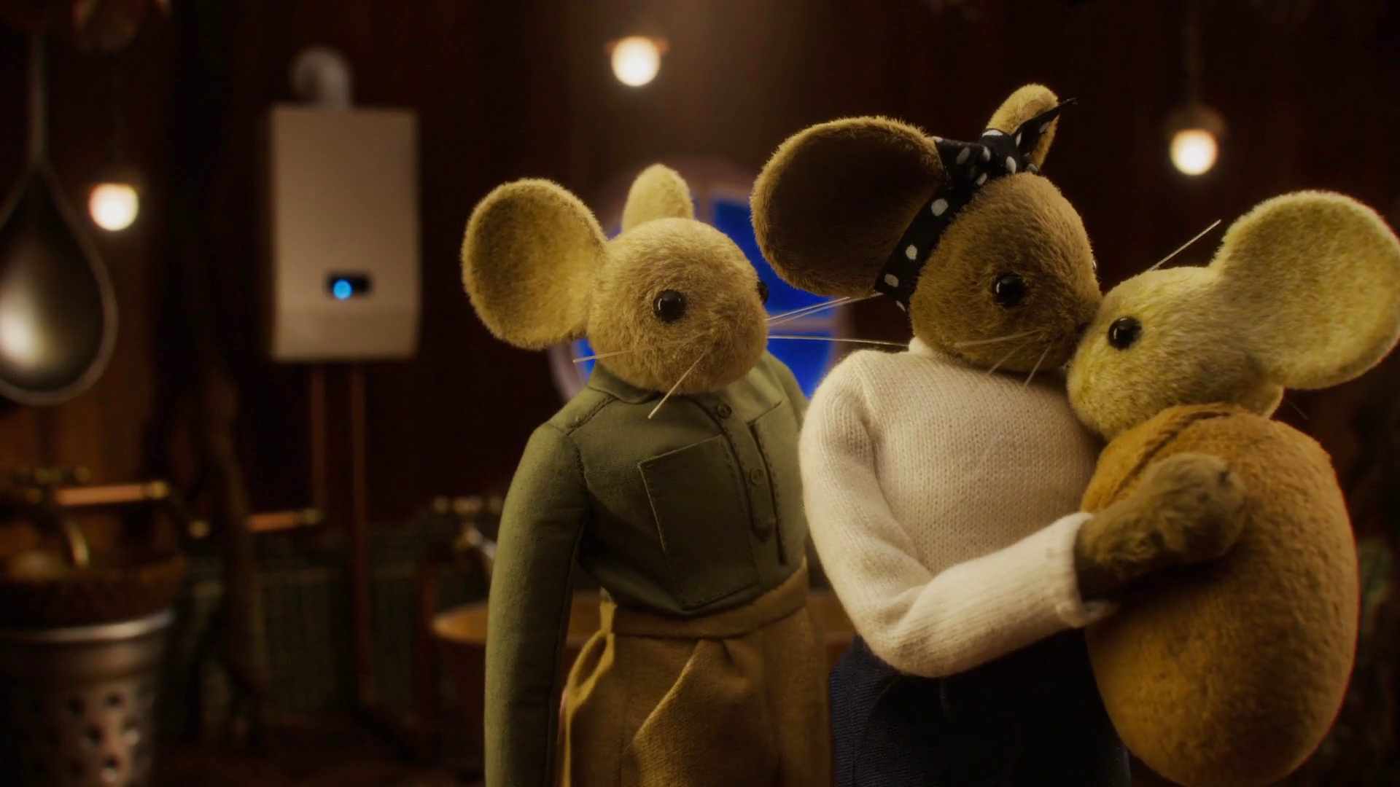
Two thirds of our video viewing is to help us:
Stay in touch
Share & bond
Relax & unwind
These needs are universal and enduring
Notes:
In Touch – 15%
Experience – 9%
Comfort – 15%
Unwind – 22%
Total of 61%
However in the next section, we’re going to just focus on the first three
Unwind is the largest need state and around a quarter of our time is spent in this need. However, it’s pretty easy to understand and doesn’t differ much by age group so we’re not going to spend time looking at it in detail

Slide 21

Live TV viewing is driven by need to keep in touch and experience viewing with others
LIVE TV
Source: The Age of Television, 2018, B&A/TAM Ireland
Notes:
This study showed that live TV delivers across the widest range of need states, particularly in terms of helping people stay in touch, or spend time together.
Live TV also excels at providing a mass shared viewing experience, with more than two thirds of time spent in the experience need state being served by live TV.

Slide 22
In Touch with Colette Fitzpatrick
At the forefront of world/social events
Live TV
News, current affairs & docs
Online video
Notes:
Let’s imagine Colette Fitzpatrick in the IN TOUCH need state
Not many people on the planet need to stay in touch more than Colette. She’s a newscasting powerhouse and needs to be at the forefront of world events
There is an enduring need for people to feel aware and informed of what’s happening in the world around them and keep in touch with political, social and cultural events.

Slide 23



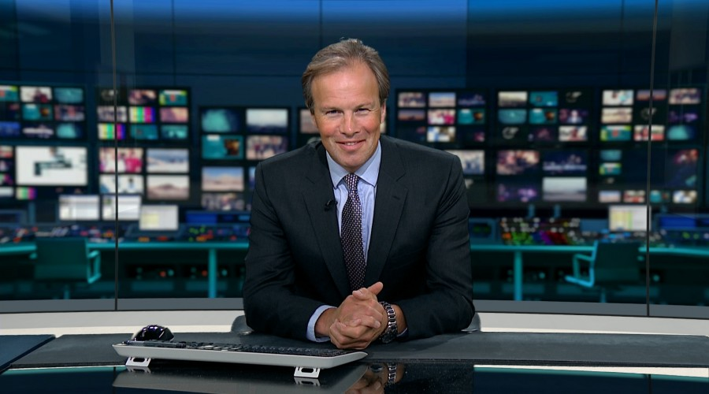

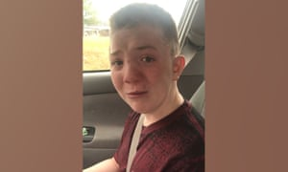
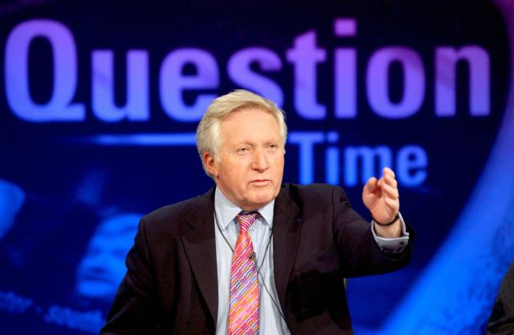

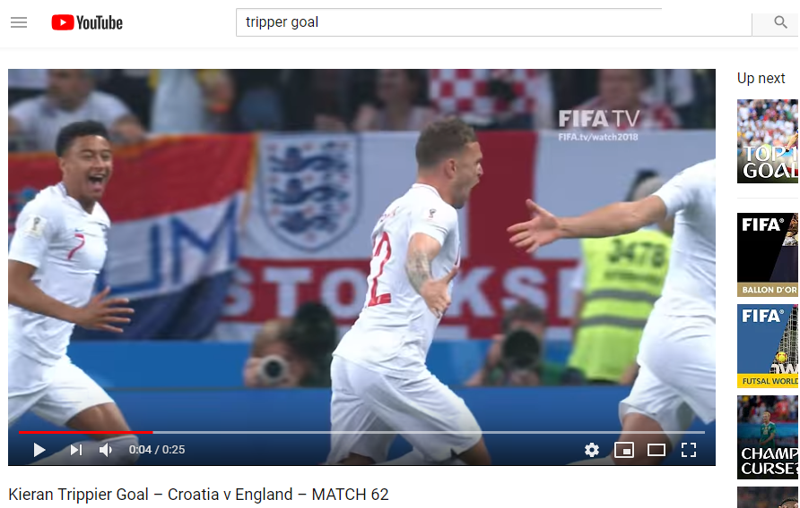
In Touch
15% of viewing time
The need to feel aware of what’s happening in the world, by being informed about political, social and cultural events
62% 45+ profile
84% live TV
84% News & Current Affairs
Served by thought-provoking content:
Source: The Age of Television, 2018, B&A/TAM Ireland
Notes:
News and current affairs are the main types of content that fulfils this need
For 16-34 audiences, online video and social media platforms allow them to feel up to date. They might seek out football highlights for example or other short form content
However, broadcaster VOD is also valued as a destination for relevant factual programming

Slide 24
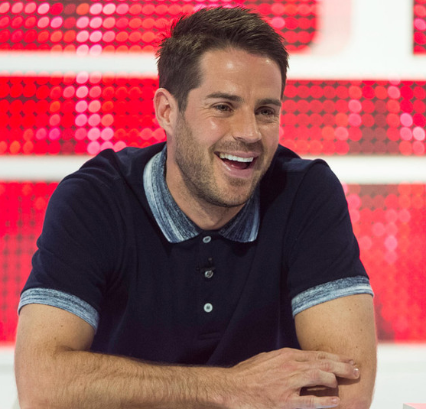
Experience with Jamie Redknapp
Loves sport, drama & enjoyed watching his dad on I’m a Celebrity
Shared experience key: talkability
Linear TV
Online video
Notes:
Let’s imagine Jamie Redknapp in the experience need state
When Jamie’s not bromancing James Cordon and Freddie Flintoff on A League of Their Own, he loves nothing more than watching live sport and he really enjoyed watching his dad on I’m a Celebrity knowing that millions were watching with him etc
This is the enduring need to share experiences with those around us. Video is an important social currency and point of connection

Slide 25









Experience
9% of viewing time
The need to feel part of a shared viewing experience, either by watching live or being able to participate in a wider social conversation
82% live TV
83% viewed on main TV set
32% Sport
Served by content which drives talkability:
Source: The Age of Television, 2018, MTM/Thinkbox. Base: all adults (514)
Notes:
The type of content watched in this need state tends to be the biggest drama and entertainment shows, as well as live sport.
It’s content with high production values that’s typically best viewed on a big screen and has high appeal across audiences.
For younger audiences, online platforms also play a role through video content that goes viral on a massive scale and people are talking about

Slide 26
Comfort with Ryan Tubridy
Always on TV, so needs family time & relaxation
Familiar, reliable viewing
Compromise
Shared time in evening
TV set
Notes:
Let’s imagine Ryan Tubridy in the comfort need state. Ryan is on TV a lot. This makes him really tired so he’s desperate to go home and veg out on the sofa with his kids.
Comfort is an enduring video need state and reflects the highly valued need for shared time together in households and is relevant across all life stages

Slide 27







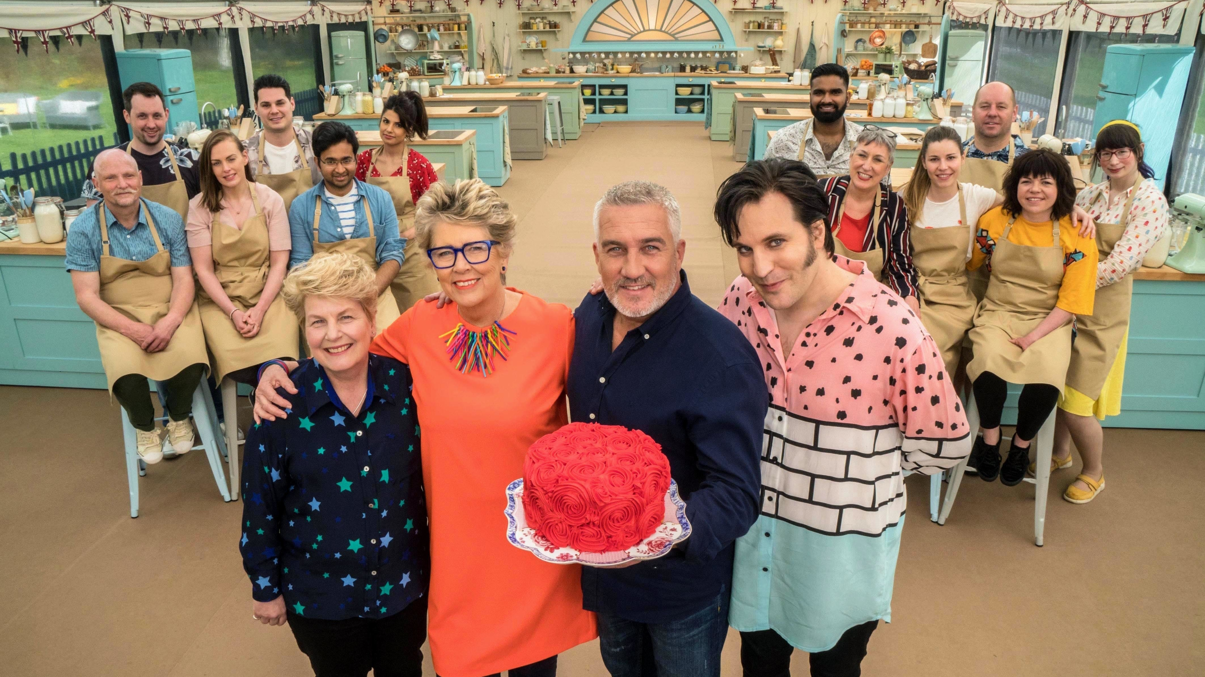

Comfort
15% of viewing time
The need for shared family / couple time, which tends to be served by familiar programmes and viewing routines
94% shared viewing
87% viewed on main TV set
46% 25-44
Served by familiar programmes:
Source: The Age of Television, 2018, B&A/TAM Ireland
Notes:
The final need state is COMFORT. Comfort viewing mostly takes place in the evening on the main TV set when households want to spend time together. Viewers are relaxed, sociable and happy.
Content choice is often a compromise and less important than the household being able to spend time together. Content tends to be familiar programmes, which cater to different ages and genders such as accessible drama, soaps, quizzes, and films.

Slide 28
Need states differ at different life stages
Source: The Age of Television, 2018, B&A/TAM Ireland
Notes:
Whilst many needs are consistent across life stage, the need for distraction - which is heavily served by online video - declines with age.
In contrast the need to stay ‘In touch’ which is served by online video for younger audiences and TV for older audiences, increases with age.

Slide 29
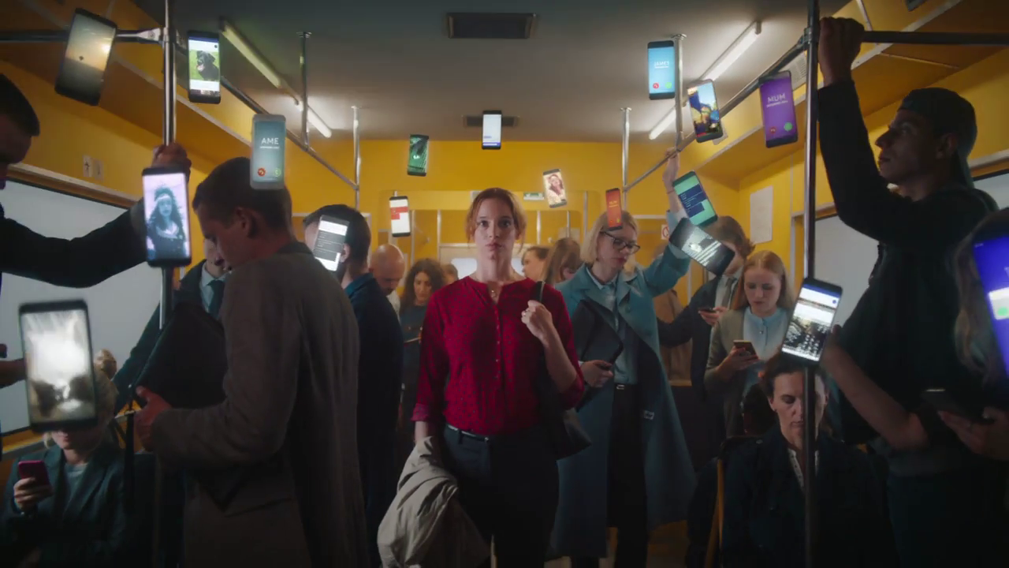
But what next?
Notes:
So we’ve learnt about the needs states, what the size of each one is, which type of video they are most likely to be served by and the different characteristics of each one.
But to complete this project, we also tried to look forward to see how things might change in the near future

Slide 30



On the whole, online video needs differ from those of TV
Core TV need states
Core online video need states
Notes:
The core TV need states are COMFORT, UNWIND, IN TOUCH, EXPERIENCE and ESCAPE
The core online video need states are DISTRACT and DO
The need state of INDULGE straddles the two

Slide 31
The UK market is maturing – many devices are mass-market and major services are already highly used
SMARTPHONE
BROADBAND
CONNECTED TV
SVOD
CONNECTED DEVICE / TECHNOLOGY
TAKE-UP
TABLET
TV RECORDER
Source: The Age of Television, 2018, MTM/Thinkbox. Ofcom Technology Tracker. Data from Q 1 of each year 2007-2014, H1 2015-2018. Base: All adults aged 16+ (2018 n=3730); BARB / Sky / Ofcom / IPA Touchpoints 2017 / Thinkbox estimates
Notes:
The internet market is starting to mature.
If you look at the penetration of some key devices: smartphones, broadband, connected TVs, well over three quarters of the population already has access to these devices. The rate of change over the next five years will probably see these devices make their way up to 80-90%, but it is a relatively small change from where we are today.
Most of the growth has happened over the last 20 years or so. So, yes, it is starting to mature.
However, there is room for Netflix and Amazon Prime to continue their growth.

Slide 32
SVOD competes with broadcaster TV, but doesn’t replace it
DAILY VIDEO VIEWING AMONGST NETFLIX VIEWERS, (MINS PER DAY)
Source: IPA Touchpoints 2018
Notes:
However, Netflix quintile analysis shows that, even for the heaviest users, Netflix is not replacing TV on a TV set
Only the heaviest 20% of Netflix viewers watch more Netflix than Broadcast TV
The other 80% watch more TV than Netflix

Slide 33

Netflix is investing heavily in its global service, but broadcaster investment in large markets is much higher
TOTAL BROADCASTER CONTENT SPEND (2016, £BN)
Global content spend equivalent to Germany’s
£8.1bn
Source: The Age of Television, 2018, MTM/Thinkbox.
Ofcom ICMR 2017, IHS Markit, Netflix
Notes:
We know Netflix spend around $8b = £6.2m on content. However, if we compare that figure to what some individual countries are spending, we can see it in context.
Netflix spend quite a bit less than the UK on content and their spend is a global one. It’s roughly equal to what Germany spend.
If you look at a per capita spend, geographies like the UK and the US spend much more heavily per viewer than Netflix are spending per subscriber.

Slide 34
Some non-UK content viewing has shifted to SVOD while UK content has remained stable
2012
2017
MINUTES PER DAY
INDIVIDUALS
16-34s
Source: BARB, Broadcaster data. Drama, comedy & film genres. NB. Figures for 2017 include post 7 day and non-TV device viewing to broadcast TV
Notes:
A lot of the viewing that SVOD services are capturing is non-UK content, previously broadcast on channels, now shifting to those services. Both on average and the 16-34s.

Slide 35
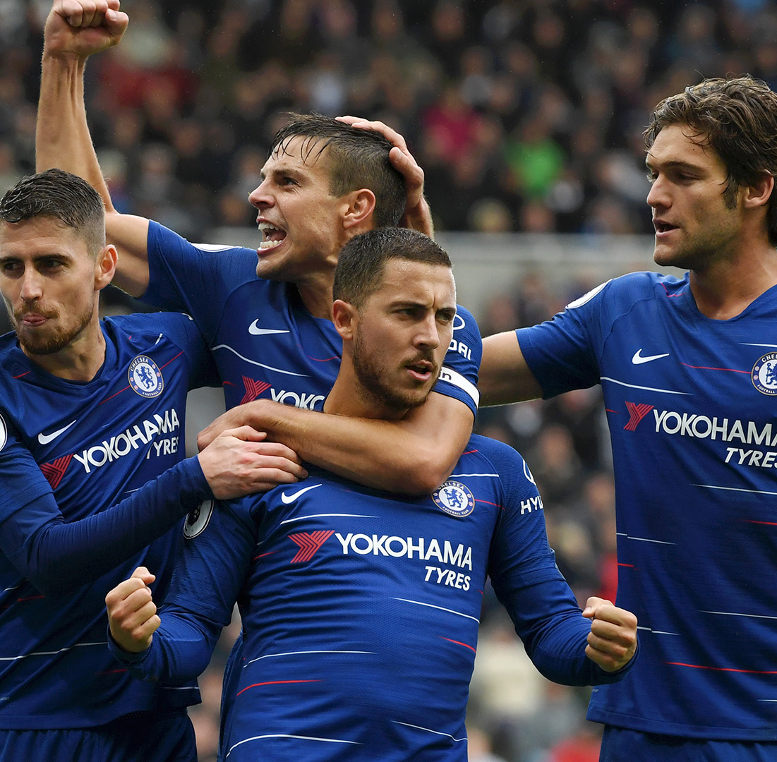
Premium sports are unlikely to be a battering ram for OTT entrants
Netflix’s annual global spend of $8 billion ≈ sum raised by Premier League last rights auction
Delivery is technologically challenging
Sports rights owners need to balance reach and revenue
Source: Morgan Stanley, English Premier League, SportsPro, Seven League
Notes:
Finally, let’s have a look at sports rights. It’s worth noting that Netflix’s annual global spend of $8 billion, is roughly the sum of money that the Premier League raised from its last rights auction. In other words, if you were Netflix and you wanted to go big into Premier League rights, and assuming the Premier League would send you all of their windows, both domestic and international, you could blow your entire global budget on buying three years’ worth of Premier League rights. Of course, you’d then have no money to spend on anything else and that would be rather difficult.
In addition, it is technologically challenging to deliver a high quality sports OTT experience. When Amazon broadcast the US Open Tennis last year, a staggering 82% rated it one star and if you read the comments pages, a proportion of those gave it one star because there was no option to give it zero stars.
Why did they rate it so poorly? Because, when you are watching a really good quality sports event on a TV platform, you can pause, you can record it, you can do all sorts of things with features none of which were available at this point, on the Amazon platform.
There is also the issue that rights owners are very keen to deliver both reach and revenue for sports events. It’s unlikely that most sports rights holders will want all of their content to go on one single OTT service. They will continue to look for a spread, and that obviously limits the traction that OTT providers can get with that content. It’s very hard to have all of it behind a pay wall and then attract the requisite number of subscribers.
It’s also worth flagging that lots of UK sports rights are actually tied up for the next three to five years so for at least a period, we know where these rights are going to be.
Obviously, by the time we get to the mid-2020s, it will be a different story.

Slide 36
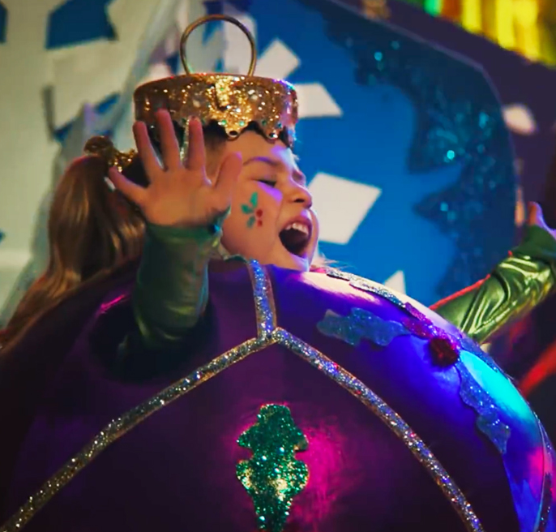
Five points to remember…
Video now fulfils more needs than ever
TV satisfies more needs than any other platform
Platforms now free to do what they do best
The value of home-grown content is huge
Things are changing (particularly with SVOD), but probably not as much as we think
Notes:
Video now fulfils more needs than ever
TV satisfies more needs than any other platform
Platforms now free to do what they do best
The value of home-grown content is huge
Things are changing (particularly with SVOD), but probably not as much as we think

