Slide 1


Television
Fuel for growth
Notes:
Good morning....
I’m Sian Gray/Rob Sheehan…
Thanks to TAM...

Slide 2
To show you how TV has helped fuel growth for Lidl in Ireland

Slide 3
Agenda
TAM Plannervision – Fuel for growth
01
Introduction to Lidl
02
Early Days of Marketing - 2011
03
What did we do to drive growth?
04
What’s next for Lidl?

Slide 4
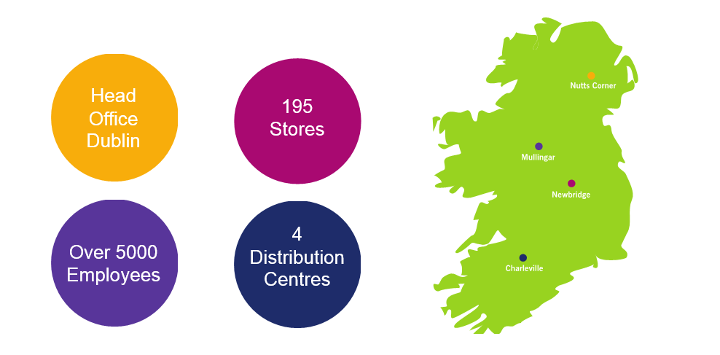
Introduction to Lidl
TAM Plannervision – Fuel for growth

Slide 5
Early days of marketing
TAM Plannervision – Fuel for growth
Lidl Ireland Grocery Markey Share
6.1%
June 2011
Source: Kantar Worldpanel

Slide 6

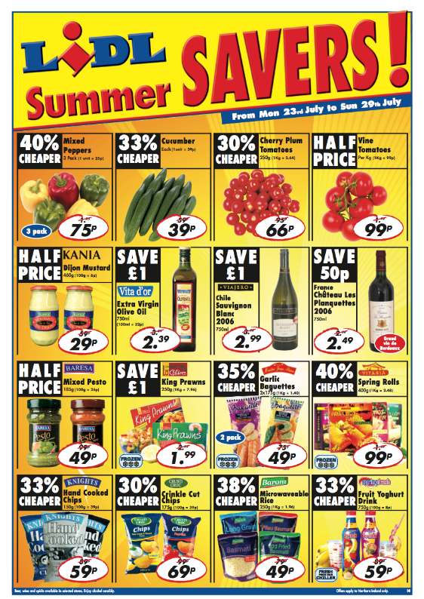
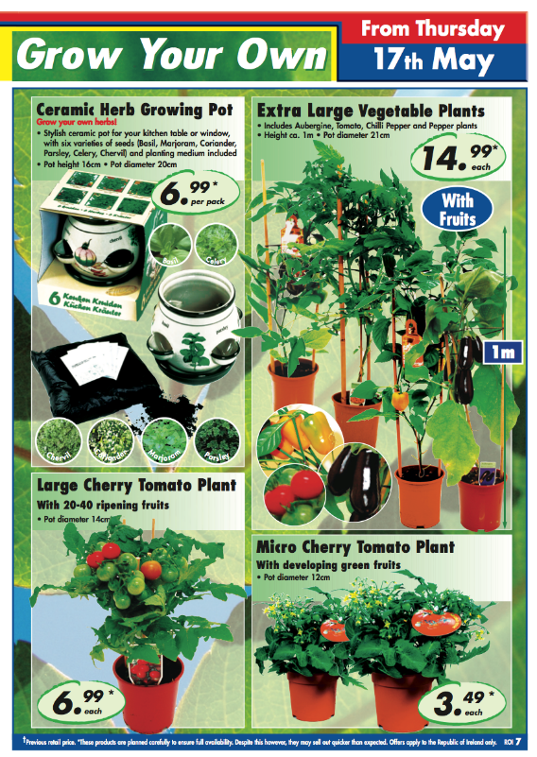
Early days of marketing
TAM Plannervision – Fuel for growth

Slide 7
Early days of marketing
TAM Plannervision – Fuel for growth
In 2011, 90% of our media investment was in print
Source: Nielsen Addynamix
Notes:
Our media mix and budget reflected our heavy reliance on print media. And while print does a fantastic job of conveying the range and value that Lidl offers customers, it limits us somewhat in terms of building a deeper, emotional connection with Irish shoppers.
A dramatic change from single minded promotions through print to 360-degree brand led communications was needed.

Slide 8
TAM Plannervision – Fuel for growth
Positioning Lidl Brand for Growth
SCALE OF TASK
Growth
Strong growth via organic expansion, rate of store openings slowed, had to look at other avenues for growth.
Proposition
Single minded proposition “Low prices” a barrier to growth.
Ambitious double digit growth target in a declining market.
Growth would have to come from brand-led investment.
Recession
Not converting consumer behaviour as expected.
A new growth model
A dramatic change from single minded promotions through print to 360 degree brand led.

Slide 9
TAM Plannervision – Fuel for growth
Positioning Lidl Brand for Growth
SCALE OF TASK
Growth
Strong growth via organic expansion, rate of store openings slowed, had to look at other avenues for growth.
Increase Penetration
Proposition
Single minded proposition “Low prices” a barrier to growth.
Change Perceptions
Ambitious double digit growth target in a declining market.
Growth would have to come from brand-led investment.
Recession
Not converting consumer behaviour as expected.
Increase Consideration
A new growth model
A dramatic change from single minded promotions through print to 360 degree brand led.
Change Strategy

Slide 10
What did consumers think about Lidl?

Slide 11

TAM Plannervision – Fuel for growth
Positioning Lidl Brand for Growth
Sure it’s grand for toilet paper...

Slide 12


TAM Plannervision – Fuel for growth
Positioning Lidl Brand for Growth
Lidl Brand Equity : The Dark Side of Value (cheap)
Good for cheap bulk and bargains
Not suitable for main weekly shop

Slide 13
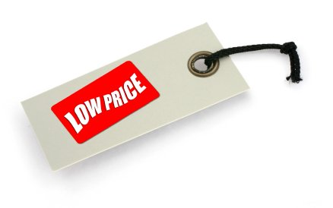

TAM Plannervision – Fuel for growth
Positioning Lidl Brand for Growth
From
To
Best known for Low Price
Good Quality Value for Money
Close the positioning & reality gap for consumer by repositioning Lidl from Low prices to VFM

Slide 14
TAM Plannervision – Fuel for growth
Positioning Lidl Brand for Growth
CHOOSE AS THE BRAND POSITIONING
Show consumers (Mum) that when she shops at Lidl, she doesn’t have to choose between the quality and value she seeks. Even on a tight budget or in recession, she still has choice and can make the very best choices with Lidl.
Align these closer

Slide 15

TAM Plannervision – Fuel for growth
Choose Campaign
15

Slide 16


Timeline
TAM Plannervision – Fuel for growth
2012
Choose Campaign
2014
Choose to Live a little
2016
LGFA
2017
Trolleycam
2018
Trolleycam
2014
Approved by you
2016
Full Shop Half Price
2018
Beef Campaign
Summer 2013
Brand Challenge

Slide 17

Challenger brands – Lidl Ireland & Northern Ireland
More emotive brand strategy
17

Slide 18

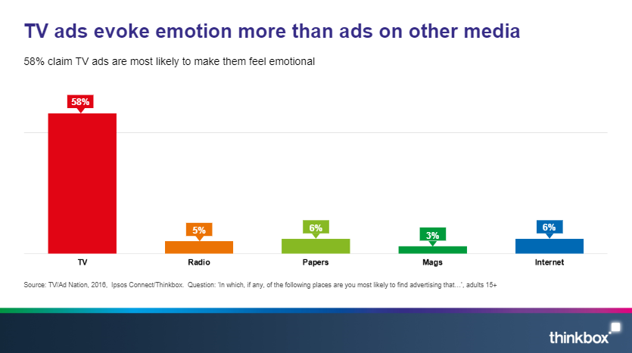
TV’s ability to connect with audiences on an emotional level is unique

Slide 19
TAM Plannervision – Fuel for growth
Consistency is key
Higher amounts of
exposure
Higher chance of consideration
From
To
“In and Out” weekly offers
Campaigns communicating the Lidl value promise
Notes:
We also recognised that consistency in terms of both the frequency at which we communicate and the message we are delivering was going to be key to us increasing consideration to shop at Lidl.
This required a step change in how we operated, promotionally, as a business, moving from “In and out” weekly offers to Campaigns that continuously communicated our value promise.

Slide 20

TAM Plannervision – Fuel for growth
Trolleycam
Building on Full shop 2016
Contemporary
Memorability
More for you (meaning)
Range

Slide 21

TAM Plannervision – Fuel for growth
Trolleycam

Slide 22
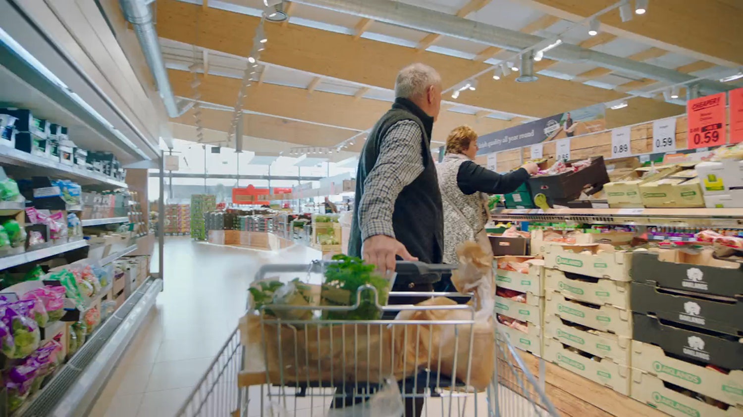

Slide 23
TAM Plannervision – Fuel for growth
Creating assets that are distinctive is critical
Number of ads the average Irish person see’s per day
2007
140
2016
346
2021
426

Slide 24


Slide 25
Where to next?
Notes:
So, where to next for us?

Slide 26
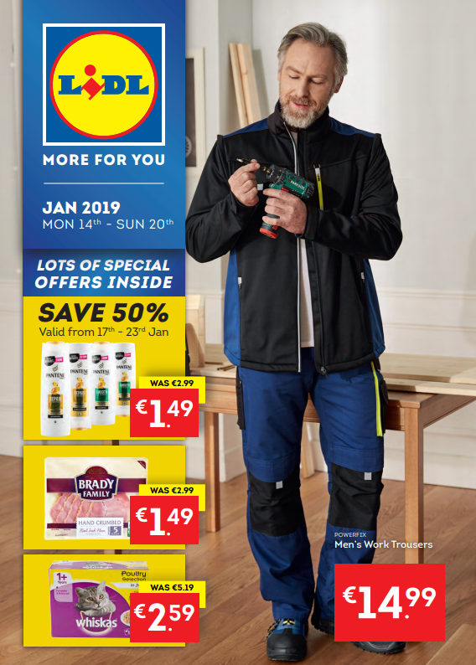
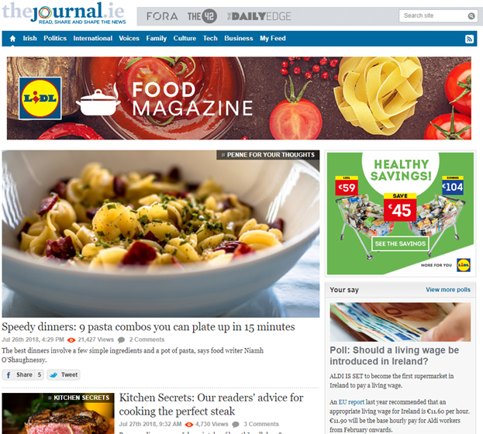
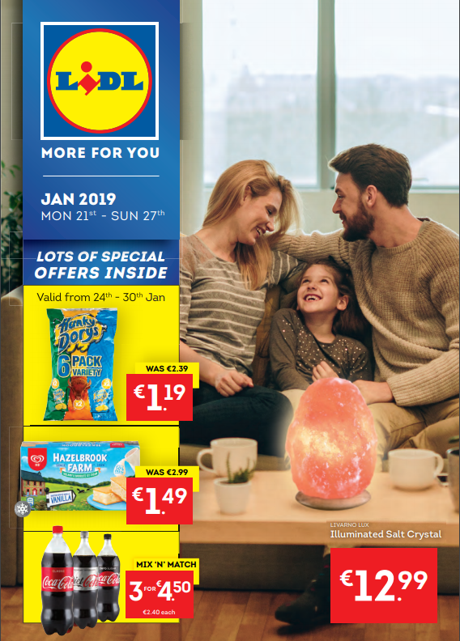
Evolving roles of media
TAM Plannervision – Fuel for growth

Slide 27
Using video in more dynamic ways
TAM Plannervision – Fuel for growth
Create impact
<60”
Cinema
Create impact
30-60”
App. to View
Campaign Linear TV
30-60”
Building Reach
Catch-Up (TV)
10-30”
Visual Cue
VOD
(on TV)
30”
Extra Reach
Owned Social Site
>60”
Tell The Story
Long Form Device
10”-20”
Personal
Social Feed
>10”
Billboard
Short Form Device
10”
Recency
OOH Digital
10”
Recency
Right Message, Right Place, Right Time

Slide 28
Early days of marketing
TAM Plannervision – Fuel for growth
Lidl Ireland Grocery Markey Share
6.1%
June 2011
Source: Kantar Worldpanel

Slide 29
Where we are now
TAM Plannervision – Fuel for growth
11.9%
July 2018
Source: Kantar Worldpanel

Slide 30

Thank
You

