Slide 1








Share of Viewing in Ireland
content
There are eight primary needstates, the size of which is dictated by the time audiences spend meeting each one with video content. A significant proportion of time spent watching video content is to fulfil the need to Unwind, and for Distraction.
A great amount of time is also spent consuming video to meet the need for Comfort, and to remain In Touch with what is happening in the world.
The role of content and context varies across each needstate with, for example, content particularly important for Escape and Experience, and context (e.g. the need to de-stress without having to concentrate too much) a key motivator for the Unwind needstate.
8% ESCAPE
9% EXPERIENCE
8% INDULGE
15% IN TOUCH
3% DO
15% COMFORT
personal
social
19% DISTRACT
22% UNWIND
context

Slide 2

The Unwind Needstate: 22% of all viewing time
The need to relax and de-stress from the pressures of the day
Viewers are tired and don’t want to think too much
Content must be familiar and easy to view
Low effort need state
Dominated by solus viewing

Slide 3
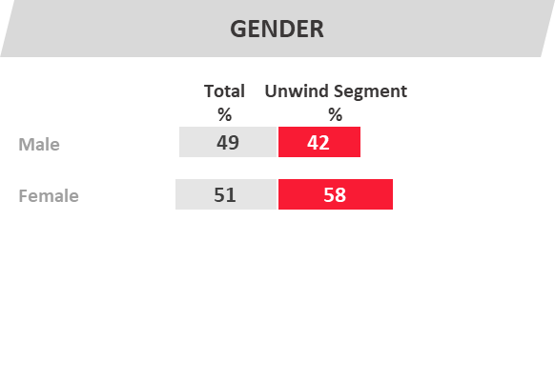
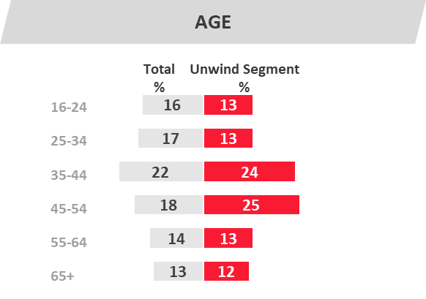
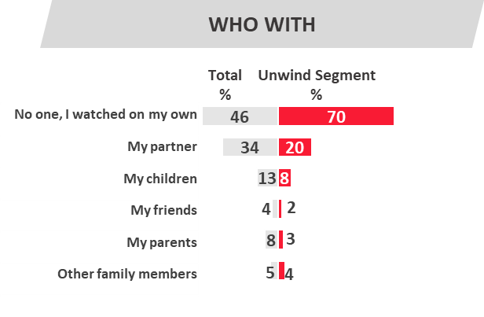



WHERE WATCHED
LIFESTAGE
Total
%
Unwind Segment
%
Total
%
Unwind Segment
%
Living room
Bedroom
Kitchen
Bathroom
Under 45 Single
45+ Single
U45 Pre family
Children aged 0-10
Children Aged 11-17
Children 18+
Empty nesters
Empty
nester or pre family
View on TV in bedroom
Solo Viewer
Females,
35-54 yrs

Slide 4
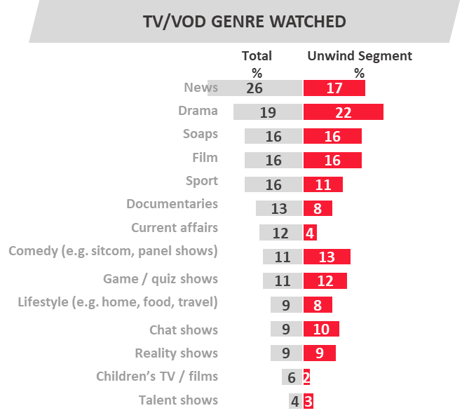
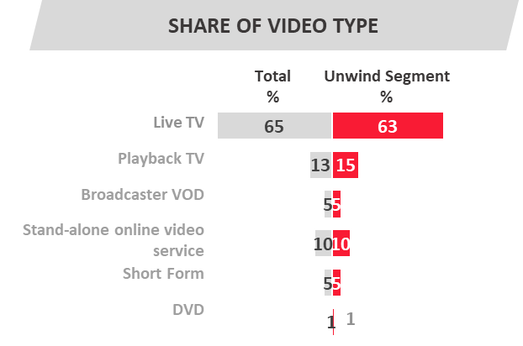
Chat Shows
Drama
Game Shows
Live TV accounts for approx 2/3 of all viewing for this needstate. There is also a significant amount of viewing to playback TV and stand-alone online video.

Slide 5
The Comfort Needstate: 15% of all viewing time
Viewers are relaxed and sociable
The need for comfort in the company of family/partner
Familiar programmes which can cater to everyone
Shared family/couple time
Main TV set provides a hub for the household to catch-up

Slide 6
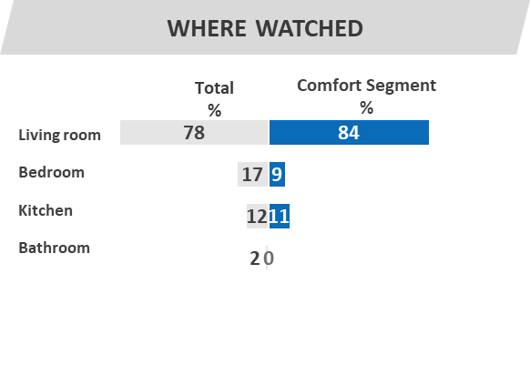
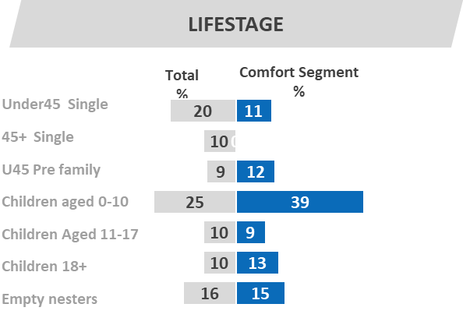
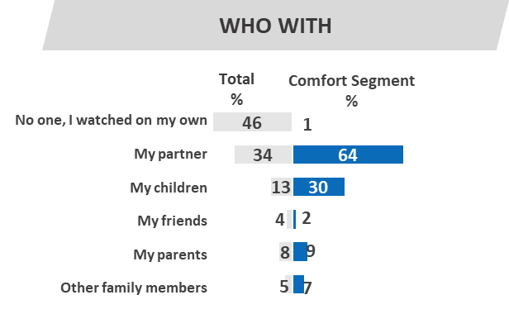

GENDER
Total
%
Comfort Segment
%
Male
Female
AGE
Total
%
Comfort Segment
%
16-24
25-34
35-44
45-54
55-64
65+
A family with
kids under 11 years of age
View on TV in living room
Shared
viewing experience

Slide 7
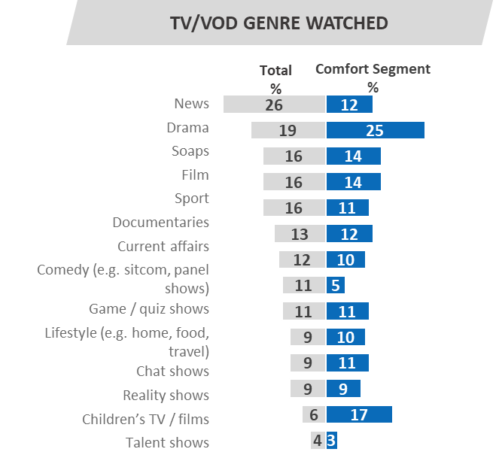
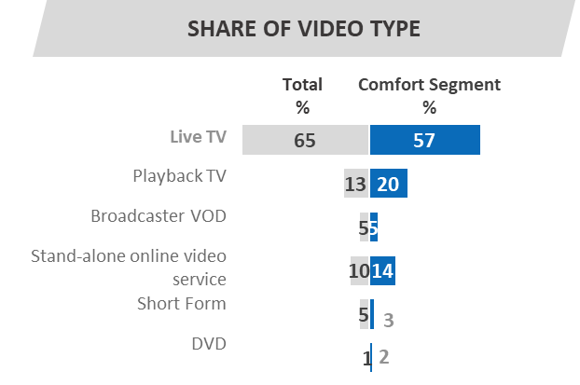
Drama
Kids TV
Films
Live TV is still a primary destination for this type of viewing (making up almost 2/3 of video consumption). Broadcaster VOD, on demand TV and subscription VOD (particularly films) also provide more options.

Slide 8

The Experience Need State: 9% of all viewing time
Desire to be part of a shared experience
Motivation to watch live/as close to live as possible to avoid spoilers.
Not missing out = key motivation
Served by content that drives talkability
Viewing on the main TV set

Slide 9
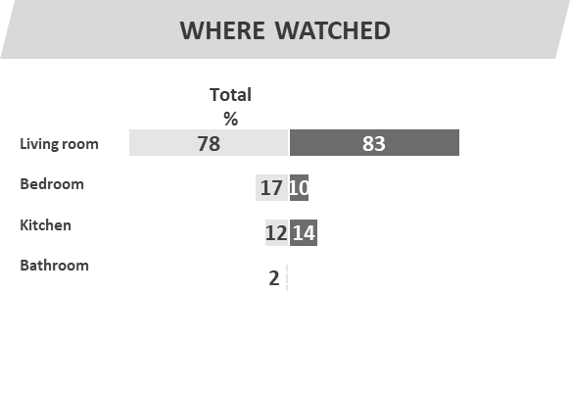
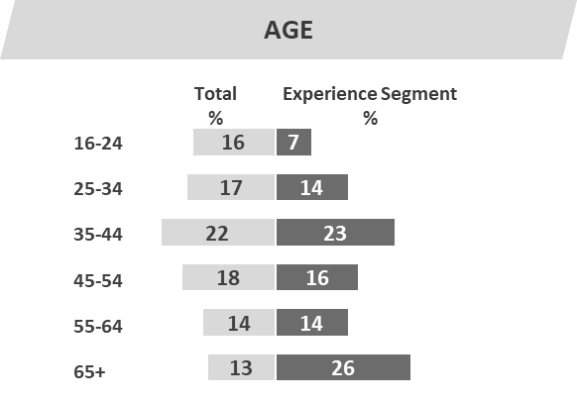
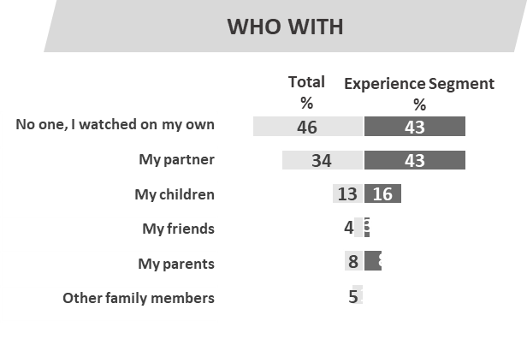
GENDER
LIFESTAGE
Total
%
Experience Segment
%
Total
%
Experience Segment
%
Male
Female
Under 45 Single
45+ Single
U45 Pre family
Children aged 0-10
Children Aged 11-17
Children 18+
Empty nesters
More likely
to be
male viewers
View on TV in living room
Viewing alone or shared
viewing experience with partner

Slide 10
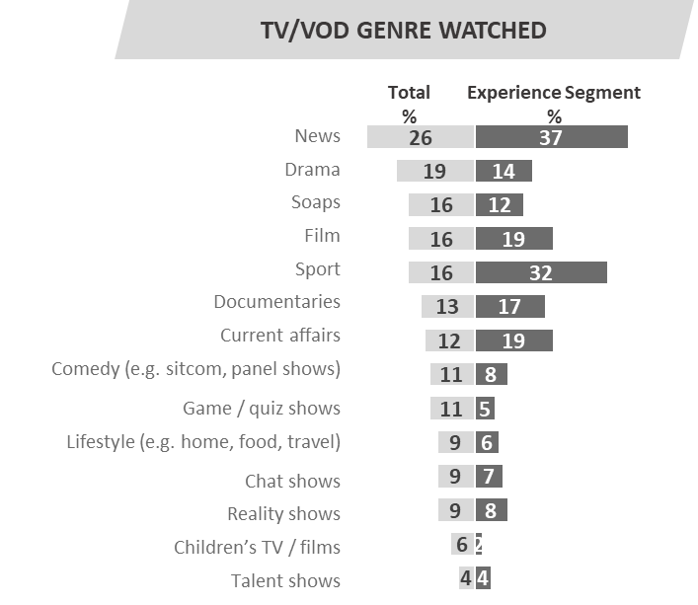
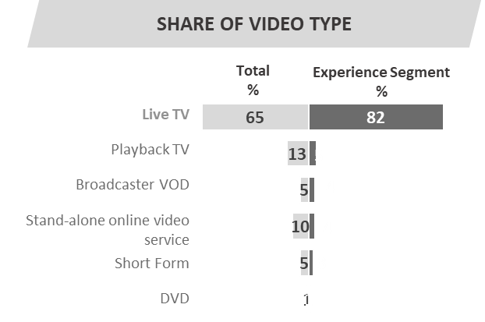
News
Live Sport
Current Affairs
Live, appointment to view TV dominates here making up with 82% of this type of viewing. The needs of Experience are met to a great extent by a mix of News, Current Affairs and Sports.

Slide 11

The In Touch Need State: 15% of all viewing time
The need to feel aware of what’s happening in the world
Served by thought-provoking content
Viewers informed about political, social and cultural events
The vast bulk of viewing within this needstate is to live TV
Those aged 45+ dominate this Needstate

Slide 12
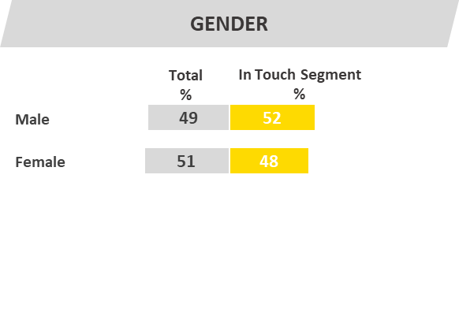
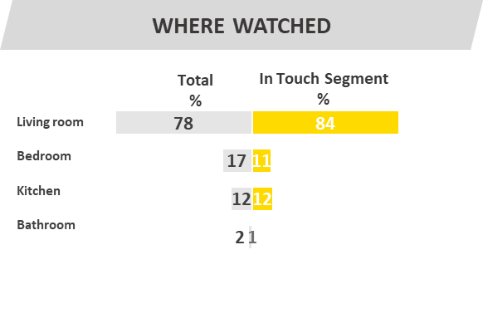
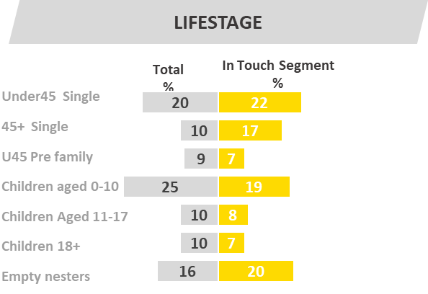
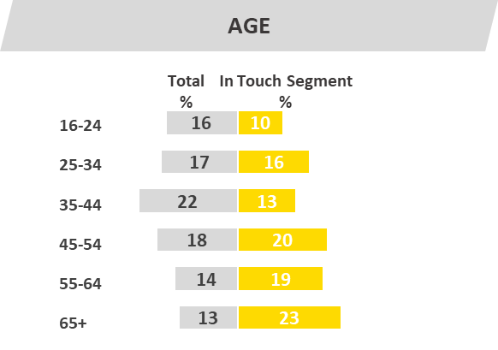
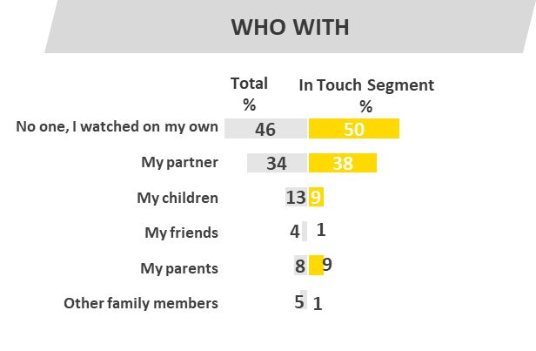
More likely
to aged 45+
View on TV in living room
Viewing alone or shared
viewing experience with partner

Slide 13
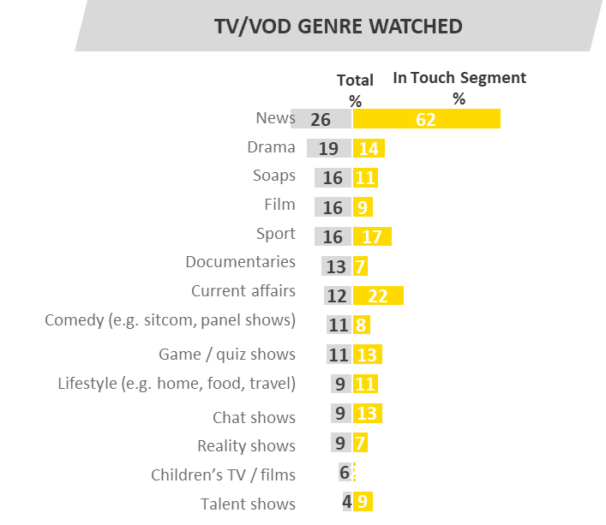
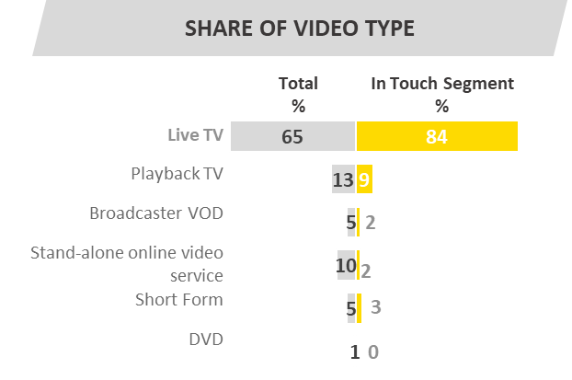
News
Current Affair
The vast bulk of viewing within this needstate is to live TV, specifically news and current affairs by way of appointment viewing

Slide 14

Indulge Need State: 8% of all viewing time
The need to pursue personal interests/hobbies & fulfil guilty pleasures
Fulfils a personal viewing need
Viewers are active, engaged and relaxed
Moment is viewed as ‘my time’
The Indulge needstate straddles all age groups

Slide 15
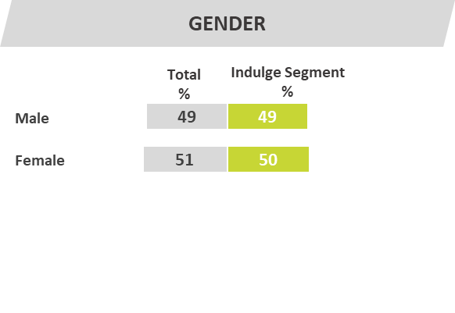
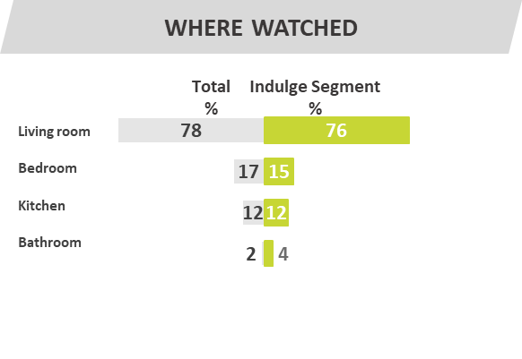
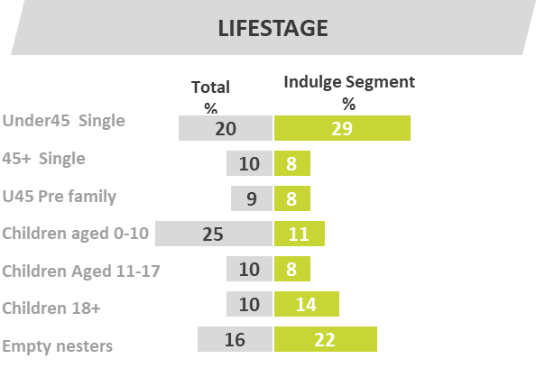
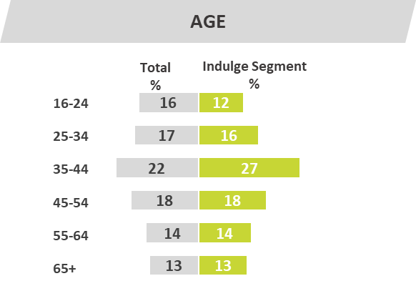
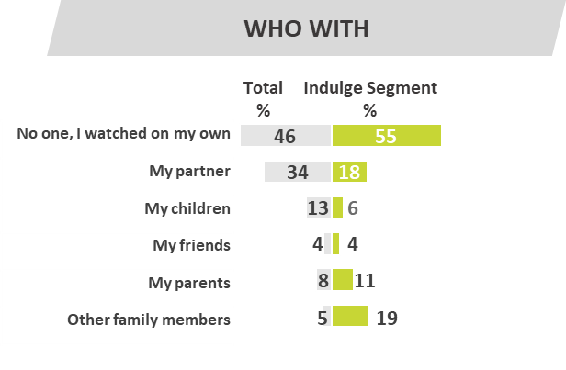

Covers
all age
groups but peaks with under 45s
Viewing on
main house TV set, & also on digital devices
The majority of Indulge video consumption occurs on a solus basis

Slide 16
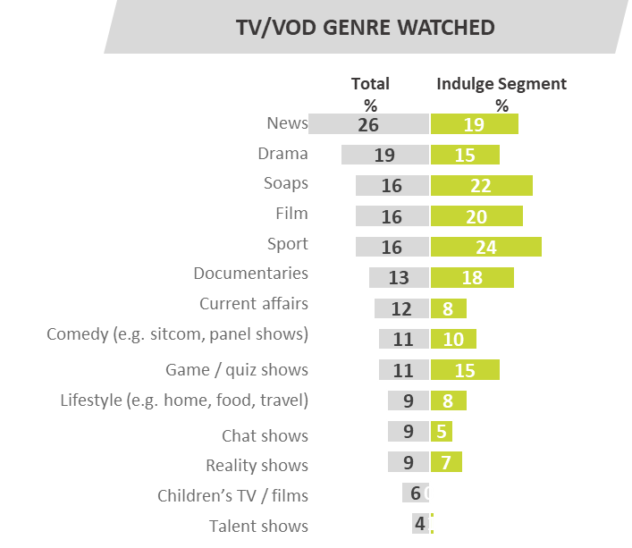
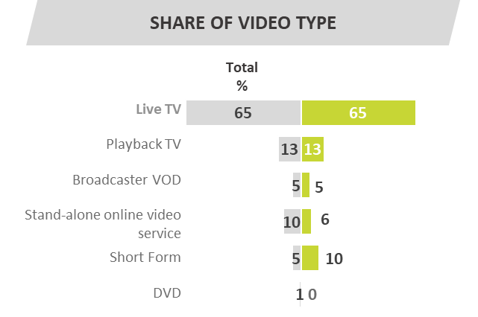
Quiz Show
Soaps
Documentaries
While live TV is predominant, 10% of Indulge viewing is nevertheless accounted for by shortform video covering a wide mix of online video genres.

Slide 17

The Escape Need State: 8% of all viewing time
The need to lose yourself in another world
Content has high production values
Become fully immersed in highly involving and engaging content
Platform choice is driven by where content available
The Escape needstate covers all age groups

Slide 18
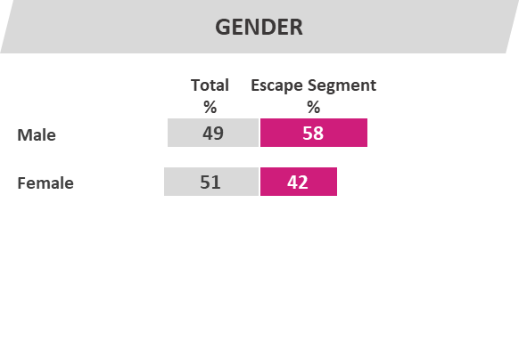
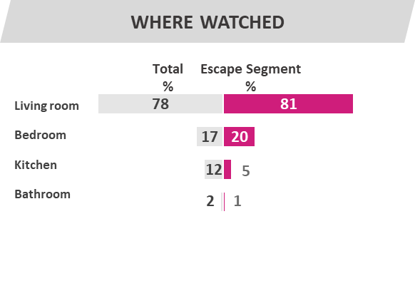
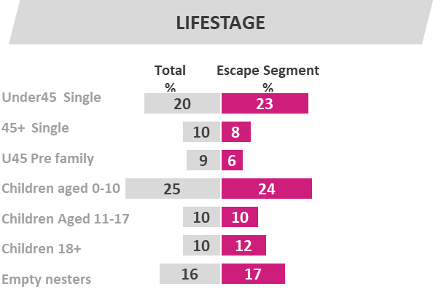
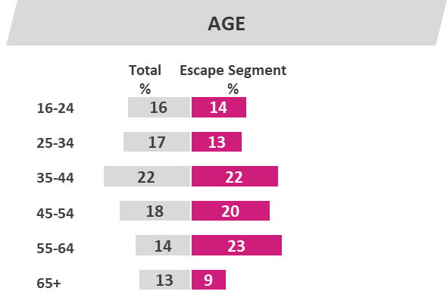
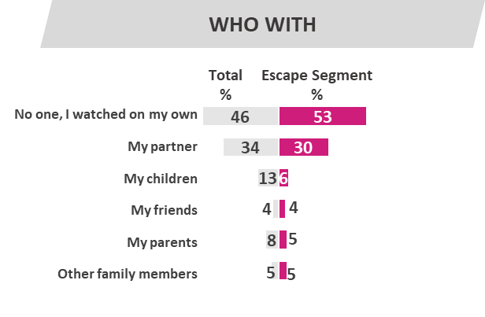
Covers all
age
groups-more likely to be male
View on TV
in
living room or in bedroom
Solo Viewing Experience

Slide 19
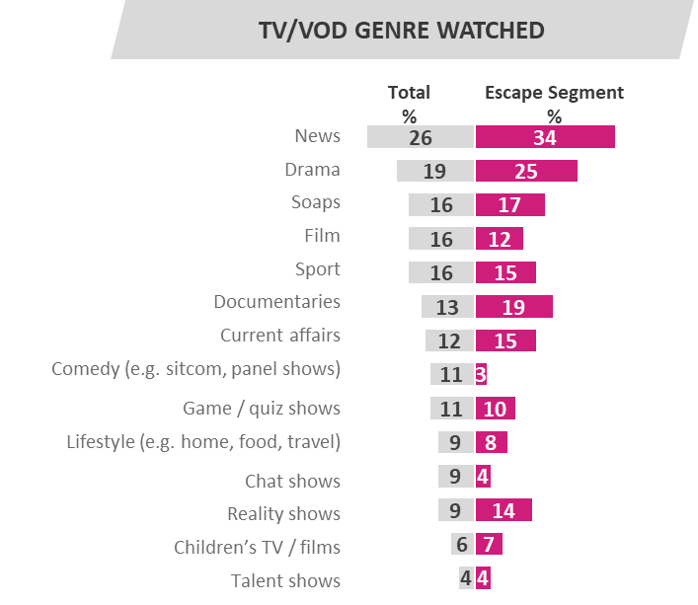
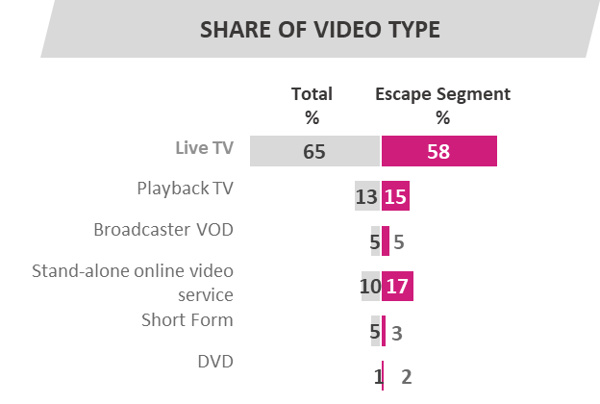

Documentaries
Reality Shows
Drama
Playback/catch up TV and Broadcaster VOD is serving this need across ages. Subscription on demand services, particularly Netflix, also deliver against this need state.

Slide 20

The Do Need State: 3% of all viewing time
The need to learn how to do things of practical benefit.
Heavily skewed towards 16-34 year old males
Focussed and task/ goal-orientated
Production values and quality less important
Content from across a range of platforms

Slide 21
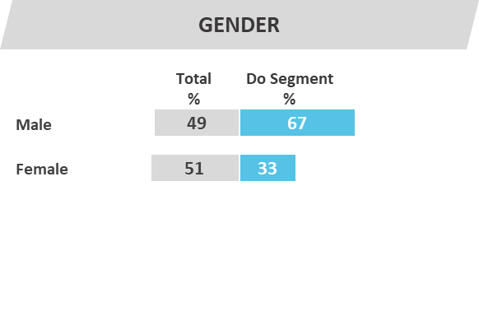
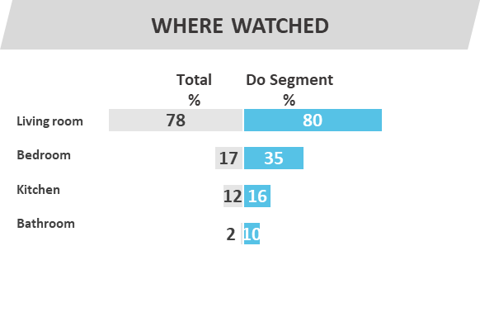
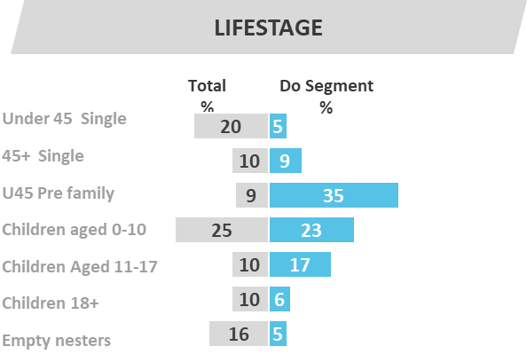

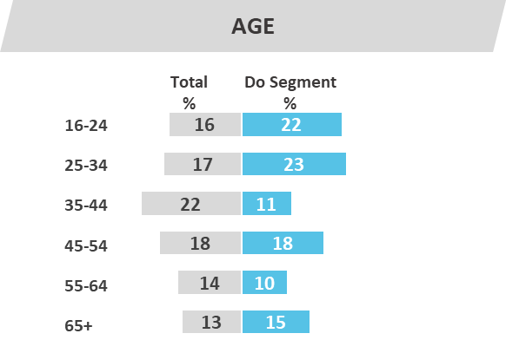
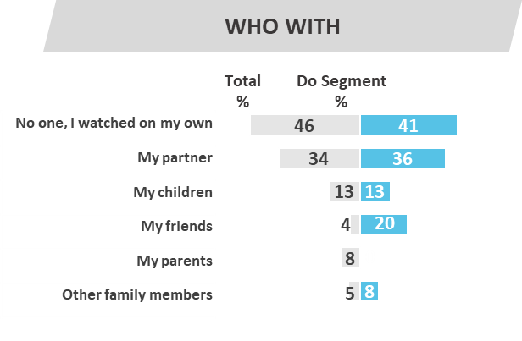

Very heavily skewed
towards 16-34 year old males
Multiple
viewing locations
Viewing
with friends
prevalent

Slide 22
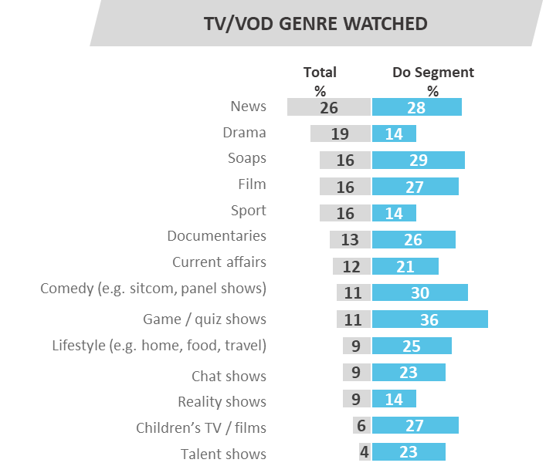
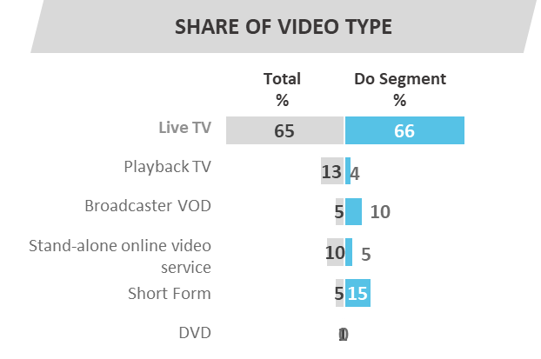
How-To Videos
Comedy
Reality Show
Those whose primary needstate is to Do, consciously seek out the type of content they need to learn from across a range of platforms, encompassing multiple TV and online genres.

Slide 23

The Distract Need State: 19% of all viewing time
The need for instant gratification
revalent amongst those aged 16-34 years
Viewers are taking a break or filling time
Looking to lighten mood/ put smile on face
Viewing is more likely than average to occur in the bedroom

Slide 24
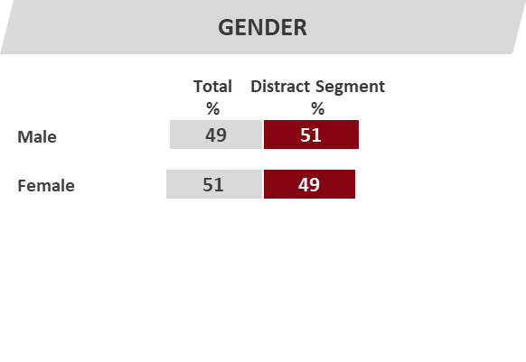
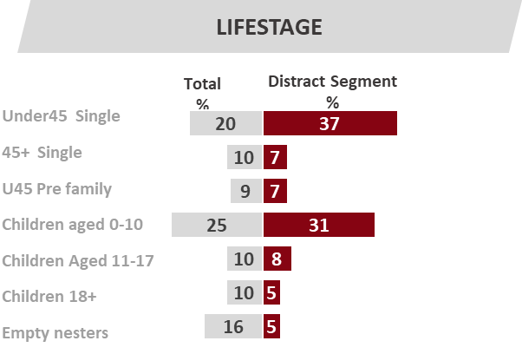
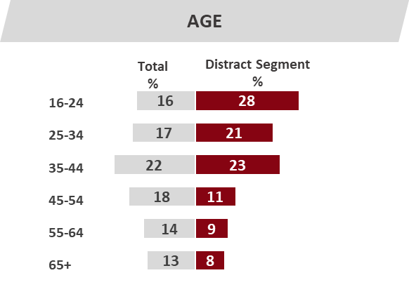
WHERE WATCHED
Total
%
Distract Segment
%
Living room
Bedroom
Kitchen
Bathroom
WHO WITH
Total
%
Distract Segment
%
No one, I watched on my own
My partner
My children
My friends
My parents
Other family members
Prevalent
amongst
16-34 year olds
Viewing is more
likely than average
to occur in the bedroom
Viewers single, or at the very early
stage of family formation.

Slide 25
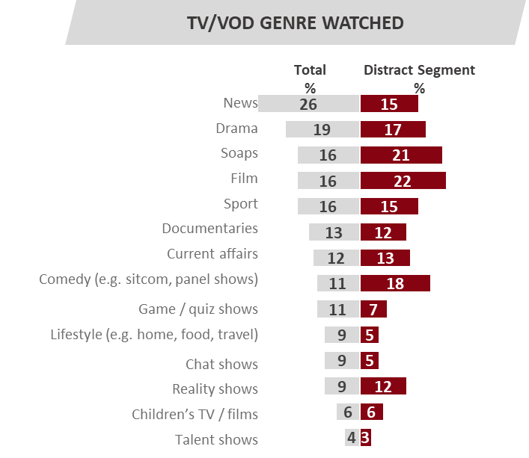
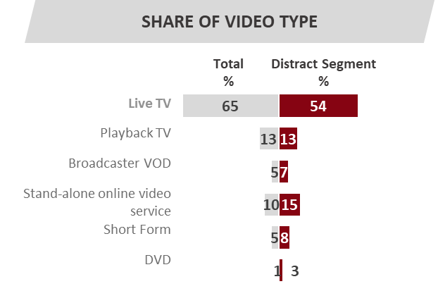
How-To Videos
Comedy
Clips/Outtakes
Half of all viewing here is accounted for by live TV. Stand-alone and short form video content such as cute spoofs, ‘how to’ tutorials, clips or highlights from programmes/films/live events, etc. is also commonly consumed.

Slide 26

Needstate x Viewing Type, Age and Day Part

Slide 27
Need State x Viewing Type
Base: All participants any viewing
Total |  | Viewing Type
 |  | Live TV | Playback TV | Broadcaster VOD | Stand-alone online video service | Short Form | DVD
1085 |  | 362 | 145 | 160 | 142 | 261 | 15
% |  | % | % | % | % | % | %
15% COMFORT
22% UNWIND
9% EXPERIENCE
15% IN TOUCH
8% INDULGE
8% ESCAPE
3% DO
19% DISTRACT
Half of all Playback TV is viewed in the Comfort and Unwind need states, as is 44% of all standalone online video. Just under 30% of all Broadcaster VOD, standalone online video and short form video viewing occurs in the Distract need state.
B4-B12

Slide 28
Need State x Age
Base: All participants any viewing
Total |  | Age
 |  | 16-24 | 25-34 | 35-44 | 45-54 | 55-64 | 65+
1085 |  | 144 | 158 | 236 | 231 | 186 | 130
% |  | % | % | % | % | % | %
15% COMFORT
22% UNWIND
9% EXPERIENCE
15% IN TOUCH
8% INDULGE
8% ESCAPE
3% DO
19% DISTRACT
A third of all 16-24 year olds viewing is experienced in the Distract need state. A fifth of all 55 yrs+ viewing fulfils the needs of In Touch.
xxx
B4-B12

Slide 29
Need State x Day Part
Base: All participants any viewing
 |  | Day Parts
TOTAL |  | AFTERNOON | EVENING | DURING THE NIGHT (12am-6am)
1098 |  | 199 | 749 | 27
% |  | % | % | %
15% COMFORT
22% UNWIND
9% EXPERIENCE
15% IN TOUCH
8% INDULGE
8% ESCAPE
3% DO
19% DISTRACT
The single greatest need state met by afternoon viewing is Distract, followed by Unwind.
B4-B12

