Slide 1
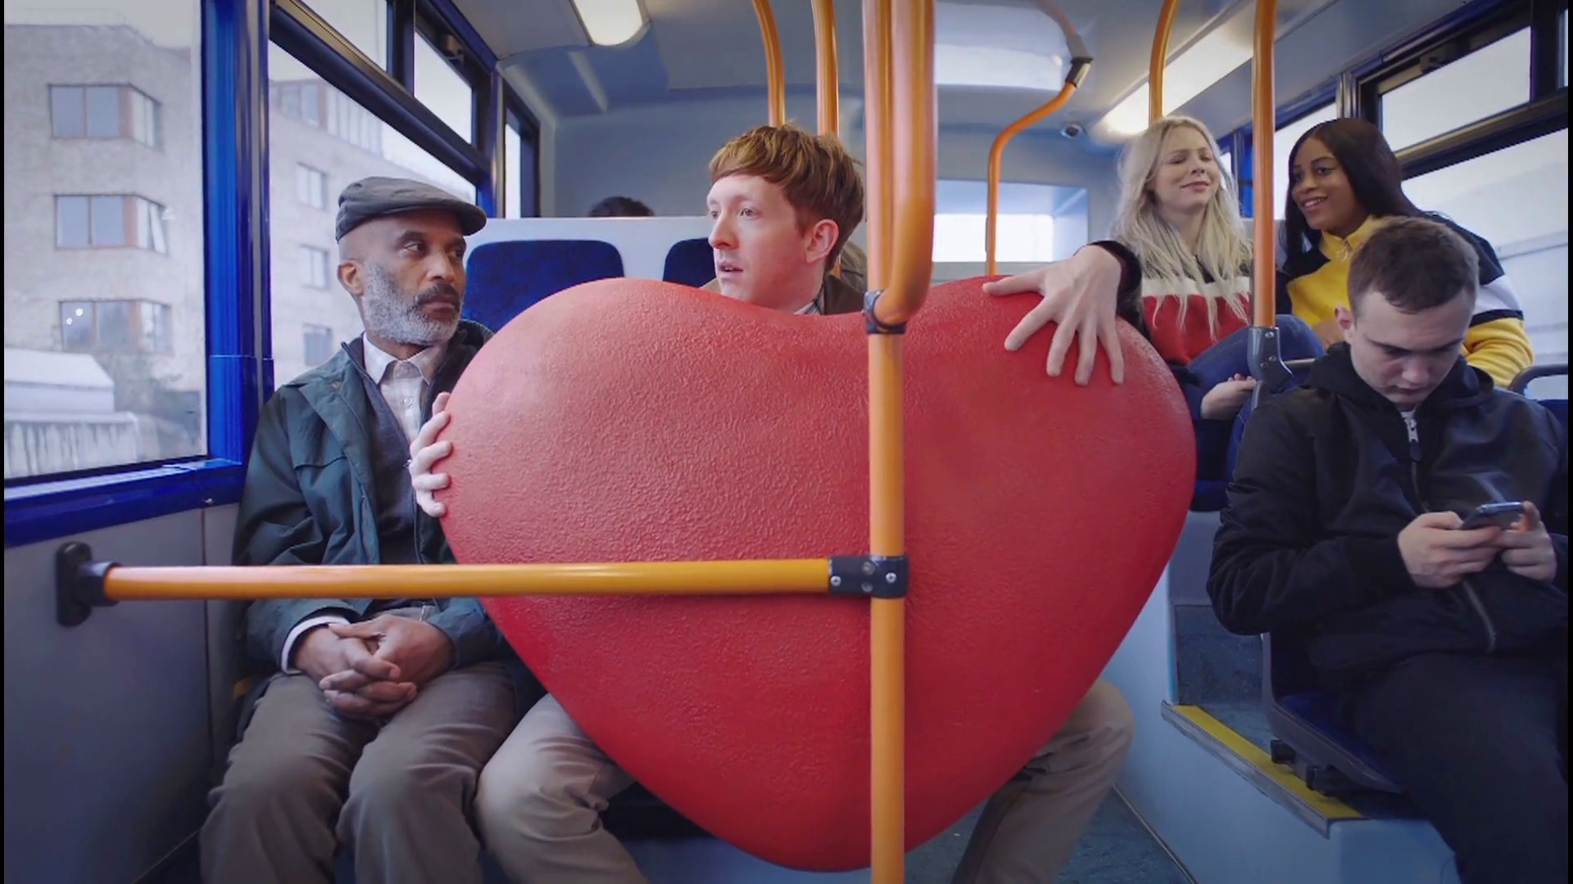
Charts every advertiser should cherish

Slide 2
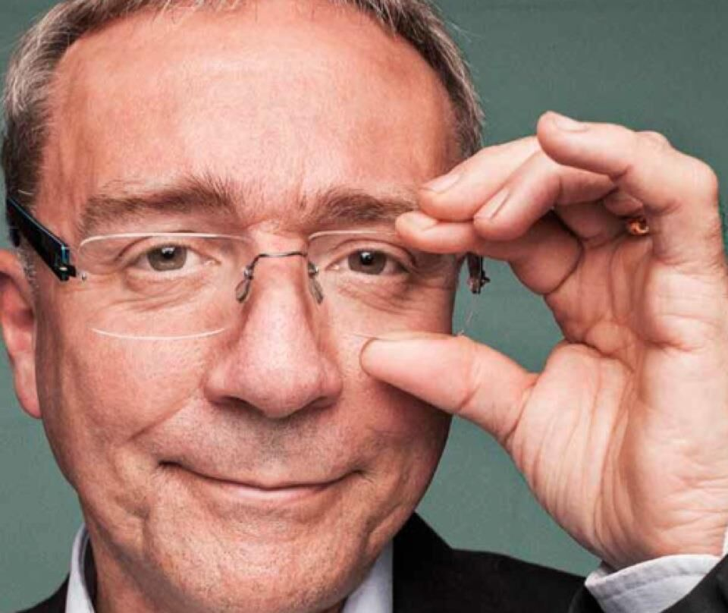
Les Binet: The Zig Zag Chart
Key finding: Brand building is always the primary driver. Short-term selling is never enough.
“Most marketers assume that, if you look after the short term, the long term will look after itself. This chart explains why this is dangerously wrong.”
Les Binet
adam&eve\DDB

Slide 3
Les Binet: The Zig Zag Chart
Brand building
Long term growth in base sales
Reduced price sensitivity
Sales activation
Immediate sales response
High efficiency & ROI
Time
Notes:
Most marketers assume that, if you look after the short term, the long term will look after itself. This chart explains why this is dangerously wrong. The key is to understand that marketing works in two very different ways.
Sales activation aims to get an immediate behavioural response. Activation is good for short-term selling, and ROIs can be high. But the effects don’t last long, and do little to foster long-term growth.
Brand activity creates long-term memories, associations and habits which influence consumers for years to come. This is a harder job, requiring repeated exposure, but the effects last longer and accumulate over time to drive growth and long-term profit.
Businesses need both. They need brand activity to create demand, and they need activation to convert demand efficiently into cash. When the balance is right, each enhances the other. But brand building is always the primary driver. Short-term selling is never enough.

Slide 4

Alex Steer: Brand:activation ratio, by category
Key finding: The ‘60:40’ norm varies by category, but there’s a clear overall relationship between brand and activation effects.
“In categories where consumers switch more easily, are swayed by pricing, or research heavily, activation effects tend to be larger – but even here, brand effects always have the edge.”
Alex Steer
Wavemaker

Slide 5
Alex Steer: Brand:activation ratio, by category
‘Short-term’
(Activation effects)
‘Long-term’
(Brand equity effects)
Source: Wavemaker/BrandZ benchmarks database. (60,000 brand case studies over 11 years)
Notes:
At risk of nepotism, my favourite chart comes from Wavemaker’s own benchmarks database.
The chart shows what we found. Each category differs in the relative importance of brand equity (built over the long term, before consumers enter the market) and activation effects (generated in the short term, when they are in-market). But there is a clear and consistent shape. Across more than 100 categories, long-term effects always contribute between 50% and 85% of communications impact on market share. And across all those studies, the average ratio of long-term to short-term converges at – guess what? – about 60:40. In categories where consumers switch more easily, are swayed by pricing, or research heavily, activation effects tend to be larger – but even here, brand effects always have the edge.
Does this mean you should always spend 60% of your budget on ‘brand’? No – your category, your brand’s immediate circumstances, and the day-to-day demands of the market all need to be considered. But in the long run, successful brands invest in building the sustained equity that becomes the engine of consumer and shareholder demand. It is one of marketing’s laws of physics, and no marketer who cares about growth can afford to ignore it.

Slide 6

Tom Roach: Your fans are not your most valuable consumers
Key finding: Targeting ‘fans’ who frequently buy the product is likely to make little difference to volume of sales.
“At its simplest it just shows the importance to all brands of very light buyers and the relative unimportance of very heavy buyers.”
Tom Roach
BBH

Slide 7


Tom Roach: Your fans are not your most valuable consumers
Incremental numbers of buyers of Pantene Vs. Fructis
000’s OF HOUSEHOLDS BUYING
FANS
Fructis can’t match Pantene in size by just targeting fans
ANNUAL PURCHASE FREQUENCY
Source: Martin Weigel, How to Not Fail. Nielsen
Notes:
If I had to choose one marketing chart above all others it would be this rather ordinary-looking bar chart, or some version of it, which is arguably one of the most significant in all of marketing.
At its simplest it just shows the importance to all brands of very light buyers and the relative unimportance of very heavy buyers: “The unbearable lightness of buying”, in the words of Wiemer Snijders. But from that simple observation many other important ideas flow and other marketing myths, such as the importance of brand fans, begin to have their flawed logic exposed.
If you haven’t yet made your own brand’s NBD (negative binomial distribution) chart, I seriously suggest you make one. It will help neutralise the distorting effect of working up close with a brand, reminding you that your brand’s growth depends on regular people who will need a little mental nudge and some attention-grabbing, well-branded communication to help them remember it next time they’re in the market.

Slide 8

Fran Cassidy: The importance of long-term effects
Key finding: 58% of all media impact comes in the long term.
“The majority of a company’s value will come from profitable sales made in the future.”
Fran Cassidy
Consultant

Slide 9

Fran Cassidy:
The importance of long-term effects
18%
Attribution modelling
42%
Short-term econometrics
The proportion of total profit revealed by attribution modelling and econometrics
100%
The majority of advertising
returns (58%) occur in the
long-term
Holistic studies (long-term and short-term)
Source: ‘Profit Ability: the business case for advertising’, November 2017
Gain Theory long-term ROI study
Notes:
My favourite effectiveness chart is from ‘Profit Ability’, the brilliant study by Gain Theory and Ebiquity. Three reasons:
The majority of a company’s value will come from profitable sales made in the future. This chart reveals the potentially catastrophic effect on profit for brands obsessed with short-term performance. Indeed, it perfectly highlights the misnomer of the phrase ‘performance marketing’.
It quantifies the necessity for better balance between short-, medium- and long-term objectives for brands searching for sustainable profit and long-term cash flow. It’s therefore essential ammunition for discussions with finance.
It validates that better balance is not only the most effective but the most responsible strategy.
Whilst the work was commissioned by Thinkbox, the fact that it was written by two of the most highly regarded analytics and foresight consultancies and covers 2,000 campaigns pretty much eradicates any of the usual complaints of partisanship.

Slide 10

Lorna Hawtin: UK investment in the long-term today
Key finding: Advertisers are not putting enough money behind their best work.
“It shows just how much of the UK’s TV advertising budgets are currently being invested in what appears to be sub-optimal copy.”
Lorna Hawtin
TBWA

Slide 11
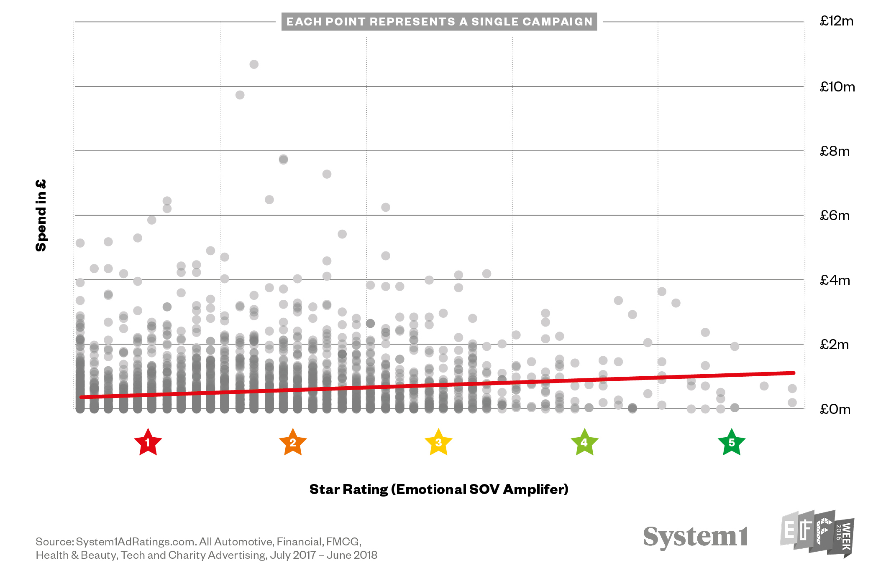
Lorna Hawtin: UK investment in the long-term today
Notes:
I was drawn towards this chart from System 1’s latest research. Using their emotional resonance star ratings, it shows just how much of the UK’s TV advertising budgets are currently being invested in what appears to be suboptimal copy.
So sobering to see all those precious pound coins being ploughed into at best average ideas. What I like though, is that it’s a great chart to help create a shared benchmark for success at the beginning of a project or even relationship. Together do we want to do good; or do we want to do great?

Slide 12
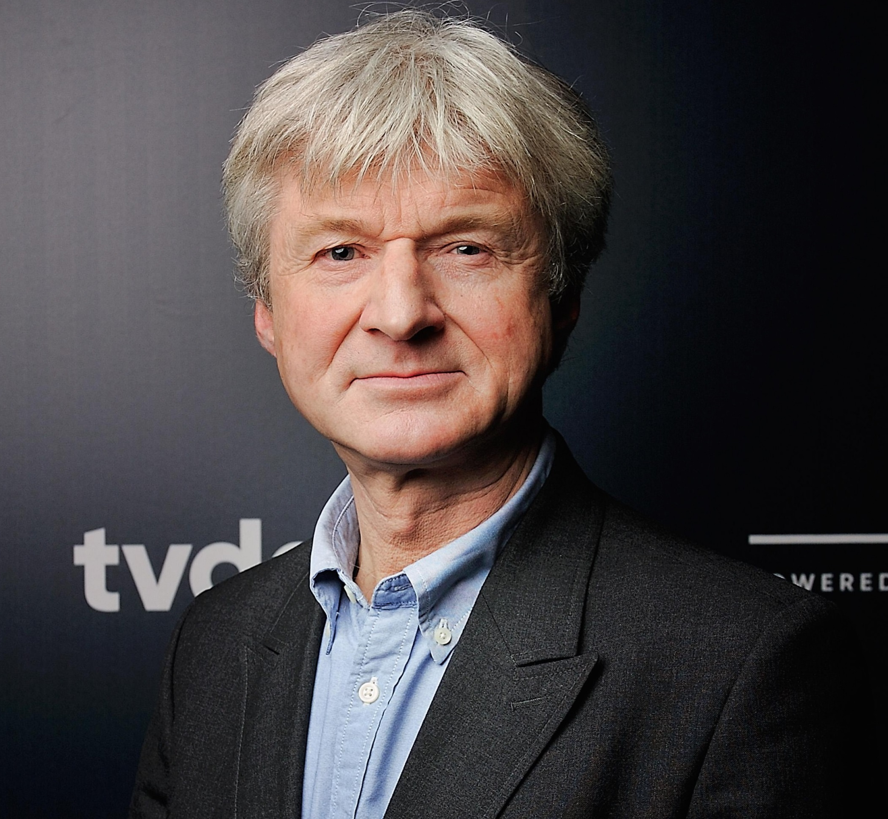
Peter Field: Big Tech use traditional advertising media
Key finding: Major tech firms spend on traditional brand media.
“Clearly Big Tech are looking more objectively at what works: despite having access to advanced digital tools and data, these companies choose to put ever more money into traditional advertising media.”
Peter Field
Marketing Consultant

Slide 13
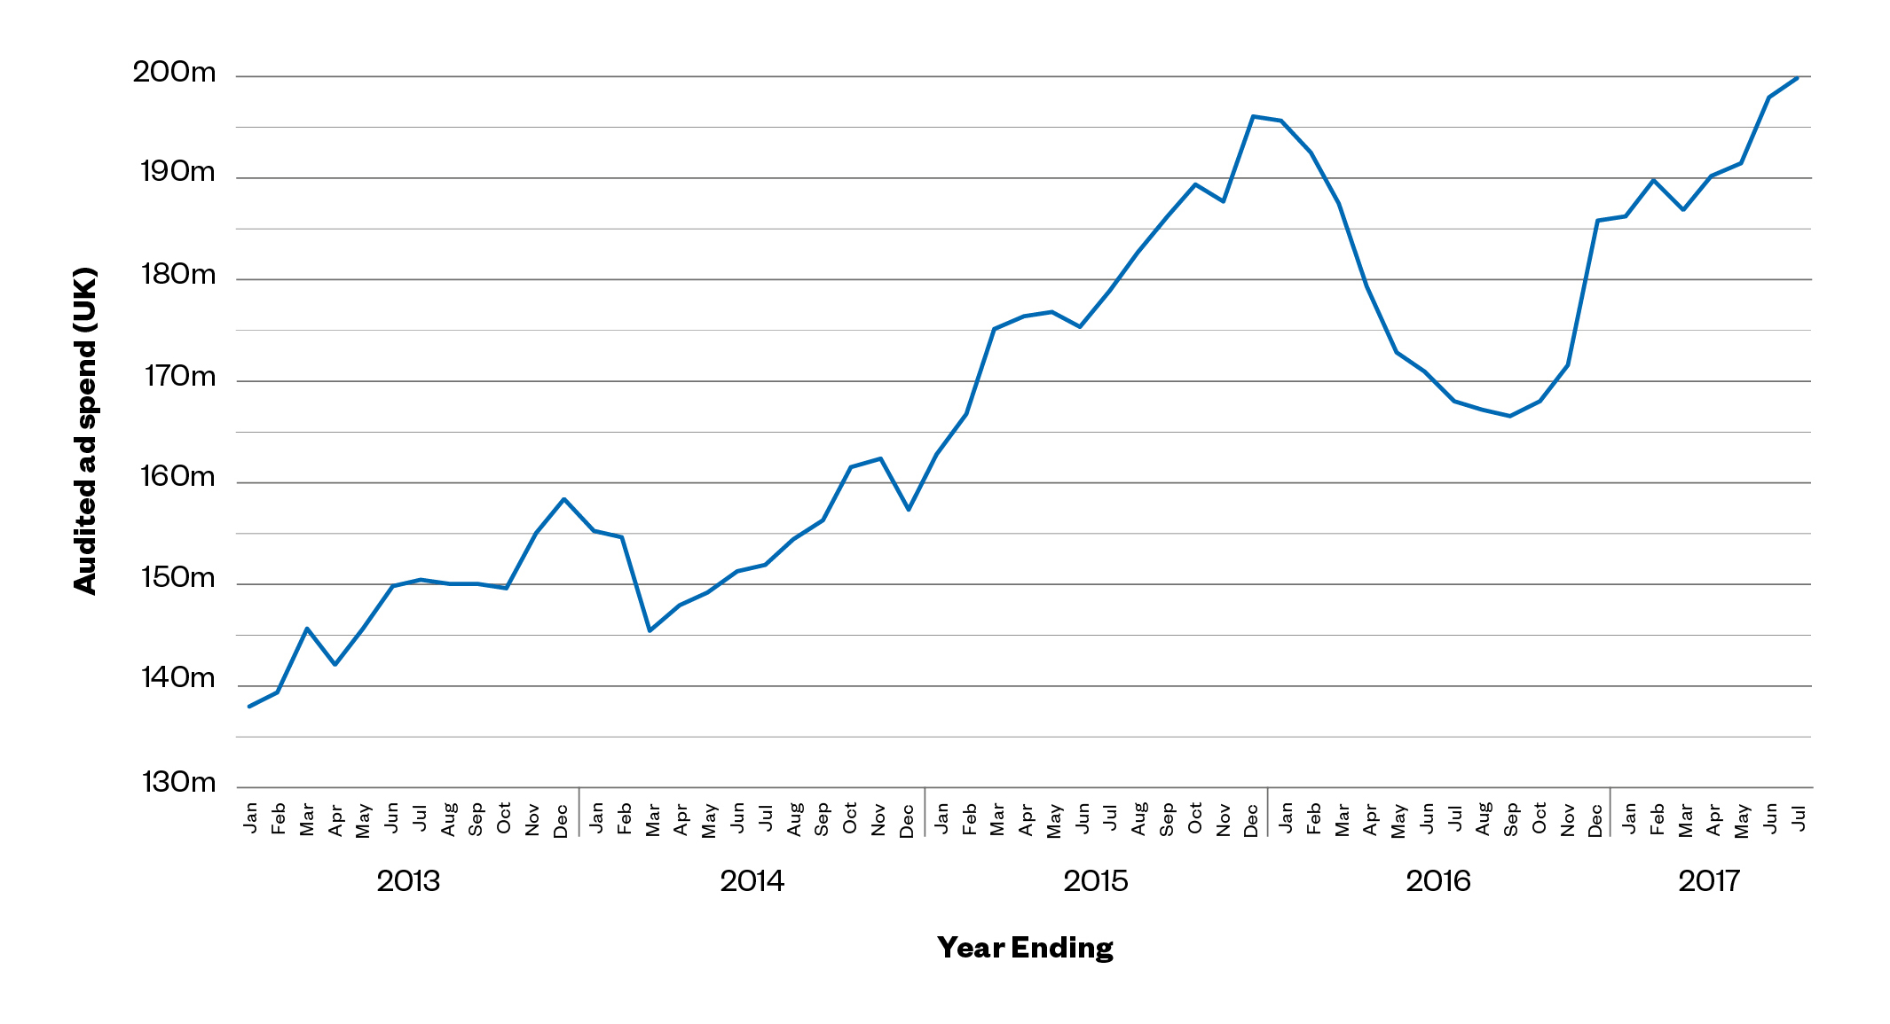
Peter Field: Big Tech use traditional advertising media
Source: Nielsen Brands: Amazon, Google, Apple
Facebook, Twitter, AirBnB, Uber, Spotify
Notes:
The army of digital consultants and planners relentlessly tell us that we should be putting more (if not all) of our money into newer online channels and that the established advertising media, like TV, radio, OOH and print are no longer effective.
Quite why they do this when the overwhelming body of effectiveness evidence points to the opposite conclusion, is increasingly an enigma. Clearly Big Tech are looking more objectively at what works: despite having access to advanced digital tools and data, these companies choose to put ever more money into traditional advertising media. Perhaps 2019 will be the year that we all wake up and smell the coffee?

Slide 14

Patrick Barwise: Proportion of advertising-generated profit by medium
Key finding: TV delivers 71% of total profit generated by advertising.
“This chart shows that TV generates the highest average three-year return.”
Patrick Barwise
London Business School

Slide 15
Patrick Barwise: Proportion of advertising-generated profit by medium
Bubble size represents % of total profit
Total profit = all return (short + long-term)
generated over 3 years
Print: 18%
TV: 71%
Online Video: 4%
TOTAL PROFIT ROI EFFICIENCY
Radio: 3%
OOH: 3%
BREAK EVEN
Online Display: 1%
% OF BUDGET
Source: ‘Profit Ability: the business case for advertising’, Nov 2017
Ebiquity ROI campaign database (Feb’14-May’17) & Gain Theory. Campaign obs: 1,954
NB: Online Video includes Broadcaster VOD, YouTube, Facebook video & online programmatic video
Notes:
What most companies want when allocating resources to advertising is to maximise its contribution to the long-term value of the business.
The challenges are to sustain investment in long-term brand-building, looking beyond short-term sales, and to optimise the media mix. This chart shows that, for the mid-sized and large B2C advertisers covered by Ebiquity and Gain Theory’s client-funded econometric studies, TV generates the highest average three-year return and online display the lowest. These are average figures and the results will vary greatly between different brands and campaigns because of variations in the context, the objectives, and the quality of creative strategy and execution. There may also be synergies between media. But, overall, because of TV’s high average three-year return, it still captures over 50% of these brands’ media budgets. It’s that combination of high profitability and high investment that explains its remarkable 71% share of the total profit contribution in the chart.

