Slide 1

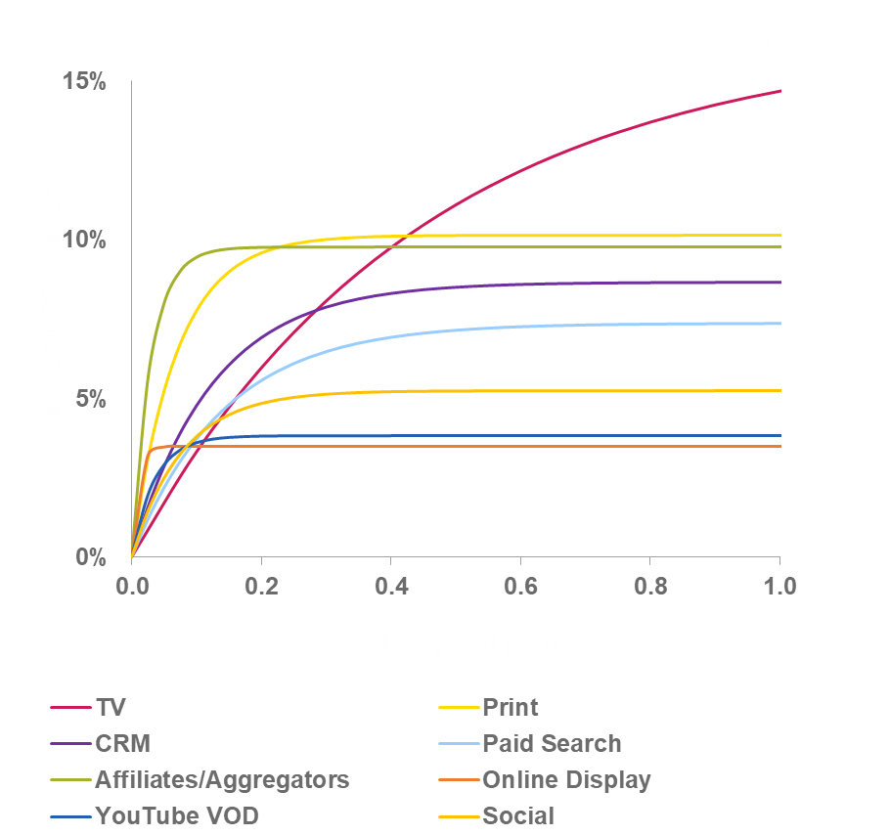


Principle of diminishing returns is paramount
Sales uplift level dependent on:
Size of market
Product accessibility
Brand size
Diminishing returns dependent on:
Scale of ad channels
Creative messaging
Notes:
Media response curves capture the sales impact at different budget levels.
As spend increases we see diminishing returns as media starts to approach what is often called ‘saturation’.
Some channels are highly effective at low spend levels but saturate quickly, as in the example of the blue line.
Other channels saturate much more slowly, which means that they have greater potential to drive growth (e.g. red line).
These curves are important for media planning and optimisation and can be used to maximise profit from marketing.

