Slide 1


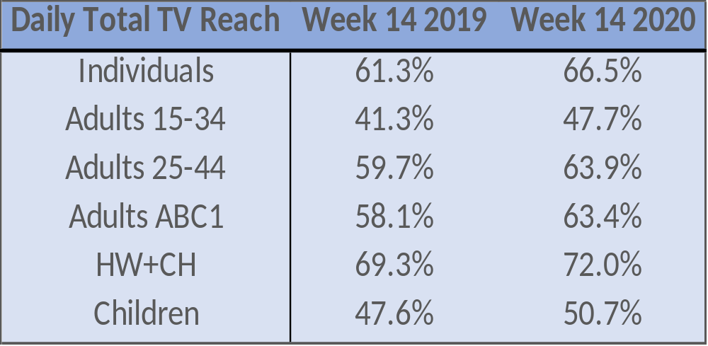


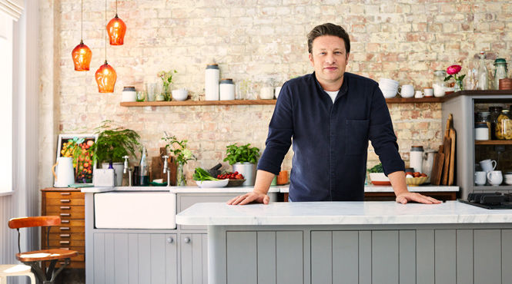

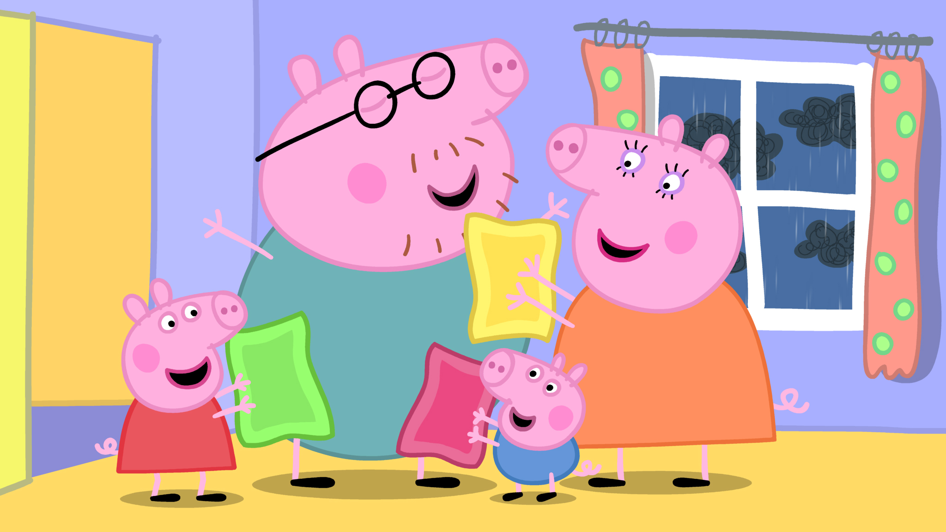
TAM IRELAND TV VIEWING REPORT MARCH 30th-April 5th 2020
As Irish audiences adjust to more time at home, our weekly viewing report gives you the most up-to-date analysis of shifts and trends in TV viewing.
REACH
As Easter approaches we’re all coming to terms with this new ‘normal’. We're all still watching increased levels of TV and are still hungry for trusted, credible news. The viewing numbers also show us that Irish people are also balancing their days with drama, entertainment and soaps.
Source: TAM Ireland/Nielsen, National, Total TV, Live + VOSDAL, Individuals 4+, incl guests Average Daily Reach based on 1+ consecutive minutes
AVERAGE DAILY MINUTES
Average daily minutes for Live and VOSDAL continue to be up across all audiences year on year.
Source: TAM Ireland/Nielsen, National, Total TV, Live + VOSDAL, Individuals 4+,Average Mins Per person
VIEWING PATTERNS
As the average number of minutes viewed per person has increased in March, we also can see that Co-viewing in particular has grown as more groups and families settle down together to watch Broadcaster content. Co-viewing has grown by 14% month on month (Feb 20 V Mar 20) and 8% year on year (Mar 19 V Mar 20)
Source: TAM Ireland/Nielsen, National, Total TV, Consolidated, Individuals 4+,Average Time Per person
PROGRAMMING
Brand new content is being created that reflects the exceptional times we’re living in such as Ireland on Call, Operation Transformation-Keeping Well Apart on RTÉ One and Homeschool Hub on RTÉ 2. On Virgin Media One, The Graham Norton Show is back from this Saturday. The show returns with big name “virtual guests” while the notorious red chair is relocated to the comfort of your own armchair at home. Graham and his team have found new, entertaining ways to keep the show on the road so that the familiar faces people love will still be in their living rooms in the weeks ahead. Other creative ideas can be seen on Channel 4, with Jamie Oliver's Keep Cooking and Carry On (which is now filmed from his home on an iPhone without a camera crew and with help from his wife, Jools, and five kids!)
The Guards-Inside the K finishes its run on Virgin Media One on Wed 8th April. Last weeks episode (April 1st) had 301,100 viewers (indiv Live+VOSDAL)
Kids viewing to Nick Jnr Too was up 30% week on week. (Ave ‘000s) The station has been rebranded as Nick Jnr Peppa for the month of April!
Please note: All data based on live & VOSDAL TV set viewing

