Slide 1

Tracker Study: Re-Opening Ireland
PHASE 1

Slide 2





Methodology
A nationally representative online survey of 371 adults aged 18+
Sample Size
317 Adults aged 18+
Online Survey
Interviewing was completed by members of B&A’s Online Panel. This panel is regularly refreshed, while strict quality controls are in place on all surveys submitted.
Quota Controls
Based on CSO Census 2016 figures for gender, age, region and area, as well as AIMRO agreed figures for social class.
Fieldwork Dates
22nd – 25th May, 2020.
Weights
Corrective weighting was applied by gender, age and socio economic status to ensure a fully representative sample.

Slide 3


Summary of Findings
Of the 60% of adults who had to cancel any type of holiday because of the crisis, 44% expect to spend the money they saved on other products and services in Ireland instead.
Key purchases being planned for the next six months include household furnishings/goods and home improvements, purchasing (re-purchasing?) car insurance, and buying health insurance.
Younger people in particular are planning to treat themselves once all or most of the Covid 19 restrictions are lifted, with significant retail therapy also in the offing. 1 in 6 of us are also planning on shedding a few lbs. as we emerged from hibernation.
TV has been by far the single most important source of news and information during the Covid-19 crisis.
The power of TV as a reliable and trusted source of information and entertainment remains strong across all demographic groupings.
TV has been by far the most trusted source of advertising during the Covid 19 crisis, followed at some remove by radio.
Significant increases in the number of individuals working from home, furloughed and made unemployed are evident since the onset of Covid-19.
Full-time working from home is most evident amongst those aged 18-49 years and from an ABC1 socio-economic background. Those aged under 35 years are more likely than the average individual to have been made unemployed due to Covid-19, while working part-time from home is significantly more prevalent amongst females than males.
Half of all Irish adults actually report that their personal finances have remained the same since the beginning of the Covid 19 crisis, a third report their personal finances have disimproved, with one in six (presumably those on Government support) actually reporting an improvement in their personal finances.
Six in ten have managed to build up cash reserves by way of saving money since the beginning of the crisis – a positive indication of a potential spending boost once restrictions are lifted.
Twice as many individuals expect to spend more money as businesses reopen as expect to spend less – another positive indicator of the likely economic boost when things begin to return to a ‘new normal’.
Given the onset of the crisis during the typical holiday booking season, it is perhaps not surprising that six in ten of all adults had to cancel an overseas holiday as a direct result.
Significant increases in the number of individuals working from home, furloughed and made unemployed are evident since the onset of Covid-19.

Slide 4
2/3 of people report that their personal finances have remained the same or improved since the onset of the Covid-19 crisis
Base: All Adults 18+ N - 317
Dis-improved significantly
Improved significantly
Improved slightly
Dis-improved slightly
Remained the same
Half of all Irish adults actually report that their personal finances have remained the same since the beginning of the Covid 19 crisis, a third report their personal finances have disimproved, with one in six actually reporting an improvement in their personal finances.
Q.3 To what extent have your personal finances improved, disimproved or remained the same since the beginning of the COVID 19 crisis?

Slide 5
Extent to which personal finances have been impacted by Covid-19
Base: All Adults 18+ N - 317
Total |  | Gender |  |  | Age |  |  |  |  | Social Class |  |  | Region |  |  |  |  | Area
 |  | Male | Female |  | up to 34 | 35-49 | 50-64 | 65+ |  | ABC1F | C2DE |  | Dublin | Lein-ster | Mun-ster | Conn/Ulster |  | Urban | Rural
317 |  | 137 | 180 |  | 113 | 87 | 77 | 40 |  | 131 | 186 |  | 87 | 77 | 92 | 61 |  | 224 | 93
% |  | % | % |  | % | % | % | % |  | % | % |  | % | % | % | % |  | % | %
Improved significantly
Improved slightly
Remain the same
Disimproved slightly
Disimproved significantly
Don’t know
NET (Improved) | 17 |  | 21 | 12 |  | 26 | 12 | 12 | 16 |  | 20 | 13 |  | 20 | 15 | 19 | 11 |  | 17 | 15
NET (Disimproved) | 35 |  | 34 | 35 |  | 38 | 39 | 31 | 27 |  | 37 | 33 |  | 36 | 28 | 32 | 46 |  | 37 | 31
Males, and those aged 18-34 years, are significantly more likely than the average individual to report improved personal finances.
Q.3 To what extent have your personal finances improved, disimproved or remained the same since the beginning of the COVID 19 crisis?

Slide 6









60% of people have saved money during the crisis
Base: All Adults 18+ N - 317
% agree they have managed to save any money
SAVE ANY MONEY
Male
57%
Female
63%
Age
60%
agree they have managed to save money
ABC1
C2DE
Class
65%
55%
Urban
56%
Rural
68%
Area
Six in ten have managed to build up cash reserves by way of saving money since the beginning of the crisis – a positive indication of a potential spending boost once restrictions are lifted.
Q.4 Have you managed to save any money since the beginning of the COVID 19 crisis?

Slide 7

And 37% have managed to clear or reduce debt
Base: All Adults 18+ N - 317
% agree they have managed to reduce or clear debt
CLEAR/REDUCE ANY DEBT
Male
41%
Female
33%
Age
37%
agree they have managed to clear or reduce debt
Class
ABC1
C2DE
35%
39%
Urban
35%
Rural
39%
Area
In addition to increased savings, 37% report having managed to clear or reduce debt since the beginning of the crisis.
Q.5 Have you managed to reduce or clear any debts since the beginning of the COVID 19 crisis?

Slide 8

Expected expenditure when business reopens
Base: All Adults 18+ N - 317
NET MORE
NET LESS
49%
of Irish adults feel expect to spend more
25%
of Irish adults feel expect to spend less
25%
Expect to spend about the same amount as during the full COVID 19 lockdown
5% Considerably more/
45% a little more
18% a little less/
7% considerably less
Twice as many individuals expect to spend more money as businesses reopen as expect to spend less – another positive indicator of the likely economic boost when things begin to return to a ‘new normal’.
Q.6 As businesses continue to re-open, do you expect you will be spending more money, less money, or about the same amount of money each week compared to what you were spending when most businesses were closed?

Slide 9
Expected expenditure when business reopens
Base: All Adults 18+ N - 317
% agree they will spend more when businesses reopen
Male
51%
Female
48%
Expect to spend considerably more
Expect to spend considerably less
Age
Expect to spend a little less
Expect to spend a little more
Class
ABC1
C2DE
46%
53%
Area
Expect to spend about the same amount as during the full COVID 19 lockdown
The propensity to spend more when businesses reopen over-indexes among those living in the Greater Dublin Area, as well as those in the youngest (18-34 years) and oldest (65 years+) age categories.
Q.6 As businesses continue to re-open, do you expect you will be spending more money, less money, or about the same amount of money each week compared to what you were spending when most businesses were closed?

Slide 10
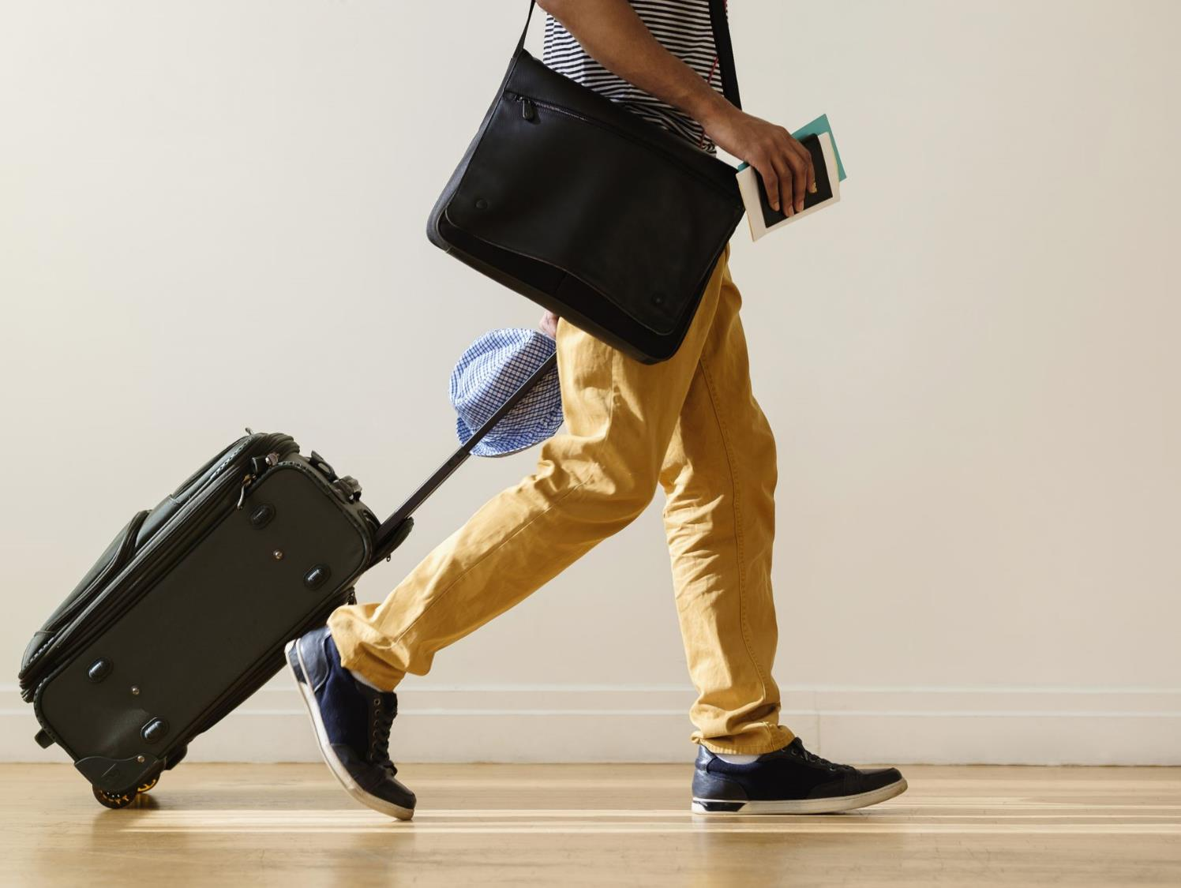
Incidence of having to cancel a holiday
Base: All Adults 18+ N - 317
Cancelled a holiday in Ireland
Cancelled a holiday overseas
40%
Yes
59%
Yes
Higher among:
Higher among:
Female | 63%
50-64 | 64%
Dublin | 64%
Working full-time | 67%
Those with adult children age 20+ in h/hold | 71%
65+ | 48%
Working full time | 45%
Student | 54%
Given the onset of the crisis during the typical holiday booking season, it is perhaps not surprising that six in ten of all adults had to cancel an overseas holiday as a direct result.
Q.7 Have you had to cancel a holiday in Ireland due to the COVID 19 crisis?
Q.8 Have you had to cancel a holiday overseas due to the COVID 19 crisis?

Slide 11
Over four in ten expect to spend the money they have saved on holidays on other products and services in Ireland
Base: All Adults who had to cancel holiday 18+ N - 186
Total |  | Gender |  |  | Age |  |  |  |  | Social Class |  |  | Region |  |  |  |  | Area
 |  | Male | Female |  | up to 34 | 35-49 | 50-64 | 65+ |  | ABC1F | C2DE |  | Dublin | Lein-ster | Mun-ster | Conn/Ulster |  | Urban | Rural
186 |  | 75 | 111 |  | 68 | 47 | 49 | 22 |  | 80 | 106 |  | 58 | 47 | 46 | 35 |  | 134 | 52
% |  | % | % |  | % | % | % | % |  | % | % |  | % | % | % | % |  | % | %
Yes
No
Don’t know
Of the 60% of adults who had to cancel any type of holiday because of the crisis, 44% expect to spend the money they saved on other products and services in Ireland instead, with a further 26% still uncertain as to what they will do with the money. Those aged 18-49 years are most likely of all to spend their holiday ‘savings’ on other products and services in Ireland.
Q.9 And will you be spending any of the money that you have saved from that/those holidays on other products and services in Ireland instead?

Slide 12
Summary purchase plans post Covid
Base: All Adults 18+ N - 317
Key purchases being planned for the next six months include household furnishings/goods and home improvements, purchasing (re-purchasing?) car insurance, and buying health insurance.
Q.10 When, if at all, do you expect to do each of the following?

Slide 13
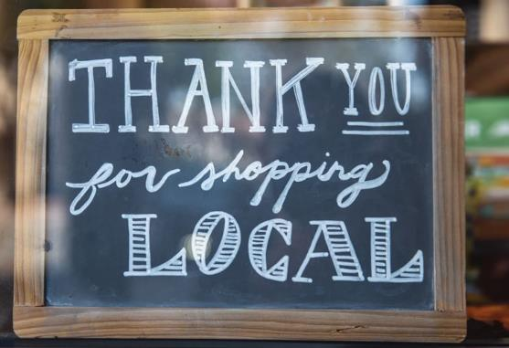
Frequency of Purchasing Irish brands from smaller local shops and suppliers since the onset of Covid-19 crisis
Base: All Adults 18+ N - 317
NET MORE
%
NET MORE
Gender:
Age:
43%
of Irish adults report purchasing Irish brands from smaller local shops and suppliers
Social Class:
Region:
Area:
Age of Children in H/Hold
ABC1s are significantly more likely to have been purchasing more Irish brands from local shops than have their C2DE counterparts.
Q.12 To what extent have you been doing more, less, or about the same amount of each of the following, since the onset of the COVID 19 crisis?

Slide 14

Frequency of Purchasing Irish brands from larger supermarkets since the onset of Covid 19 crisis
Base: All Adults 18+ N - 317
NET MORE
%
NET MORE
Gender:
Age:
32%
of Irish adults report purchasing more Irish brands from larger supermarkets
Social Class:
Region:
Area:
Age of Children in H/Hold
Increased purchasing of Irish brands from larger supermarkets peaks in the Dublin area.
Q.12 To what extent have you been doing more, less, or about the same amount of each of the following, since the onset of the COVID 19 crisis?

Slide 15

Intentions once Covid 19 restrictions lifted
Base: All Adults 18+ N - 317
56%
for those in the 18-34 years
age group
44%
for those in the 18-34 years
age group
Younger people in particular are planning to treat themselves once all or most of the Covid 19 restrictions are lifted, with significant retail therapy also in the offing. 1 in 6 of us are also planning on shedding a few lbs. as we emerged from hibernation.
Q.11 Which of the following do you intend to do once all or most of the COVID 19 restrictions are lifted?

Slide 16
Most trusted source
Base: All Adults 18+ N - 317
Social media has been by far the least trusted source of news and information during the Covid 19 crisis.
Q.17And please rank each of these sources from 1 to 5, where 1 is the source of news and information that you have trusted most during the COVID 19 crisis, and 5 is the source that you have trusted least?

Slide 17





Most trusted source of Advertising communication
Base: All Adults 18+ N - 317
Websites/Apps
TRUST TV MOST
%
Social Media
Gender:
Age:
Social Class:
Newspapers/press
TV
Region:
Area:
Radio
Age of Children in H/Hold
TV has been by far the most trusted source of advertising during the Covid 19 crisis, followed at some remove by radio.
Q.24 Please rank each of these sources from 1 to 5, where 1 is the source of Advertising that you have trusted most during the Covid 19 crisis, and 5 is the source that you have trusted least?

Slide 18
Television Viewing: Consolidated Minutes viewed daily
April 2020 V April 2019
TV viewing in April was strong across demographic groupings.
Source: TAM Ireland Ltd / Nielsen TAM / Av mins Pn, Total TV, Consolidated, National

