Slide 1

Tracker Study: Re-Opening Ireland
PHASE 2

Slide 2





Methodology
A nationally representative online survey of 310 adults aged 18+
Sample Size
P1 317 Adults aged 18+
P2 310 Adults
aged 18+
299 of the 310 respondents for phase 2 were also interviewed for the Phase 1 survey
Online Survey
Interviewing was completed by members of B&A’s Online Panel. This panel is regularly refreshed, while strict quality controls are in place on all surveys submitted.
Quota Controls
Based on CSO Census 2016 figures for gender, age, region and area, as well as AIMRO agreed figures for social class.
Fieldwork Dates
P1 22nd – 25th May, 2020.
P2 11th to 15th June, 2020
Weights
Corrective weighting was applied by gender, age and socio economic status to ensure a fully representative sample.

Slide 3


Summary of Findings
Perhaps not surprisingly, people are most looking forward to meeting
up with family and friends as restrictions continue to be lifted.
Many Irish adults also claim that they have been purchasing more Irish brands since lockdown, especially from smaller local shops and suppliers.
Price and quality remain the greatest purchase decision factors for the Irish consumer,
with safety, convenience and trust in the brand also appearing in most people’s top three purchase decision considerations.
Viewing
TV remains by far the single most important source of news and information during the Covid-19 crisis.
It is clear that TV has become even more important to people since the onset of the crisis as a source of news, information and entertainment.
We know from the TAM Ireland data that viewing has remained well ahead of last year throughout the last 3 months Irish adults viewed for an average of 3 hrs 9 mins per day from March – May 2020 an increase of 7% from the previous years.
In the tracker study many have reported that they are watching more boxsets and more daytime TV since the beginning of the Lockdown.
TV has been by far the most trusted source of advertising during the Covid 19 crisis
Respondents were asked to identify a specific TV ad that they felt was the best one they had seen in recent weeks. The Three Ireland Monster Hunt ad tops the charts here, followed by Aldi, Virgin Media, and the TAM Ireland TV Builds Brands campaign. Use of all types of VOD and Catch-Up platforms has increased since the onset.
With Netflix continuing to benefit particularly so from Lockdown. 35% of people claim to be watching more BVOD since the outset and 78% of them expect to continue watching the same amount or more BVOD once restrictions are lifted.
In the second of our Tracker Surveys we find that over the last four weeks there has been an increase in the number of people working full time outside the home, along with a corresponding decline in the proportion of adults who are currently furloughed.
Improved Sentiment
There has been a significant improvement in consumer sentiment as it relates to the broader Irish economy since last month, with the proportion of adults expecting the Irish economy to dis-improve over the next 12 months declining from 86% in May to 80% in June.
There has been a marginal month-on-month improvement in the state of people’s personal finances since the beginning of the crisis, with the proportion indicating their finances have improved increasing from 17% to 20%, and the proportion suggesting they have dis-improved significantly reducing from 12% to 9%. None of these differences are statistically significant, although they are nudging in the right direction.
Six in ten have managed to build up cash reserves by way of saving money since the beginning of the crisis – a positive indication of a potential spending boost once restrictions are lifted.
Getting Sociable and buying quality Irish products a priority
Almost half of all Irish adults expect to eat out at a restaurant within the next three months. People are more circumspect about their likelihood of visiting a pub, with 29% expecting to do so within the next three months.
Some notable differences in terms of category purchase intentions over the next 6 months, include an increased intention to invest in home improvements (36% up from 28%) and holiday in Ireland (48% up from 39%)with females wielding more power than males in the purchase decision process – apart from visiting the pub, where males come into their own!
Significant increases in the number of individuals working from home, furloughed and made unemployed are evident since the onset of Covid-19.

Slide 4
Expected impact of COVID-19 on the Irish economy and personal finances
Base: All Adults 18+ N - 310
There has been a significant improvement in consumer sentiment as it relates to the broader Irish economy since last month, with the proportion of adults expecting the Irish economy to disimprove over the next 12 months declining from 86% in May to 80% in June.
41% expect their personal finances to disimprove over the next 12 months – no significant change from the corresponding 43% in May.
The impact of COVID-19 on the Irish economy
The impact of COVID-19 on my personal finances
80%
NET
Disimprove
41%
NET
Disimprove
Vs 86% May 2020
Net improve +6%
Vs 43% May 2020
Net improve +2%
Higher among:
Net Disimprove
50-64s | 87%
Rural | 85%
Higher among:
Net Disimprove
50-64s | 46%
Munster | 46%
Q.2 To what extent do you expect each of the following to improve, disimprove, or remain the same over the next 12 months?

Slide 5
65% say personal finances the same or better since onset of crisis
Base: All Adults 18+ N – 317/310
May 2020 | June 2020
% | %
Diff =/- Before
P 2 vs P1
%
Improved significantly
Improved slightly
Remain the same
Disimproved slightly
Disimproved significantly
Don’t know
Net improve +3%›››
There has been a marginal month-on-month improvement in the state of people’s personal finances since the beginning of the crisis, with the proportion indicating their finances have improved increasing from 17% to 20%, and the proportion suggesting they have disimproved significantly reducing from 12% to 9%. None of these differences are statistically significant, although they are nudging in the right direction.
Q.3 To what extent have your personal finances improved, disimproved or remained the same since the beginning of the COVID 19 crisis?

Slide 6
Extent to which personal finances have been impacted by Covid-19
Base: All Adults 18+ N - 310
Total |  | Gender |  |  | Age |  |  |  |  | Social Class |  |  | Region |  |  |  |  | Area
 |  | Male | Female |  | up to 34 | 35-49 | 50-64 | 65+ |  | ABC1F | C2DE |  | Dublin | Lein-ster | Mun-ster | Conn/Ulster |  | Urban | Rural
310 |  | 132 | 178 |  | 115 | 84 | 74 | 37 |  | 133 | 177 |  | 85 | 76 | 87 | 62 |  | 219 | 91
% |  | % | % |  | % | % | % | % |  | % | % |  | % | % | % | % |  | % | %
Improved significantly
Improved slightly
Remain the same
Disimproved slightly
Disimproved significantly
Don’t know
NET (Improved) | 20 |  | 26 | 14 |  | 25 | 18 | 11 | 28 |  | 22 | 18 |  | 19 | 22 | 21 | 16 |  | 18 | 23
NET (Disimproved) | 34 |  | 39 | 30 |  | 34 | 41 | 35 | 25 |  | 37 | 32 |  | 35 | 29 | 37 | 37 |  | 36 | 31
ABC1s, males, and those aged 18-34 years, are significantly more likely than the average individual to report improved personal finances.
Q.3 To what extent have your personal finances improved, disimproved or remained the same since the beginning of the COVID 19 crisis?

Slide 7



Top 3 Activities Planned in next three months ….
Eat out in a restaurant
Go to a pub
46%
29%
73% next
6 months
53% next
6 months
Purchase a holiday in Ireland
29%
48% next
6 months

Slide 8
Summary purchase plans post Covid
Base: All Adults 18+ N - 310
Next 6 months P1
%
n/a
39
n/a
42
n/a
45
28
20
14
19
19
17
17
12
7
6
5
4
4
1
1
2
Almost half of all Irish adults expect to eat out at a restaurant within the next three months. People are more circumspect about their likelihood of visiting a pub, with 29% expecting to do so within the next three months and a further 24% within the next six months.
Q.10 When, if at all, do you expect to do each of the following?

Slide 9

Most looking forward to once Covid 19 restrictions lifted
Base: All Adults 18+ N - 310
Perhaps not surprisingly, people are most looking forward to meeting up with family and friends as restrictions continue to be lifted.
Q.10a What are you most looking forward to doing as restrictions are lifted? Please rank in order of preference, where 1 is your first preference, 2 is your second preference, etc

Slide 10
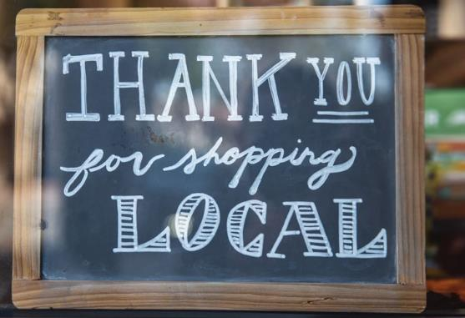
More people Buying Irish and Shopping Local
Base: All Adults 18+ N - 310
NET MORE
%
NET MORE
Gender:
Age:
41%
of Irish adults report purchasing Irish brands from smaller local shops and suppliers
Social Class:
Region:
Area:
(43% P1)
Age of Children in H/Hold
Older respondents, and households with primary school aged children are significantly more likely to have been purchasing more Irish brands from local shops than the average consumer.
Q.12 To what extent have you been doing more, less, or about the same amount of each of the following, since the onset of the COVID 19 crisis?

Slide 11
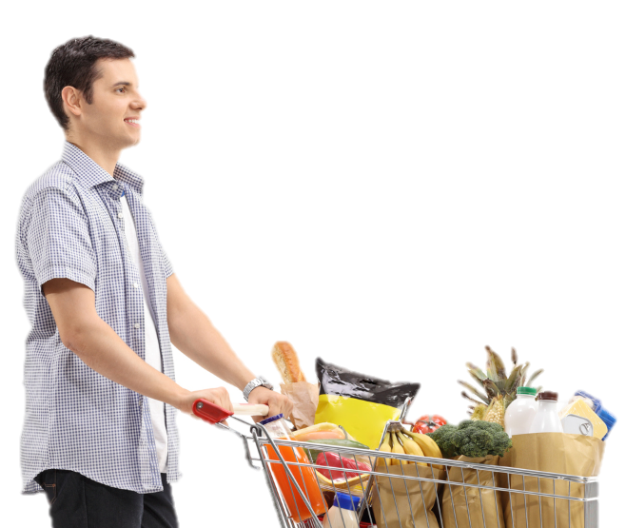
Increase in buying Irish from supermarkets
Base: All Adults 18+ N - 310
NET MORE
%
NET MORE
Gender:
Age:
35%
of Irish adults report purchasing more Irish brands from larger supermarkets
Social Class:
Region:
Area:
(32% P1)
Age of Children in H/Hold
Older, Munster-based individuals report the most significantly increased level of purchasing Irish brands from larger supermarkets since the beginning of the crisis.
Q.12 To what extent have you been doing more, less, or about the same amount of each of the following, since the onset of the COVID 19 crisis?

Slide 12
Price and Quality most important factors when deciding on products & Services
Base: All Adults 18+ N - 310
42% male, 45% 18-34 yrs, 43% C2DE
32% female, 37% 65+ yrs, 33% Conn/Ulster
n/a
There is some evidence to suggest that shoppers are becoming a little less concerned about safety in terms of how important it is to them in deciding on the products and service they buy.
Q.13 Please rank the following factors in terms of how important they are to you in deciding on the products and services you buy?

Slide 13
Year on Year Viewing is up 7% from March – May 2020 for Adults
Source TAM/Nielsen Avg. Mins per person -. All day, all week, live/timeshift Mar-May 2020 v Mar –May 2019

Slide 14
Most trusted source
Base: All Adults 18+ N - 310
Social media has been by far the least trusted source of news and information during the Covid 19 crisis.
Q.17And please rank each of these sources from 1 to 5, where 1 is the source of news and information that you have trusted most during the COVID 19 crisis, and 5 is the source that you have trusted least?

Slide 15

70%
Watching more news and current affairs
(71% P1)
TV’s status as most trusted source of information is confirmed by the levels agreeing that since the lockdown I am watching more news and current affairs
(76% for women)

Slide 16
Level of agreement with each statement
Base: All Adults 18+ N - 310
It is clear that TV has become even more important to people since the onset of the crisis as a source of news, information and entertainment.
Q.20 To what extent do you agree or disagree with each of the following statements. -

Slide 17
Best Ads on TV
Base: All Adults 18+ N - 310
No ads only watch On Demand/Streaming
%
(3)
Do not pay attention to adverts
Specific ad mentioned
41%
(5)
(3)
(3)
(4)
(12)
(2)
Don’t know/can’t recall/none
(43)
(31)
(17)
Other ads
Other mentions less than 1% for total
Four in ten of all adults could identify a specific TV ad that they felt was the best one they had seen in recent weeks. The Three Ireland Monster Hunt ad tops the charts here, followed by Aldi, Virgin Media, and the Irish TAM TV Builds Brands campaign.
Q.21 What is the best TV ad that you have seen over the last couple of weeks?

Slide 18





Most trusted source of Advertising communication
Base: All Adults 18+ N – 317/310
TRUST TV MOST – P2 JUN 20
TV
P1 May 2020 | P2 June 2020
% | %
%
Gender:
Age:
TV
Social Class:
Radio
Region:
Newspapers/press
Area:
Social Media
Websites/Apps
Age of Children in H/Hold
TV has been by far the most trusted source of advertising during the Covid 19 crisis, followed at some remove by radio.
Q.24 Please rank each of these sources from 1 to 5, where 1 is the source of Advertising that you have trusted most during the Covid 19 crisis, and 5 is the source that you have trusted least?

Slide 19
BVOD and SVOD Channels accessed since onset of Covid 19
Base: All Adults 18+ N - 310
With Netflix continuing to benefit particularly so from Lockdown.
Q.22 Since the onset of the COVID 19 crisis, have you been accessing each of the following more, less or about the same amount as usual? -

Slide 20
Expected frequency of accessing channels once Covid-19 restrictions lifted
Base: All Adults 18+ who use each channel – 317/310
Amongst those who use each channel, the indications are that consumption of them is likely to decrease once the Covid 19 restrictions
are lifted.
Q.26 Once the Covid 19 restrictions are lifted, do you think you will access each of the following more, less or about the same amount as you did before the onset of the Covid 19 crisis?

