Slide 1
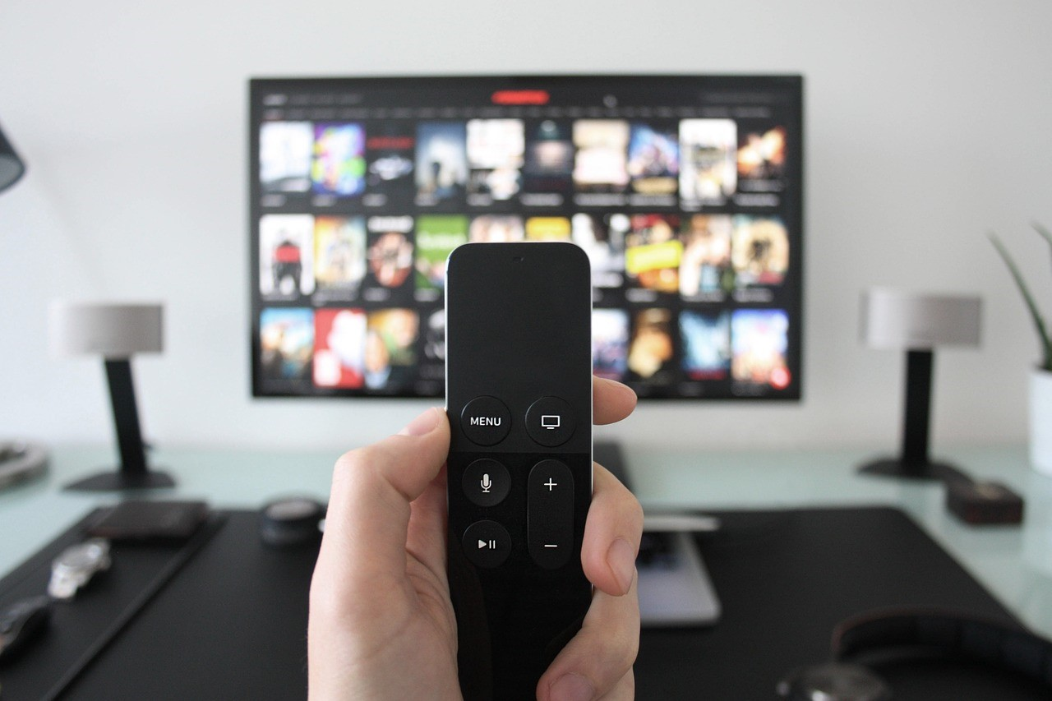

August 2020
Viewing Trends Overview

Slide 2
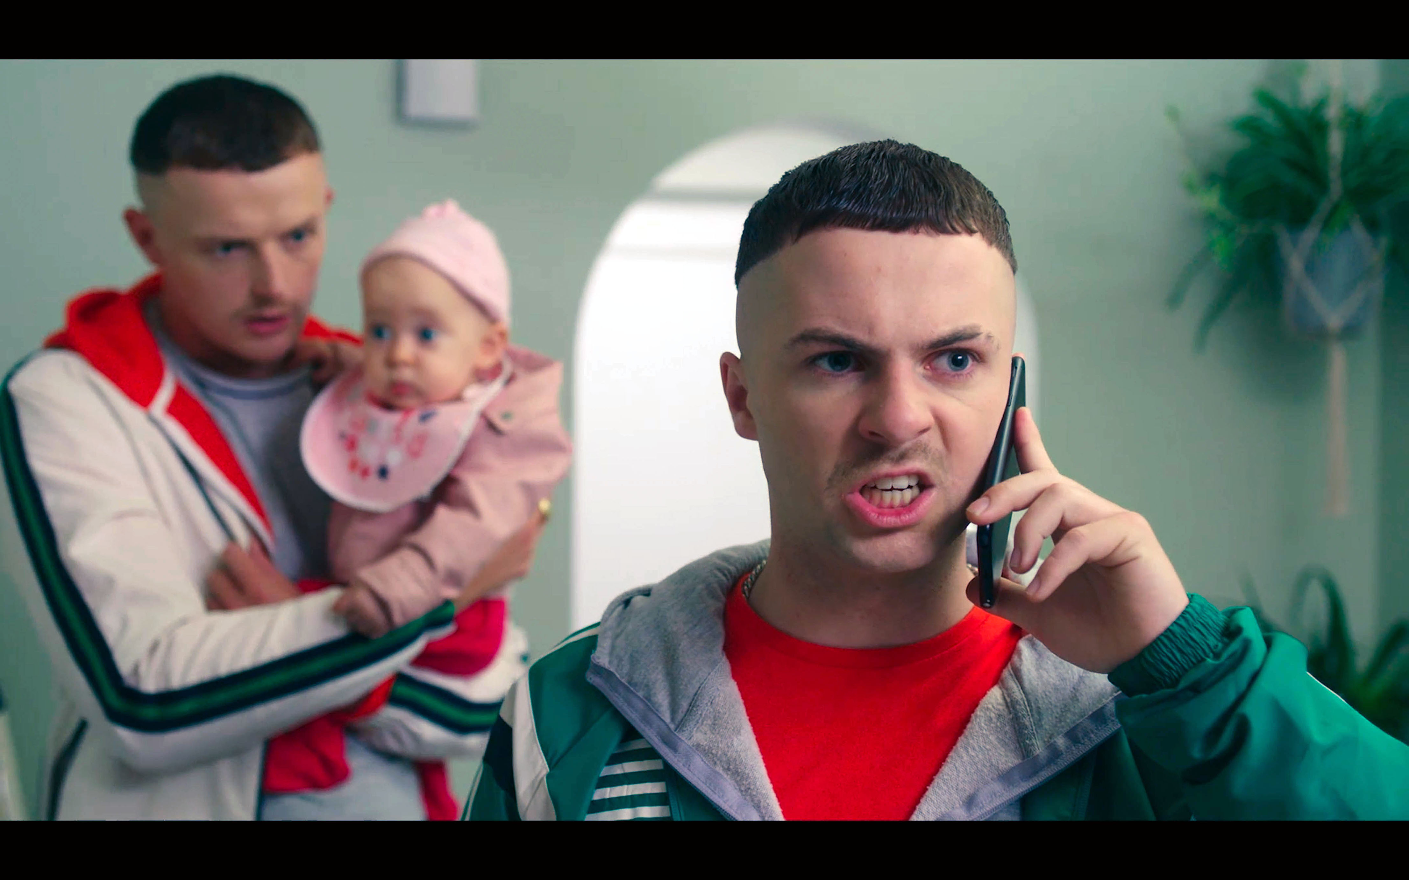
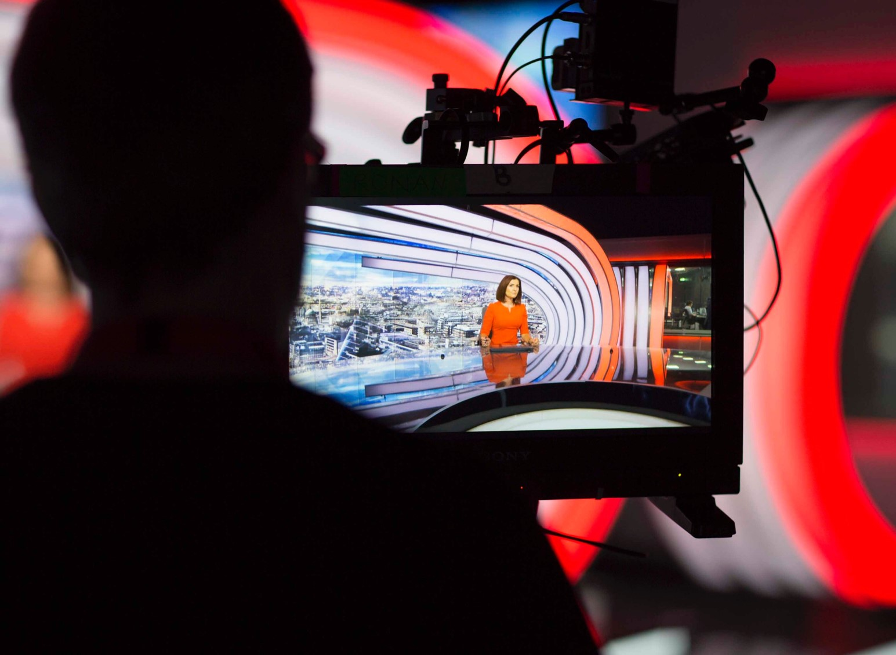
AUGUST 2020 VIEWING TRENDS
TAM Ireland Commercial Channels reached an average of 72% of individuals each week in August 2020
Individuals watched an average of 138 minutes (2 hours 18 minutes) each day in August 2020
Nine O’ Clock News on RTÉ One on Wednesday August 26th was the most watched programme with 568,700 individuals tuning in
Current Affairs and News programming continued to dominate the top watched programme lists in August:
    RTÉ News at SixOne on August 20th was the second most viewed programme of the month
    News at 5.30 On Virgin Media One on August 18th was Virgin Media’s 4th most viewed programme in August

Slide 3
WEEKLY REACH: AUGUST 2020

Slide 4
TOP 10 ADVERTISERS: AUGUST 2020
1: Procter & Gamble
2: Vodafone Ireland
3: National Lottery
4: Sky Ireland
05: Bank of Ireland
10: Lidl Ireland
07: Diageo
08: Reckitt Benckiser
09: Three Ireland
06: Tesco Ireland

Slide 5
TOP PROGRAMMES: August 2020
Top 5 programmes by station group. A breakdown of the Top 10 programmes by station for August 2020 can be found here
RTE News: Nine O'Clock 26-08-2020
CORONATION STREET 20 24-08-2020
FBI 27-08-2020
RTE News: Six One 20-08-2020
Prime Time 20-08-2020
Prime Time Special 13-08-2020
Reeling In The Years 20-08-2020
UCL: PAR V BAY LIVE 23-08-2020
EMMERDALE 2020 24-08-2020
NEWS AT 5.30 (2020) 18-08-2020
VIRGIN MEDIA NEWS 18-08-2020
SKY SPORTS NEWS SPECIALS 2020 26-08-2020
9-1-1 04-08-2020
A LEAGUE OF THEIR OWN 27-08-2020
S.W.A.T. 02-08-2020

Slide 6
TOP PROGRAMMES: AUGUST 2020
Top 5 programmes by station group. A breakdown of the Top 10 programmes by station for August 2020 can be found here
JURGEN KLOPP: GERMANY'S GREATEST EXPORT 03-08-2020
Come all you Dreamers - Christy Moore with Declan 02-08-2020
GEORDIE SHORE 25-08-2020
PRO14 GUINNESS PRO14 2019 22-08-2020
LOCATION LOCATION LOCATION 27-08-2020
SWINGERS 24-08-2020
GOGGLEBOX: CELEBRITY SPECIAL SU2C 2018 06-08-2020
LOSE A STONE IN 21 DAYS WITH MICHAEL MOS 05-08-2020
BEN AND HOLLY'S LITTLE KINGDOM 01-08-2020
FILM: DIRTY DANCING (1987) 27-08-2020
FILM: AS GOOD AS IT GETS (1997) 20-08-2020
FILM: SCARY MOVIE 3 (2003) 26-08-2020
Mike Denver - Live From Castlebar 04-08-2020
GAA BEO 2019 - 2020 09-08-2020
Michael English -Live from INEC 18-08-2020
Fleadh 2020 - Lean leis an gceol 08-08-2020
FOOTBALL FA CUP ENG 01-08-2020
BOXING CLASSICS 29-08-2020
F SUB DICK WARNER'S GREAT 26-08-2020
FOOTBALL FA CUP CLASSICS 05-08-2020

