Slide 1


September 2020
Viewing Trends

Slide 2

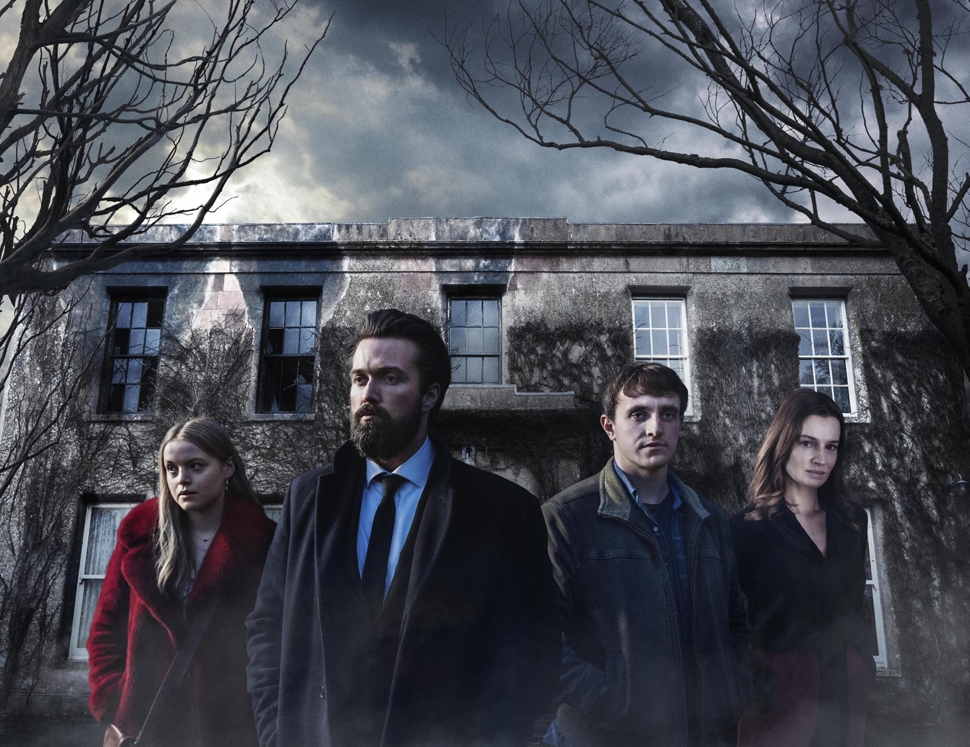
SEPTEMBER 2020 VIEWING TRENDS
TAM Ireland Commercial Channels reached an average of 73.8% of individuals each week in September 2020
Individuals watched an average of 142 minutes (2 hours 22 minutes) each day in September 2020
Nine O'Clock News on RTÉ One on Sunday September 27th was the most watched programme with 550,100 individuals tuning in
:New dramas and entertainment shows lead the way with viewers in September
    “The South Westerlies” on RTÉ One on Sept 6th was the 5th most viewed programme of the month
    The new season of “The Great British Bake” on Sept 22nd on Channel 4 brought in over 218,600 viewers (individuals)
    “The Deceived” on Virgin Media One had 257,700 viewers

Slide 3
WEEKLY REACH: SEPTEMBER 2020

Slide 4
TOP 10 ADVERTISERS: SEPTEMBER 2020
1: Sky Ireland
2: Procter & Gamble
3: Unilever
4: National Lottery
05: HSE
10: AIB
07: Diageo
08: L’Oréal
09: Virgin Media
06: Vodafone Ireland

Slide 5
TOP PROGRAMMES: September 2020
Top 5 programmes by station group. A breakdown of the Top 10 programmes by station for September 2020 can be found here
RTE News: Nine O'Clock 27-09-2020
CORONATION STREET 21-09-2020
LIVE SNF: LIVERPOOL V LEEDS 12-09-2020
Late Late Show, The 04-09-2020
RTE News: Six One 22-09-2020
Prime Time 29-09-2020
South Westerlies, The 06-09-2020
EMMERDALE 2020 24-09-2020
GOGGLEBOX IRELAND S6 23-09-2020
THE DECEIVED 07-09-2020
NEWS AT 5.30 24-09-2020
LIVE SNF: MAN UTD V CRYSTAL PALACE 19-09-2020
LIVE RENAULT SUPER SUNDAY 20-09-2020
LIVE MNF: LIVERPOOL V ARSENAL 28-09-2020
LIVE EFL CUP: BRIGHTON V MAN UTD 30-09-2020

Slide 6
TOP PROGRAMMES: SEPTEMBER 2020
Top 5 programmes by station group. A breakdown of the Top 10 programmes by station for September 2020 can be found here
THE GREAT BRITISH BAKE OFF 22-09-2020
GAA BEO 2019 - 2020 20-09-2020
GEORDIE SHORE 08-09-2020
PRO14 GUINNESS PRO14 2019 04-09-2020
GOGGLEBOX 25-09-2020
LOCATION, LOCATION, LOCATION: 20 YEARS A 30-09-2020
THE WRITE OFFS 22-09-2020
JAMIE: KEEP COOKING FAMILY FAVOURITES 21-09-2020
PETER KAY COMEDY GENIUS: IN HIS OWN WORD 16-09-2020
THE DAILY SHOW 12-09-2020
FILM: LEGALLY BLONDE 2 (2003) 13-09-2020
FRIENDS 06-09-2020
Rugbaí Beo Pro 14 2019-2020 12-09-2020
Opry le Daniel 10 22-09-2020
The Irish Pub 18-09-2020
Once Upon A Time In The West 25-09-2020
CLASSIC GAA 26-09-2020
CLASSIC FOOTBALL 19-09-2020
FOOTBALL FA CUP FINALS 20-09-2020
SSE AIRTRICITY LEAGUE 05-09-2020

