Slide 1


November 2020
Viewing Trends

Slide 2
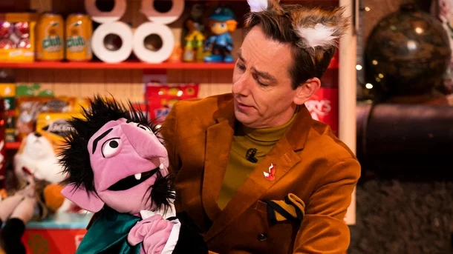
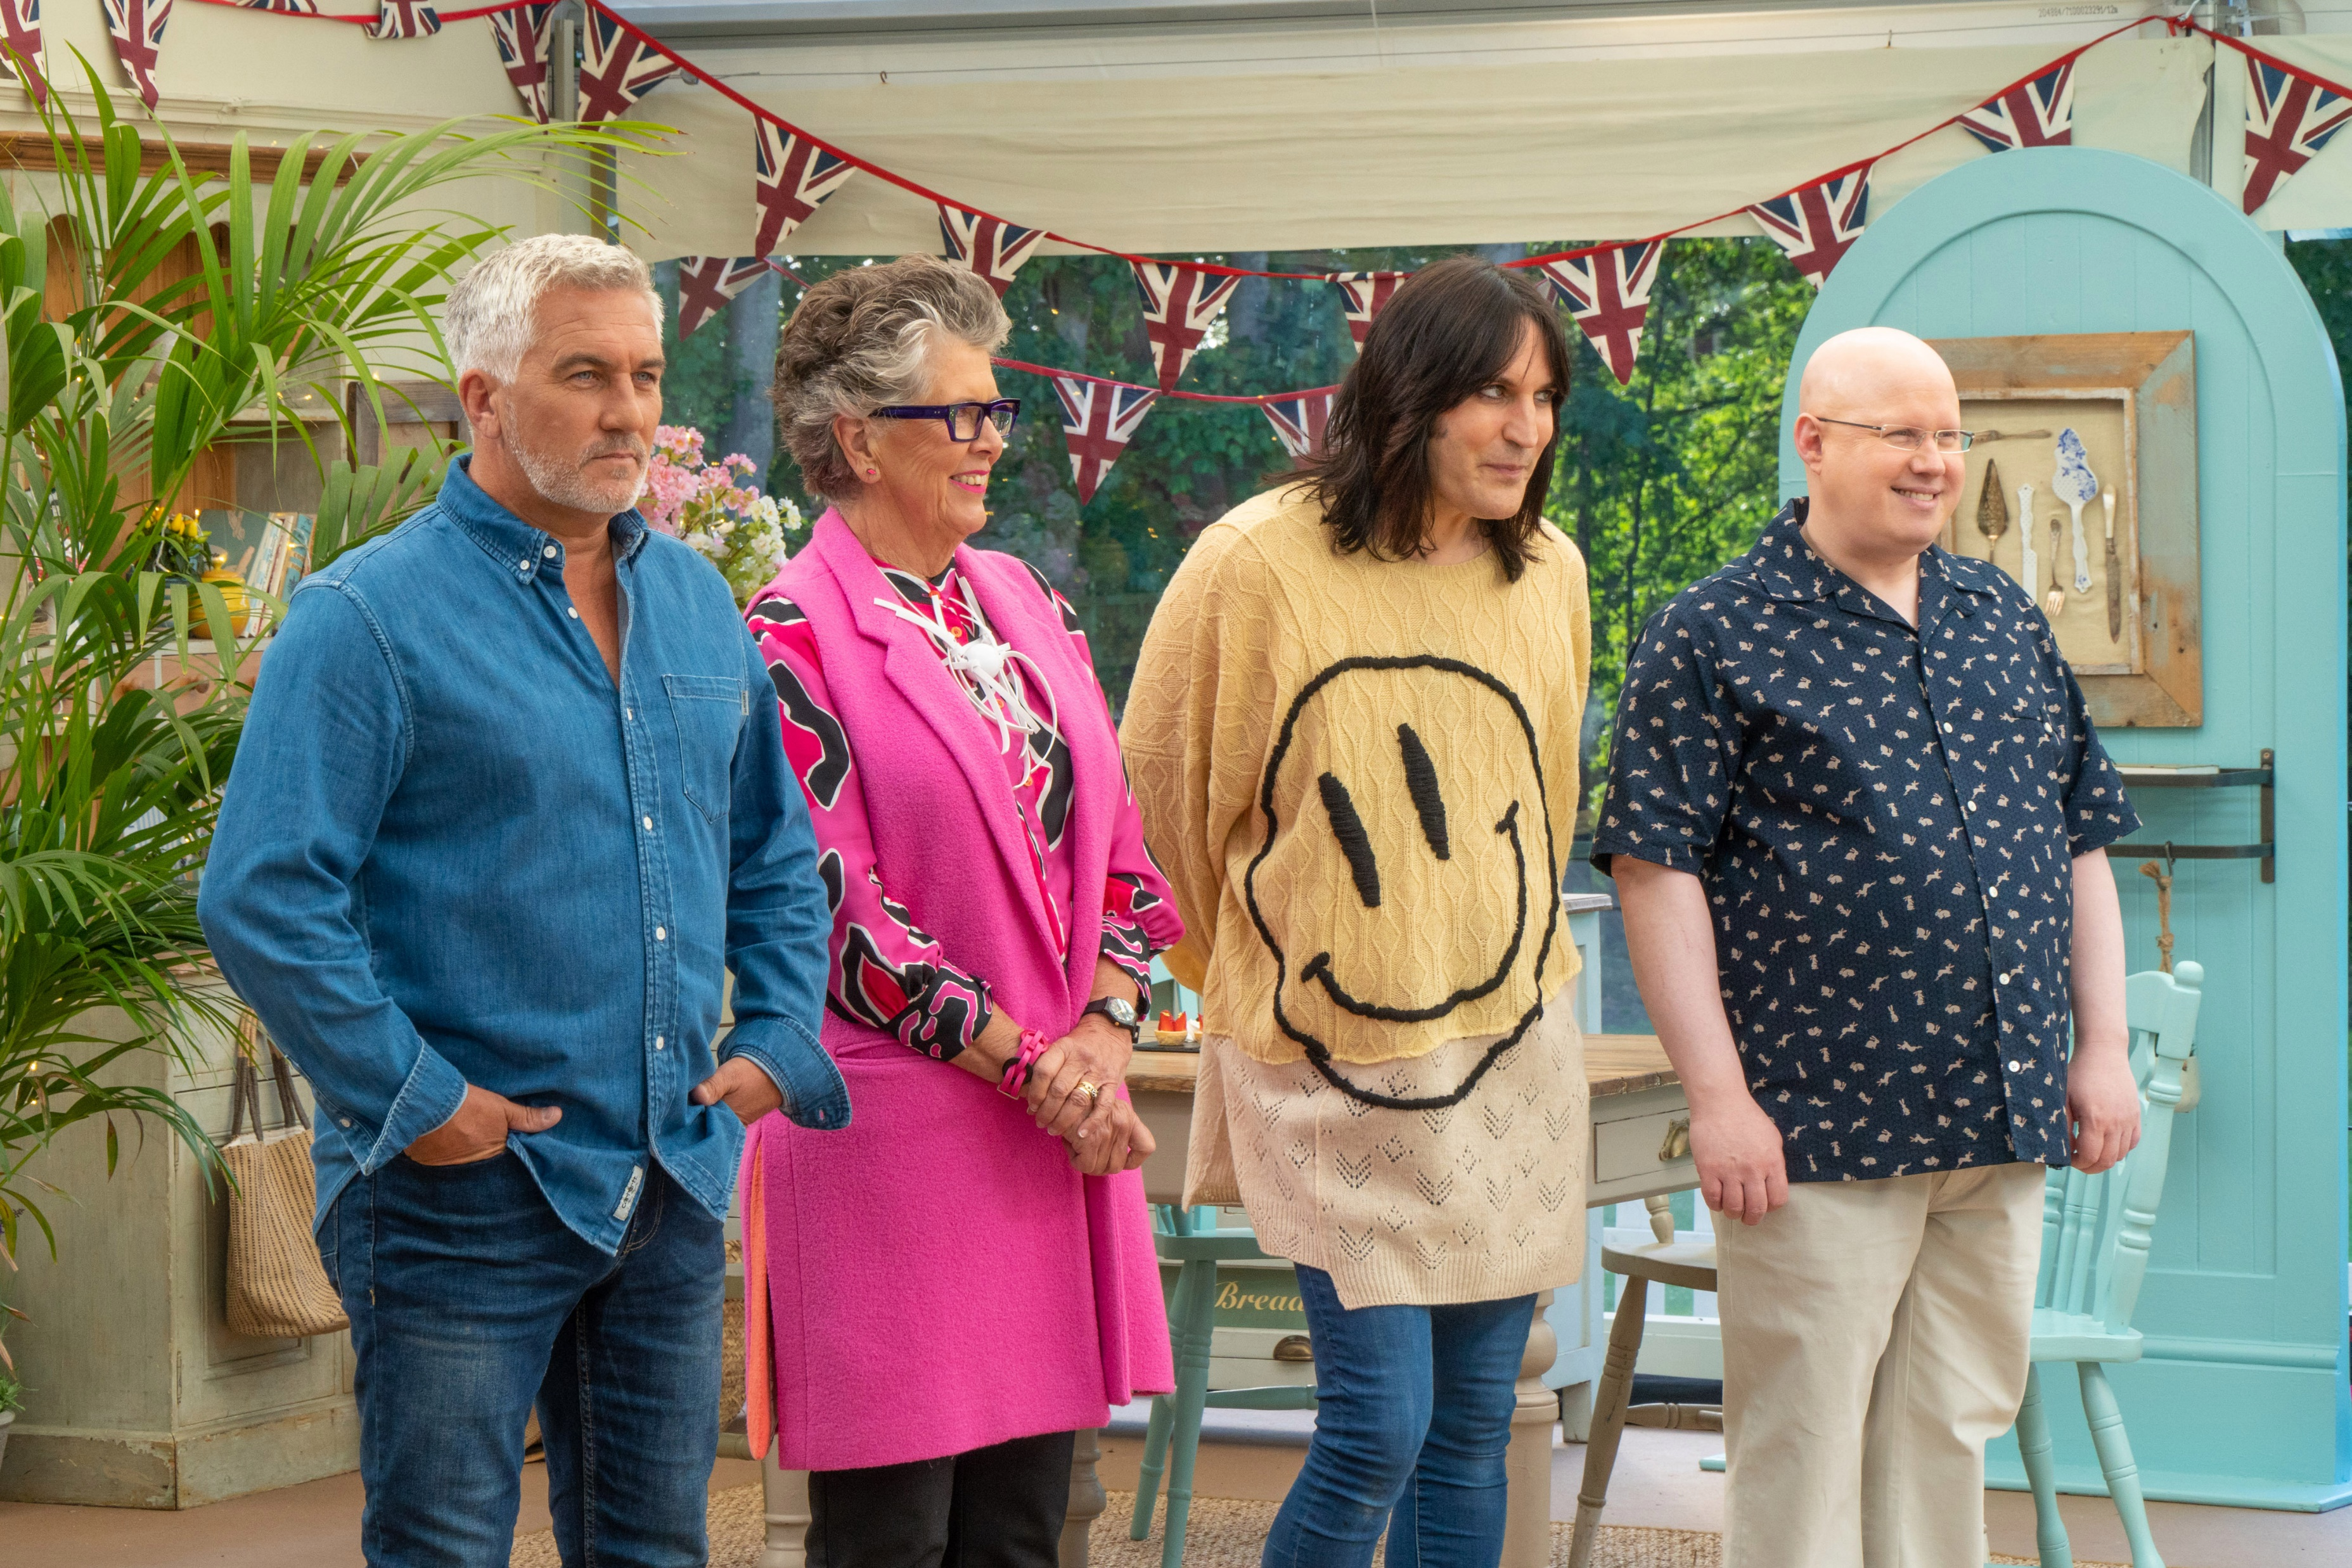
NOVEMBER 2020 VIEWING TRENDS
TAM Ireland Commercial Channels reached an average of 77.2% of individuals each week in November 2020
Individuals watched an average of 173 minutes (2 hours 53 minutes) each day in November 2020-up 6.6% on Nov 2019
The Late Late Toy Show on RTÉ One on Fri 27th was the most viewed programme of the month and of 2020 to date. A record 1,716,800 individuals tuned in to the show and it captured a 77.9% share amongst this audience.
On Virgin Media One I’m a Celebrity Get Me Out of Here on Nov 15th was the 4th watched programme of the month with 639,900 individuals.
Viewing to The Great British Bake Off finale on Channel 4 on Nov 24th was up 29% on the 2019 finale with 244,000 viewers

Slide 3
WEEKLY REACH: NOVEMBER 2020

Slide 4
TOP 10 ADVERTISERS: NOVEMBER 2020
1: Unilever
2: Procter & Gamble
3: Sky Ireland
4: Aldi Ireland
05: Lidl Ireland
10: Reckitt Benckiser
07: HSE
08: Tesco Ireland
09: Bank of Ireland
06: Allied Irish Banks

Slide 5
TOP PROGRAMMES: NOVEMBER 2020
Top 5 programmes by station group. A breakdown of the Top 10 programmes by station for November 2020 can be found here
Late Late Toy Show, The 27-11-2020
I'M A CELEBRITY...GE 15-11-2020
LIVE RENAULT SUPER SUNDAY 01-11-2020
RTE News: Nine O'Clock 27-11-2020
RTE News: Six One 27-11-2020
DIY SOS 01-11-2020
Late Late Show, The 06-11-2020
CORONATION STREET 20 16-11-2020
EMMERDALE 2020 16-11-2020
NEWS AT 5.30 (2020) 27-11-2020
I'M A CELEBRITY...20 YEARS 08-11-2020
LIVE FIGHT NIGHT 14-11-2020
SKY NEWS 07-11-2020
LIVE PL: TOTTENHAM V MAN CITY 21-11-2020
LIVE MNF: LEEDS V LEICESTER 02-11-2020

Slide 6
TOP PROGRAMMES: NOVEMBER 2020
Top 5 programmes by station group. A breakdown of the Top 10 programmes by station for November 2020 can be found here
THE GREAT BRITISH BAKE OFF 24-11-2020
Rugbaí Beo Pro 14 2020-2021 01-11-2020
BLAZE AND THE MONSTER MACHINES 15-11-2020
PRO14 2020/21 EIR 16-11-2020
GOGGLEBOX 13-11-2020
UGLY HOUSE TO LOVELY HOUSE WITH GEORGE C 05-11-2020
FILM: RED SPARROW (2018) 14-11-2020
TASKMASTER 05-11-2020
TEEN MOM 2 18-11-2020
PAW PATROL: JET TO THE RESCUE 27-11-2020
BEVERLY HILLS COP III 21-11-2020
FRIENDS 20-11-2020
Glór Tíre 16 17-11-2020
Unknown 02-11-2020
Peil na mBan Beo 2020 28-11-2020
Opry le Daniel Duets 10 03-11-2020
THE MASTERS 2020 ENG GOLF 14-11-2020
CLASSIC FOOTBALL 17-11-2020
CLASSIC RUGBY WORLD CUP 06-11-2020
SUB STORIES 12-11-2020

