Slide 1


February 2021
Viewing Trends Overview

Slide 2
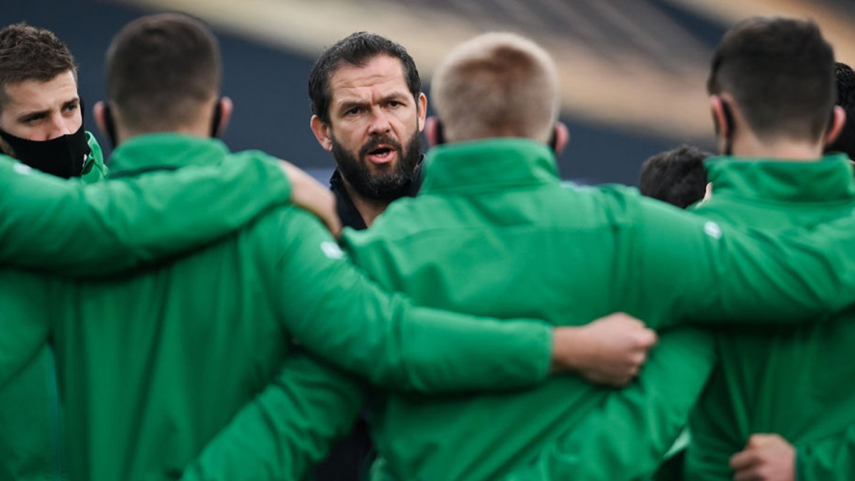
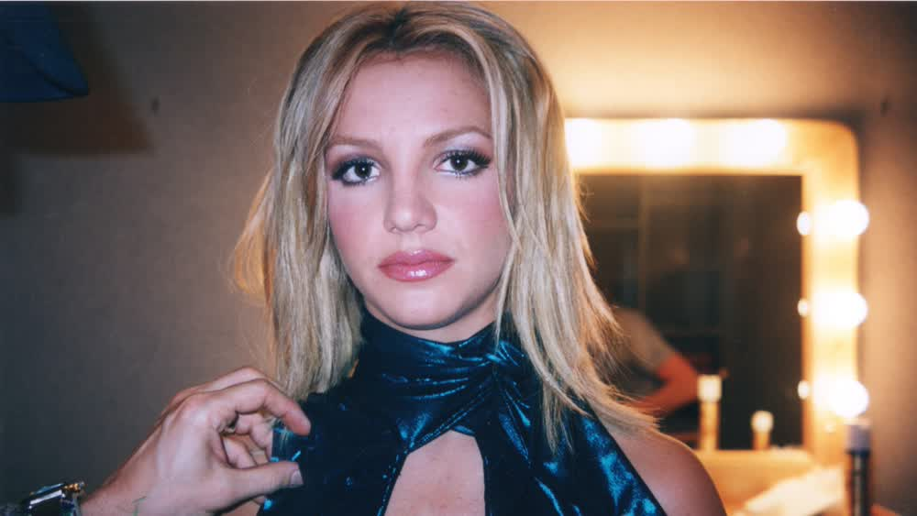
FEBRUARY 2021 VIEWING TRENDS
TAM Ireland Commercial Channels reached an average of 74.8% of individuals each week in February 2021
Individuals watched an average of 167 minutes (2 hours 47 minutes) each day in February 2021. This is an increase of 3 minutes on Feb 2020.
The Six Nations Live Ire V Fra on Virgin Media One on Sunday 14th Feb was the most viewed programme of the month. An average of 798,400 individuals tuned in to the broadcast.
On Sky One the documentary Framing Britney Spears on Feb 19th was the most viewed programme of the month

Slide 3
WEEKLY REACH: FEBRUARY 2021

Slide 4
TOP 10 ADVERTISERS: FEBRUARY 2021
1: Procter & Gamble
2: Sky Ireland
3: Vodafone Ireland
4: Unilever
05: Virgin Media
10: L’Oréal
07: Reckitt Benckiser
08: HSE
09: Allied Irish Banks
06: Lidl Ireland

Slide 5
TOP PROGRAMMES: FEBRUARY 2021
Top 5 programmes by station group. A breakdown of the Top 10 programmes by station for February 2021 can be found here
RTE News: Six One 23-02-2021
6 NAT LIVE IRE V FRA 14-02-2021
LIVE RENAULT SUPER SUNDAY 28-02-2021
Ireland's Fittest Family 21-02-2021
RTE News: Nine O'Clock 07-02-2021
Late Late Show, The 05-02-2021
Operation Transformation 10-02-2021
6 NAT LIVE WAL V IRE 07-02-2021
6 NAT LIVE ITA V IRE 27-02-2021
6 NAT POST IRE V FRA 14-02-2021
CORONATION STREET 20 22-02-2021
LIVE SNF: LIVERPOOL V EVERTON 20-02-2021
LIVE SNF: MAN UNITED V EVERTON 06-02-2021
LIVE SNF: MAN CITY V TOTTENHAM 13-02-2021
LIVE SNF: BRIGHTON V ASTON VILLA 13-02-2021

Slide 6
TOP PROGRAMMES: FEBRUARY 2021
Top 5 programmes by station group. A breakdown of the Top 10 programmes by station for February 2021 can be found here
GOGGLEBOX 26-02-2021
Rugbaí Beo Pro 14 2020-2021 26-02-2021
FRIENDS 10-02-2021
PRO14 2020/21 EIR 20-02-2021
MARRIED AT FIRST SIGHT AUSTRALIA 22-02-2021
THE GREAT POTTERY THROWDOWN 28-02-2021
IT'S A SIN 19-02-2021
GOGGLEBOX 26-02-2021
JERSEY SHORE FAMILY VACATION 18-02-2021
BEN & HOLLY'S LITTLE KINGDOM 26-02-2021
JERSEY SHORE FAMILY VACATION - COMMERCIA 04-02-2021
THE A-TEAM 09-02-2021
Glór Tíre 17 02-02-2021
Laochra Gael 19 04-02-2021
Angels & Demons 22-02-2021
Hacksaw Ridge 08-02-2021
BOXING CLASSICS 20-02-2021
FA CUP 2020/21 ENG 09-02-2021
CLASSIC GAA 13-02-2021
CLASSIC FOOTBALL 01-02-2021

