Slide 1


TV ADVERTISING IN IRELAND
Nickable Charts 2021

Slide 2

TV Viewers in Ireland have never had it better
53% of households now own a smart TV ¹
€285 million was spent by Irish Broadcasters on Irish content in 2018²
Access to Broadcaster VOD is now mainstream² ⁻ 86% of households have access to BVOD on a TV set³ and 92% of individuals have access to BVOD on a TV set or another device (laptop, tablet, phone)
“Spencer, Vogue and Wedding Two” E4
Sources: Nielsen Media Ireland TAM Ireland Establishment Survey. Base all TV Households^{2 .} BAI Annual Review of Performance Funding 2018
Notes:
The last decade has seen increased spend on TV content and great improvements in viewing technology and flexibility of accessing content.
¹ Source:
Nielsen Media Ireland TAM Ireland Establishment Survey. Base all TV Households
² Source:
BAI Annual Review of Performance Funding 2018. (RTÉ had the largest content budget for broadcasters in Ireland (€180m in 2018), followed by Virgin Media TV at around €70m and TG4 at €35m. Sky spent a small amount directly on Irish content (including Irish sport) and altogether it offers a large array of content that is commissioned/acquired for its combined UK and Ireland subscribers)
³ Source:
Nielsen Media Ireland TAM Ireland Establishment Survey. July-Dec 2020 Base all Households

Slide 3








TV in Ireland is a class apart in the video world
High completion rates
Robust measurement
Full Screen
Brand safe content & pre-cleared ads
Sound on
Shared viewing
Viewed by humans
Irish Broadcasters spent €285million on high quality TV programming in 2018
Notes:
TV in the Ireland is full of wonderful, high quality content which broadcasters invest in heavily. This, alongside the tight regulation which governs TV content and advertising, makes it a safe environment for viewers and brands.
In addition, TV has a robust, metred measurement system, via Nielsen and TAM Ireland, which provides a joint industry currency for TV advertising trading based on completed ads, watched full screen (and by humans).

Slide 4
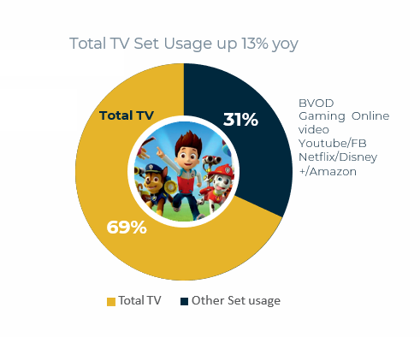
Broadcaster content is by far the largest contributor to TV set usage
Broadcast television remains valued and still accounts for the vast majority of people’s TV viewing.
69%
Source: TAM Ireland/Nielsen Media Ireland Total Set Usage Adults 15+ Jan – Dec 2020

Slide 5
TV has unbeatable scale and reach
In an average MONTH in 2020, linear TV reached……
88.7%
of individuals
89.8%
of adults 15+
88.5%
of ABC1 adults
93%
of housekeepers
87.6%
of 25-44s
81.4%
of 15-34s
91.8%
of housekeepeers with children
Source: TAM Ireland/Nielsen TAM,Consolidated, 1st January - 31st December 2020, National, Individuals 4+, All Day, All ROI Channels, Reach 1+ Consecutive

Slide 6

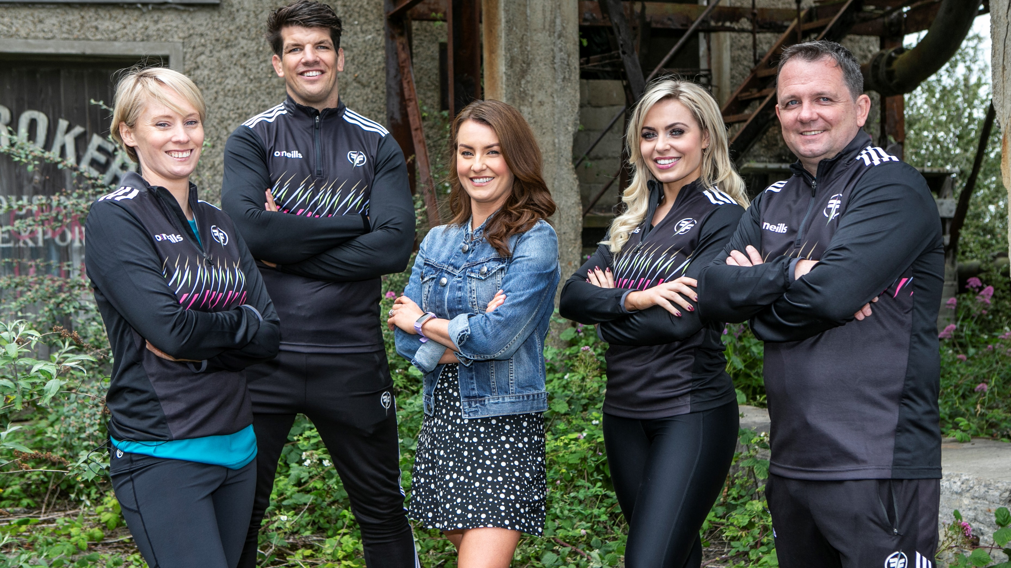
The average broadcast TV campaign in Ireland gets 17.77 million views
The average broadcast TV campaign in Ireland gets 17.77 million views
Average 400 TVR TV Campaign , Individual Universe 4442 , 1 TVR= 1% of Universe so 44,420 Views , 400 TVRS = 400 x 44,420 = 17.77 Million Views
Notes:
Average 400 TVR TV Campaign , Individual Universe 4442 , 1 TVR= 1% of Universe so 44,420 Views , 400 TVRS = 400 x 44,420 = 17.77 Million Views
Beware the seduction of ‘views’. Views that TV ads get online are an important part of the way brands now communicate. However, because the figures are so visible, the offline views-TV – which are often driving them – can get overlooked. A million online views is not to be sniffed at, but an average broadcast TV campaign in the Ireland gets 16.38 million ‘views’ – and that is before you consider the different quality of the viewing experiences.

Slide 7

In 2020, the average person watched 89 hours of linear TV each month
This is the equivalent of watching the whole of
The Queens Gambit on Netflix 12.5 times.
TAM Ireland/Nielsen TAM,Consolidated, 1st January - 31st December 2020 National, Individuals 4+, All Day, Total TV, Average Minutes per person

Slide 8










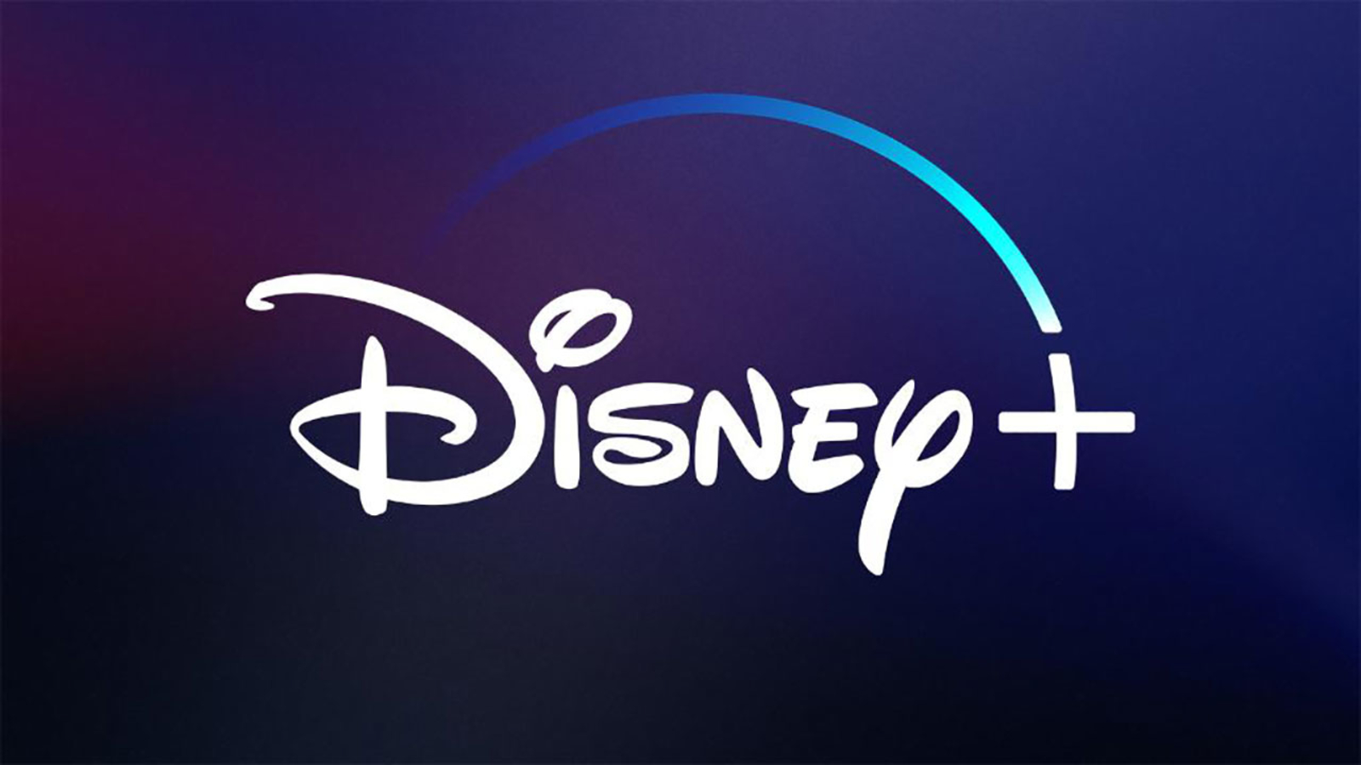







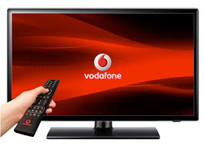

Viewing to linear TV on a TV set remains exceptionally strong

Slide 9
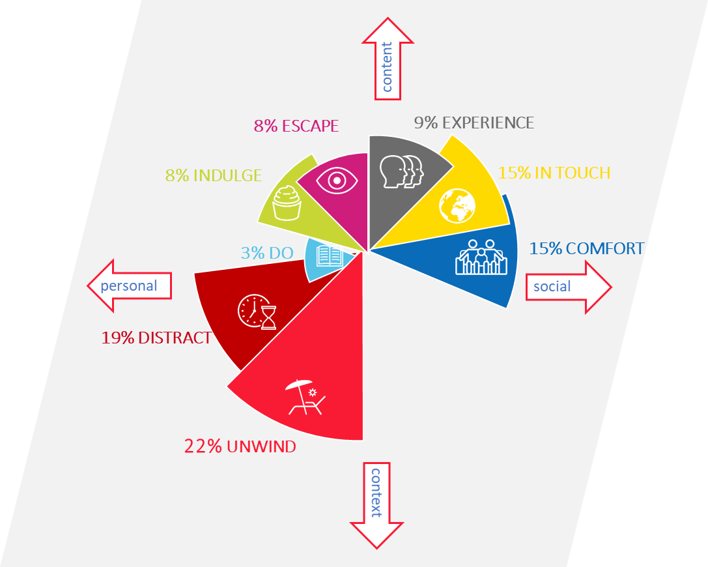
There are 8 Needstates which drive video viewing
Video is firmly entrenched in our lives. Whether we’re snuggling on the sofa for an evening of telly or killing time on our mobiles before the bus arrives, the opportunities to watch have never been greater.
Partnering with Thinkbox UK and with the Irish research carried out by Behaviour & Attitudes, we looked the role that video plays in our lives to determine how the different video formats coexist and why viewers choose to invest their time in a range of video platforms.
The study found that our motivations can be categorised into eight different ‘need states’: unwind, distract, comfort, in touch, experience, indulge, escape and do.
Notes:
There are eight primary needstates, the size of which is dictated by the time audiences spend meeting each one with video content. A significant proportion of time spent watching video content is to fulfil the need to Unwind, and for Distraction.
A great amount of time is also spent consuming video to meet the need for Comfort, and to remain In Touch with what is happening in the world.
The role of content and context varies across each needstate with, for example, content particularly important for Escape and Experience, and context (e.g. the need to de-stress without having to concentrate too much) a key motivator for the Unwind needstate.
For more information on this study please visit https://www.tamireland.ie/downloads/our-video-world-the-needs-that-drive-us/

Slide 10
On average each Irish person sees 27 ads per day
The average viewer watched 27 ads a day on a TV set in 2020.
That’s 27 ads viewed:
-on full screen,
-at normal speed
-with the sound on,
-viewed by humans
⁷ Source:: TAM Ireland/Nielsen Media Ireland TAM, National, All ROI Commercial Channels, Consolidated.
Notes:
What really matters to us in the advertising world is where our ads get seen and the fundamental job of any medium is to help advertisers get their message across, in full.
The average viewer watched 27 ads a day on a TV set in 2020. That’s 27 ads viewed on full screen, at normal speed with the sound on, viewed by humans.

Slide 11
TV is the most trusted source of news and information in Ireland
Source TAM Ireland/B&A Tracker Study 2020 Q.17And please rank each of these sources from 1 to 5, where 1 is the source of news and information that you have trusted most during the COVID 19 crisis, and 5 is the source that you have trusted least?

Slide 12
TV is the most trusted source of advertising in Ireland
Source TAM Ireland/B&A Tracker Study 2020 Q.17a And please rank each of these sources from 1 to 5, where 1 is the source of advertising that you have trusted most during the COVID 19 crisis, and 5 is the source that you have trusted least?

Slide 13


TV can be perceived as the exclusive domain of big brands with big budgets.
This is a myth, fuelled by the fact that just being on TV makes brands appear big.
When you look at the make-up of TV advertisers in Ireland across 2020 in terms of spend, 29% fall within the <€25,000 spend bracket.
Source: Nielsen. Data Based on TV Spend Jan-Dec2020 by Advertiser.
Please note, the Advertising Spend figures are not actual revenue figures. They are based on Nielsen Media Ireland's coverage and a defined methodology .

Slide 14
Many online businesses in Ireland grew their TV advertising investment in 2020
Source: TAM Ireland/Media Ireland, National, Individuals, Consolidated 30” TVR Equivalent, All Commercial Channels
Notes:
Some of the world’s largest online companies invested in building their image, reputation and sales through the reach and influence of TV during 2020. While events in 2020 meant that we saw obvious year on year drops in spend for travel brands, shopping and clothing brands increased their investment. It is a testament to TV’s continuing power to deliver, that online organisations, that understand their customers so well, are using TV to power their success. Justeat up 110% amazon up 39%, Emma up 85%
Clearly online brands understand the online world inside out. They know how to optimise search, how to track customers through their own CRM data, and how to target the people most likely to buy through highly addressable advertising. And yet so many online brands spend a huge amount of their marketing investment on TV advertising. It’s clear that TV provides them with something different, something that they can’t achieve by marketing solely within the online world, that TV fulfils a unique role that is needed by even the biggest online brands

