Slide 1
Adland 2021 Survey
In the Adland 2021 Survey TAM Ireland have put the advertising industry in the spotlight and see how accurately they reflect the rest of the nation.
We have found that in Ireland, the advertising industry is quite unique. Adlanders are generally well-educated, upmarket, Dublin-centric and time-poor.
This is evident in our lifestyles, attitudes and behaviour – particularly when it comes to technology and media. In short, those working in Adland are nothing like the general Irish public with whom we try to communicate with, via our brands, on a daily basis. Take a look at some of the differences

Slide 2
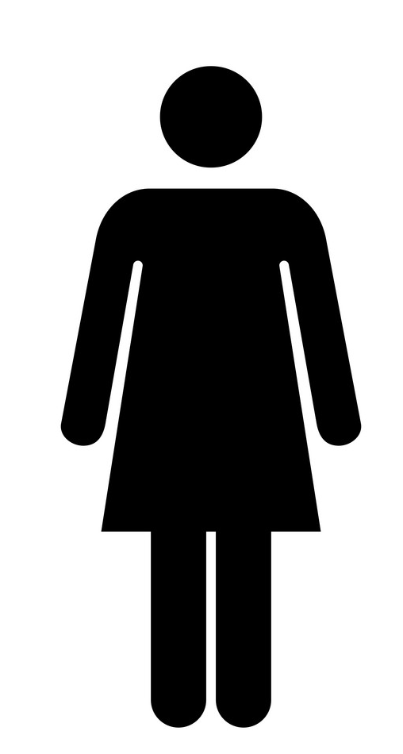
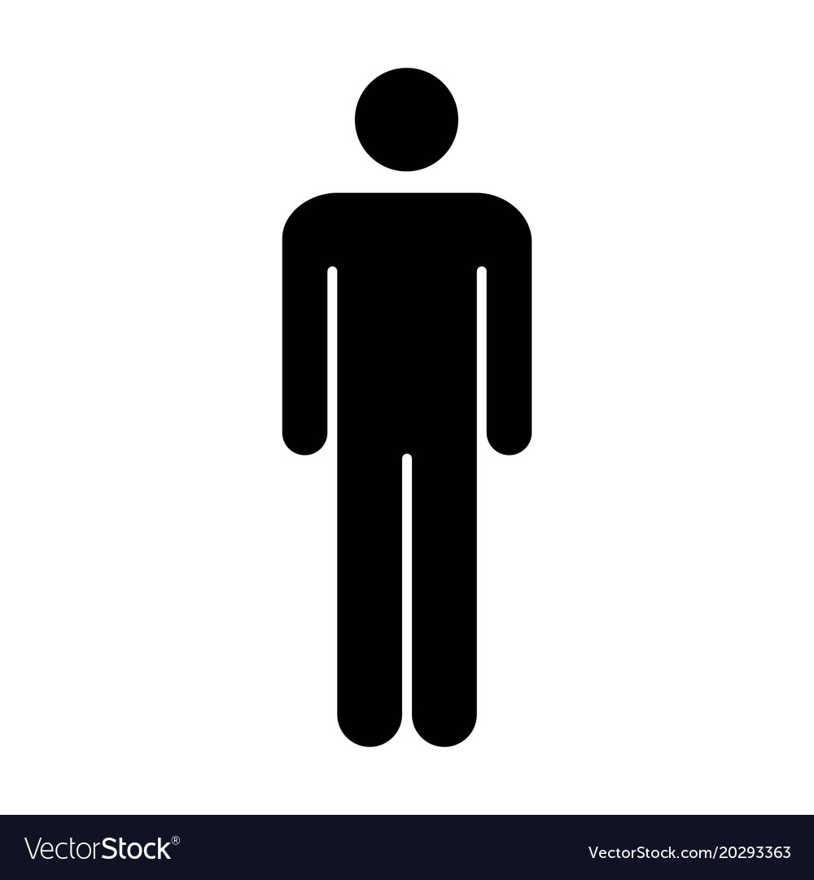
Different demographics: Adland is female focused
50.5%
49.5%
Irish Population
57%
43%
Adland
Source: Source CSO Population and Migration estimates 2019
Notes:
Female focused: According to our survey women outnumber men in the advertising industry in Ireland by 57% to 43%. While females outnumber males among the general Irish population-it is by a much smaller percentage-50.5% to 49.5% (Source CSO Population and Migration estimates 2019).

Slide 3

Different demographics: Adland loves youth
Our report confirms the underrepresentation of the over 55s in our industry; only 5% of the sample were aged 55-64. By comparison, 16% of the Irish workforce is aged 55-64 according to the CSO
Source: (Source CSO 2017. % based upon people aged 18-70)
Notes:
Adland loves youth: Our report confirms the underrepresentation of the over 55s in our industry; only 5.22% of the sample were aged 55-64. By comparison, 16% of the Irish workforce is aged 55-64 according to the CSO (Source CSO 2017. % based upon people aged 18-70)
There is no definite answer as to why this is the case and while there will always be economic and social reasons as to why older age groups abandon advertising Rory Sutherland -Ogilvy’s Vice Chairman- offers up a possible explanation:
“Advertising, by failing to ally itself to any recognisable science or body of knowledge, does not really pay a premium for experience. There is no mental framework on which you can hang a lifetime of accumulated experience. This means that we habitually value youth and vitality over wisdom and maturity. Engineers, doctors, lawyers, have the advantage of “an argument from authority. We have no such luxury. Every argument, every point of view, has to be defended from scratch. This becomes increasingly frustrating with time. “

Slide 4
Different demographics: Adland is highly educated
45%
Of Adland have completed postgraduate education
This compares to 9% of the Irish public
Source: CSO 2016 Highest level of education attained
Notes:
Adland is highlight educated: Similar differences can be seen when we look at level of education attained. Those working in Adland are much more likely to have received a third-level education than the average Irish person. This makes sense as many advertising agencies specify a university degree requirement. However this does reduces the pool of diverse applicants significantly. Outside of the industry the general Irish population know little about what happens in Adland and hence the pool is smaller to attract talent. Hiring practices can rely on word of mouth and friends of employees, family, etc and hence diversity suffers.

Slide 5
Adland’s media diet and viewing habits differ significantly from the rest of the Irish public.

Slide 6
TV viewing habits of Adland does not match the average Irish adult
149
Or 2 hours 29 mins
Or 1 hour 1 minute
61
LIVE TV watching by an Irish Adults 15+ on an average day
The estimate of those in Adland of their LIVE TV watching on an average day
Adland estimate that when watching Broadcaster TV on a TV set on an average DAY they watch Live TV for 61 minutes and recorded/timeshift TV for 50 minutes. In reality the Irish public (Ads 15+) watch nearly 3 times as much Live TV with an average of 149 minutes a DAY and recorded/timeshift TV for 29 minutes
Source: TAM Adults 15+ 2020 Total TV Ave Mins Per Person)
Notes:
The industry’s TV viewing habits and opinions differ significantly from the rest of the Irish public.
Those in Adland estimate that when watching Broadcaster TV on a TV set on an average DAY they watch Live TV for 61 minutes and recorded/timeshift TV for 50 minutes.
In reality the Irish public (Ads 15+) watch nearly 3 times as much Live TV with an average of 149 minutes (2 hours 29 mins) a DAY and recorded/timeshift TV for 29 minutes. .(Source: TAM Adults 15+ 2020 Total TV Ave Mins Per Person)
This is a reminder to us all in the advertising industry that our preferences do not represent those of the typical Irish viewer.

Slide 7

The research shows that the industry population feel TV advertising is the medium they trust the most, the one that is more likely than any other to make them laugh or feel emotional and the medium that is most likely to show ads that they like
Where are you most likely to find ads you TRUST?
Where are you most likely to
find ads that make you
EMOTIONAL?
Where are you most likely to
find ads you LIKE?
78%
68%
60%
#01
#01
#01
Notes:
One thing that Adland and the Irish public very much are very much in-sync on is trust in TV adverting. The research shows that the advertising industry feels that TV adverting is the medium they trust the most. This closely mirrors data from research we conducted in 2020 TV was very much seen the most trusted source of advertising. (Source: *B&A Reopening Ireland Study June 2020)
TV advertising also is more likely than any other to make Adlanders feel emotional -which we know can be key for driving fame for a brand.

Slide 8


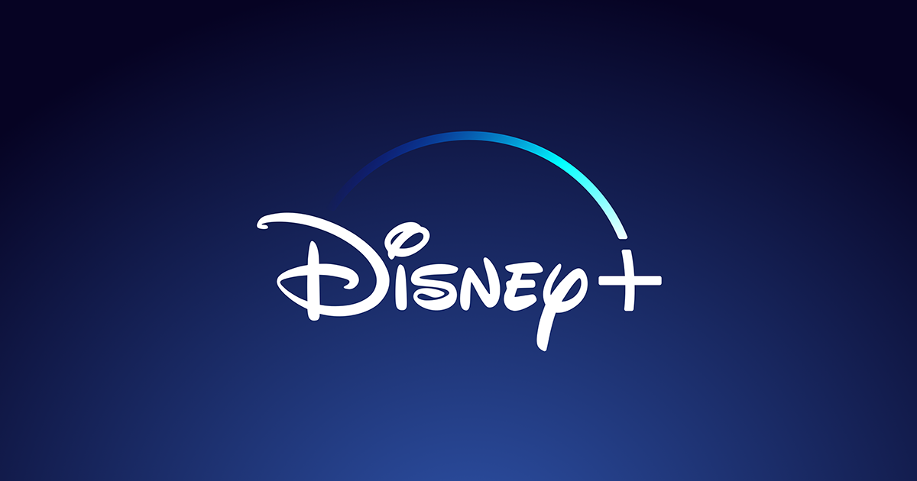
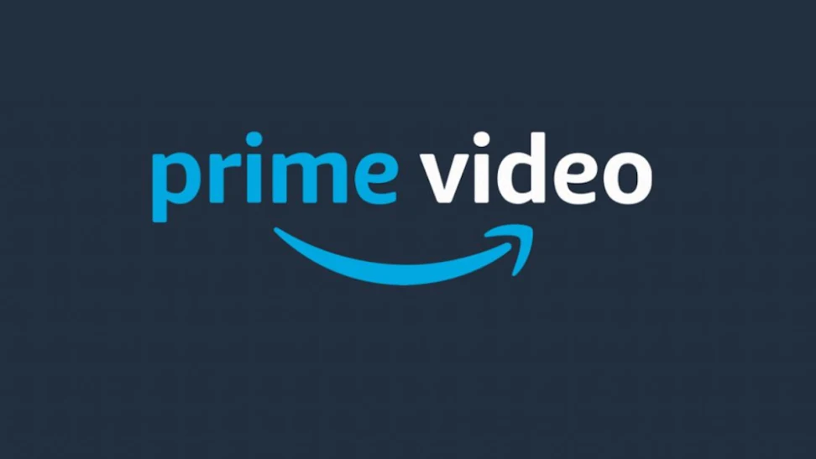

Adlanders access on-demand services much more frequently than the general public
56% of Adlanders have already accessed new service Disney+, compared to just 10% of the general population. Just under half of the general population never access Netflix, this compares to just over 4% of Adland.
Source: Establishment survey Jan-June 2021 All TV households
Notes:
As people who work in advertising are at the forefront of technology it is no surprise that they are much quicker to embrace steaming services in comparison to the Irish population. 56% of Adlanders have already accessed new service Disney+, compared to just 10% of the general population. Just under half of the general population never access Netflix, this compares to just 4.49% of Adland.

Slide 9

Adlanders love Social Media
Facebook
TicTok
Irish Pop: 70%
Adland: 75%
Irish Pop: 16%
Adland: 40%
Instagram
Irish Pop: 44%
Adland: 87%
Twitter
Irish Pop: 21%
Adland: 87%
LinkedIn
Irish Pop: 19%
Adland: 96%
Source: B&A Sign of the Times 2021-Which of the following do you use?
Notes:
It is no surprise that those who work in Adland are social media addicts! They are 5 times more likely to be using LinkedIn, 4 times as likely to use Twitter and are twice as likely to use Instagram. In fact, it is only in the usage of Facebook where Adland (75%) mirrors the general (70%) population in terms of usage (Source: B&A Sign of the Times 2021. Q “Which of the following, if any, do you ever use nowadays?”)

Slide 10

Adland 2021 Survey Summary
This Adland 2021 Survey highlights how we must exercise caution when we think about planning campaigns for the Irish public.
It’s very easy to think that Ireland is a small country and that everyone is the same. However, media habits/ practices of those who work in Adland continue to be markedly different from that of the public and we need to avoid letting this impact our judgment.
We need to use data and not rely on gut feel or instinct.

