Slide 1


March 2021
Viewing Trends

Slide 2
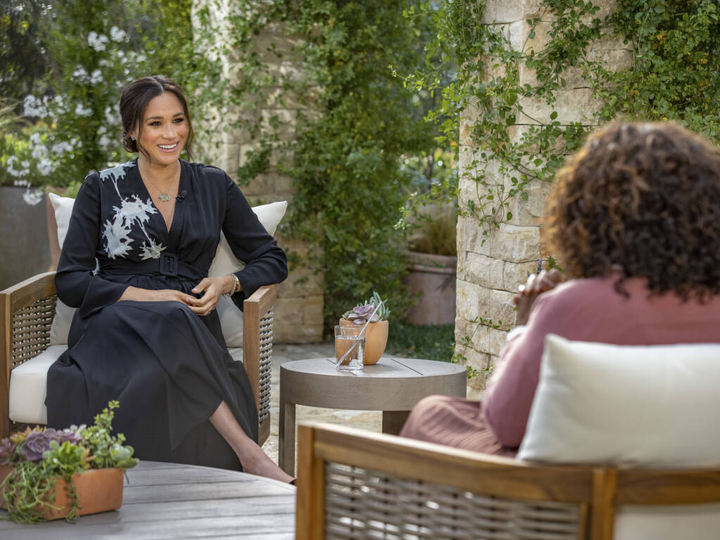
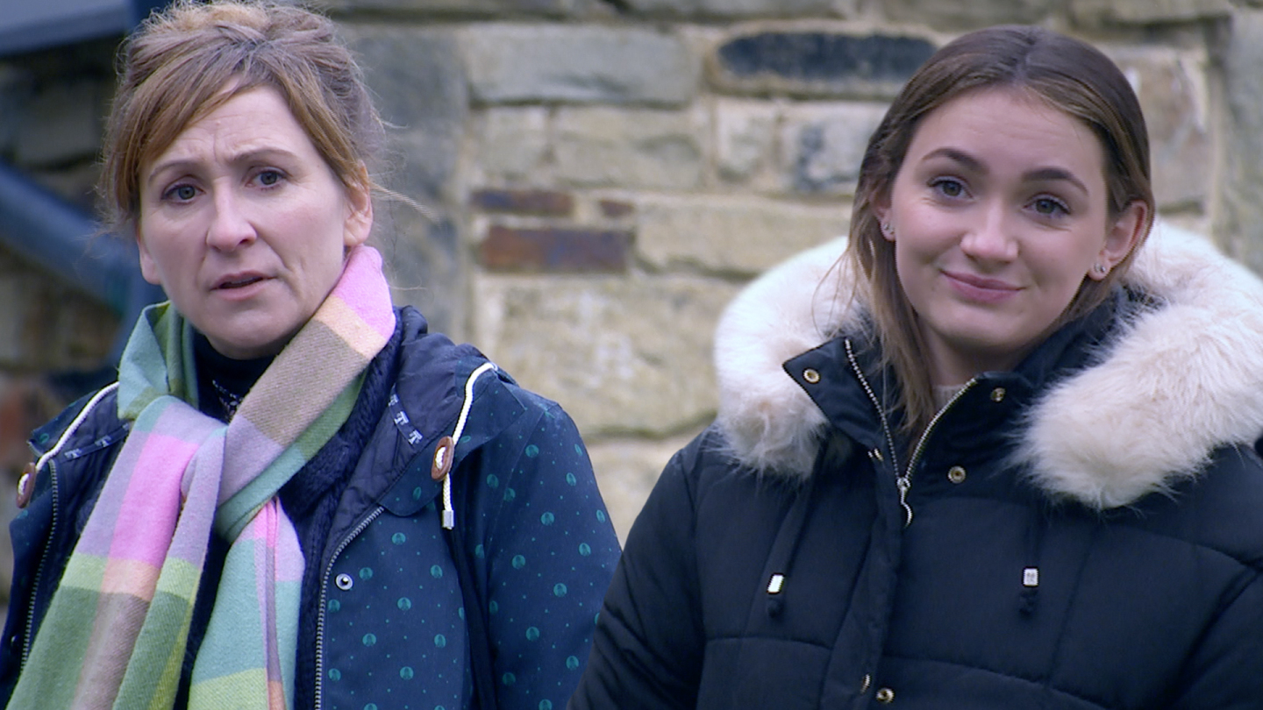
MARCH 2021 VIEWING TRENDS
TAM Ireland Commercial Channels reached an average of 73% of individuals each week in March 2021
Individuals watched an average of 157 minutes (2 hours 23 minutes) each day in March 2021. This is a 12% decrease on March 2020
The Oprah with Meghan and Harry interview on RTÉ 2 on March 8th was the most viewed programme of the month. An average of 836,500 individuals tuned in to the broadcast.
On Virgin Media One the Six Nations game (live) between Ireland and France was the most viewed programme of the month.

Slide 3
WEEKLY REACH: March 2021

Slide 4
TOP 10 ADVERTISERS: March 2021
1: Procter & Gamble
2: Bank Of Ireland
3: Sky Ireland
4: HSE
05: Allied Irish Banks
10: Mars Ireland
07: Diageo
08: Nestlé
09: Walt Disney Company
06: Tesco Ireland

Slide 5
TOP 5 RTÉ PROGRAMMES
March 2021
Oprah With Meghan And Harry 08-03-2021
RTE News: Six One 17-03-2021
Late Late Show St. Patrick's Night Special, The 17-03-2021
RTE News: Nine O'Clock 14-03-2021
Tommy Tiernan Show, The 27-03-2021
The Great Pottery Throw Down, Channel 4
Top 5 programmes by station group. A breakdown of the Top 10 programmes by station for March 2021 can be found here
Notes:
Top 5 programmes – Channel 4

Slide 6
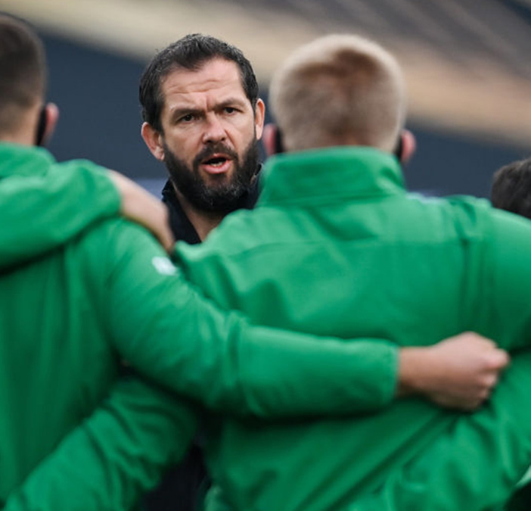
TOP 5 VIRGIN MEDIA
PROGRAMMES March 2021
6 NAT LIVE IRE V ENG 20-03-2021
6 NAT LIVE SCO V IRE 14-03-2021
6 NAT POST IRE V ENG 20-03-2021
6 NAT POST SCO V IRE 14-03-2021
6 NAT LIVE FRA V WAL 20-03-2021
Notes:
Top 5 programmes – Channel 4

Slide 7

TOP 5 SKY MEDIA
PROGRAMMES March 2021
LIVE RENAULT SUPER SUNDAY 07-03-2021
LIVE PL: LIVERPOOL V CHELSEA 04-03-2021
LIVE PL: C. PALACE V MAN UNITED 03-03-2021
LIVE MNF: WOLVES V LIVERPOOL 15-03-2021
FLIGHT ATTENDANT, THE 20-03-2021
Notes:
Top 5 programmes – Channel 4

Slide 8
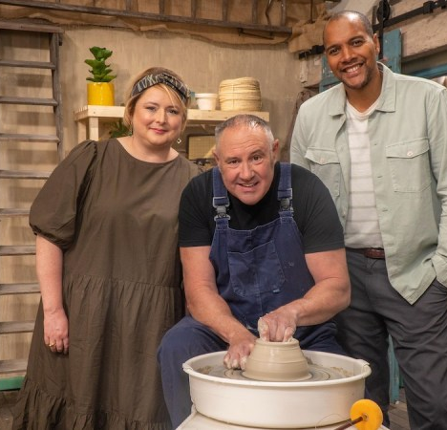
TOP 5 4 Sales
PROGRAMMES March 2021
GOGGLEBOX 12-03-2021
THE GREAT CELEBRITY BAKE OFF FOR SU2C
23-03-2021
CAROLINE FLACK: HER LIFE AND DEATH
17-03-2021
THE GREAT POTTERY THROWDOWN
14-03-2021
24 HOURS IN POLICE CUSTODY 22-03-2021
Notes:
Top 5 programmes – Channel 4

Slide 9
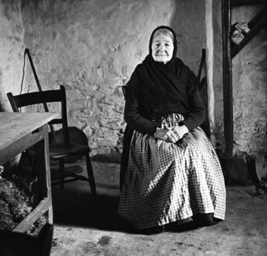
TOP 5 TG4 PROGRAMMES
March 2021
Rugbaí Beo Pro 14 2020-2021 27-03-2021
Opry le Daniel Duets 10 16-03-2021
PEIG 10-03-2021
Glór Tíre 17 09-03-2021
Opry le Daniel - Togha Sraith 9 23-03-2021
Notes:
Top 5 programmes – Channel 4

Slide 10

TOP 5 VIACOM
PROGRAMMES March 2021
BAYWATCH 29-03-2021
FRIENDS 18-03-2021
FILM: OLIVER! (1968) 27-03-2021
PAW PATROL 23-03-2021
FILM: YOU, ME AND DUPREE (2006)
28-03-2021
Notes:
Top 5 programmes – Channel 4

Slide 11
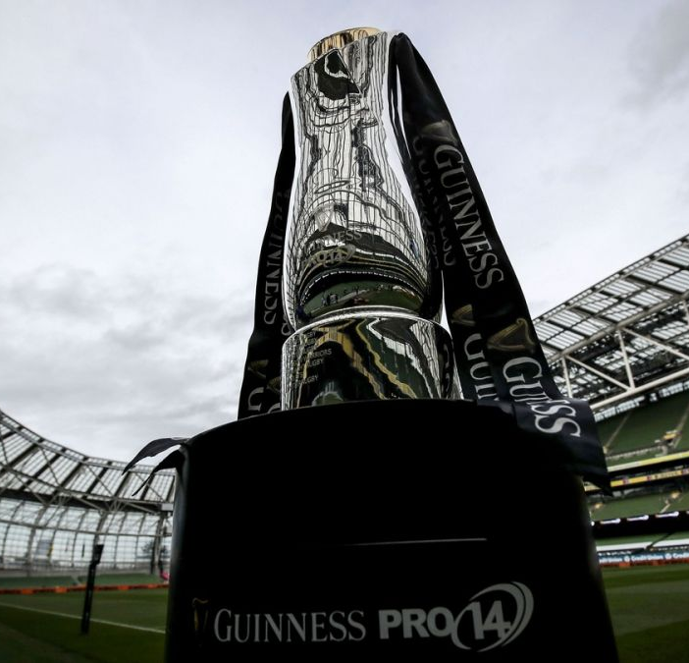
TOP 5 EIR SPORT
PROGRAMMES March 2021
PRO14 2020/21 FINAL 27-03-2021
FA CUP 2020/21 ENG 21-03-2021
CLASSIC GAA 31-03-2021
PRO14 HOUR 2020 31-03-2021
FOOTBALL FA CUP FINALS 13-03-2021
Top 5 programmes by station group. A breakdown of the Top 10 programmes by station for February 2021 can be found here
Notes:
Top 5 programmes – Channel 4

