Slide 1


May 2021
Viewing Trends

Slide 2
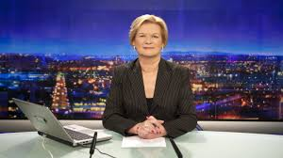

MAY 2021 VIEWING TRENDS
TAM Ireland Commercial Channels reached an average of 73.2% of individuals each week in May 2021
Individuals watched an average of 140 minutes (2 hours 20 minutes) each day in May 2021. This is a 8% decrease on May 2020 which had registered huge uplifts in viewing due to the Covid-19 lockdown.
RTE News: Nine O Clock on RTÉ One on May 23rd was the most viewed programme of the month. An average of 526,100 individuals tuned in to the broadcast.
Across the Sky Media network of channels, Friends: The Reunion on Sky One was the most viewed programme of the month with an average of 278,800 individuals tuning in.

Slide 3
WEEKLY REACH: May 2021

Slide 4
TOP 10 ADVERTISERS: May 2021
1: Procter & Gamble
2: Unilever
3: Virgin Media
4: Tesco Ireland
05: Diageo
10: Vodafone Ireland
07: National Lottery
08: Coca Cola Ireland
09: Heineken
06: Sky Ireland

Slide 5
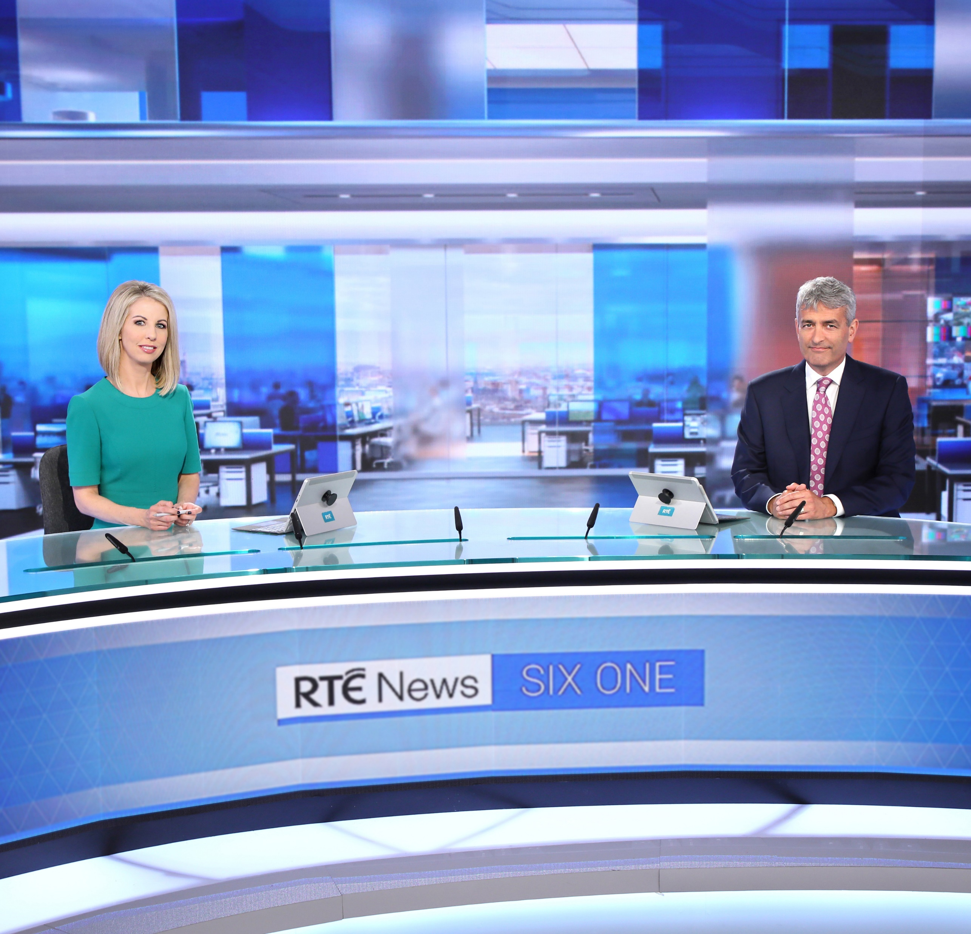
TOP 5 RTÉ PROGRAMMES
May 2021
RTE News: Nine O'Clock 23-05-2021
Reeling In The Years - 2013 02-05-2021
Dr Cassidy's Casebook 17-05-2021
Late Late Show, The 28-05-2021
RTE News: Six One 03-05-2021
The Great Pottery Throw Down, Channel 4
Top 5 programmes by station group. A breakdown of the Top 10 programmes by station for May 2021 can be found here
Notes:
Top 5 programmes – Channel 4

Slide 6

TOP 5 VIRGIN MEDIA
PROGRAMMES May 2021
CORONATION STREET 07-05-2021
UCL: MCI V CHE LIVE 29-05-2021
UEL: VIL V MUN LIVE 26-05-2021
EMMERDALE 10-05-2021
UCL: TROPHY LIFT 29-05-2021
Top 5 programmes by station group. A breakdown of the Top 10 programmes by station for May 2021 can be found here
Notes:
Top 5 programmes – Channel 4

Slide 7
TOP 5 SKY MEDIA
PROGRAMMES May 2021
FRIENDS: THE REUNION 27-05-2021
LIVE PL: MAN UNITED V LIVERPOOL 13-05-2021
LIVE RENAULT SUPER SUNDAY 02-05-2021
LIVE PL: CHELSEA V LEICESTER 18-05-2021
LIVE SNF: L’POOL V S’HAMPTON 08-05-2021
Top 5 programmes by station group. A breakdown of the Top 10 programmes by station for May 2021 can be found here
Notes:
Top 5 programmes – Channel 4

Slide 8
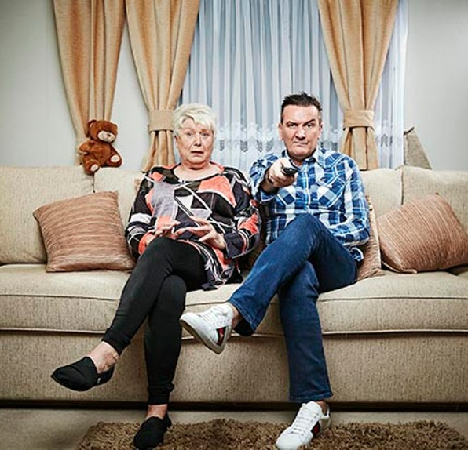
TOP 5 4 SALES
PROGRAMMES May 2021
- GOGGLEBOX 14-05-2021
DAVINA MCCALL: SEX, MYTHS & THE MENOPAUS
12-05-2021
LOCATION, LOCATION, LOCATION 26-05-2021
GOGGLEBOX 14-05-2021
SAS: WHO DARES WINS 16-05-2021
Top 5 programmes by station group. A breakdown of the Top 10 programmes by station for May 2021 can be found here
Notes:
Top 5 programmes – Channel 4

Slide 9
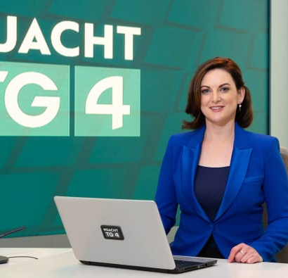
TOP 5 TG4 PROGRAMMES
May 2021
GAA BEO 2021 - 2022 23-05-2021
Laochra Gael 2017 22-05-2021
NUACHT TG4 2021 16-05-2021
Rugbaí Beo Pro 14 28-05-2021
Viva Ceol Tíre 08-05-2021
Top 5 programmes by station group. A breakdown of the Top 10 programmes by station for May 2021 can be found here
Notes:
Top 5 programmes – Channel 4

Slide 10

TOP 5 VIACOM
PROGRAMMES May 2021
BABY SHARK'S BIG SHOW 30-05-2021
FILM: THE PROPOSAL (2009) 09-05-2021
FILM: JURASSIC PARK (1993) 09-05-2021
FRIENDS 17-05-2021
PAW PATROL 30-05-2021
Top 5 programmes by station group. A breakdown of the Top 10 programmes by station for May 2021 can be found here
Notes:
Top 5 programmes – Channel 4

Slide 11
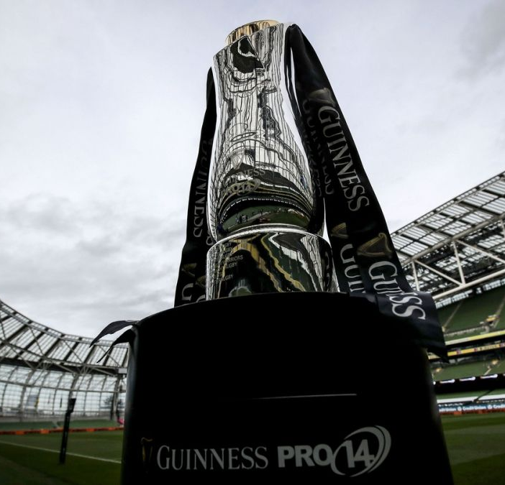
TOP 5 EIR SPORT
PROGRAMMES May 2021
ALLIANZ HURLING LEAGUES 2 08-05-2021
ALLIANZ FOOTBALL LEAGUES 15-05-2021
THE RAINBOW CUP 2021 14-05-2021
FA CUP 2020/21 ENG 15-05-2021
BOXING CLASSICS 22-05-2021
Top 5 programmes by station group. A breakdown of the Top 10 programmes by station for May 2021 can be found here
Notes:
Top 5 programmes – Channel 4

