Slide 1
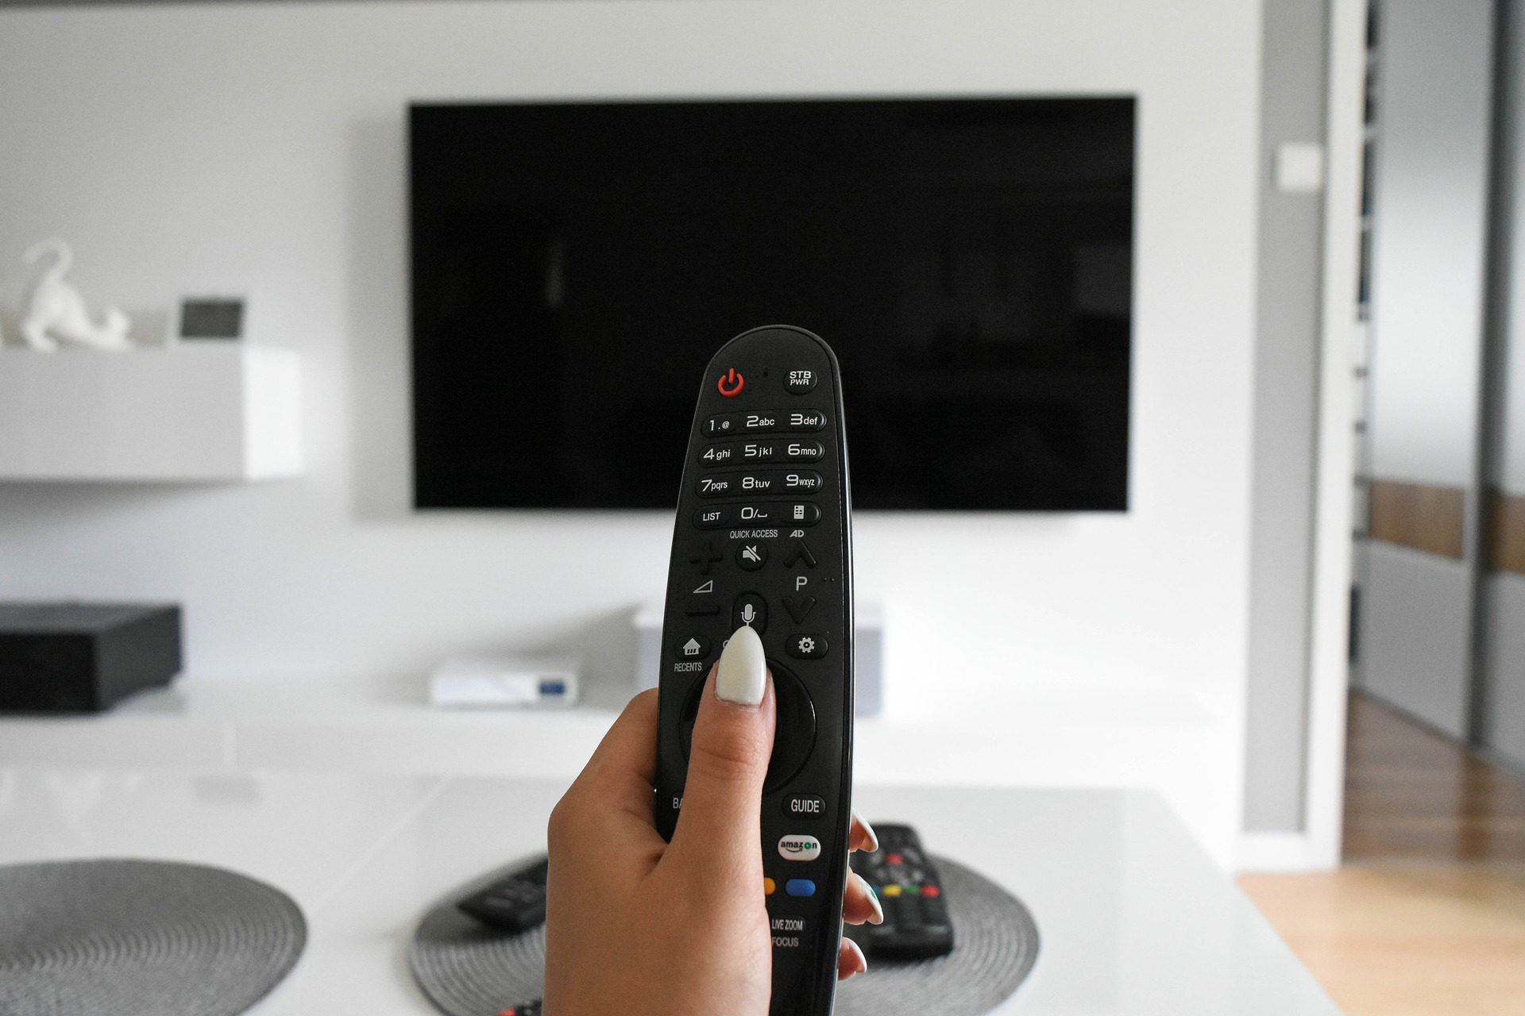

July 2021
Viewing Trends

Slide 2
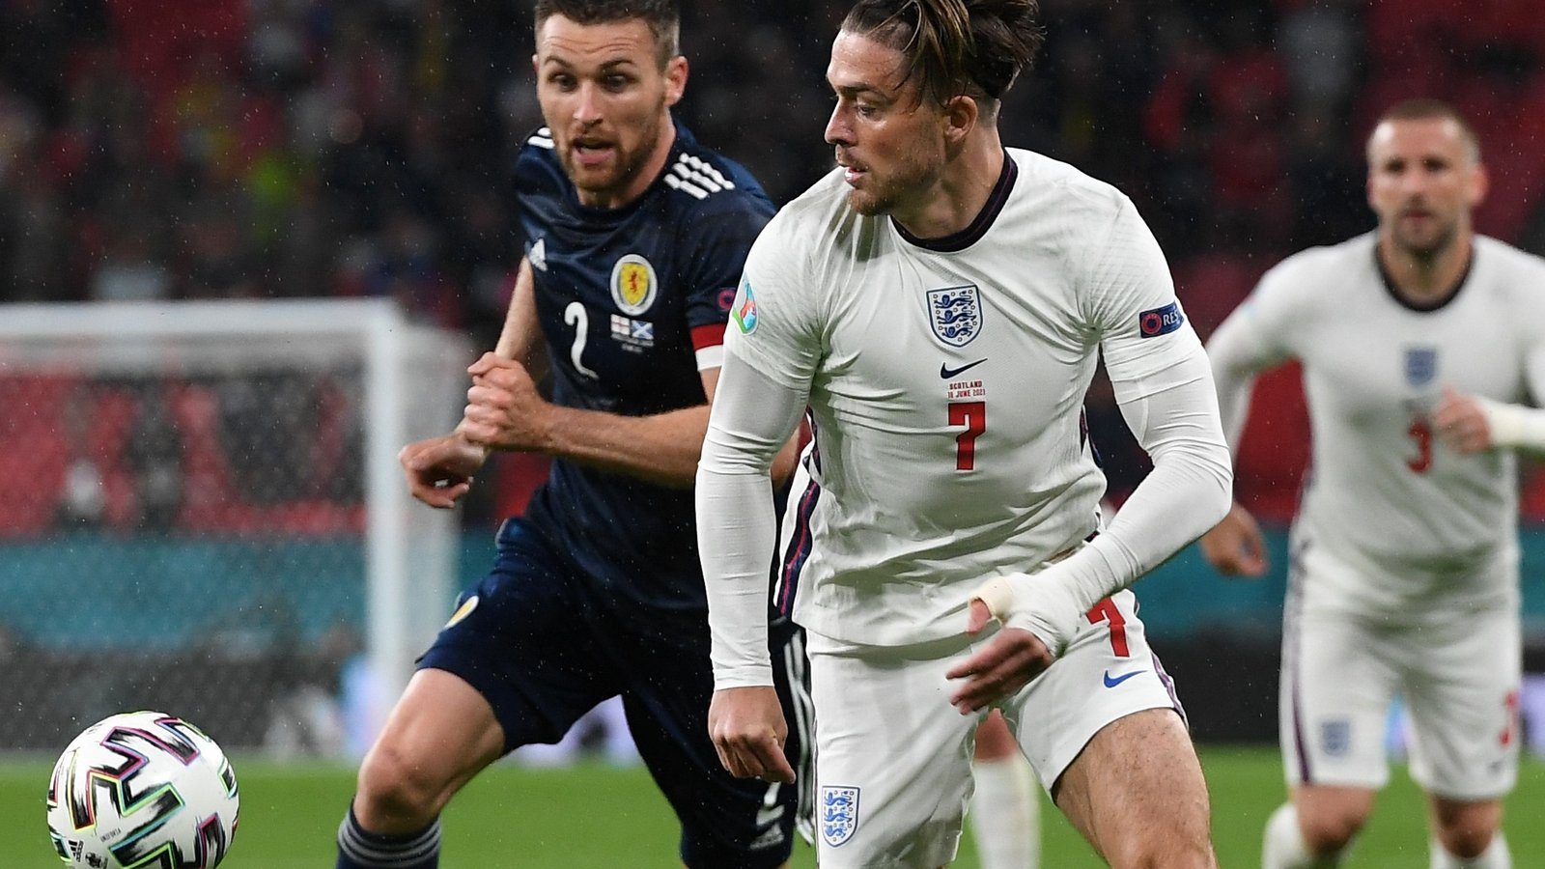

JULY 2021 VIEWING TRENDS
TAM Ireland Commercial Channels reached an average of 72.8% of individuals each week in July 2021
Individuals watched an average of 134 minutes (2 hours 14 minutes) each day in July 2021. This is a 6% decrease on July 2020
UEFA 2020 Final Italy V England Live Play on RTÉ 2 on July 11th was the most viewed programme of the month. An average of 941,300 individuals tuned in to the broadcast.
Over on the Virgin Media suite of channels, Coronation Street and Emmerdale occupied the top two spots with Love Island on July 30th on Virgin Media One being the third most viewed programme of the month with an average of 321,200 individuals tuning in.

Slide 3
JULY 2021: AVERAGE DAILY MINUTES

Slide 4
TOP 10 ADVERTISERS: July 2021
1: Procter & Gamble
2: Sky Ireland
3: Diageo
4: Unilever
05: Allied Irish Banks
10: Reckitt Benckiser
07: Aldi Ireland
08: Vodafone Ireland
09: Heineken
06: Tesco Ireland

Slide 5
TOP 5 RTÉ PROGRAMMES
July 2021
UEFA Euro 2020 - Live Play - Final - Italy V England 11-07-2021
UEFA Euro 2020 - Live Play - Semi Final - England 07-07-2021
UEFA Euro 2020 - Post Match - Semi Final - England 07-07-2021
UEFA Euro 2020 - Post Match - Final - Italy V Engl 11-07-2021
UEFA Euro 2020 - Live Play - Semi Final - Italy V 06-07-2021
The Great Pottery Throw Down, Channel 4
Top 5 programmes by station group. A breakdown of the Top 10 programmes by station for July 2021 can be found here
Notes:
Top 5 programmes – Channel 4

Slide 6

TOP 5 VIRGIN MEDIA
PROGRAMMES July 2021
CORONATION STREET 20 19-07-2021
EMMERDALE 2021 30-07-2021
LOVE ISLAND S7 30-07-2021
NEWS AT 5:30 (2021) 08-07-2021
NEWS AT 8 (2021) 30-07-2021
Top 5 programmes by station group. A breakdown of the Top 10 programmes by station for July 2021 can be found here
Notes:
Top 5 programmes – Channel 4

Slide 7

TOP 5 SKY MEDIA
PROGRAMMES July 2021
9-1-1 05-07-2021
LIVE BRITISH & IRISH LIONS SERIES 31-07-2021
S.W.A.T. 11-07-2021
9-1-1: LONE STAR 26-07-2021
NEW AMSTERDAM 21-07-2021
Top 5 programmes by station group. A breakdown of the Top 10 programmes by station for July 2021 can be found here
Notes:
Top 5 programmes – Channel 4

Slide 8
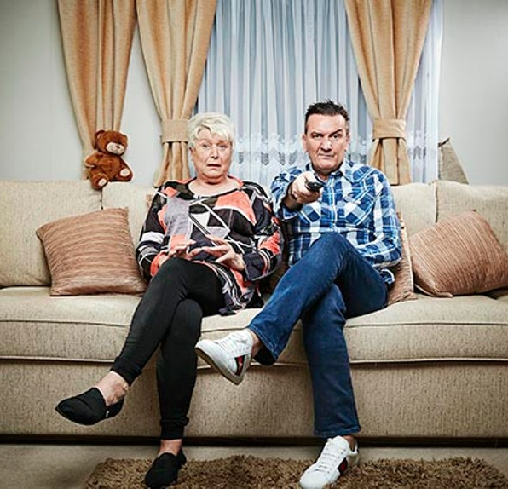
TOP 5 4 SALES
PROGRAMMES July 2021
CELEBRITY GOGGLEBOX 16-07-2021
CELEBRITY GOGGLEBOX 2020 30-07-2021
F1: BRITISH GP LIVE 18-07-2021
THE LAST LEG 02-07-2021
FILM: JOHN WICK: CHAPTER 3 - PARABELLUM
10-07-2021
Top 5 programmes by station group. A breakdown of the Top 10 programmes by station for July 2021 can be found here
Notes:
Top 5 programmes – Channel 4

Slide 9
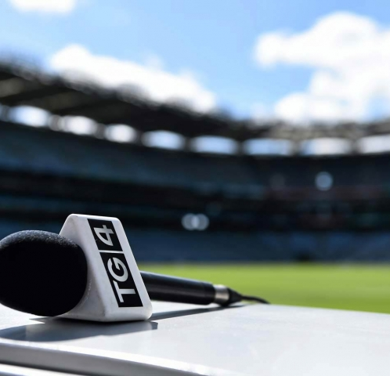
TOP 5 TG4 PROGRAMMES
July 2021
GAA BEO 2021 - 2022 22-07-2021
Viva Ceol Tíre 10-07-2021
Hang 'em High 16-07-2021
Fleadhfest 2021 25-07-2021
The Wonderful Country 23-07-2021
Top 5 programmes by station group. A breakdown of the Top 10 programmes by station for July 2021 can be found here
Notes:
Top 5 programmes – Channel 4

Slide 10

TOP 5 VIACOM
PROGRAMMES July 2021
FRIENDS 10-07-2021
FILM: THE NAKED GUN: FROM THE FILES OF P 23-07-2021
LIVE AT THE APOLLO 20-07-2021
CRIMINALLY FUNNY 23-07-2021
BLAZE AND THE MONSTER MACHINES 05-07-2021
Top 5 programmes by station group. A breakdown of the Top 10 programmes by station for July 2021 can be found here
Notes:
Top 5 programmes – Channel 4

Slide 11
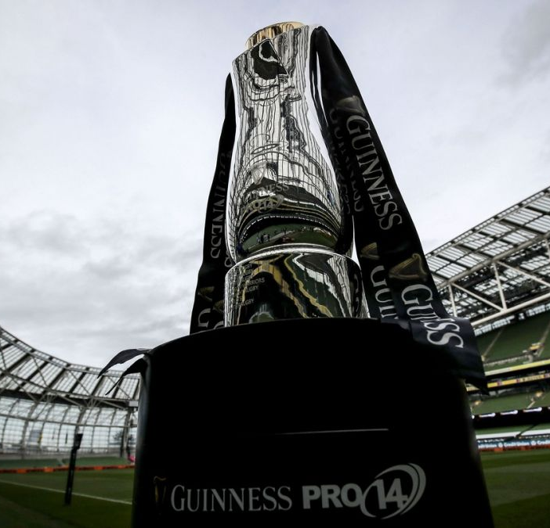
TOP 5 EIR SPORT
PROGRAMMES July 2021
SUB OUT OF THEIR LEAGUE 30-07-2021
F SUB THE TEAM THAT TURNE 16-07-2021
FOOTBALL FA CUP FINALS 24-07-2021
2016 O'DONOVAN BROTHERS R 19-07-2021
CLASSIC GAA 03-07-2021
Top 5 programmes by station group. A breakdown of the Top 10 programmes by station for July 2021 can be found here
Notes:
Top 5 programmes – Channel 4

