Slide 1
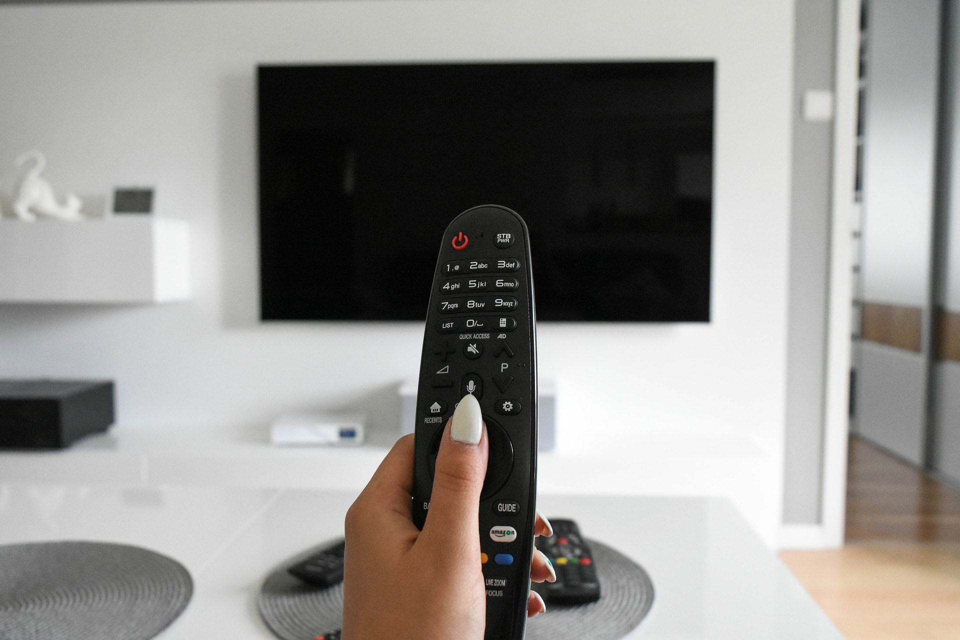

August 2021
Viewing Trends

Slide 2


August 2021 VIEWING TRENDS
TAM Ireland Commercial Channels reached an average of 72.7% of individuals each week in August 2021
Individuals watched an average of 136 minutes (2 hours 16 minutes) each day in August 2021. This is the same figure a August 2020
Saturday Game Live-All Ireland Hurling Semi Final-Post Match on RTÉ 2 on August 14th was the most viewed programme of the month. An average of 887,800 individuals tuned in to the broadcast.
Googlebox on Channel 4 on August 6th was the top performing programming for 4Sales with an average of 59,200 individuals tuning in. Coronation Street and Love Island occupied the top two spots on the Virgin Media suite of stations.

Slide 3
AUGUST 2021: AVERAGE DAILY MINUTES

Slide 4
TOP 10 ADVERTISERS: August 2021
1: Procter & Gamble
2: Sky Ireland
3: Unilever
4: Vodafone Ireland
05: Diageo
10: SuperValu
07: National Lottery
08: Three
09: Virgin Media
06: Lidl Ireland

Slide 5
TOP 5 RTÉ PROGRAMMES
August 2021
Saturday Game Live - Post Match - Football Semi Fi 14-08-2021
Sunday GAA Live - Live Play - All-Ireland Hurling 22-08-2021
Saturday Game Live - Live Play - Football Semi Fin 14-08-2021
Sunday GAA Live - Post Match - All-Ireland Hurling 22-08-2021
Sunday GAA Live - Live Play - Hurling Semi Final - 08-08-2021
The Great Pottery Throw Down, Channel 4
Top 5 programmes by station group. A breakdown of the Top 10 programmes by station for August 2021 can be found here
Notes:
Top 5 programmes – Channel 4

Slide 6

TOP 5 VIRGIN MEDIA
PROGRAMMES August 2021
CORONATION STREET 20 11-08-2021
LOVE ISLAND S7 23-08-2021
EMMERDALE 2021 16-08-2021
NEWS AT 5:30 (2021) 20-08-2021
USC: CHE V VIL EX TI 11-08-2021
Top 5 programmes by station group. A breakdown of the Top 10 programmes by station for August 2021 can be found here
Notes:
Top 5 programmes – Channel 4

Slide 7

TOP 5 SKY MEDIA
PROGRAMMES August 2021
LIVE RENAULT SUPER SUNDAY 29-08-2021
LIVE FNF: BRENTFORD V ARSENAL 13-08-2021
LIVE SNF: LIVERPOOL V CHELSEA 28-08-2021
9-1-1 09-08-2021
LIVE S.AFRICA V LIONS:THE DECIDER 07-08-2021
Top 5 programmes by station group. A breakdown of the Top 10 programmes by station for August 2021 can be found here
Notes:
Top 5 programmes – Channel 4

Slide 8
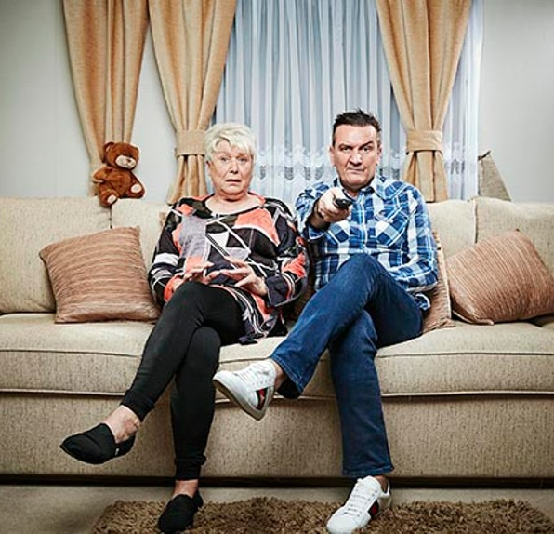
TOP 5 4 SALES
PROGRAMMES August 2021
GOGGLEBOX 06-08-2021
24 HOURS IN POLICE CUSTODY 09-08-2021
GOGGLEBOX 18-08-2021
DECEIT 13-08-2021
GEORGE CLARKE'S REMARKABLE RENOVATIONS 04-08-2021
Top 5 programmes by station group. A breakdown of the Top 10 programmes by station for August 2021 can be found here
Notes:
Top 5 programmes – Channel 4

Slide 9
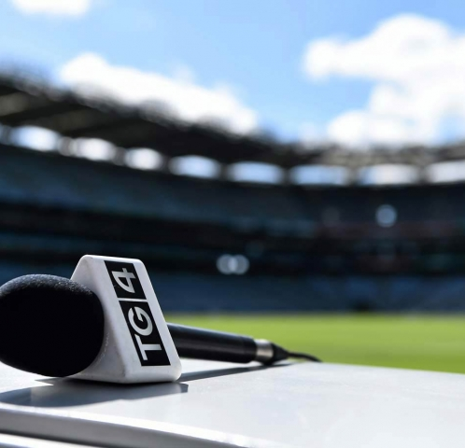
TOP 5 TG4 PROGRAMMES
August 2021
GAA BEO 2021 - 2022 15-08-2021
Peil na mBan Beo 2021 15-08-2021
Fleadhfest 21 06-08-2021
Opry an Iúir 5 24-08-2021
Togha Opry an Iúir 5 31-08-2021
Top 5 programmes by station group. A breakdown of the Top 10 programmes by station for August 2021 can be found here
Notes:
Top 5 programmes – Channel 4

Slide 10

TOP 5 VIACOM
PROGRAMMES August 2021
FILM: AMERICAN PIE: THE REUNION (2012)
24-08-2021
GEORDIE OGS 03-08-2021
BEN & HOLLY'S LITTLE KINGDOM 14-08-2021
FRIENDS 13-08-2021
BAYWATCH 11-08-2021
Top 5 programmes by station group. A breakdown of the Top 10 programmes by station for August 2021 can be found here
Notes:
Top 5 programmes – Channel 4

