Slide 1


September 2021
Viewing Trends Overview

Slide 2

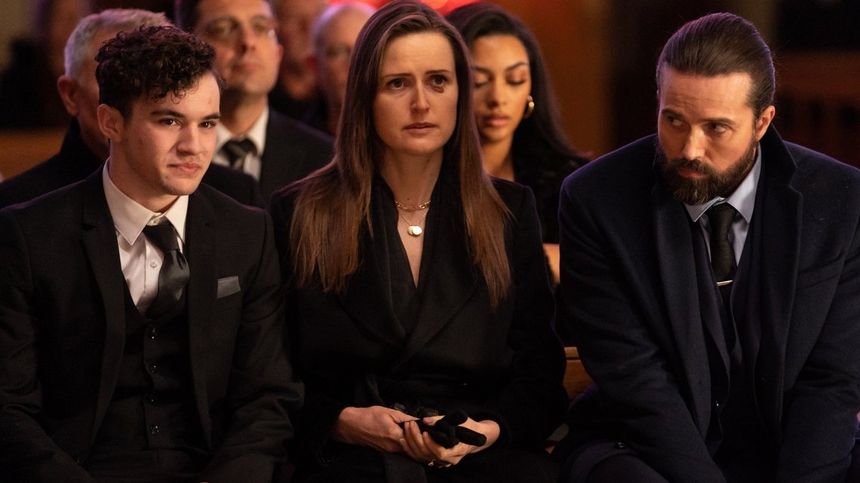
SEPTEMBER 2021 VIEWING TRENDS
TAM Ireland Commercial Channels reached an average of 71.6% of individuals each week in September 2021
Individuals watched an average of 131 minutes (2 hours 11 minutes) each day in September 2021.
Saturday Game Live-All Ireland Football Final Live Play on RTÉ 2 on September 11th was the most viewed programme of the month. An average of 944,600 individuals tuned in to the broadcast.
New drama Kin on RTE One on September 12th was the second most viewed programme of the month with an average of 686,600 individuals tuning in.
**Due to transmission issues we currently we have no Commercial activity on the C4 Sales channels from 25th September.

Slide 3
AVERAGE DAILY MINUTES: September 2021

Slide 4
TOP 10 ADVERTISERS: September 2021
1: Procter & Gamble
2: Sky Ireland
3: An Post
4: AIB
05: Vodafone Ireland
10: SuperValu
07: Unilever
08: National Lottery
09: Lidl Ireland
06: Three

Slide 5
TOP 5 RTÉ PROGRAMMES
SEPTEMBER 2021
Saturday Game Live - Live Play - All Ireland Football 11-09-2021
Kin 12-09-2021
Saturday Game Live - Post Match - All Ireland Foot 11-09-2021
European Qualifiers World Cup 2022 - Live Play 01-09-2021
Late Late Show, The 03-09-2021
The Great Pottery Throw Down, Channel 4
Top 5 programmes by station group. A breakdown of the Top 10 programmes by station for September 2021 can be found here
Notes:
Top 5 programmes – Channel 4

Slide 6
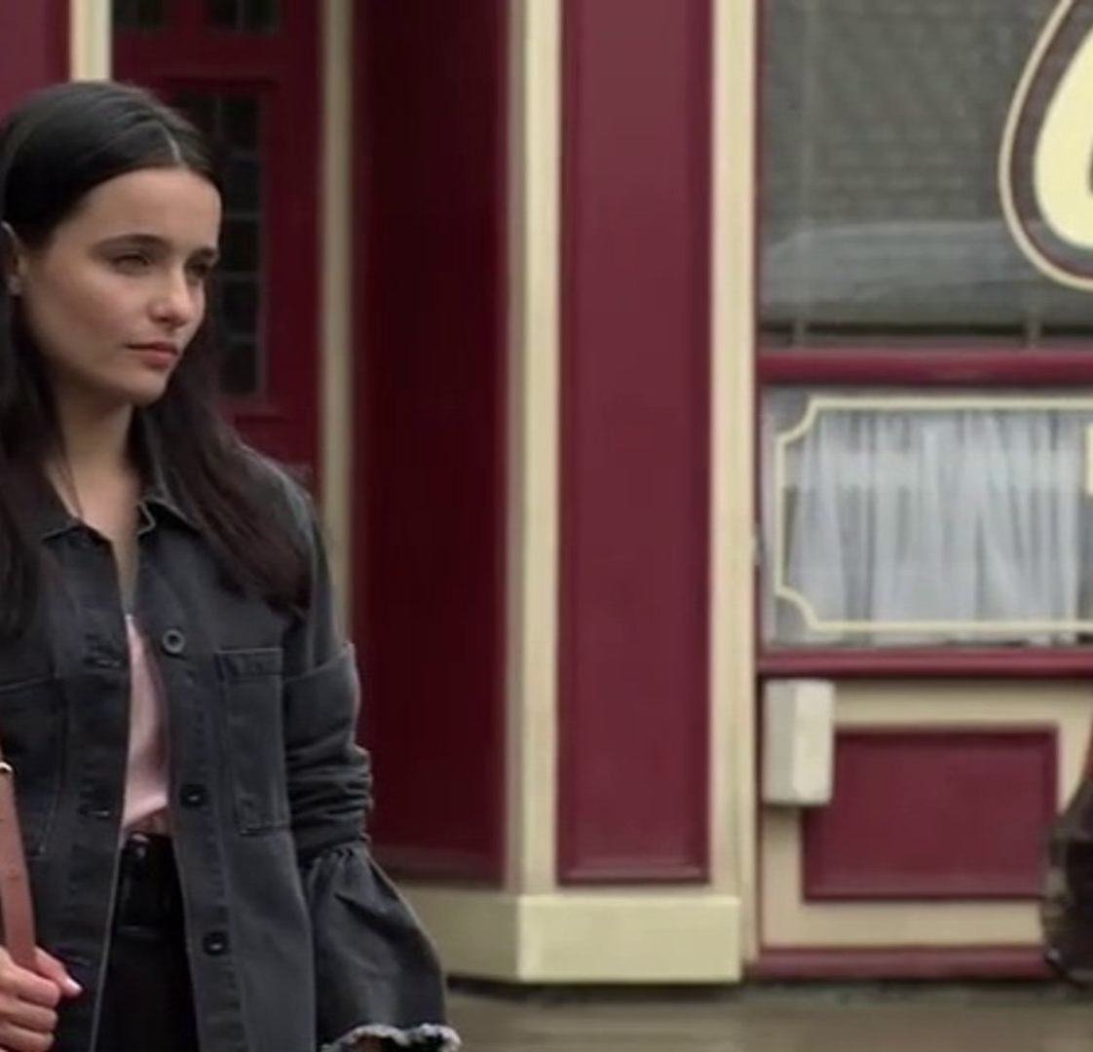
TOP 5 VIRGIN MEDIA
PROGRAMMES SEPT 2021
CORONATION STREET 13-09-2021
EMMERDALE 2021 30-09-2021
UCL: LIV V MIL LIVE 15-09-2021
THE BIG INTERVIEW 13-09-2021
UCL: MUN V VIL LIVE 29-09-2021
Top 5 programmes by station group. A breakdown of the Top 10 programmes by station for September 2021 can be found here
Notes:
Top 5 programmes – Channel 4

Slide 7
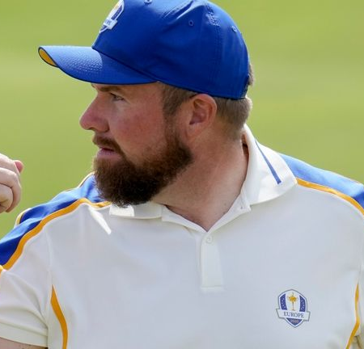
TOP 5 SKY MEDIA
PROGRAMMES SEPT 2021
LIVE RENAULT SUPER SUNDAY 19-09-2021
LIVE RYDER CUP DAY 1 FOURBALLS 24-09-2021
LIVE RENAULT SUPER SUNDAY 19-09-2021
LIVE RYDER CUP SINGLES 26-09-2021
LIVE SNF: BRENTFORD V LIVERPOOL25-09-2021
Top 5 programmes by station group. A breakdown of the Top 10 programmes by station for September 2021 can be found here
Notes:
Top 5 programmes – Channel 4

Slide 8
TOP 5 4 SALES
PROGRAMMES Sept 2021
THE GREAT BRITISH BAKE OFF 21-09-2021
GOGGLEBOX 24-09-2021
CELEBRITY GOGGLEBOX 10-09-2021
LIVE US OPEN TENNIS FINAL RADUCANU
11-09-2021
HELP 16-09-2021
Top 5 programmes by station group. A breakdown of the Top 10 programmes by station for September 2021 can be found here
Notes:
Top 5 programmes – Channel 4

Slide 9

TOP 5 TG4 PROGRAMMES
SEPTEMBER 2021
Peil na mBan Beo 2021 05-09-2021
GAA BEO 2021 - 2022 26-09-2021
Opry Dhoire 6 21-09-2021
Hector - Éire Nua 30-09-2021
Hector Africa - A go Z 09-09-2021
Top 5 programmes by station group. A breakdown of the Top 10 programmes by station for September 2021 can be found here
Notes:
Top 5 programmes – Channel 4

Slide 10

TOP 5 VIACOM
PROGRAMMES SEPT 2021
FRIENDS 05-09-2021
BLOCKBUSTERS 15-09-2021
BEN & HOLLY'S LITTLE KINGDOM 16-09-2021
PAW PATROL 21-09-2021
BLAZE AND THE MONSTER MACHINES 28-09-2021
Top 5 programmes by station group. A breakdown of the Top 10 programmes by station for September 2021 can be found here
Notes:
Top 5 programmes – Channel 4

