Slide 1
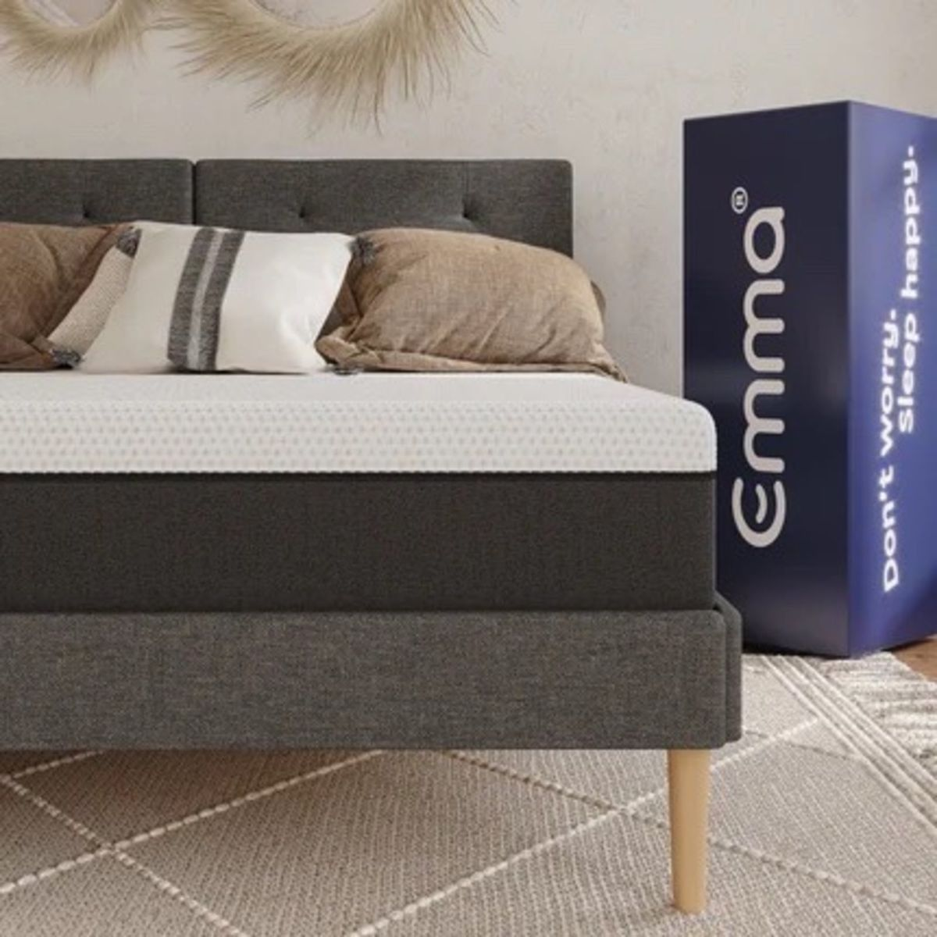
Online businesses using TV advertising in Ireland 2021

Slide 2
In 2021, Online businesses was 3rd place in terms of share of TV impacts delivered.
Source: TAM Ireland Ltd / Nielsen Media Ireland TAM / 30” 000s, Consolidated, National, All Commercial Channels Jan-Dec 2021

Slide 3
MANY DIFFERENT ONLINE SECTORS EMBRACED TV ADVERTISING IN 2021
CLOTHING
MATRESSES
MARKET PLACE
PRICE COMPARISON
STREAMING PLATFORMS
TRAVEL
Source: TAM Ireland Ltd / Nielsen Media Ireland TAM / 30” 000s, Consolidated, National, All Commercial Channels Jan-Dec 2021

Slide 4
ONLINE YEAR-ON-YEAR TV ADVERTISING GROWTH HAS COME FROM EXISTING AND NEW ADVERTISERS
Existing
Emma Mattresses +16%
New
Graze.com
Disney Plus +29%
Amazon.com +97%
Refurbed.ie
Free Now
Littlewoods Ireland +28%
Betfair +61%
Get Set Go Insurance
Source: TAM Ireland Ltd / Nielsen Media Ireland TAM / 30” 000s, Consolidated, National, All Commercial Channels Jan-Dec 2021

