Slide 1


March 2022
Viewing Trends

Slide 2
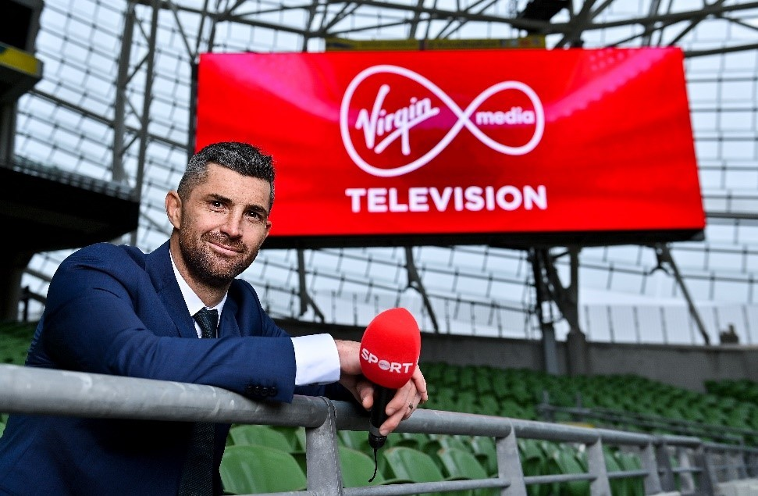
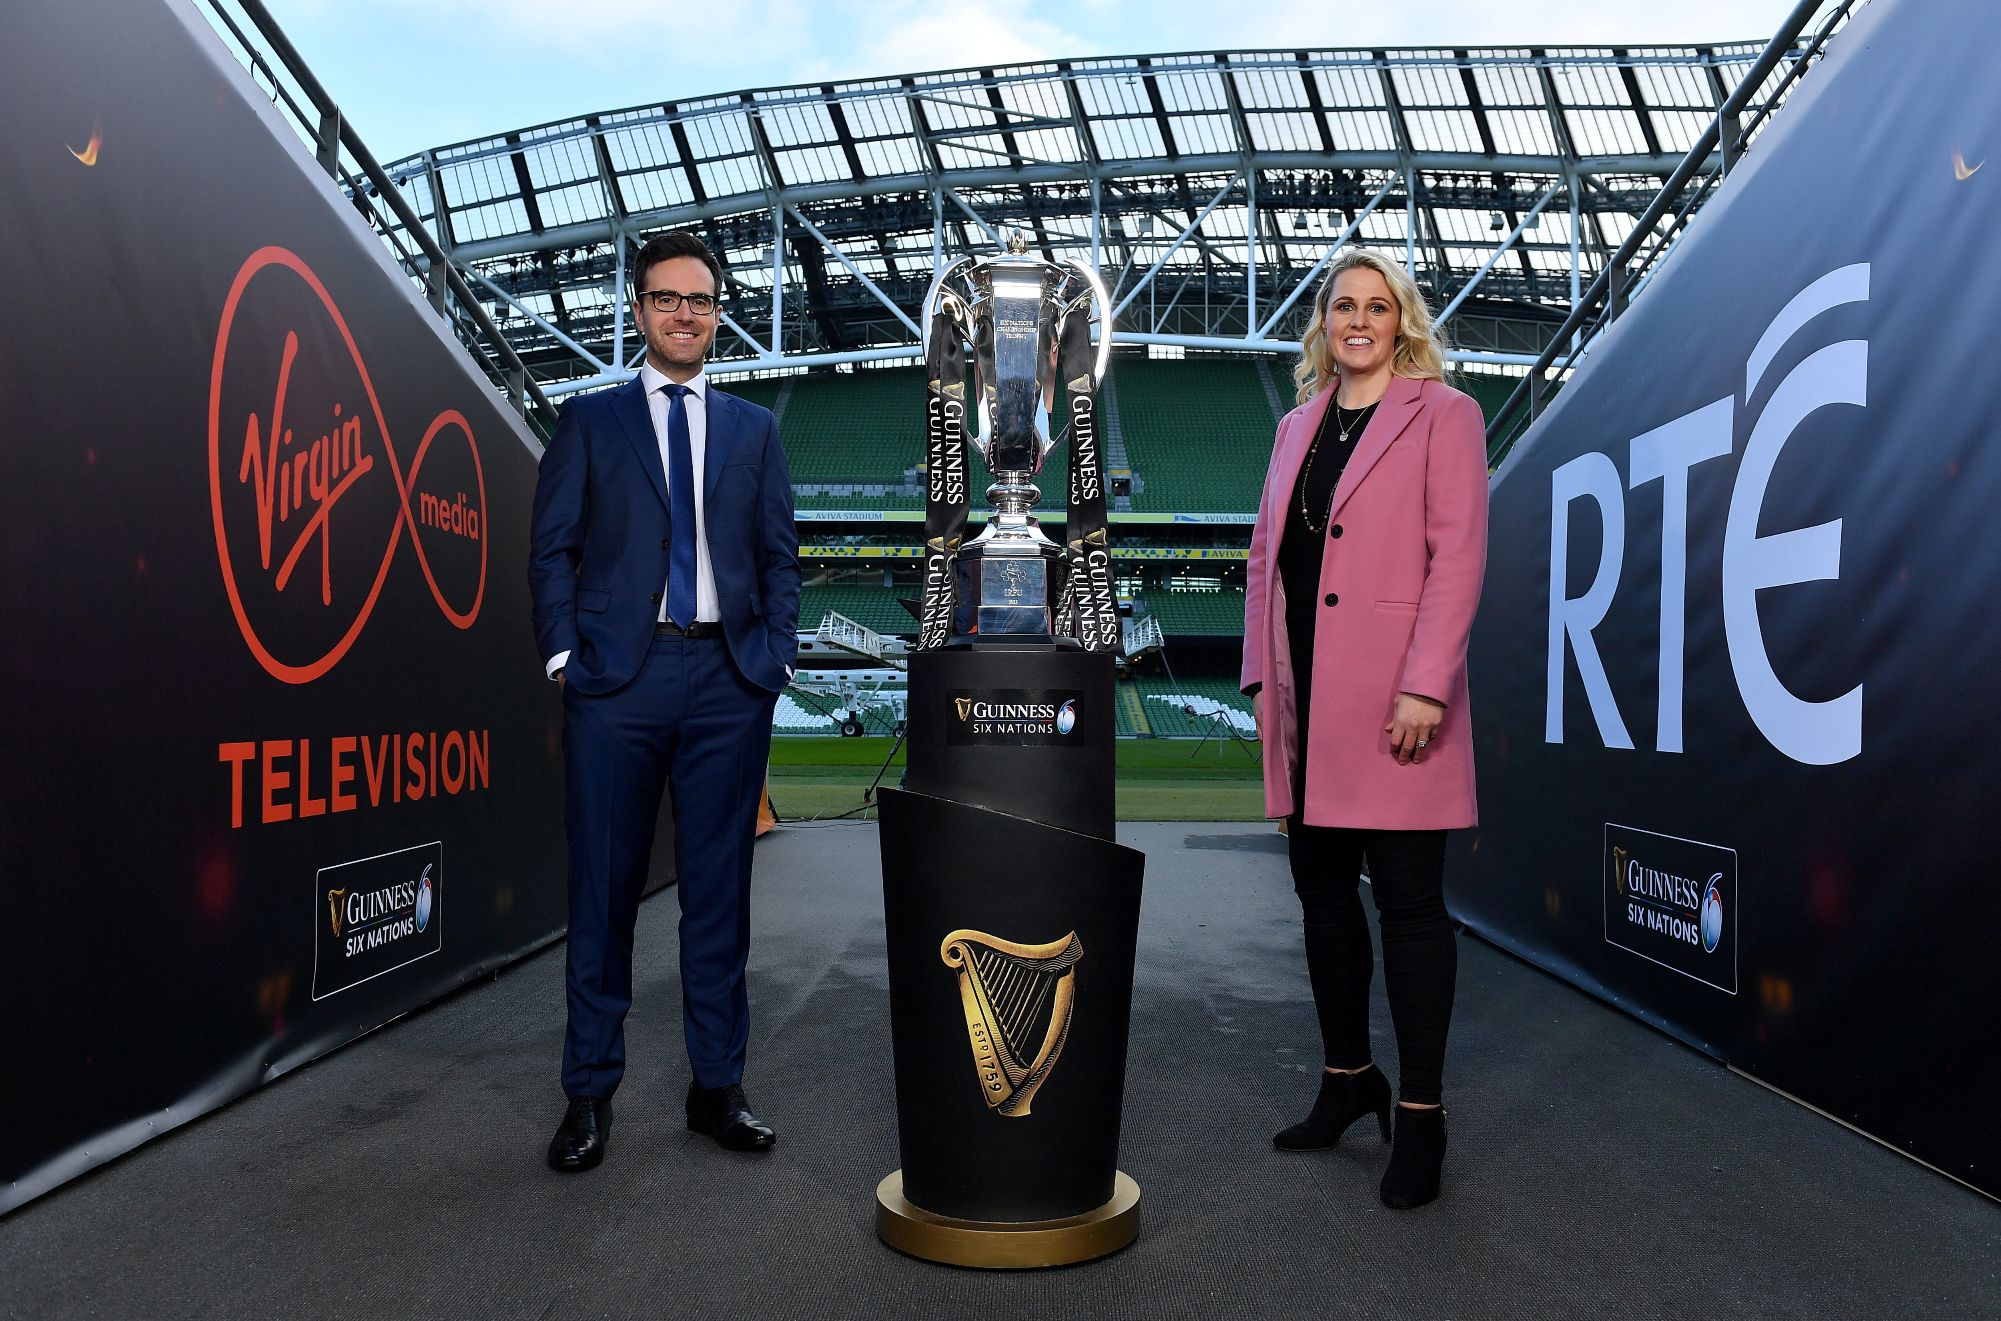
MARCH 2022 VIEWING TRENDS
TAM Ireland Commercial Channels reached an average of 76.7% of Adults 15+ each week in March 2022
Adults 15+ watched an average of 165 minutes (2 hours 45 minutes) each day in March 2022 (Live + Timeshifted viewing)
6 Nations Live England V Ireland on RTÉ 2 on March 12th was the most viewed programme of the month. An average of 778,500 individuals tuned in to the broadcast.
The Six Nations Ireland V Scotland on Virgin Media One was the second most viewed programme of the month with an average of 683,600 individuals watching the game.

Slide 3
WEEKLY REACH: March 2022

Slide 4
TOP 10 ADVERTISERS: March 2022
1: Procter & Gamble
2: L’Oréal
3: Supervalu
4: Diageo
05: Sky
10: HSE
07: Heineken
08: National Lottery
09: AIB
06: Lidl Ireland

Slide 5
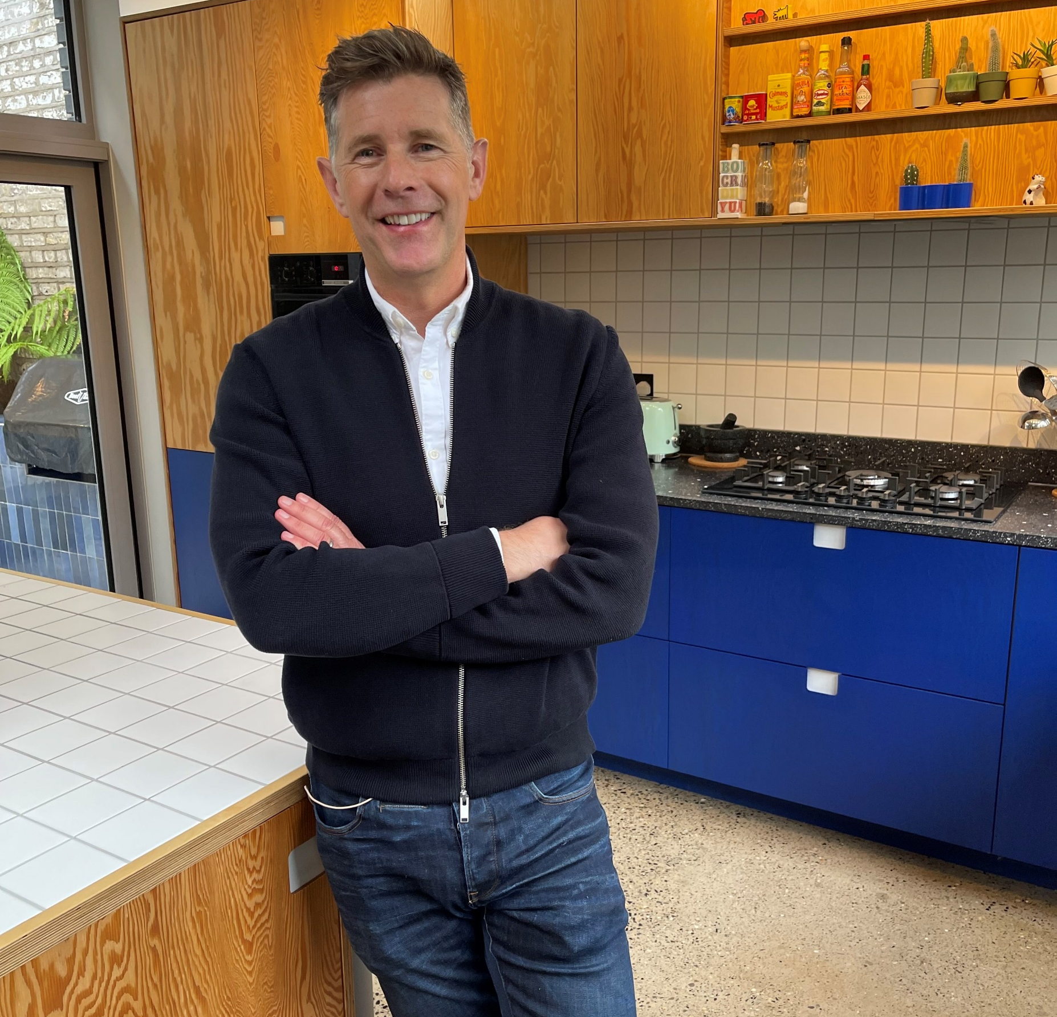
TOP 5 RTÉ PROGRAMMES
March 2022
1 Six Nations - Live Play - England V Ireland 12-03-2022
2 Six Nations - Post Match - England V Ireland 12-03-2022
3 RTE News: Nine O'Clock 06-03-2022
4 Room To Improve 06-03-2022
5 Late Late Show, The 04-03-2022
The Great Pottery Throw Down, Channel 4
Top 5 programmes by station group
Notes:
Top 5 programmes – Channel 4

Slide 6
TOP 5 VIRGIN MEDIA
PROGRAMMES March 2022
6 Nations Live Ireland V Scotland
19-03-2022
2 Coronation Street 2022 18-03-2022
3 6 Nations Post Ireland V Scotland 19-03-2022
4 Emmerdale 2022 04-03-2022
5 Cheltenham Gold Cup Live 18-03-2022
Top 5 programmes by station group.
Notes:
Top 5 programmes – Channel 4

Slide 7

TOP 5 SKY MEDIA
PROGRAMMES March 2022
LIVE RENAULT SUPER SUNDAY
06-03-2022
LIVE SNF: LIVERPOOL V WEST HAM
05-03-2022
LIVE PL: ARSENAL V LIVERPOOL
16-03-2022
SKY NEWS AT NINE WITH ANNA BOTTING
02-03-2022
5 EQUALIZER, THE 01-03-2022
Top 5 programmes by station group.
Notes:
Top 5 programmes – Channel 4

Slide 8

TOP 5 4 SALES
PROGRAMMES Feb 2022
1 GOGGLEBOX 04-03-2022
2 THE GREAT CELEBRITY BAKE OFF FOR SU2C 22-03-2022
3 JEREMY KYLE SHOW: DEATH ON DAYTIME 13-03-2022
THE GREAT POTTERY THROW DOWN
06-03-2022
LOVE IT OR LIST IT: BRILLIANT BUILDS
09-03-2022
Top 5 programmes by station group.
Notes:
Top 5 programmes – Channel 4

Slide 9

TOP 5 VIACOM
PROGRAMMES March 2022
BEN & HOLLY'S LITTLE KINGDOM
25-03-2022
2 PAW PATROL 11-03-2022
3 SOUTH PARK 18-03-2022
4 FRIENDS 02-03-2022
BLAZE AND THE MONSTER MACHINES
30-03-2022
Top 5 programmes by station group.
Notes:
Top 5 programmes – Channel 4

Slide 10

TOP 5 TG4 PROGRAMMES
March 2022
1 GAA BEO 2021 - 2022 13-03-2022
2 Kill the Irishman 07-03-2022
3 Contractors 26-03-2022
4 Opry le Daniel 10 29-03-2022
The Dubliners - The Parting Glass
17-03-2022
Top 5 programmes by station group
Notes:
Top 5 programmes – Channel 4

