Slide 1


April 2022
Viewing Trends

Slide 2
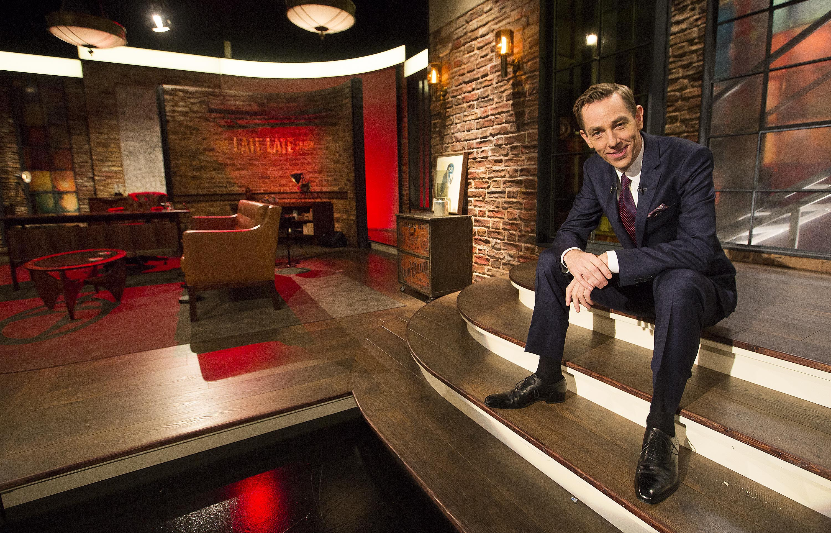
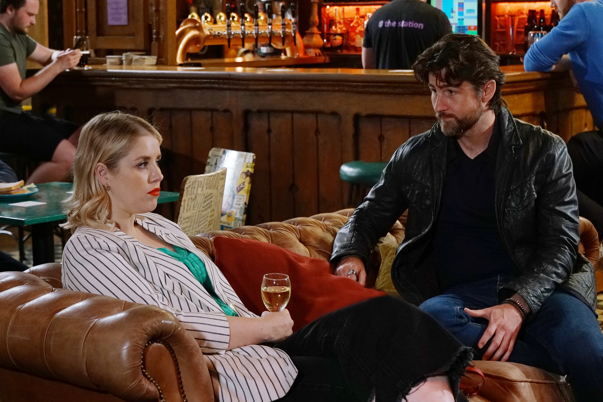
APRIL 2022 VIEWING TRENDS
TAM Ireland Commercial Channels reached an average of 75.1% of Adults 15+ each week in April 2022
Adults 15+ watched an average of 152 minutes (2 hours 32 minutes) each day in April 2022 (Live + Timeshifted viewing)
The Late Late Show on RTÉ One on April 1st was the most viewed programme of the month. An average of 471,600 individuals tuned in to the broadcast.
Soaps performed well in April with Coronation Street on Virgin Media One and Fair City on RTÉ One also appearing in the Top 10 programmes for the month

Slide 3
WEEKLY REACH: April 2022

Slide 4
TOP 10 ADVERTISERS: April 2022
1: Procter & Gamble
2: Sky
3: Diageo
4: Aldi
05: National Lottery
10: Lidl
07: Bank of Ireland
08: Three
09: Heineken
06: Supervalu

Slide 5
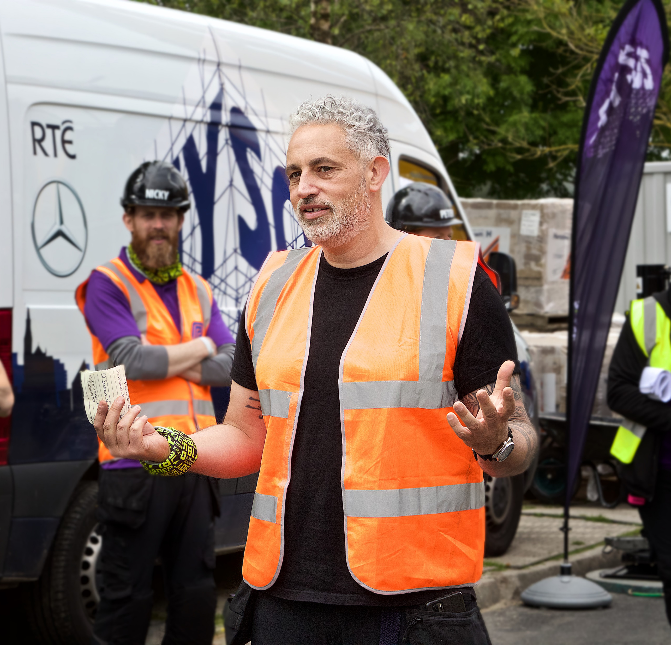
TOP 5 RTÉ PROGRAMMES
April 2022
1 Late Late Show, The 01-04-2022
2 DIY SOS 03-04-2022
3 RTE News: Nine O'Clock 03-04-2022
4 RTE News: Six One 04-04-2022
5 Great House Revival, The 10-04-2022
The Great Pottery Throw Down, Channel 4
Top 5 programmes by station group
Notes:
Top 5 programmes – Channel 4

Slide 6
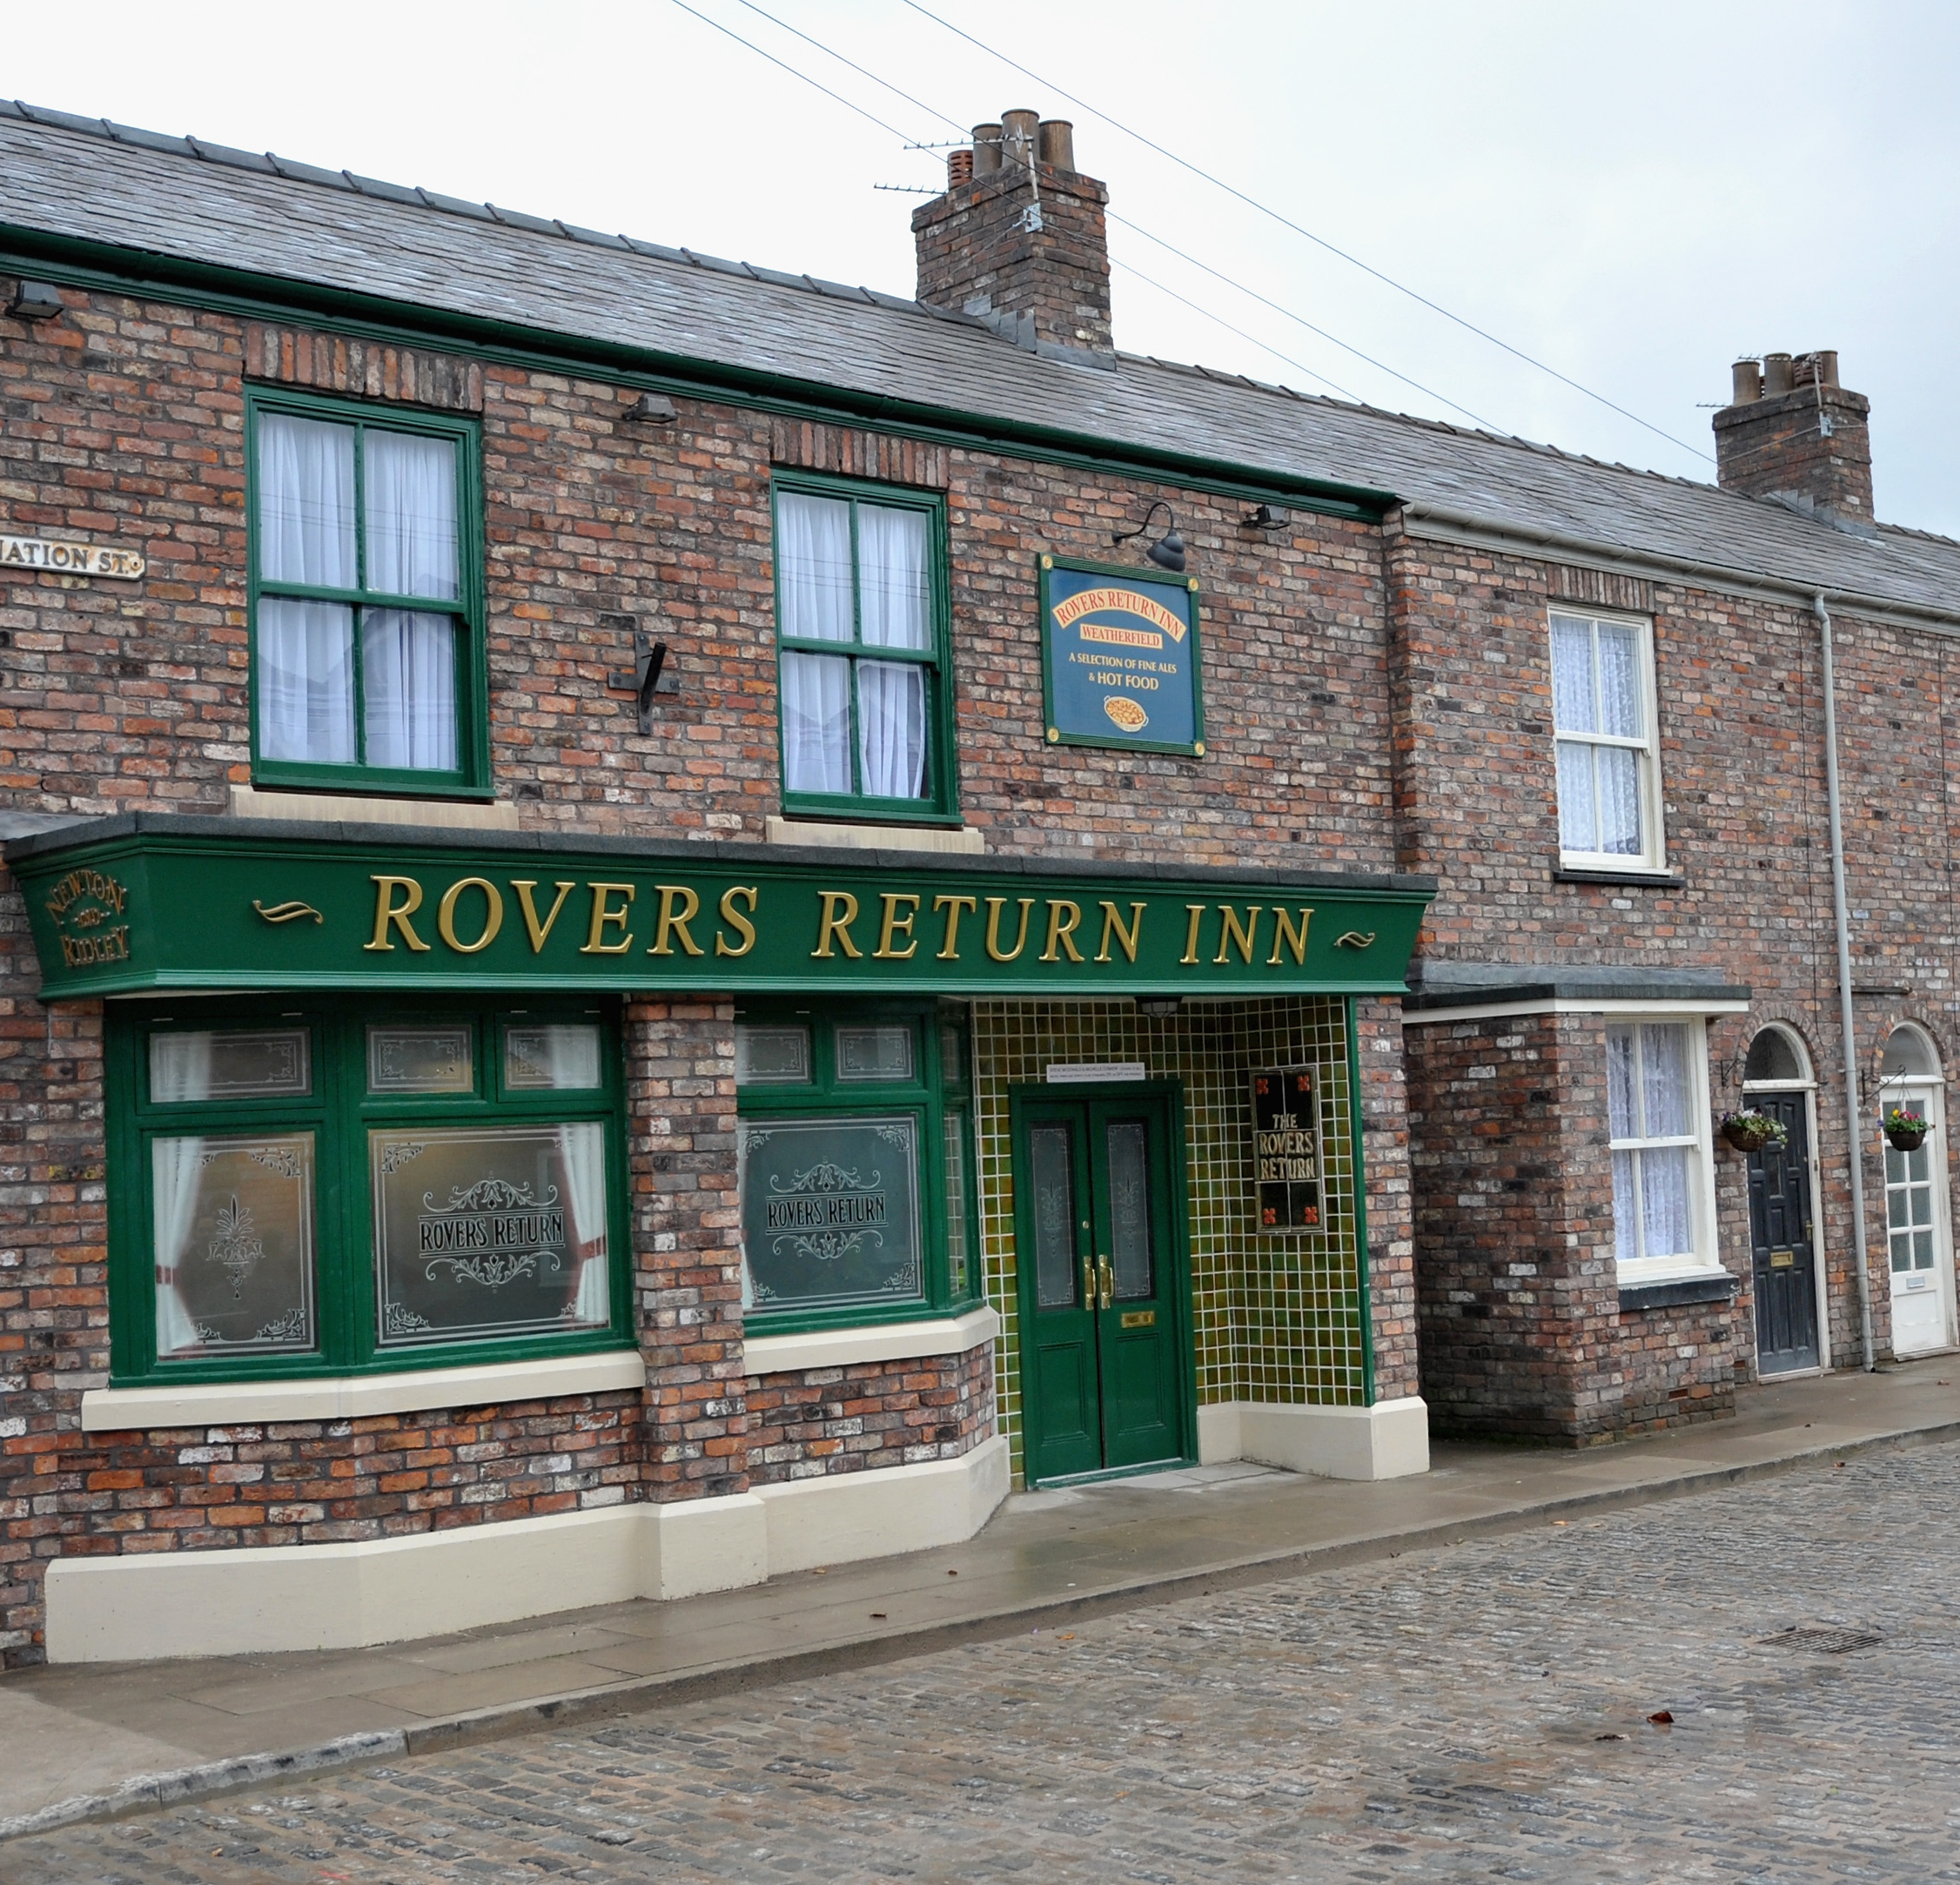
TOP 5 VIRGIN MEDIA
PROGRAMMES April 2022
1 Coronation Street 2022 04-04-2022
2 Grand National Live 09-04-2022
UCL: Liverpool v Villarreal Live
27-04-2022
4 Emmerdale 2022 15-04-2022
5 Grand National build-up 09-04-2022
Top 5 programmes by station group.
Notes:
Top 5 programmes – Channel 4

Slide 7
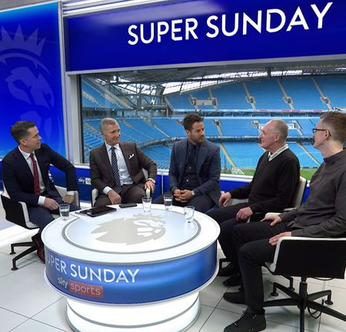
TOP 5 SKY MEDIA
PROGRAMMES April 2022
LIVE RENAULT SUPER SUNDAY
10-04-2022
2 LIVE PL: LIVERPOOL V MAN UNITED 19-04-2022
LIVE PL: MANCHESTER UTD V CHELSEA
28-04-2022
4 LIVE MASTERS FINAL ROUND 10-04-2022
5 LIVE SNF: MAN UTD V LEICESTER 02-04-2022
Top 5 programmes by station group.
Notes:
Top 5 programmes – Channel 4

Slide 8
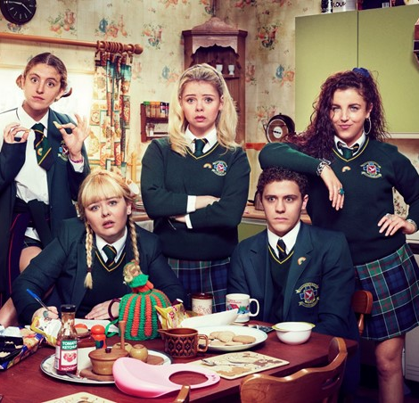
TOP 5 4 SALES
PROGRAMMES April 2022
1 DERRY GIRLS 12-04-2022
2 GOGGLEBOX 01-04-2022
3 THE GREAT CELEBRITY BAKE OFF FOR SU2C 05-04-2022
4 HULLRAISERS 19-04-2022
MARRIED AT FIRST SIGHT AUSTRALIA
25-04-2022
Top 5 programmes by station group.
Notes:
Top 5 programmes – Channel 4

Slide 9

TOP 5 VIACOM
PROGRAMMES April 2022
1 PAW PATROL 08-04-2022
2 FRIENDS 23-04-2022
3 IMPRACTICAL JOKERS 11-04-2022
BEN & HOLLY'S LITTLE KINGDOM
04-04-2022
FILM: DADDY'S HOME 2 (2017)
15-04-2022
Top 5 programmes by station group.
Notes:
Top 5 programmes – Channel 4

Slide 10

TOP 5 TG4 PROGRAMMES
April 2022
1 GAA BEO 2021 - 2022 03-04-2022
2 Contractors 07-04-2022
3 Peil na mBan Beo 2022 10-04-2022
4 Rugbaí Beo URC 2021- 2022 29-04-2022
5 Laochra Gael 2017 03-04-2022
Top 5 programmes by station group
Notes:
Top 5 programmes – Channel 4

