Slide 1


May 2023
Viewing Trends

Slide 2

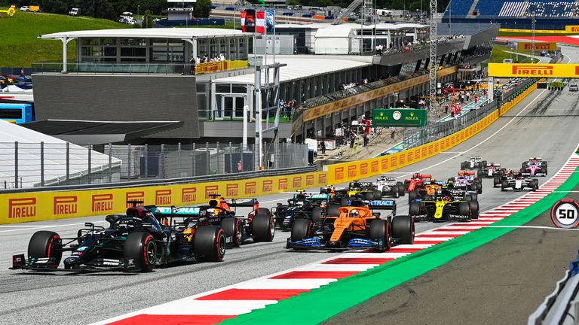
MAY 2023 VIEWING TRENDS
TAM Ireland Commercial Channels reached an average of 75.2% of Adults 15+ each week in May 2023
Adults 15+ watched an average of 141 minutes (2 hours 21 minutes) each day in May 2023 (Live + Time shifted viewing)
The Late Late Show on May 26th on RTÉ One(Ryan Tubridy’s last show) was the most viewed programme of the month. An average of 695,000 individuals tuned in to the broadcast.
Over on the Sky group of channels the Live Miami Grand Prix on Sky Sports Main Event performed well

Slide 3
WEEKLY REACH: May 2023

Slide 4
TOP 10 ADVERTISERS: May 2023
1: Procter & Gamble
2: Unilever
3: Diageo
4: Three Ireland
05: Aldi
10: Tesco Ireland
07: National Lottery
08: Heineken Ireland
09: McDonald’s
06: Lidl

Slide 5
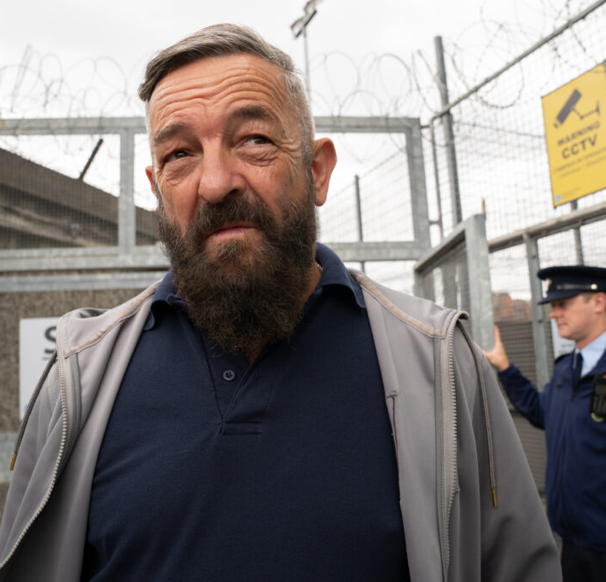
TOP 5 RTÉ PROGRAMMES
May 2023
1 The Late Late Show 26-05-2023
2 Kin 07-05-2023
3 The Sunday Game Live - Limerick v Cork - Hurl:Live 28-05-2023
4 RTE News: Nine O'Clock 28-05-2023
5 The Sunday Game Live - Tipperary v Limerick -:Live 21-05-2023
The Great Pottery Throw Down, Channel 4
Top 5 programmes by station group
Notes:
Top 5 programmes – Channel 4

Slide 6

TOP 5 VIRGIN MEDIA
PROGRAMMES May 2023
1 Coronation Street 2023 08-05-2023
2 Emmerdale 2023 04-05-2023
UCL: Man City v Real Madrid Live
17-05-2023
4 I'm A Celebrity South Africa 10-05-2023
5 Britain's Got Talent S16 2023 06-05-2023
Top 5 programmes by station group.
Notes:
Top 5 programmes – Channel 4

Slide 7

TOP 5 SKY MEDIA
PROGRAMMES May 2023
CORONATION PROGRAMMING 06-05-2023
LIVE PL: BRIGHTON V MAN UNITED
04-05-2023
3 LIVE MIAMI F1 GRAND PRIX 07-05-2023
4 LIVE SNF: LIVERPOOL V BRENTFORD 06-05-2023
5 LIVE MNF: LEICESTER V LIVERPOOL 15-05-2023
Top 5 programmes by station group.
Notes:
Top 5 programmes – Channel 4

Slide 8

TOP 5 4 SALES
PROGRAMMES May 2023
1 GOGGLEBOX 12-05-2023
ANDREW: THE PROBLEM PRINCE
08-05-2023
MARRIED AT FIRST SIGHT AUSTRALIA
08-05-2023
4 TASKMASTER 18-05-2023
5 REBEKAH VARDY: JEHOVAH'S WITNESSES AND M 16-05-2023
Top 5 programmes by station group.
Notes:
Top 5 programmes – Channel 4

Slide 9

TOP 5 VIACOM
PROGRAMMES May 2023
1 FRIENDS 03-05-2023
2 PAW PATROL 03-05-2023
FILM: LETHAL WEAPON (1987)
28-05-2023
4 KANGAROO BEACH 14-05-2023
BLAZE AND THE MONSTER MACHINES
15-05-2023
Top 5 programmes by station group.
Notes:
Top 5 programmes – Channel 4

Slide 10

TOP 5 TG4 PROGRAMMES
May 2023
1 Rugbaí Beo URC 2022- 2023 27-05-2023
2 Munster Rugby - The Brave and the Faithful 27-05-2023
3 GAA BEO 2022 - 2023 17-05-2023
4 Ceol Tíre ón nGrianán 16-05-2023
5 Agnes Brown 27-05-2023
Top 5 programmes by station group
Notes:
Top 5 programmes – Channel 4

