Slide 1
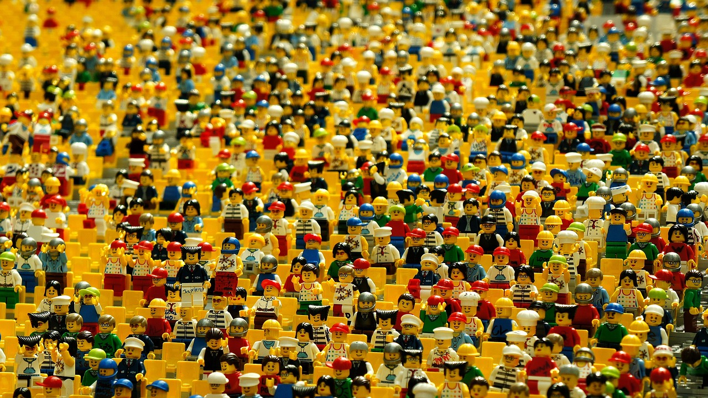

“Ad People” and “Normal People”
2023
“Natural Instincts” – Batiste

Slide 2
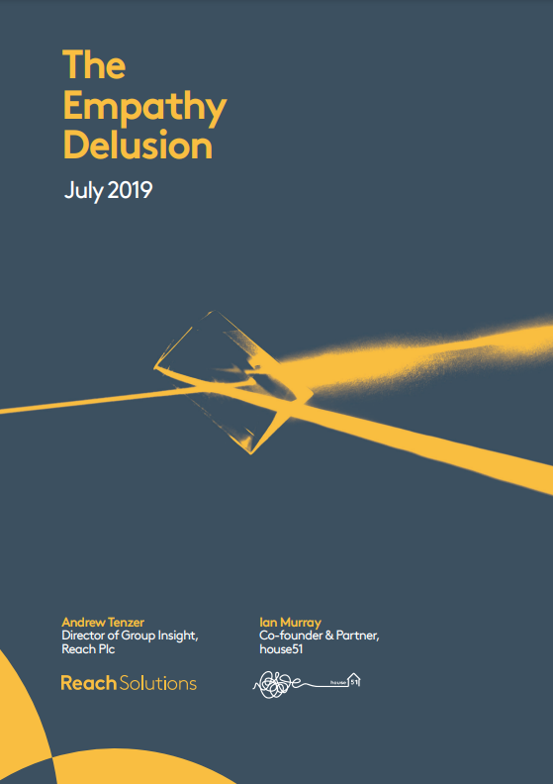
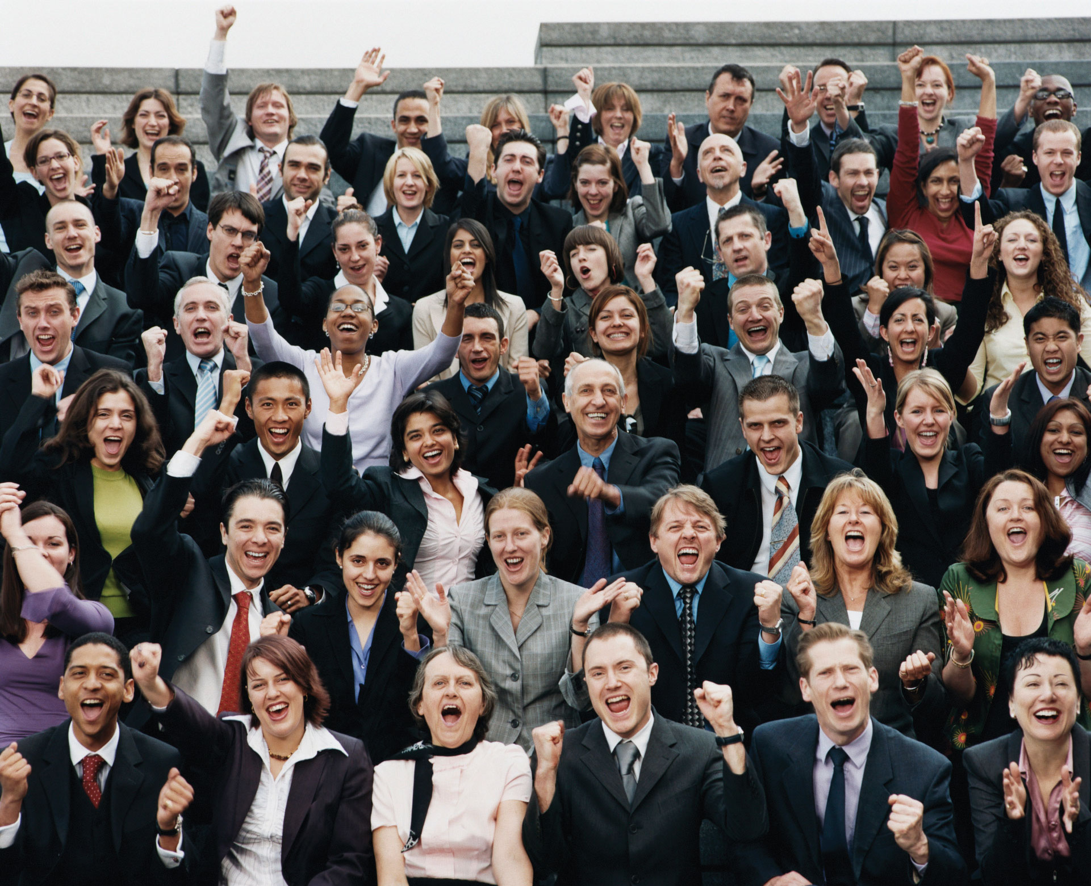
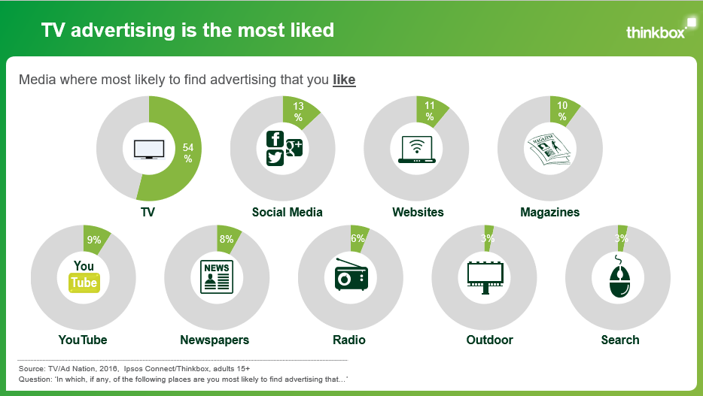
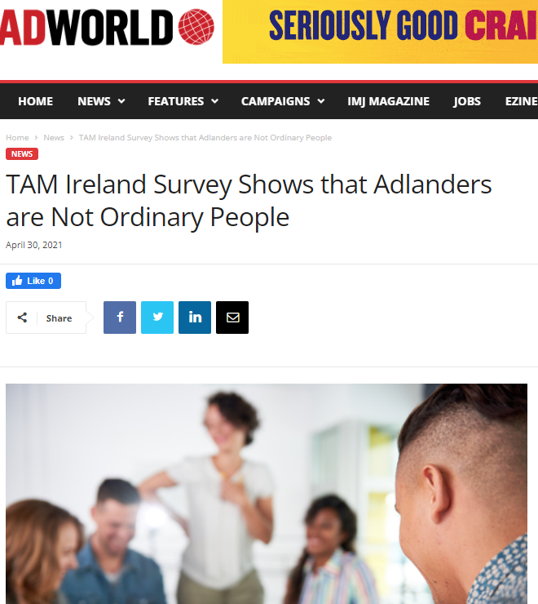
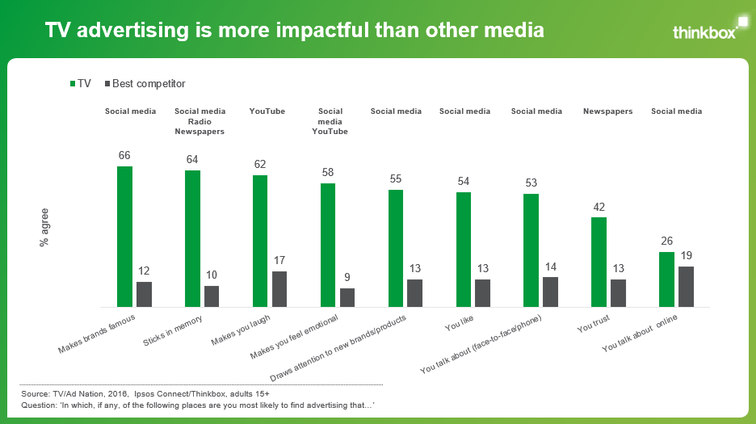
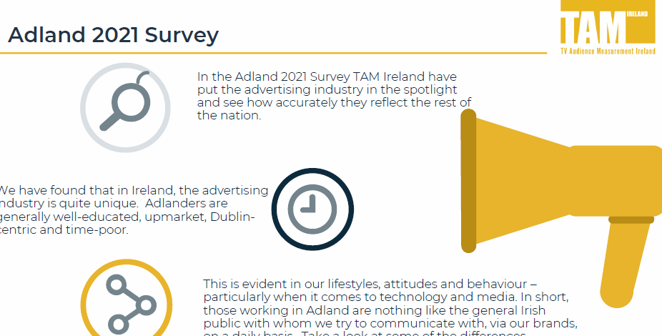




Differences between the ad industry and the general public is an ongoing topic of conversation
‘The Empathy Delusion’
2019
‘Remember: You Are
Not The Target Audience’
Forbes 2019
‘TV Nation / Ad Nation’
2012, 2013, 2014, 2016
‘Adland v TV land
July 2021
Notes:
Differences between the ad industry and the general public is an ongoing topic of conversation. Understanding your audiences is the golden rule within marketing and ensuring that their behaviour is accurately reflected is key. At TAM Ireland, we’ve previously explored this area, having published our Adland V Tvland studies in 2018 and 2021, that explore the differences in media consumption and perception between those who work in media and the average person in Ireland. Similarly, there have been a number of other international ad industry studies, including Thinkboxes Ad Nation studies Newsworks’ ‘Sample of one’ and Reach Solutions ‘The Empathy Delusion.’ Much like our project, these studies sought to have a positive impact on media professionals ability to better estimate the media consumption patterns of the general population versus those working in Advertising
Since our last study back in 2021 there has been even more change to the media landscape. BVOD consumption is growing alongside the rise of subscription streaming services. The way people consume video content is constantly evolving and changing.
We wanted to update our last study to see if the difference between the media consumption habits of the Irish public and media professionals changed

Slide 3


We look at two different groups in this study
‘Normal’
people
Data sourced from:
CSO
B&A
TAM Ireland/Nielsen Media Ireland
Ad
people
Voluntary response survey from the Ad industry (June 2023)

Slide 4




Differences between the two samples
Gender
Age
Region
18-24: | 11%
25-34: | 16%
35-44 | 20%
45-54 | 18%
55-64 | 15%
65+ | 20%
Dublin: | 28%
Rest of Leinster: | 27%
Munster | 27%
Connaught | 11%
Ulster | 6%
Women: | 51%
Men: | 49%
‘Normal’ people
18-24: | 7%
25-34: | 29%
35-44 | 28%
45-54 | 24%
55-64 | 8%
65+ | 1%
Dublin: | 77%
Rest of Leinster: | 20%
Munster | 1%
Connaught | -
Ulster | 2%
Ad
people
Women: | 53%
Men: | 47%
Source: TAM Ireland Adland V TV Land 2023. and CSO Census 2022.
Notes:
With two very different samples in the study, it’s worth noting the demographic breakdown. Whilst the gender split in both samples is relatively equal, ad people are on the younger end of the scale and much more Dublin focused.

Slide 5

Which media services are most commonly accessed by ‘normal’ people and ad people?
“Natural Instincts” – Batiste
Notes:
Which media services are most commonly accessed by ‘normal’ people and Ad people?

Slide 6
The video viewing habits of “normal” people differ widely to those of Ad People
Source: TAM Ireland Adland V TV Land 2023. “Thinking of your average video viewing day what proportion of your time is spend with …”Normal People” source: ?TAM Ireland / Nielsen Media Ireland. Based on Total Video, Average Minutes per Person, Consolidated 7-Days Linear + Streaming, TV Sets and Digital Devices, Adults 15+, May 2023, Mon-Sun 03:00-26:59
Notes:
Broadcast TV services are the most accessed service by ‘normal’ people. From the TAM Ireland Total Video Panel, we can see that for “normal people” 74% of their video viewing day is with Total TV (Live, recorded and BVOD). This was massively ahead of Netflix (7%) and YouTube (8%)
When we delve into the consumption of Ad people their video consumption is more evenly split. They spend 39% of their video viewing day with Total TV-far below what “Normal People” spend.
* The TAM Ireland Total Video Panel is representative of all TV Households and measure all viewing across all devices in the household. This data is actual usage data gathered by the technology installed in the panel homes by Nielsen and is gold standard internationally recognised independent measurement.

Slide 7




Device usage also differs between the two groups
Thinking of your average video viewing day what % of your video time is spent on:
TV Set
Laptop/ PC
Tablet
Smartphone
82%
3%
3%
12%
‘Normal’ people
52%
11%
4%
33%
Ad people
Source: TAM Ireland Adland V TV Land 2023. Normal People” source: ?TAM Ireland / Nielsen Media Ireland. Based on Total Video, Average Minutes per Person, Consolidated 7-Days Linear + Streaming, TV Sets and Digital Devices, Adults 15+, May 2023, Mon-Sun 03:00-26:59
Notes:
The device used to watch content is also an important factor in how people choose to consume content. Unsurprisingly, TV set is the leading device across both samples but there are significant differences in the splits. The Total Video Panel tell us that Adults (“Normal People”) spend 82% of their video viewing day viewing contact on the TV set, however Ad People claim to only spend 52% of their time with video content viewing on the TV set with the smaller smartphone device taking up 33% of their device time. Again this viewing device split does not mirror the general population.

Slide 8
People are underestimating the proportion of Live TV that is viewed
Source: TAM Ireland Adland V TV Land 2023. When watching Broadcaster TV on a TV set on an average DAY, for how many minutes do you think THE AVERAGE IRISH ADULT AGED 15+ watches: Live time/Timeshifted TV. Normal people source TAM Ireland/Nielsen Media Ireland, Total TV, All Platforms Ave Minutes per person, 1st Jan-31st Dec 2022
Notes:
Consuming TV content comprises of various elements, and TV in all its forms plays a large role in our lives. When looking at the proportion of the industry trading current (live and recorded / catch up), it provides a detailed view on how the nation engages with TV.
Ad people claimed that over half of their time of 1 hour 36 minutes a day (56%) spent watching TV was spent watching Live TV. The same question was asked to the sample to predict the behaviour of ‘normal’ people. Ad people predicted that normal people watch TV for a lot longer each day (2 hours 43 minutes) with Live TV accounting for a larger % share (61%) of a normal persons viewing day
Actual data from TAM displays a different story. While Ad peoples expectation of the total number of minutes viewed is quite close to the actual figure (163 minutes versus the actual 153 minutes) the split is very different. Live TV actually accounts for by far the largest share with 75%, whilst recorded / catch up accounts for 25%. Despite the reported claims, live viewing plays a much larger role in the way TV content is consumed, with Ad People considerably underestimating the proportion of live viewing.

Slide 9
Ad People tend to have a much higher use of social media
Source: TAM Ireland Adland V TV Land 2023. “Normal People” source: B&A Techscape May 2022 All Adults 16+
Notes:
With ad people having a higher consumption of streaming services, a similar trend was seen in social media. Looking at platform access Facebook and Whatsapp were the most popular services for ‘normal people’.
However, when compared with ad people, a different story emerges. With Instagram much more popular amongst ad people than normal people. Unsurprisingly, LinkedIn is a hugely popular platform for ad People-4 times more popular amongst ad people than normal people! Ad people consistently had larger usage of social media platforms apart from Facebook which is used more by normal people than ad people.

Slide 10
Ad People tend to have a much higher use of social media –even across more niche sites
Source: TAM Ireland Adland V TV Land 2023. “Normal People” source: ? B&A Techscape May 2022 All Adults 16+
Notes:
Even amongst the smaller more niche social media sites Ad People have a higher usage than Normal people (except for Tinder which normal people use more than Ad people!)

Slide 11

Attitudes to Advertising
“Arrows” – Expedia
Notes:
Attitudes to advertising

Slide 12
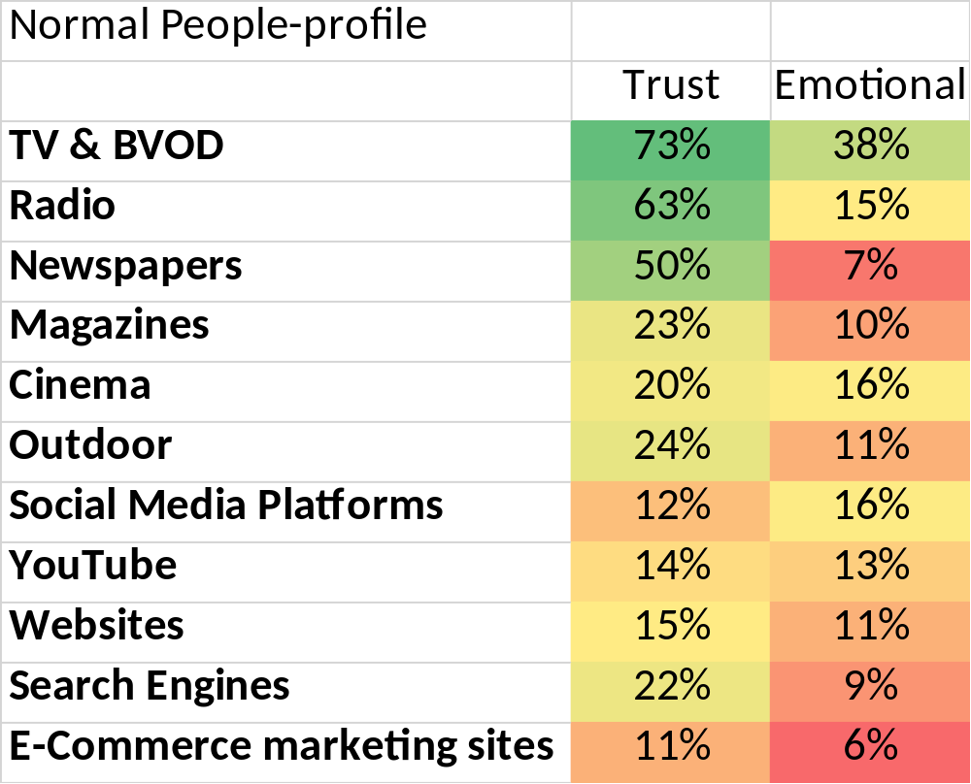





Where do “Normal People” find advertising that they trust and makes them feel emotional
% who agreed with the statement
Source: TAM Ireland Adland V TV Land 2023. “Normal People” data source -2023 Lifestyle Survey TAM Ireland/ Nielsen Media Ireland. Based on National, Consolidated, Total TV, Adults 18+, profile, 1st Jan 2023, Mon-Sun 03:00 - 26:59
Notes:
As we all know there is a wealth of effectiveness data out there that shows how advertising that elicits an emotional response creates a lasting impact. We looked at normal people and their attitudes to advertising to see what channels generated particular outcomes.
When asked what channel they were most likely to find advertising that makes them feel emotional and advertising that they trust, the vast majority of ‘normal’ people selected TV, with over 73% agreeing that they find ads that they trust on TV and 38% claiming that TV ads have the ability to make them feel emotional. Cinema and radio and outdoor also appeared at the top of the list for trust however when looking at how the different media channels performed against the other attributes, TV outperformed all other media.

Slide 13
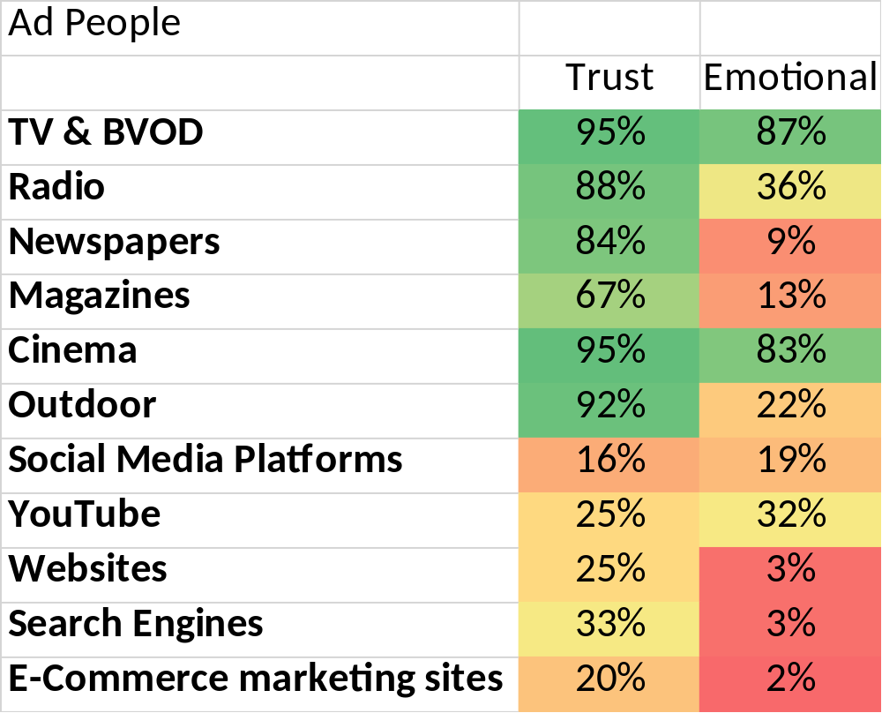
Where do “Ad People” find advertising that they trust and makes them feel emotional
% who agreed with the statement
Source: TAM Ireland Adland V TV Land 2023. “Normal People” data source -2023 Lifestyle Survey TAM Ireland/ Nielsen Media Ireland. Based on National, Consolidated, Total TV, Adults 18+, profile, 1st Jan 2023, Mon-Sun 03:00 - 26:59
Notes:
But how does this compare with ad people’s attitudes to advertising
Looking at all the media channels for both trust and emotion TV is the leading medium for both. Like ‘normal’ people, ad people also selected radio and newspapers as places to find trustworthy advertisements but cinema and outdoor scored higher with them.
When asked about where they were most likely to find advertising that made them feel emotional, TV was also the leading medium for ad people. Interestingly, both groups were also aligned with their selection of media channels, including radio, , social media and cinema as places you are most likely to find emotional advertising.

Slide 14
The importance of understanding your audience
‘Normal’
people
Advertising and media professionals are much more likely to use social media than the average Irish person.
Both “Ad people” and “Normal people” consider TV/BVOD advertising to be the most trusted form of advertising
Ad people underestimate the proportion of live viewing that occurs
Ad people watch much less TV (live, recorded and BVOD) than the general Irish public
Ad people consume video media in a different way to “normal people” and are 3 times more likely to use a mobile for video consumption.
This study reminds us not to look at the world through the prism of our own behaviour.
Ad
people

