Slide 1



As an industry, we’ve never been more aware of how hard it is to get people’s attention and how difficult it is to drive trust and creativity and be unmissable.
With this in mind, TAM Ireland asked Red C Research and Amplified Intelligence to conduct the first ever piece of research on attention across AV in Ireland.

Slide 2

WHY ATTENTION?
Attention is the human-centric principle that determines whether people are really watching ads, both in terms of how long and how focused.
Understanding real-world behaviours is critical to successful campaigns.
Why should we pay attention?
Brand Growth
Effectiveness
Attention has a strong correlation with business outcomes and driving brand growth.
Are humans actually watching? Understand the role of attention in advertising effectiveness and its impact on the bottom line
Mental Availability
Compete for Attention
Understand how ads are processed to help reveal how much attention is needed to create and place distinctive brand assets in order to deliver mental availability.
Understand how we choose to pay attention to one out of multiple sources to help understand how ads can better compete for attention e.g. addition of auditory attention to visual attention.

Slide 3






THE DIFFERENT TYPES OF ATTENTION
Active Attention
Passive Attention
Non Attention
Mobile: Looking directly at the ad
Desktop: Looking directly at the ad
TV: Looking directly at the ad
Mobile: Eyes on screen, not on ad
Desktop: Eyes on screen, not on ad
TV: In the room but not looking at
the TV
Mobile: Eyes not on screen, not on ad
Desktop: Eyes not on screen, not on ad
TV: TV is on but person is not in the room

Slide 4
THE DIFFERENT TYPES OF ATTENTION
We use Active & Passive only for Linear TV given the TV currency doesn’t charge for non-attention.
Active Attention
Passive Attention
Mobile: Looking directly at the ad
Desktop: Looking directly at the ad
TV: Looking directly at the ad
Mobile: Eyes on screen, not on ad
Desktop: Eyes on screen, not on ad
TV: In the room but not looking at
the TV

Slide 5


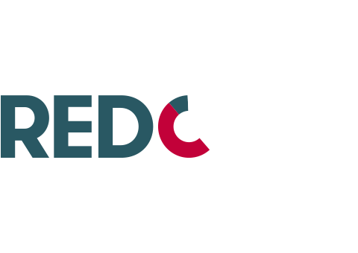




THE ATTENTION STUDY IN IRELAND
A custom TV panel in Ireland to measure human attention
1 month study across linear and VOD
200 home human-gaze panel (Ireland wide
involved in VOD content capture
113 brands collected across 10 Linear Channels
13,013 total adviews collected across all platforms and devices

Slide 6
ACTIVE ATTENTION
% of Active Attention viewing
70%
67%
47%
24%
7%
BVOD mobile
Linear TV
BVOD TV Set
YouTube
Meta
Source: Amplified Intelligence/RedC Ireland Attention to AV Study

Slide 7
THE ATTENTION OPPORTUNITY
Its important not to consider attention in isolation - reach and time spent viewing is important too.
Linear TV captures the largest Share of Attention across all platforms. The Attention Opportunity is the level of attention multiplied by the time spent viewing to each platform
Source: Amplified Intelligence/RedC Ireland Attention Study/ TAM Total videopanel and the Total viewing study done for TAM by Red C (used to split out BVOD mobile, BVOD, and linear share).

Slide 8
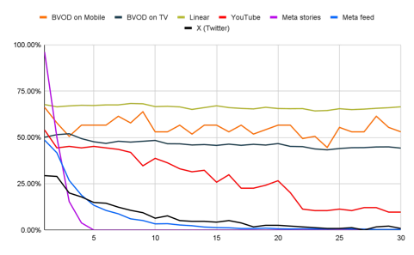
NOT ALL REACH IS EQUAL: ATTENTION DECAY-TV V SOCIALS
Comparing slow and fast decay
Attention levels remain consistent across TV platforms while dropping rapidly on social media platforms.
Competing socials experience rapid drop off within the first 3 seconds with less than 5% of viewers actively watching by the 15sec point
YouTube is a hybrid platform - its doesn’t decay as slowly as TV but its also not as fast as other social media platforms. The biggest thing to watch for with YouTube is skippable ads see a significant drop beyond 6sec mark.
Slow decay means TV is very strong for telling stories and delivering emotional creative so helping to grow mental availability
Source: Amplified Intelligence/RedC Ireland AV Attention Study

Slide 9
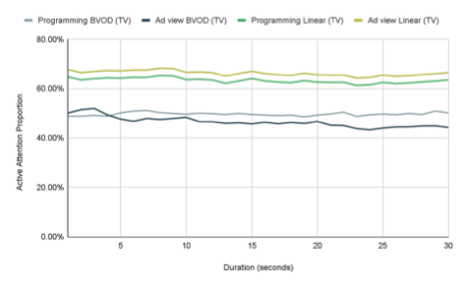
PROGRAMMING VERSUS AD VIEW ATTENTION
To help identify the best performing programmes for attention within the TAM Data
Average Audience over Programme Reach
will give you an estimate of the level of attention across a total programme.
Overall decay difference is only 5pp (avg).
The more popular the content the smaller the gap between attention to programming and attention to ads
Source: Amplified Intelligence/RedC Ireland AV Attention Study

Slide 10

LIGHT VIEWERS ACTIVELY WATCH LINEAR
Light viewers actively watch linear - 30% more active viewing time than average viewers
They have actively chosen TV or BVOD content to view and therefore invest their attention.
Younger male viewers show similar behaviour
LIVE TV
A viewer watches a TV program on the channel it is presented on at its scheduled time.
Eg: if you watch “Fair City” as scheduled on RTÉ One at 7pm on Friday, that is considered a live TV viewing experience.
Source: Amplified Intelligence/RedC Ireland AV Attention Study

Slide 11

LIKELIHOOD TO BUY
Advertising on TV in Ireland increases likelihood to buy by 30%
Key categories such as finance and healthcare see increases of 68% & 21% respectively.
LIVE TV
A viewer watches a TV program on the channel it is presented on at its scheduled time.
Eg: if you watch “Fair City” as scheduled on RTÉ One at 7pm on Friday, that is considered a live TV viewing experience.
Source: Amplified Intelligence/RedC Ireland AV Attention Study

