Slide 1


March 2024
Viewing Trends

Slide 2
WEEKLY REACH: March 2024

Slide 3
TOP 10 ADVERTISERS: March 2024
1: Procter & Gamble
2: Sky
3: Vodafone Ireland
4: Lidl
05: Diageo
10: Reckitt Benckiser
07: Tesco Ireland
08: IKEA
09: McDonalds
06: National Lottery

Slide 4

TOP 5 RTÉ PROGRAMMES
March 2024
1 Guinness Six Nations - England v Ireland:Live 09-03-2024
2 Guinness Six Nations - England v Ireland:Post 09-03-2024
3 Dancing With The Stars 17-03-2024
4 RTÉ News: Six One 01-03-2024
5 RTÉ News: Nine O'Clock 10-03-2024
The Great Pottery Throw Down, Channel 4
Top 5 programmes by station group
Notes:
Top 5 programmes – Channel 4

Slide 5
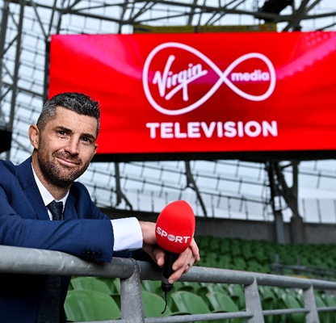
TOP 5 VIRGIN MEDIA
PROGRAMMES March 2024
6 Nations Live Ireland v Scotland
16-03-2024
2 6 Nations Live Trophy Lift 16-03-2024
6 Nations Post Ireland v Scotland
16-03-2024
6 Nations Live Scotland v Italy
09-03-2024
5 Coronation Street 11-03-2024
Top 5 programmes by station group.
Notes:
Top 5 programmes – Channel 4

Slide 6

TOP 5 SKY MEDIA
PROGRAMMES March 2024
LIVE PL: LIVERPOOL V MAN CITY
10-03-2024
LIVE PL: MAN CITY V MAN UNITED
03-03-2024
LIVE SNF: BRENTFORD V MAN UNITED
30-03-2024
LIVE PL: MANCHESTER CITY V ARSENAL
31-03-2024
LIVE PL: LIVERPOOL V BRIGHTON
31-03-2024
Top 5 programmes by station group.
Notes:
Top 5 programmes – Channel 4

Slide 7

TOP 5 4 SALES
PROGRAMMES March 2024
1 GOGGLEBOX 01-03-2024
2 THE GREAT STAND UP TO CANCER BAKE OFF 24-03-2024
THE GREAT POTTERY THROW DOWN
10-03-2024
4 CRUFTS 2024 10-03-2024
5 THE GREAT STAND UP TO CANCER BAKE OFF: 17-03-2024
Top 5 programmes by station group.
Notes:
Top 5 programmes – Channel 4

Slide 8

TOP 5 PARAMOUNT
PROGRAMMES March 2024
1 FRIENDS 29-03-2024
2 FILM: THAT'S MY BOY (2012) 14-03-2024
3 RICH KIDS GO SKINT 20-03-2024
ALVINNN!!! AND THE CHIPMUNKS
13-03-2024
5 FILM: POLICE ACADEMY 2: THEIR FIRST ASSIGNMENT 26-03-2024
Top 5 programmes by station group.
Notes:
Top 5 programmes – Channel 4

Slide 9

TOP 5 TG4 PROGRAMMES
March 2024
1 GAA BEO 2023 - 2024 31-03-2024
2 Rugbaí Beo URC 2023- 2024 22-03-2024
3 GAA GOLD ( Supers Gaeilge) 31-03-2024
4 Contractors 2 21-03-2024
5 Nuacht TG4 2024 30-03-2024
Top 5 programmes by station group
Notes:
Top 5 programmes – Channel 4

