Slide 1


April 2024
Viewing Trends

Slide 2
WEEKLY REACH: April 2024

Slide 3
TOP 10 ADVERTISERS: April 2024
1: Procter & Gamble
2: Unilever
3: Lidl
4: McDonalds
05: Sky
10: Ikea
07: Virgin Media
08: Vodafone Ireland
09: Reckitt Benckiser
06: Diageo

Slide 4

TOP 5 RTÉ PROGRAMMES
April 2024
1 RTÉ News: Nine O'Clock 14-04-2024
2 RTÉ News: Six One 08-04-2024
3 The Tommy Tiernan Show 20-04-2024
The Sunday Game Live - MSHC - Limerick v Tipp:Live
28-04-2024
5 The Late Late Show 26-04-2024
The Great Pottery Throw Down, Channel 4
Top 5 programmes by station group
Notes:
Top 5 programmes – Channel 4

Slide 5
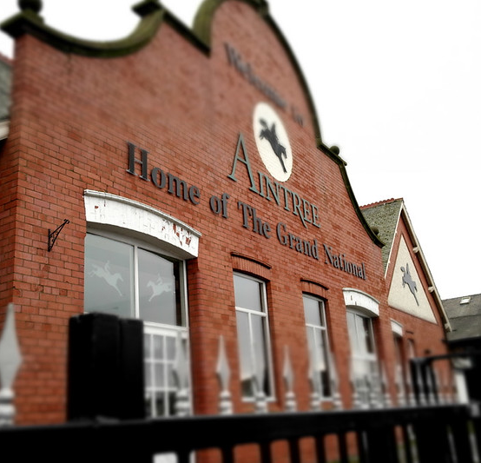
TOP 5 VIRGIN MEDIA
PROGRAMMES April 2024
1 UCL: Man City v Real Madrid Extra time and Pens 17-04-2024
2 Aintree Grand National Live 13-04-2024
3 Coronation Street 01-04-2024
UCL: Man City v Real Madrid Live
17-04-2024
5 Emmerdale 12-04-2024
Top 5 programmes by station group.
This Photo by Unknown Author is licensed under CC BY-NC-ND
Notes:
Top 5 programmes – Channel 4

Slide 6

TOP 5 SKY MEDIA
PROGRAMMES April 2024
LIVE PL: MAN UNITED V LIVERPOOL
07-04-2024
LIVE PL: EVERTON V LIVERPOOL
24-04-2024
BEN & HOLLY'S LITTLE KINGDOM
22-04-2024
4 LIVE MASTERS FINAL ROUND 14-04-2024
LIVE PL: NOTT'M FOREST V MAN CITY
28-04-2024
Top 5 programmes by station group.
Notes:
Top 5 programmes – Channel 4

Slide 7

TOP 5 4 SALES
PROGRAMMES April 2024
1 GOGGLEBOX 26-04-2024
2 THE GREAT STAND UP TO CANCER BAKE OFF 14-04-2024
MARRIED AT FIRST SIGHT AUSTRALIA
08-04-2024
4 THE PIANO 28-04-2024
5 24 HOURS IN A&E 05-04-2024
Top 5 programmes by station group.
Notes:
Top 5 programmes – Channel 4

Slide 8

TOP 5 PARAMOUNT
PROGRAMMES April 2024
BEN & HOLLY'S LITTLE KINGDOM
22-04-2024
2 THE THUNDERMANS 19-04-2024
3 FILM: POLICE ACADEMY 4: CITIZENS ON PATROL (1987) 06-04-2024
4 FRIENDS 1 5-04-2024
5 BLAZE AND THE MONSTER MACHINES
05-04-2024
Top 5 programmes by station group.
Notes:
Top 5 programmes – Channel 4

Slide 9

TOP 5 TG4 PROGRAMMES
April 2024
1 GAA BEO 2023 - 2024 06-04-2024
2 Contractors 2 04-04-2024
3 Rugbaí Beo URC 2023- 2024 27-04-2024
4 Glór Tíre 20 23-04-2024
5 The BodyGuard 1992 06-04-2024
Top 5 programmes by station group
Notes:
Top 5 programmes – Channel 4

