Slide 1
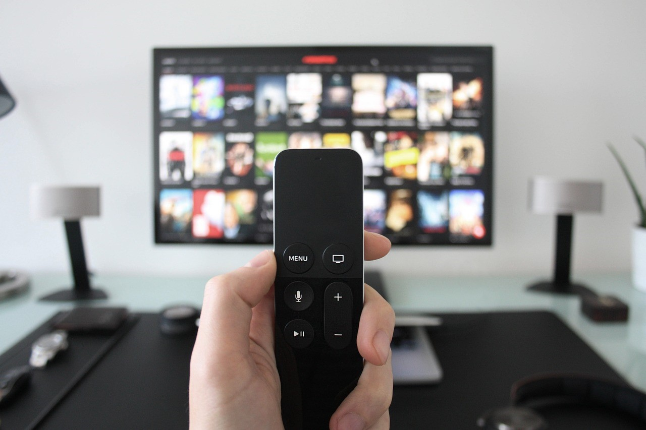

July 2024
Viewing Trends

Slide 2
WEEKLY REACH: July 2024

Slide 3
TOP 10 ADVERTISERS: July 2024
1: Procter & Gamble
2: Unilever
3: Tesco Ireland
4: Lidl
05: Reckitt Benckiser
10: Virgin Media
07: Aldi
08: Vodafone Ireland
09: PTSB
06: Mars Ireland

Slide 4

TOP 5 RTÉ PROGRAMMES
July 2024
1 The Sunday Game Live - SHCF - Clare v Cork:Live 21-07-2024
2 UEFA Euro 2024 - Final - Spain v England:Live 14-07-2024
3 The Sunday Game Live - SFCF - Armagh v Galway:Live 28-07-2024
4 UEFA Euro 2024 - SF2 - Netherlands v England:Live 10-07-2024
5 The Sunday Game Live - SHCF - Clare v Cork:Post 21-07-2024
The Great Pottery Throw Down, Channel 4
Top 5 programmes by station group
Notes:
Top 5 programmes – Channel 4

Slide 5

TOP 5 VIRGIN MEDIA
PROGRAMMES July 2024
1 Emmerdale 24-07-2024
2 Coronation Street 22-07-2024
3 Love Island S11 04-07-2024
4 News at 5:30 24-07-2024
5 Celebrity Catchphrase 05-07-2024
Top 5 programmes by station group.
Notes:
Top 5 programmes – Channel 4

Slide 6
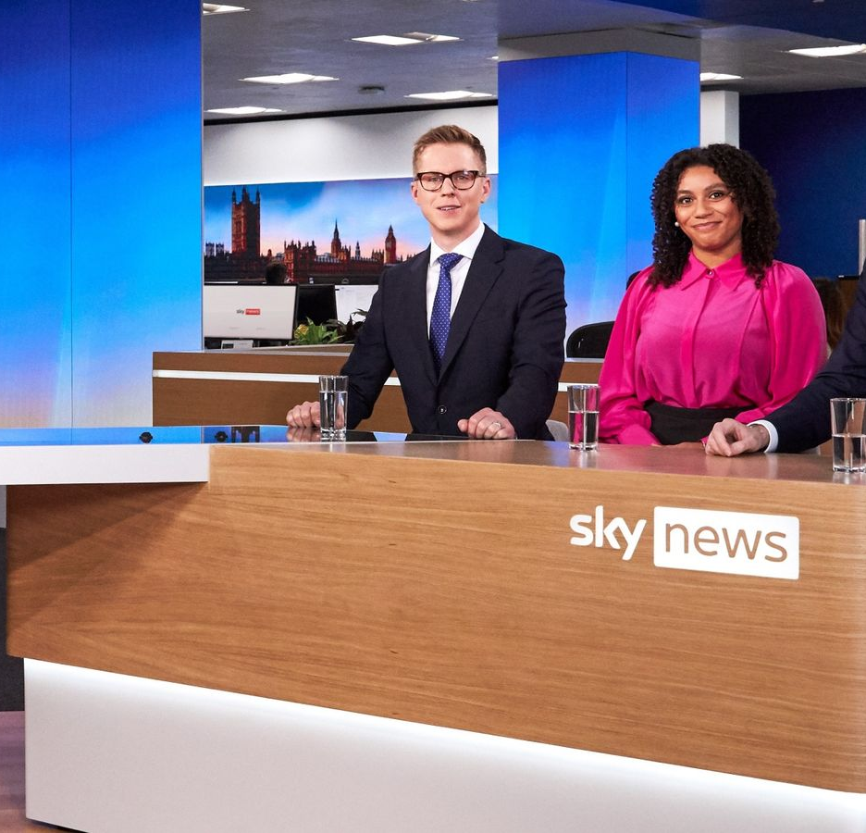
TOP 5 SKY MEDIA
PROGRAMMES July 2024
LIVE INT RUGBY: SA V IRE 2ND TEST
13-07-2024
2 LIVE BRITISH F1 GRAND PRIX 07-07-2024
3 SKY NEWS 21-07-2024
LIVE OPEN CHAMPIONSHIP ROUND 3
20-07-2024
LIVE INT RUGBY: AUS V WAL 1ST TEST
06-07-2024
Top 5 programmes by station group.
Notes:
Top 5 programmes – Channel 4

Slide 7
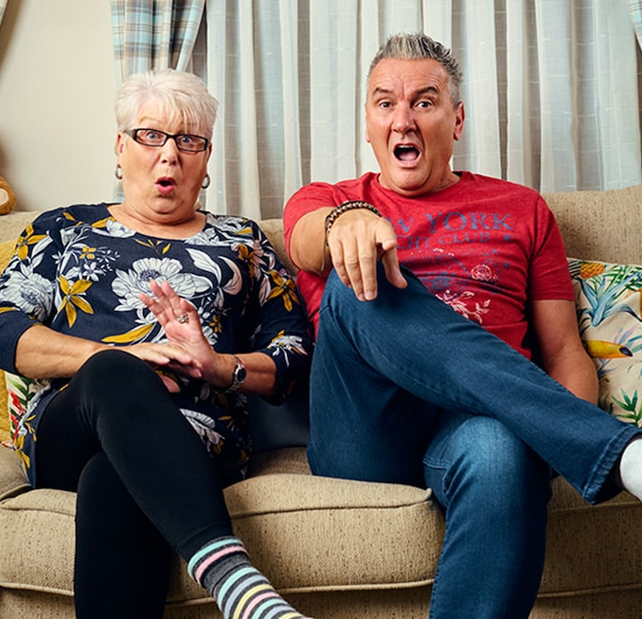
TOP 5 4 SALES
PROGRAMMES July 2024
1 CELEBRITY GOGGLEBOX 12-07-2024
2 SAUCY! SECRETS OF THE BRITISH SEX COMEDY 28-07-2024
3 LIVE: F1 BRITISH GRAND PRIX 07-07-2024
SURGEONS: LIFE IN THEIR HANDS
28-07-2024
5 GOGGLEBOX 19-07-2024
Top 5 programmes by station group.
Notes:
Top 5 programmes – Channel 4

Slide 8

TOP 5 PARAMOUNT
PROGRAMMES July 2024
1 THE PATRICK STAR SHOW 31-07-2024
2 SPONGEBOB SQUAREPANTS 31-07-2024
BEN & HOLLY'S LITTLE KINGDOM
02-07-2024
4 PAW PATROL 07-07-2024
5 THE SMURFS 03-07-2024
Top 5 programmes by station group.
Notes:
Top 5 programmes – Channel 4

Slide 9

TOP 5 TG4 PROGRAMMES
July 2024
1 Opry le Daniel 9 23-07-2024
2 Peil na mBan Beo 2024 20-07-2024
3 Hector: Ó na Philippines go dtí na Solomons 11-07-2024
4 The Professionals 1966 26-07-2024
5 Opry le Daniel 10 30-07-2024
Top 5 programmes by station group
Notes:
Top 5 programmes – Channel 4

