Slide 1


December 2024
Viewing Trends

Slide 2
AVE WEEKLY REACH: December 2024

Slide 3
AVERAGE DAILY MINUTES: December 2024

Slide 4

TOP 5 RTÉ PROGRAMMES
December 2024
1 The Late Late Toy Show 06-12-2024
2 RTÉ News: Nine O'Clock 06-12-2024
3 New Year's Eve Live 31-12-2024
4 RTÉ News: Six One 01-12-2024
5 Mrs Brown's Boys 31-12-2024
The Great Pottery Throw Down, Channel 4
Top 5 programmes by station group
Notes:
Top 5 programmes – Channel 4

Slide 5

TOP 5 VIRGIN MEDIA
PROGRAMMES Dec 2024
1 I'm a Celebrity... Get Me Out Of Here! 2024 08-12-2024
2 Coronation Street 16-12-2024
3 Emmerdale 16-12-2024
4 News at 5:30 05-12-2024
I'm A Celebrity... Get Me Out Of Here! Coming Out 16-12-2024
Top 5 programmes by station group.
Notes:
Top 5 programmes – Channel 4

Slide 6
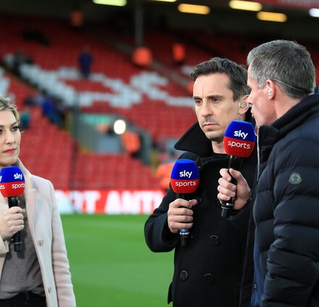
TOP 5 SKY MEDIA
PROGRAMMES Dec 2024
LIVE PL: LIVERPOOL V MAN CITY
01-12-2024
2 PREMIER LEAGUE 2024/25 26-12-2024
3 LIVE PL: MAN CITY V MAN UNITED 15-12-2024
4 LIVE PL: TOTTENHAM V CHELSEA 08-12-2024
LIVE EFL CUP: TOTTENHAM V MAN UTD
19-12-2024
Top 5 programmes by station group.
Notes:
Top 5 programmes – Channel 4

Slide 7

TOP 5 4 SALES
PROGRAMMES Oct 2024
1 GOGGLEBOX 13-12-2024
2 THE GREAT BRITISH BAKE OFF CHRISTMAS SPECIAL 24-12-2024
3 CELEBRITY GOGGLEBOX 20-12-2024
BIG FAT QUIZ OF THE YEAR 2024
27-12-2024
5 GOGGLEBOX 23-12-2024
Top 5 programmes by station group.
This Photo by Unknown Author is licensed under CC BY-NC-ND
Notes:
Top 5 programmes – Channel 4

Slide 8

TOP 5 PARAMOUNT
PROGRAMMES Dec 2024
1 MR. BEAN 31-12-2024
2 THE BEST OF MR BEAN 31-12-2024
3 FRIENDS 22-12-2024
4 MICHAEL MCINTYRE: HAPPY & GLORIOUS 25-12-2024
FILM: WE'RE THE MILLERS (2013)
8-12-2024
Top 5 programmes by station group.
Notes:
Top 5 programmes – Channel 4

Slide 9

TOP 5 TG4 PROGRAMMES
Dec 2024
1 Rugbaí Beo URC 2024- 2025 27-12-2024
2 GAA BEO 2023 - 2024 15-12-2024
3 An Cailín Ciúin 25-12-2024
4 Mrs. Doubtfire 31-12-2024
The Foster & Allen Request Show
26-12-2024
Top 5 programmes by station group
Notes:
Top 5 programmes – Channel 4

