Slide 1


SIGNALLING:
MEDIA’S X-FACTOR
Looking at the mental impact of media channels on Irish consumers

Slide 2

SIGNALLING IS A POWERFUL FORCE
Notes:
Signaling is a powerful force. It’s the motivation to buy flash, rather than functional cars; it’s the reason a peacock has an exuberant but impractical tail, and it’s the driver behind designers adorning Hollywood heavyweights with their latest red-carpet creations.
But what does this have to do with media? Usually, the focus on quantifying media quality has centred on physical measures: dwell time, shared viewing, viewability and more recently attention. All of these are reasonably well-developed datasets but none are a panacea.

Slide 3

HOW WE THINK ABOUT MEDIA GREATLY EFFECTS OUR PERCEPTIONS OF A CAMPAIGN
Notes:
The principle of media signaling suggests that the perceived cost and scale of an advertising channel can enhance brand attributes in the eyes of the consumer.
International research has identified that the media channels you select can impact the brand message your audience receives. However, there is relatively little Irish focused research out there to help us understand and quantify those effects. We wanted to understand how these signals differ between advertising channels and how planners can use them to optimum effect for their brands.

Slide 4
METHODOLOGY
TAM Ireland worked with Red C Research, in conjunction with Richard Shotton on this project. We also drew on work done in other markets.
The research was conducted with a large random representative survey of all adults aged 18+. The sample achieved was over 2700 interviews.
Aim was to develop and run a study to deliver clear insights on the impact of signalling in the Irish market.

Slide 5
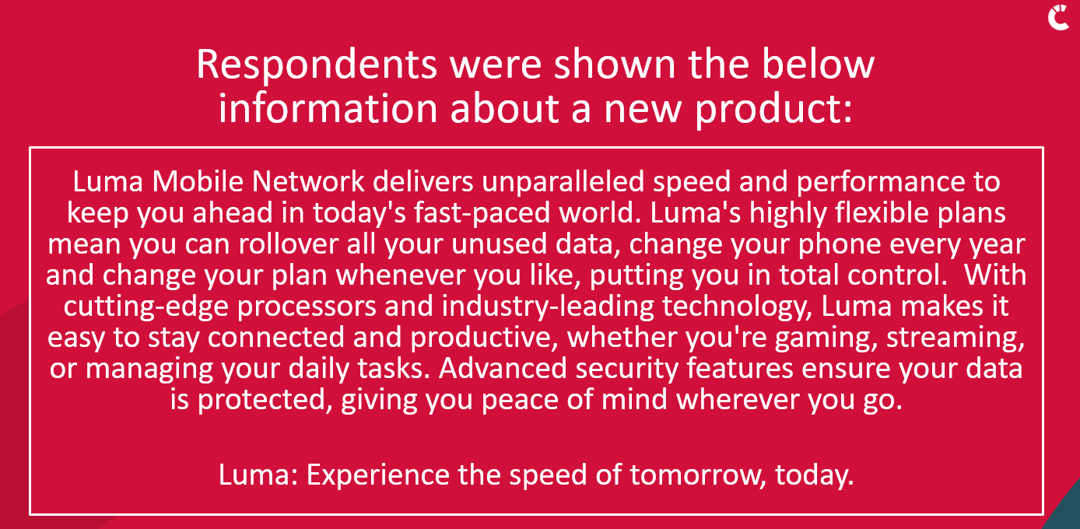
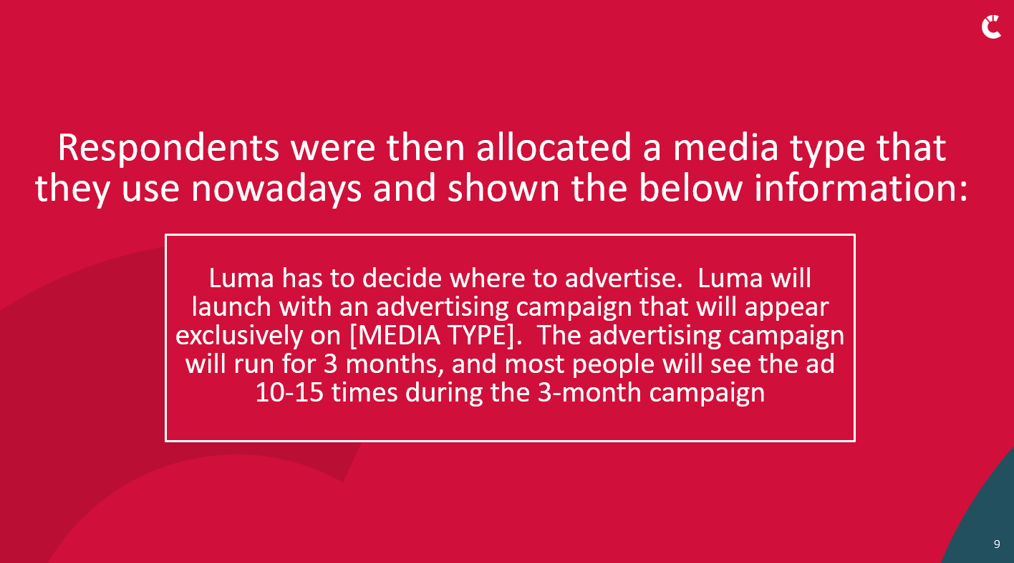
METHODOLOGY
PRODUCT PROPOSITION
ADVERTISING DESCRIPTION
Notes:
The research methodology took the form of an experimental design, inspired by US academic research from Duke and Stanford universities. Each respondent was presented with a description of a fictionalised brand alongside a brief outline of its launch advertising campaign. The respondent was then asked to answer a series of perception statements in relation to this brand, based solely on its description and proposed launch campaign. This technique strips away all factors but media
In each case, all information was identical except for the medium being used in the campaign. This allowed isolation of the ‘signalling effect’ of the media channel used, as all other variables were identical for each respondent.

Slide 6

KEY FINDINGS

Slide 7


KEY FINDINGS
FITNESS SIGNALS:
-Confidence (in the product)
-Financial Strength
-Quality
SOCIAL SIGNALS:
-Reliable
-Believability
-Accepted/likeable
Notes:
Statements asked within the study were split into two groups based on the type of signal communicated:
‘Fitness’ signals cover the perceived brand quality, financial strength of the company and the company’s confidence in their brand. The first of those are ‘fitness’ signals. For example, for an advertiser to spend large amounts of money on advertising, it is likely that their business is financially viable and that there is a level of confidence in their product or service. Many people understand that advertising on TV in Ireland is regulated, so there is also a perception that the advertiser’s claims must stand up to scrutiny.
‘Social’ signals cover the brand’s perceived believability, likeability or expectations/reliability,
The findings in the following tables show the % of respondents positively scoring the brand, or agreeing with statements in relation to the brands. The ‘fitness’ and ‘social’ signals are composite averages of the metrics listed above.

Slide 8
FITNESS SIGNALS: TV ads deliver quality, confidence and strength signals
% positively agree(net 6-7) to statements
Source: Signalling: Media’s X-Factor 2025 TAM Ireland /Red C 2025 (Base: All aged 15+; n=2,710)
Notes:
When participants were told that the ad campaign would run on TV, their perception scores for ‘fitness’ signals were significantly higher than average.
50% of respondents rated brands that advertised on TV as financially strong. The next best performing advertising channel at signalling financial strength was cinema at 34%,
Brands advertising on video sharing sites, podcasts and social media scored lower in ‘fitness’ signals. Only 26% perceived brands advertising on social media as ‘high quality’. This compared with video sharing sites at 29% and the top performing medium, TV, at 43%. Proximity to quality boosts appeal The image of a brand is influenced by what surrounds it — it’s called the mere proximity effect. If a brand advertises alongside high-status companies, it’ll be perceived as more appealing. Compared to social media, TV requires a relatively large up-front investment. There’s little risk of being surrounded by cheap products — so TV can be effective simply because of the company a brand keeps

Slide 9
SOCIAL SIGNALS: TV ads deliver likeability, believability and reliability signals
% positively agree(net 6-7) to statements
Source: Signalling: Media’s X-Factor 2025 TAM Ireland /Red C 2025 (Base: All aged 15+; n=2,710)
Notes:
TV advertising helps brands to be perceived as believable, reliable and likeable.
27% rated brands advertising on TV as being believable, slightly ahead of podcasts 24%. Social media is least likely to signal believability at 19%
TV also helps signal a brands reliability with it coming out on top at 23%

Slide 10
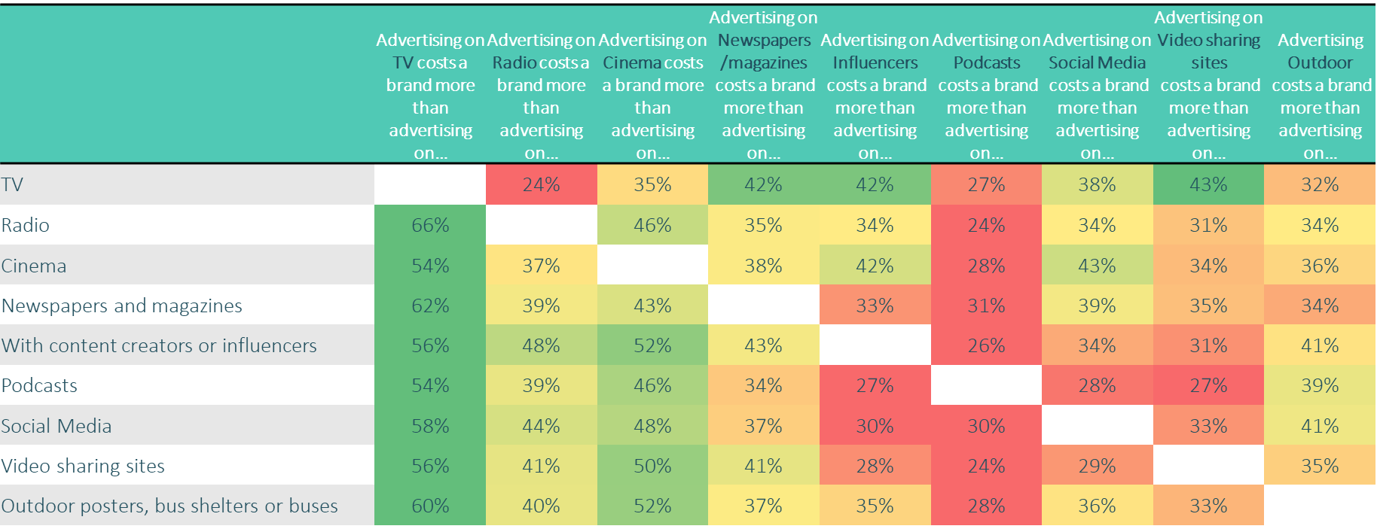
COST SIGNALS: TV ads are seen as relatively costly, which signals quality
Source: Signalling: Media’s X-Factor 2025 TAM Ireland /Red C 2025 (Base: All aged 15+; n=2,710)
Notes:
Richard Shotton states that trust in a brand is connected to the perceived expense of its marketing, and he argues that the credibility of a communication is in proportion to its perceived expense. This is relevant to media selection as viewers instinctively understand – or at least believe – that TV advertising has higher capital costs than media such as radio or print.
Compared to social media for example, TV requires a relatively large up-front investment. There’s little risk of being surrounded by cheap products — so TV can be effective simply because of the company a brand keeps.
TV perceived as a costly, therefore impactful medium
Strong linkage between medium used to advertise and consumer perceptions, underpinned by perceived cost of said platform. TV advertising is seen as most expensive, and this positively impacts on brand perceptions.
Strong correlation in spend and quality perceptions
Campaign spend is influential in perceptions of quality; if a brand spends less than average on an advertising campaign, this proves detrimental in terms of quality perceptions, however when the industry standard is reached, quality perceptions improve dramatically.

Slide 11
COST SIGNALS: Campaign spend is influential in perceptions of quality
Source: Signalling: Media’s X-Factor 2025 TAM Ireland /Red C 2025 (Base: All aged 15+; n=2,710 But how much do you think it would approximately cost Luma to advertise on XX for 3 months. There are no right or wrong answers, we are just interested in your impressions
Notes:
Strong correlation in spend and quality perceptions
Campaign spend is influential in perceptions of quality; TV significantly over indexes on top tier of spend

Slide 12
TRUST SIGNALLING: TV scores highest
Don’t Trust At All
Mean Score
4.77 | 4.55 | 4.66 | 4.63 | 4.4 | 4.49 | 4.41 | 4.39 | 4.35
Source: TAM Ireland /Red C Signalling Research 2024, (And overall, how much would you trust Luma to deliver on the promises made in this description? (Base: All aged 15+; n=2,710)
Notes:
In line with other research, brands advertised on TV were viewed as the most likely to deliver on their claims. Cinema and radio followed closely behind.
Trust in video sharing sites, however, was significantly lower

Slide 13
MASS MARKET SIGNALLING: TV scores highest
Mean Score
59.89 | 53.53 | 42.20 | 48.02 | 49.98 | 39.98 | 55.67 | 52.28 | 50.81
Source: TAM Ireland /Red C Signalling Research 2024, (And overall, how much would you trust Luma to deliver on the promises made in this description? (Base: All aged 15+; n=2,710)
Notes:
TV was perceived as having the broadest reach of any media and we know from studies by the likes of Binet and Field that reach and fame are inherently linked.
When it comes to TV advertising, we know that many other people are seeing the same thing we are, at the same time. Other video platforms have appropriated the language of ‘social’ and ‘community’. However, the reality of hypertargeting and personalisation on social and video-sharing platforms is that people have no idea what advertising other people like them are seeing, or what information they are receiving about a brand. This means that social media and video-sharing platforms are much less effective than TV at building ‘common knowledge and cultural meaning’. That is why TV remains the best way to build popular, mass market consumer brands.

Slide 14
FITNESS SIGNALS FOR 15-34s: TV dominates. Stature matters even to younger audiences
% positively agree(net 6-7) to statements
Source: Signalling: Media’s X-Factor 2025 TAM Ireland /Red C 2025 (Base: NET 15-34 age group.)
Notes:
Stature matters even to younger audiences

Slide 15
SOCIAL SIGNALS FOR 15-34s: TV still conveys something extra
% positively agree(net 6-7) to statements
Source: Signalling: Media’s X-Factor 2025 TAM Ireland /Red C 2025 (Base: NET 15-34 age group.)
Notes:
Whether we look at all adults or ads 15-34 this research has found that public media, most associated with non-addressable messaging, said the most about the brand. Even amongst 15-34s, TV scores the most strongly. Podcasts also perform strongly
Generally speaking, like adults 15+, Irish youth aged 15-34 see media which is public and shared as being stronger than more addressable, one-to-one channels.

Slide 16
SIGNALLING: MEDIA’S X-FACTOR
-TV advertising is seen as most expensive, and this positively impacts on brand perceptions.
-TV advertising is stronger than other media in signaling brand fitness, quality and strength.
-People intuitively understand that TV advertising is seen by many people
-This data shows that TV advertising in Ireland remains a strong source of differentiation on attributes like quality and reliability, that ladder up to overall perceptions of brand fitness and trust.
-Generally speaking, similar to adults 15+, Irish youth aged 15-34 see media which is public and shared as being stronger than more addressable, one-to-one channels.

