Slide 1


February 2025
Viewing Trends

Slide 2
AVE WEEKLY REACH: February 2025

Slide 3
TOP 10 ADVERTISERS: February 2025
1: Procter & Gamble
2: Sky
3: Unilever
4: Nestle
05: L’Oréal
10: Reckitt Benckiser
07: Bank of Ireland
08: Allied Irish Banks
09: Heineken Ireland
06: Dunnes Stores

Slide 4

TOP 5 RTÉ PROGRAMMES
February 2025
1 Guinness Six Nations - Scotland v Ireland:Live 09-02-2025
2 Guinness Six Nations - Scotland v Ireland:Post
09-02-2025
3 RTÉ News: Nine O'Clock 09-02-2025
4 Dancing With The Stars 23-02-2025
5 RTÉ News: Six One 09-02-2025
The Great Pottery Throw Down, Channel 4
Top 5 programmes by station group
Notes:
Top 5 programmes – Channel 4

Slide 5
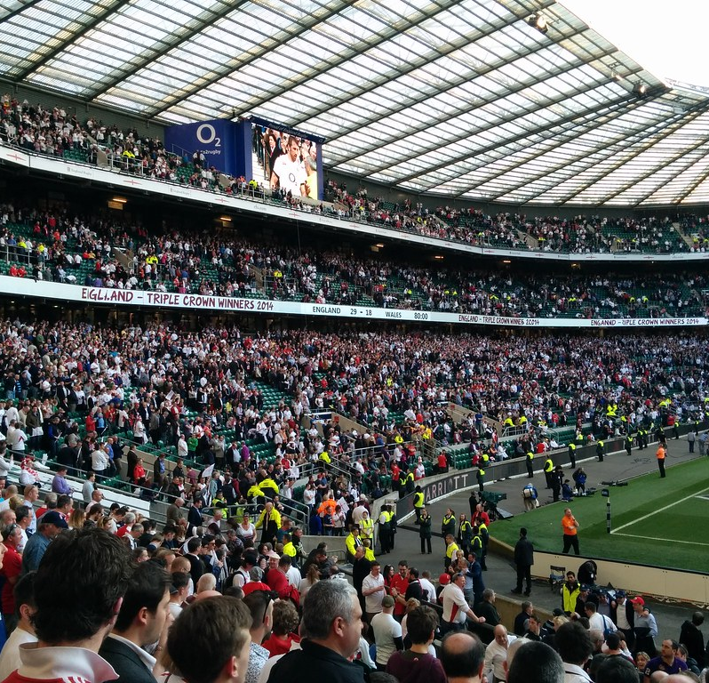
TOP 5 VIRGIN MEDIA
PROGRAMMES February 2025
6 NATIONS LIVE IRELAND V ENGLAND
01-02-2025
2 6 NATIONS: WALES V IRELAND LIVE 22-02-2025
6 NATIONS POST IRELAND V ENGLAND
01-02-2025
6 NATIONS LIVE ENGLAND V FRANCE
08-02-2025
5 6 NATIONS: WALES V IRELAND POST 22-02-2025
Top 5 programmes by station group.
This Photo by Unknown Author is licensed under CC BY-SA-NC
Notes:
Top 5 programmes – Channel 4

Slide 6
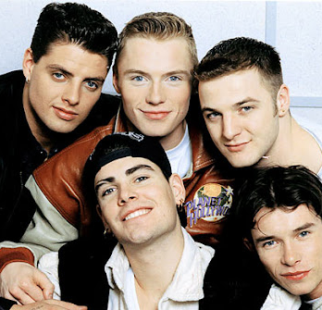
TOP 5 SKY MEDIA
PROGRAMMES February 2025
LIVE PL: MAN CITY V LIVERPOOL
23-02-2025
LIVE PL: TOTTENHAM V MAN UNITED
16-02-2025
LIVE PL: ARSENAL V MANCHESTER CITY
02-02-2025
UEFA CHAMPIONS LEAGUE 2024/25
11-02-2025
5 BOYZONE: NO MATTER WHAT 02-02-2025
Top 5 programmes by station group.
This Photo by Unknown Author is licensed under CC BY-NC-ND
Notes:
Top 5 programmes – Channel 4

Slide 7

TOP 5 4 SALES
PROGRAMMES February 2025
THE GREAT POTTERY THROW DOWN
09-02-2025
2 GOGGLEBOX 21-02-2025
3 GOGGLEBOX 13-02-2025
KIRSTIE AND PHIL'S LOVE IT OR LIST IT
12-02-2025
5 A PLACE IN THE SUN 21-02-2025
Top 5 programmes by station group.
Notes:
Top 5 programmes – Channel 4

Slide 8

TOP 5 PARAMOUNT
PROGRAMMES February 2025
BEN & HOLLY'S LITTLE KINGDOM
06-02-2025
2 FRIENDS 19-02-2025
3 DORA 19-02-2025
4 PAW PATROL 19-02-2025
5 TEEN MOM: THE NEXT CHAPTER 12-02-2025
Top 5 programmes by station group.
Notes:
Top 5 programmes – Channel 4

Slide 9

TOP 5 TG4 PROGRAMMES
February 2025
1 GAA BEO 2024 - 2025 23-02-2025
2 Rugbaí Beo URC 2024- 2025 28-02-2025
3 Seo é Joe Dolan 25-02-2025
4 The Man from Laramie 14-02-2025
5 Opry le Daniel i gConnachta 11-02-2025
Top 5 programmes by station group
Notes:
Top 5 programmes – Channel 4

