Slide 1
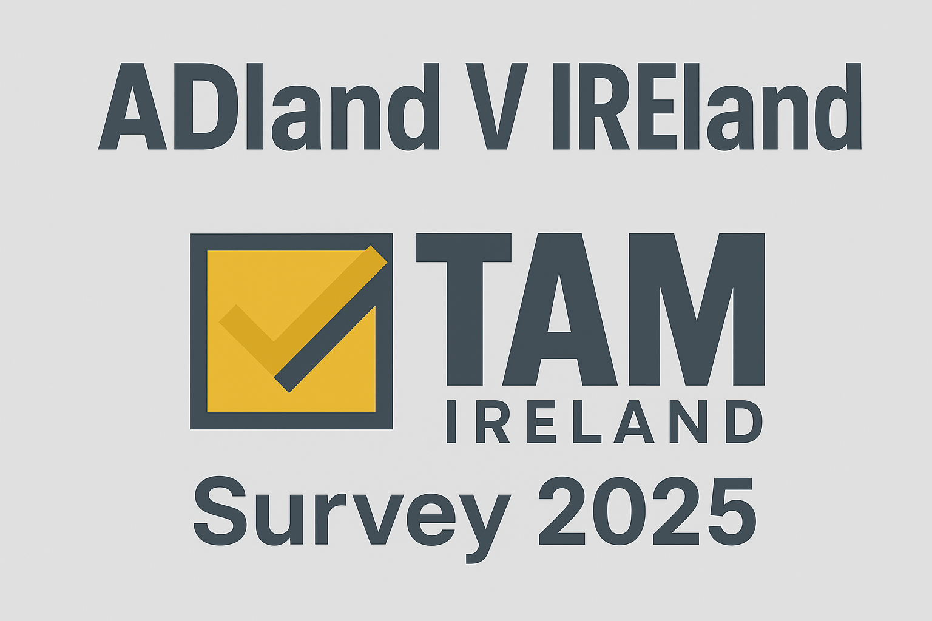



Slide 2

Adland V Ireland-An Overview
This report sets out to find out what differences, if any, there are between the general public (“IREland”) and ad industry professionals (“ADland”) in 2025.
Results regarding our lifestyle, device ownership and media consumption were compared to research for the average population to show what contrast there is between “the advertising industry bubble” and the “average everyday Irish person.”
The goal of this report is to determine if we let our own unique lifestyle and media consumption habits inadvertently affect our views.

Slide 3

Who Are Our Advertising
Community Respondents?

Slide 4
44% of respondents have a planning or buying role at work
Q: Which one of these best describes your primary function at work?
Source: TAM Ireland Adland V IREland Survey 2025

Slide 5
Adland skews younger than the general population
Q: What age bracket are you? Adland
Q: What age bracket are you? Ireland
Source: TAM Ireland Adland V IREland Survey 2025 and CSO Census 2022

Slide 6
Adland reside primarily in Dublin
Q: Where do you usually live? Adland
Q: Where do you usually live? Ireland
Source: TAM Ireland Adland V IREland Survey 2025 and CSO Census 2022

Slide 7
Adland is not as diverse as Ireland
Q: What is your ethnic group/background? Adland
Source: TAM Ireland Adland V IREland Survey 2025 and CSO Census 2022

Slide 8
Adland is not as diverse as Ireland
Q: What is your ethnic group/background?
Source: TAM Ireland Adland V IREland Survey 2025 and CSO Census 2022

Slide 9
Demographically Adland is different to the average Irish person-does this affect media and device usage?

Slide 10
Adland more likely to own and have multiples of every major device
Q: How many TV sets are in your household (in working order)?
Source: TAM Ireland Adland V IREland Survey 2025 and Nielsen Establishment Survey July 2025. Base: All Households

Slide 11
Adland more likely to own and have multiples of every major device
Q: How many game consoles are in your household (in working order)?
Source: TAM Ireland Adland V IREland Survey 2025 and Nielsen Establishment Survey July 2025 Base: All Households

Slide 12
Adland more likely to own and have multiples of every major device
Q: How many smartphone are actively used in your household
Source: TAM Ireland Adland V IREland Survey 2025 and Nielsen Establishment Survey July 2025. Base: All Households

Slide 13
Adland more likely to own and have multiples of every major device
Q: How many tablet devices are actively used in your household
Source: TAM Ireland Adland V IREland Survey 2025 and Nielsen Establishment Survey July 2025. Base: All Households

Slide 14
Adland are more likely to invest in Smart TV’s
Q: Are any of your TV sets a Smart TV?
Source: TAM Ireland Adland V IREland Survey 2025 and Nielsen Establishment Survey July 2025. Base: All Households

Slide 15
Compared to the public, Adland are huge consumers of social media
Q: Which of the following, if any, do you ever use now a days
Source: TAM Ireland Adland V IREland Survey 2025 and B&A Techscape June 2024 (base all adults 16+)

Slide 16
Adland aren’t are interested in online dating sites!
Q: Which of the following, if any, do you ever use now a days
Source: TAM Ireland Adland V IREland Survey 2025 and B&A Techscape June 2024 (base all adults 16+)

Slide 17
Does Adland’s unique media preferences skew perceptions of the general public’s media usage?

Slide 18

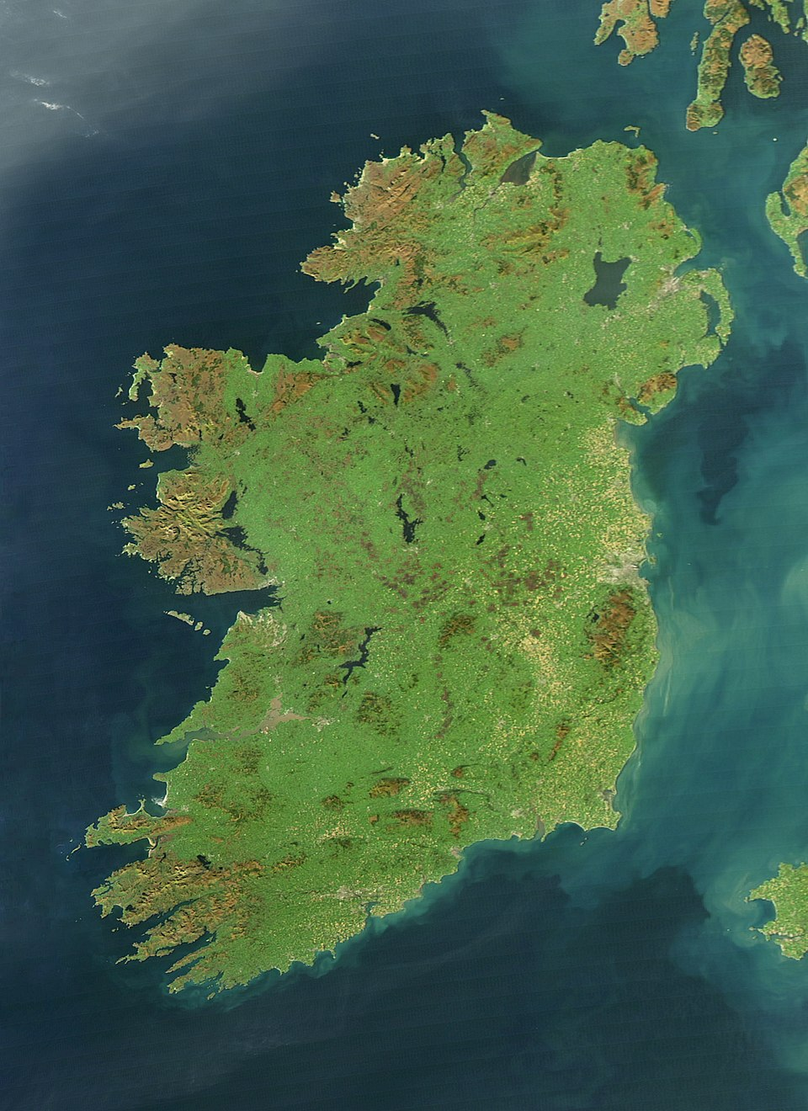
Perception V Reality
In our survey we asked our Adland respondents to provide two separate responses to our media consumption questions:
Self-Reported
Estimated
«What do you do»
«What you think an averge Irish person does»
Then we compared Adland’s responses against the general population’s “real” media consumption via TAM Ireland/Nielsen data

Slide 19
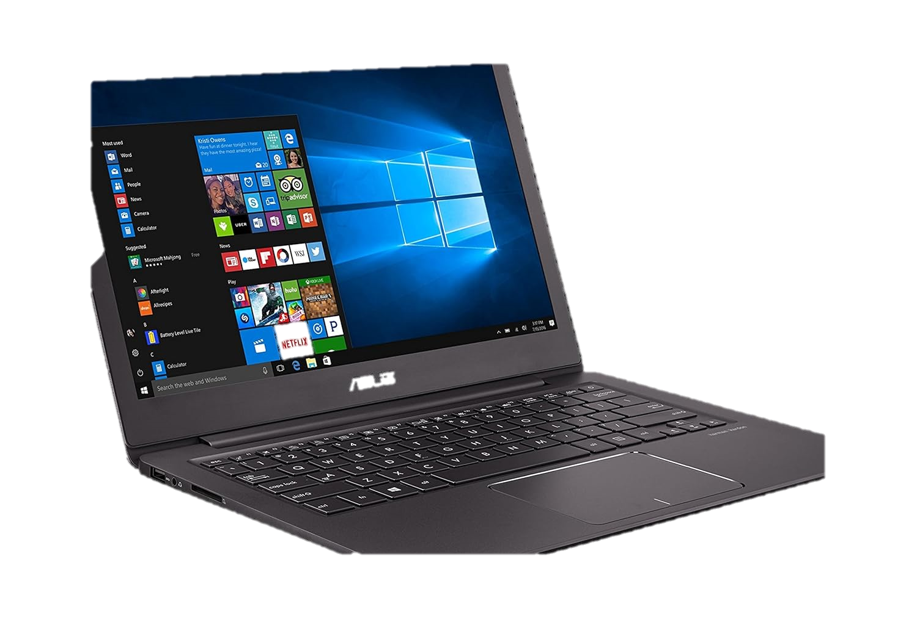

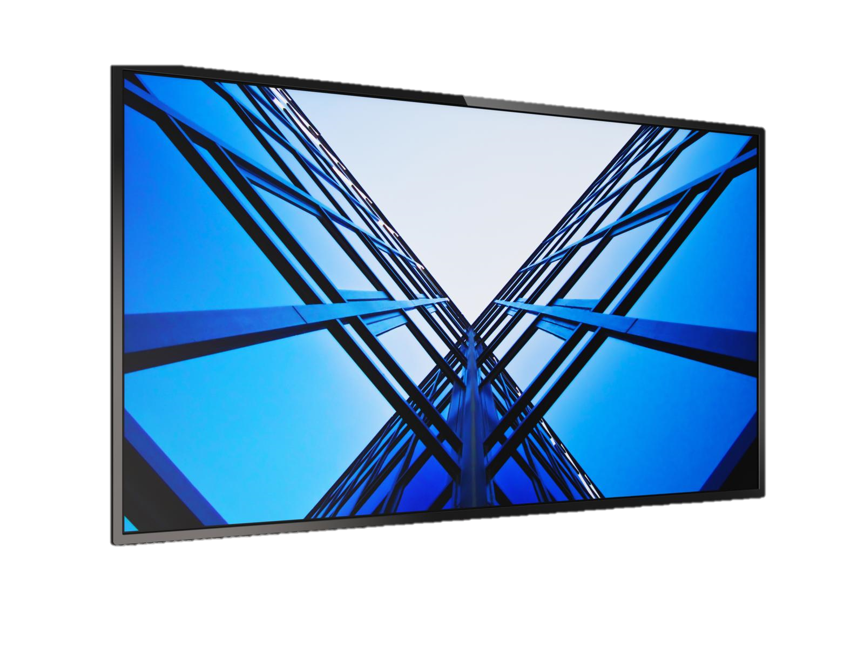
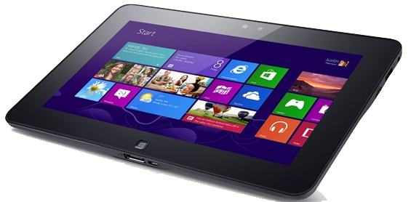
69% of Adland’s video consumption is on TV
Q: Of all the video content that YOU (or average Irish person 15+) watch (this includes commercial TV channels, BVOD, subscription VOD, video sharing platforms and other streaming services) what % of the time do you watch it on the following devices
TV
Laptop
Tablet
Smartphone
Adland
(Reported share)
69%
5.96%
3.9%
21.2%
Add text here
Source: TAM Ireland Adland V IREland Survey 2025 and TAM Ireland / Nielsen Media Ireland. Based on Total Video Panel, Average Minutes per Person, Consolidated 7 Days Linear + Streaming, 1st January - 31st December 2024, Mon-Sun. Base: All TV Homes

Slide 20
Adland believes that the average Irish adult’s share of video viewing on a TV is even lower
Q: Of all the video content that YOU (or average Irish person 15+) watch (this includes commercial TV channels, BVOD, subscription VOD, video sharing platforms and other streaming services) what % of the time do you watch it on the following devices
TV
Laptop
Tablet
Smartphone
Adland
(Reported share)
69%
5.96%
3.9%
21.2%
Irish public
(Adland’s Estimate)
57%
8.6%
9.1%
24.9%
Source: TAM Ireland Adland V IREland Survey 2025 and TAM Ireland / Nielsen Media Ireland. Based on Total Video Panel, Average Minutes per Person, Consolidated 7 Days Linear + Streaming, 1st January - 31st December 2024, Mon-Sun. Base: All TV Homes

Slide 21
In reality, 79% of Adults 15+ video viewing is on TV
Q: Of all the video content that YOU (or average Irish person 15+) watch (this includes commercial TV channels, BVOD, subscription VOD, video sharing platforms and other streaming services) what % of the time do you watch it on the following devices
TV
Laptop
Tablet
Smartphone
Adland
(Reported share)
69%
5.96%
3.9%
21.2%
Irish public
(Adland’s Estimate)
57%
8.6%
9.1%
24.9%
Add text here
Irish Ads 15+
(Actual data)
79%
2%
2%
17%
Source: TAM Ireland Adland V IREland Survey 2025 and TAM Ireland / Nielsen Media Ireland. Based on Total Video Panel, Average Minutes per Person, Consolidated 7 Days Linear + Streaming, 1st January - 31st December 2024, Mon-Sun. Base: All TV Homes

Slide 22
Time spent: Adland say they watch less than 2 hours of TV per day
Q: On an average day approximately how much time do YOU/Irish public 15+ spend watching TV on a tv set? (Live, Vosdal and consolidated (7 days))
Source: TAM Ireland Adland V IREland Survey 2025

Slide 23
Time spent: Adland estimate the Irish public watch more TV than them (128 minutes a day)
Q: On an average day approximately how much time do YOU/Irish public 15+ spend watching TV on a tv set? (Live, Vosdal and consolidated (7 days))
Source: TAM Ireland Adland V IREland Survey 2025

Slide 24
Time spent: The reality is the average Ad 15+ spends 150 mins (2 hrs 30 mins) watching TV each day
Q: On an average day approximately how much time do YOU/Irish public 15+ spend watching TV on a tv set? (Live, Vosdal and consolidated (7 days))
Source: TAM Ireland Adland V IREland Survey 2025 and TAM Ireland/Nielsen Media Ireland / Av mins pn, Total TV, Consolidated, National, Ads 15+, Jan-Dec 2024. Base: All TV Homes

Slide 25
Compared to the Irish public, Adland watch less of their TV live and more as catchup
Q: How do you consume that programming on your TV set?
Source: TAM Ireland Adland V IREland Survey 2025 and TAM Ireland/Nielsen Media Ireland / Av mins pn, Total TV, Consolidated, National, Ads 15+, Jan-Dec 2024. Base: All TV Homes

Slide 26
Adland overestimate the actual time Ads 15+ and 15-34s spend per day watching videos on YouTube
Q: On an average day, approximately how much time do you spend, and how much time do you think the average person spends, watching YouTube? Please give your answers in minutes
Source: TAM Ireland Adland V IREland Survey 2025 and TAM Ireland / Nielsen Media Ireland. Based on Total Video Panel, Average MInutes per Person, Consolidated 7 Days Linear + Streaming, TV Sets and Digital Devices, Adults 15-34, Mon-Sun. Base: All TV Homes

Slide 27
The same trend holds for SVOD
Q: On an average day, approximately how much time do you spend, and how much time do you think the average person spends, watching SVOD (includes Netflix, Apple TV, Amazon Prime)? Please give your answers in minutes
Source: TAM Ireland Adland V IREland Survey 2025 and TAM Ireland / Nielsen Media Ireland. Based on Total Video Panel, Average MInutes per Person, Consolidated 7 Days Linear + Streaming, TV Sets and Digital Devices, Adults 15-34, Mon-Sun 03002659

Slide 28
…and for Meta
Q: On an average day, approximately how much time do you spend, and how much time do you think the average person spends with video on Facebook or Instagram? Please give your answers in minutes
Source: TAM Ireland Adland V IREland Survey 2025 and TAM Ireland / Nielsen Media Ireland. Based on Total Video Panel, Average MInutes per Person, Consolidated 7 Days Linear + Streaming, TV Sets and Digital Devices, Adults 15-34, Mon-Sun 03002659

Slide 29
…and for TikTok.
Q: On an average day, approximately how much time do you spend, and how much time do you think the average person spends with video on TikTok? Please give your answers in minutes
Source: TAM Ireland Adland V IREland Survey 2025 and TAM Ireland / Nielsen Media Ireland. Based on Total Video Panel, Average MInutes per Person, Consolidated 7 Days Linear + Streaming, TV Sets and Digital Devices, Adults 15-34, Mon-Sun 03002659

Slide 30
Finally, how do Adland and Ireland feel about technology developments?

Slide 31
Adland more concerned about AI and the negative impact of technology than the general public
Q: Please let us know how much you agree or disagree with the following statements
Source: TAM Ireland Adland V IREland Survey 2025 and 2024 Ipsos B&A TechScape report. Base All Adults 16+

Slide 32
Looking forward
Adland overestimate the public’s consumption of digital video content. Do our budgetary decisions reflect this?
Adland underestimate how much time people spend with the TV set and how much time people spend with live TV. Do our planning decisions reflect this?
We need to be aware that we all have an unconscious bias. It is important to plan for our target markets’ ACTUAL media consumption and not what we THINK they consume

