Slide 1


October 2025
Viewing Trends Overview

Slide 2
AVERAGE WEEKLY REACH: October 2025

Slide 3
TOP 10 ADVERTISERS: October 2025
1: Procter & Gamble
2: McDonalds
3: Lidl Ireland
4: Vodafone Ireland
05: Supervalu
10: Sky Ireland
07: Virgin Media
08: Electric Ireland
09: Bord Bia
06: Tesco Ireland

Slide 4
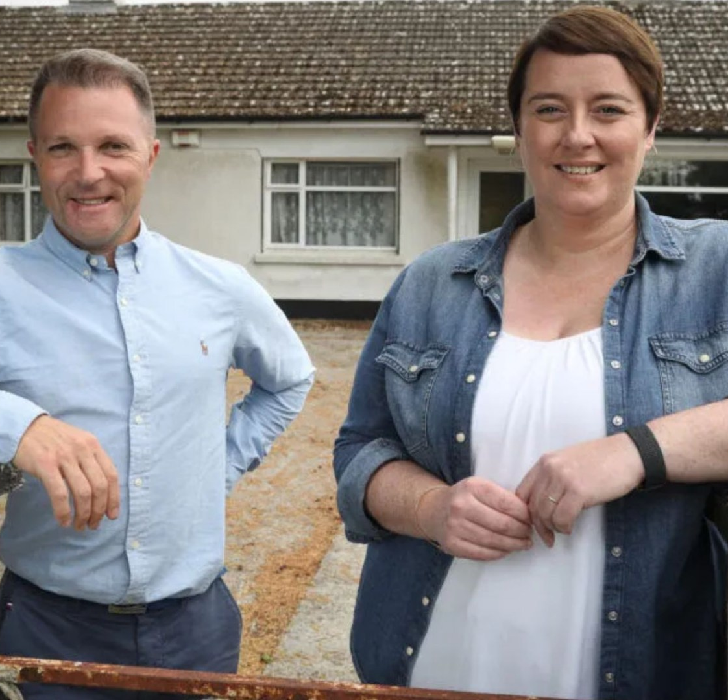
TOP 5 RTÉ PROGRAMMES
October 2025
1 FIFA World Cup 2026 Qualifier - ROI v Armenia:Live 14-10-2025
Prime Time: Presidential Debate 2025
21-10-2025
3 RTÉ News: Nine O'Clock 05-10-2025
4 Cheap Irish Homes 02-10-2025
5 FIFA World Cup 2026 Qualifier - Portugal v RO:Live 11-10-2025
The Great Pottery Throw Down, Channel 4
Top 5 programmes by station group
Notes:
Top 5 programmes – Channel 4

Slide 5

TOP 5 VIRGIN MEDIA
PROGRAMMES OCT 2025
1 Coronation Street 06-10-2025
2 Emmerdale 21-10-2025
3 News at 5:30 30-10-2025
4 Gogglebox Ireland 01-10-2025
5 Living with Lucy S7 26-10-2025
Top 5 programmes by station group.
Notes:
Top 5 programmes – Channel 4

Slide 6

TOP 5 SKY MEDIA
PROGRAMMES OCT 2025
LIVE SNF: CHELSEA V LIVERPOOL
04-10-2025
LIVE PL: LIVERPOOL V MAN UTD
19-10-2025
3 LIVE SNF: MAN UTD V BRIGHTON 25-10-2025
4 LIVE US F1 GRAND PRIX 19-10-2025
LIVE WORLD GRAND PRIX DARTS FINAL
12-10-2025
Top 5 programmes by station group.
Notes:
Top 5 programmes – Channel 4

Slide 7

TOP 5 4 SALES
PROGRAMMES OCT 2025
THE GREAT BRITISH BAKE OFF SERIES 9
07-10-2025
2 GOGGLEBOX SERIES 26 03-10-2025
3 MARRIED AT FIRST SIGHT UK 14-10-2025
4 24 HOURS IN POLICE CUSTODY
05-10-2025
5 MARRIED AT FIRST SIGHT UK S10 (SERIES 5) - INT STE 06-10-2025
Top 5 programmes by station group.
Notes:
Top 5 programmes – Channel 4

Slide 8

TOP 5 PARAMOUNT
PROGRAMMES OCT 2025
BEN & HOLLY'S LITTLE KINGDOM
02-10-2025
2 FRIENDS 25-10-2025
3 NIGEL NG: THE HAIYAA SPECIAL 31-10-2025
4 JIMMY CARR S AM I THE ASSHOLE? 31-10-2025
5 KEVIN BRIDGES: THE BRAND NEW TOUR - LIVE 30-10-2025
Top 5 programmes by station group.
Notes:
Top 5 programmes – Channel 4

Slide 9

TOP 5 TG4 PROGRAMMES
OCT 2025
1 Rugbaí Beo URC 2025 - 2026 18-10-2025
2 GAA BEO 2024 - 2025 26-10-2025
3 Nuacht TG4 2025 18-10-2025
4 Hector OZ/NZ 30-10-2025
5 High Plains Drifter 17-10-2025
Top 5 programmes by station group
Notes:
Top 5 programmes – Channel 4

