Slide 1
TV communicates strength
TV advertising doesn’t just reach people, it impresses them. This isn’t just a subjective take; it’s behavioural science. TV sends powerful signals about a brand’s success, quality, and confidence. Just by being on TV, a business communicates strength.
As Richard Shotton explains in The Value of TV: A Behavioural Science Perspective, people trust public and costly signals. TAM Ireland worked with Richard to conduct Irish focused research around that topic. The research found that:
-Campaign spend is influential in people’s perceptions of quality and TV significantly over indexes here
-TV in Ireland is perceived as a costly, therefore impactful medium.
In advertising, where you appear matters as much as what you say. And TV makes brands look strong. Consumers read into your media choices. Simply put: TV advertising conveys that you are a brand to be taken seriously.

Slide 2
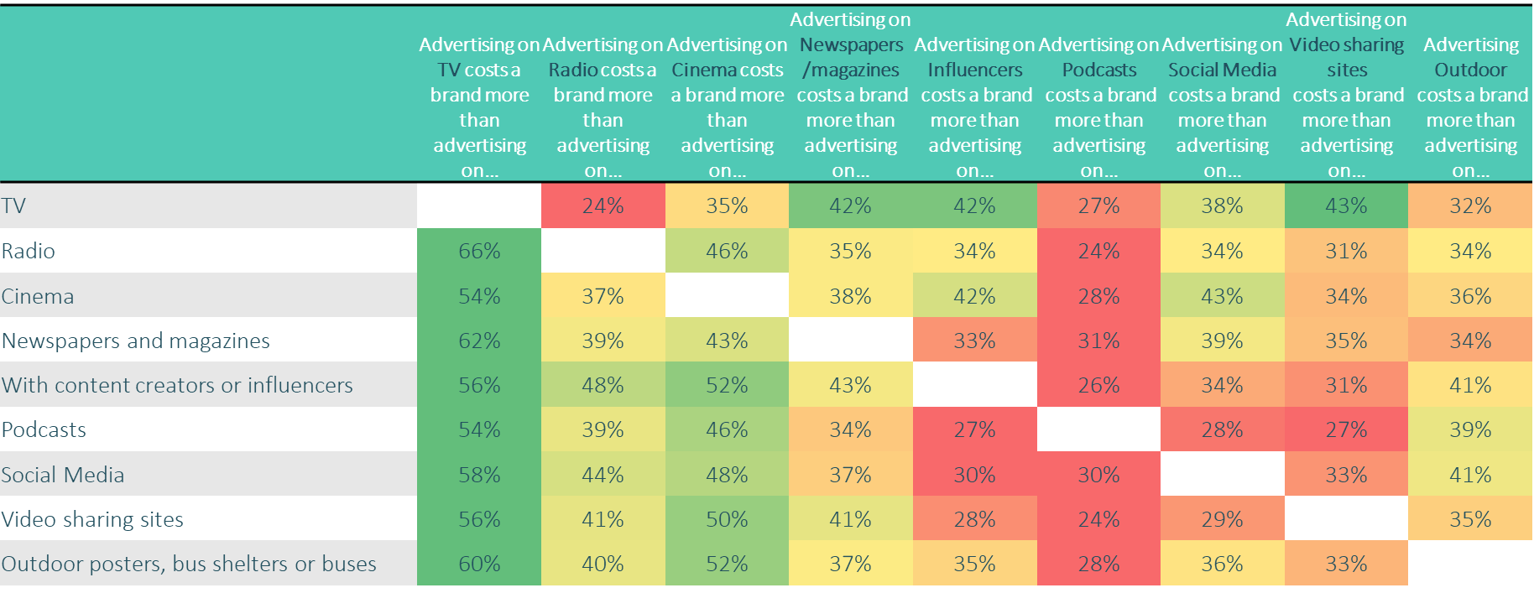
COST SIGNALS: TV ads are seen as relatively costly, which signals quality
Source: Signalling: Media’s X-Factor 2025 TAM Ireland /Red C 2025 (Base: All aged 15+; n=2,710)
Notes:
Richard Shotton states that trust in a brand is connected to the perceived expense of its marketing, and he argues that the credibility of a communication is in proportion to its perceived expense. This is relevant to media selection as viewers instinctively understand – or at least believe – that TV advertising has higher capital costs than media such as radio or print.
Compared to social media for example, TV requires a relatively large up-front investment. There’s little risk of being surrounded by cheap products — so TV can be effective simply because of the company a brand keeps.
TV perceived as a costly, therefore impactful medium
Strong linkage between medium used to advertise and consumer perceptions, underpinned by perceived cost of said platform. TV advertising is seen as most expensive, and this positively impacts on brand perceptions.
Strong correlation in spend and quality perceptions
Campaign spend is influential in perceptions of quality; if a brand spends less than average on an advertising campaign, this proves detrimental in terms of quality perceptions, however when the industry standard is reached, quality perceptions improve dramatically.

Slide 3
FITNESS SIGNALS: TV ads deliver quality, confidence and strength signals
% positively agree(net 6-7) to statements
Source: Signalling: Media’s X-Factor 2025 TAM Ireland /Red C 2025 (Base: All aged 15+; n=2,710)
Notes:
When participants were told that the ad campaign would run on TV, their perception scores for ‘fitness’ signals were significantly higher than average.
50% of respondents rated brands that advertised on TV as financially strong. The next best performing advertising channel at signalling financial strength was cinema at 34%,
Brands advertising on video sharing sites, podcasts and social media scored lower in ‘fitness’ signals. Only 26% perceived brands advertising on social media as ‘high quality’. This compared with video sharing sites at 29% and the top performing medium, TV, at 43%. Proximity to quality boosts appeal The image of a brand is influenced by what surrounds it — it’s called the mere proximity effect. If a brand advertises alongside high-status companies, it’ll be perceived as more appealing. Compared to social media, TV requires a relatively large up-front investment. There’s little risk of being surrounded by cheap products — so TV can be effective simply because of the company a brand keeps

