Slide 1
TV GRABS ATTENTION
Advertising attention is a much-debated topic. TV advertising grabs and holds attention for a number of reasons – from the fact that it is more welcome / less unwelcome than other forms of interruptive advertising, to the fact that it appears seamlessly in a high-quality environment.
TV’s big screen experience and long-established value exchange are conducive to high levels of visual attention.
In TV, advertisers are guaranteed that their ads will sit within people’s favourite TV programmes and will be played through from start to finish, with no skip button (TV ads that are fast forwarded in recorded content aren’t charged for). High-quality content is the best at converting viewing time to ad viewing.
As an industry, we’ve never been more aware of how hard it is to get people’s attention and how difficult it is to drive trust and creativity and be unmissable. TAM Ireland has worked with Red C Research and Amplified Intelligence to conduct the first ever piece of research on attention across AV in Ireland
Notes:
All attention. Active and non active and non attention. Comparing slow and fast decay
Attention levels remain consistent across TV platforms while dropping rapidly on social media platforms.
Competing socials experience rapid drop off within the first 3 seconds with less than 5% of viewers actively watching by the 15sec point
YouTube is a hybrid platform - its doesn’t decay as slowly as TV but its also not as fast as other social media platforms. The biggest thing to watch for with YouTube is skippable ads see a significant drop beyond 6sec mark.
Slow decay means TV is very strong for telling stories and delivering emotional creative so helping to grow mental availability

Slide 2
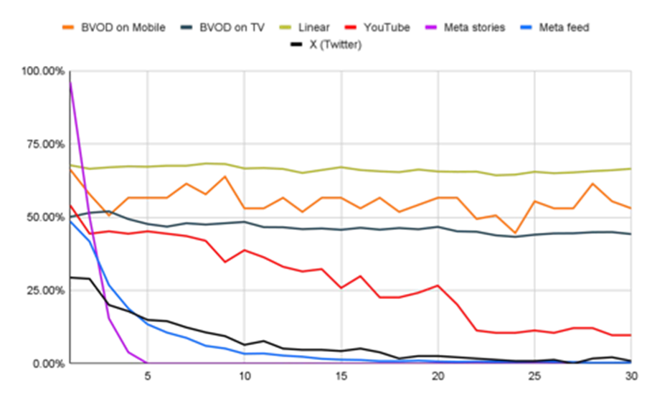

Attention Decay: Attention remains relatively flat on TV whereas attention on socials decays quickly
Source: Reasons to Pay Attention to TV. 2024 Red C and Amplified Intelligence
Notes:
All attention. Active and non active and non attention. Comparing slow and fast decay
Attention levels remain consistent across TV platforms while dropping rapidly on social media platforms.
Competing socials experience rapid drop off within the first 3 seconds with less than 5% of viewers actively watching by the 15sec point
YouTube is a hybrid platform - its doesn’t decay as slowly as TV but its also not as fast as other social media platforms. The biggest thing to watch for with YouTube is skippable ads see a significant drop beyond 6sec mark.
Slow decay means TV is very strong for telling stories and delivering emotional creative so helping to grow mental availability

Slide 3
Active Attention: TV platforms perform much better at gaining attention to ads than social media
70%
67%
47%
24%
7%
BVOD Mobile
Linear TV
BVOD TV
You Tube
Meta
% active attention
Notes:
Active attention Is Mobile:
Looking directly at the ad
Desktop: Looking directly at the ad
TV: Looking directly at the ad

