Slide 1
TV is brand safe
TV is brand-safe by design. In an era of misinformation, ad fraud, and misplaced content, brand safety matters more than ever. It’s not just about protecting reputation, it’s about ensuring your advertising appears in environments that reinforce trust, quality, and credibility – which in turn drive business results.
This is where TV stands apart. TV in Ireland is a professionally regulated, tightly controlled, human-reviewed advertising environment.
TV offers:
Transparent media buys (you know where your ads are running)
Fixed break structures (you’re not placed next to unknown content)
Creative guidelines and broadcast standards (to protect both viewers and brands)
Ongoing monitoring and enforcement

Slide 2
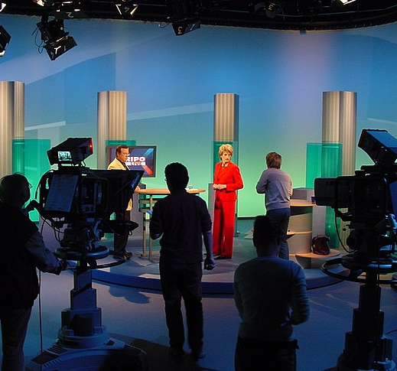
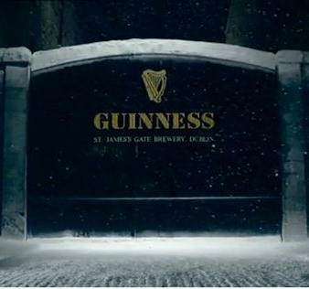
Everything you see on TV is pre-vetted…by humans
AND
The programmes
The ads

Slide 3
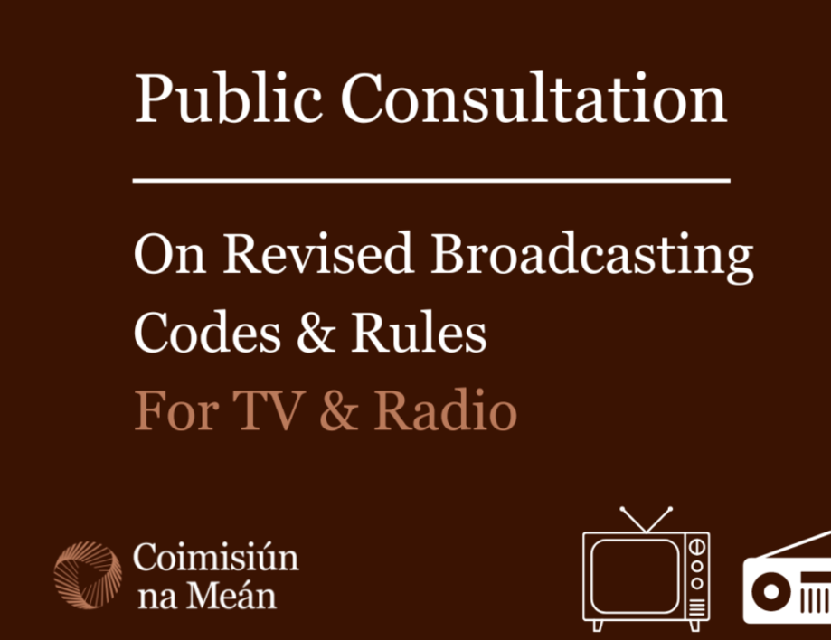
COIMISIUN NA MEAN
PROGRAMMING​
​Content
Restrictions
Bad language, nudity, violence​
Investigate complaints
Notes:
When it comes to TV legislation, there are two areas that the C Na Mean focus on.
The first is to do with PROGRAMMING. Through their broadcast code, C Na Mean specify what type of content can be aired on TV and when, the level of Irish produced programming etc. They define any restrictions around that content - for example it can only be shown after the 9pm watershed - and also what is or isn’t appropriate for viewing by children.
They would check things like bad language, nudity, violence as well as the likelihood to cause harm or offence and many more things besides.
They also investigate any complaints made by the public about the content they’ve seen on TV.

Slide 4
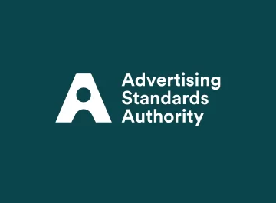
ASI
ADVERTISING​
​All advertising should be legal, decent, honest and truthful.
All advertising should be prepared with a sense of responsibility both to the consumer and to society.
All advertising should conform to the principles of fair competition as generally accepted in business.
Notes:
All TV advertising in Ireland must not only comply with the C Na M broadcast code but also the extra layer of scrutiny laid down by the ASAI.
Some of the additional restrictions include:
All advertising should be legal, decent, honest and truthful.
All advertising should be prepared with a sense of responsibility both to the consumer and to society.
All advertising should conform to the principles of fair competition as generally accepted in business.
There are also specific guidelines that apply only when advertising to children
There are a few categories where there are additional safety measures in place is alcohol, gambling and HFSS products

Slide 5
Restrictions to adverting on TV
Alcohol
Gambling
High fat, sugar, salt
Cigarettes
Guns
Escort Agency
Notes:
There are also specific guidelines that apply only when advertising to children
There are a few categories where there are additional safety measures in place is alcohol, gambling and HFSS products

Slide 6

Copy Clearance
Irish Broadcasters
Internal copy clearance
UK Broadcasters selling into Irish market
Clearcast
Ad Clearance
Verifying Claims
Clarifying restrictions
Uphold certification
Notes:
Because of the way the Irish TV ad industry is structured, having both Irish channels and UK channels selling into the market, you need to be aware of the different systems for each.
The Irish broadcasters each have their own internal copy clearance operations as we don’t have an organisation that does it on behalf of the whole Irish industry. Each broadcasters have a copy clearance committee that meet twice weekly to review all copy. You need to submit copy at least a week before its due to air so that it can reviewed and amended if necessary.
All adverts that air on TV on the UK channels are required to be cleared and certified by Clearcast.
Clearcast will also verify any claims made in your TV ad to ensure that any claim can be substantiated with evidence and they will clarify any restrictions placed on your advert.

