Slide 1
TV IS FOR EVERYONE
TV is for everyone, in every sense: every advertiser, every marketing budget, every audience, and every need state.
*TV reaches almost everyone. In 2024, linear TV and broadcaster VOD (BVOD) combined reached 92.8% of the adult population each month.
*We watch TV and other forms of video for a variety of reasons (or need states), from the desire to unwind to our need for comfort or distraction. Unlike some forms of video, TV is fundamental to almost all of these viewing need states. It has something for everyone.
*TV appeals to businesses of all sizes. Looking at the make-up of TV advertisers in 2024, 32% of all advertisers spent under €25,000 . TV offers value to large and small brands

Slide 2
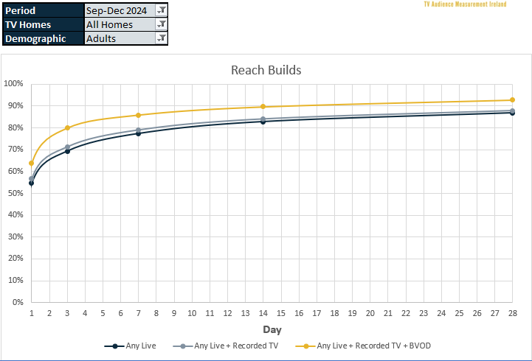
Linear TV and BVOD reaches over 90% of adults every month
Source: TAM Ireland BVOD Planning Aid, Sept-Dec 2024, All Homes, Adults

Slide 3
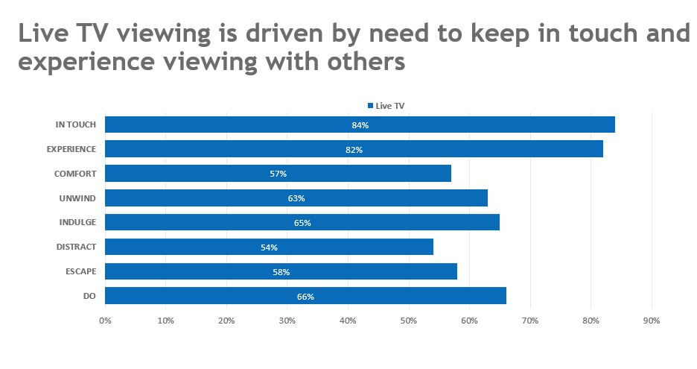
Live TV is key in all viewing need states

Slide 4
TV offers value to smaller brands
When you look at the make-up of TV advertisers in Ireland across 2024 in terms of spend, 32% fall within the <€25,000 spend bracket.
Source: Nielsen. AdIntel TV Spend Jan-Dec 2024 (spot only)by Advertiser. Please note, the Advertising Spend figures are not actual revenue figures. They are based on a defined methodology which is agreed and reviewed with key industry stakeholders)
Notes:
TV can be perceived as the exclusive domain of big brands with big budgets.
This is a myth, fuelled by the fact that just being on TV makes brands appear big.
When you look at the make-up of TV advertisers in Ireland across 2024 in terms of spend, 32% fall within the <€25,000 spend bracket.
Research from Thinkbox shows that for a small brand with <£50m brand value a £0.5m TV campaign can drive sales by 10%
TV is highly responsive across all brand sizes and can efficiently create sales uplifts at even low investment levels.
But TV has a stronger proportional effect for smaller brands – showing the power of TV to help build the brand. This is because small brands are working from a lower base and are often new brands where they are communicating new news.
TV efficiently creates sales uplifts even at low levels of investment

