Slide 1
TV is great value
TV advertising gives brands remarkable value. It’s accessible to businesses of any size; is cost-efficient, delivers free bonus exposure beyond target audiences; drives sales, profit, and long-term brand growth…and does all of this in a trusted, brand safe, premium environment.
In a world of inflated metrics and fleeting impressions, TV advertising remains the most trustworthy, effective, and efficient investment a brand can make.

Slide 2
The Great Wastage Illusion
LINEAR TELEVISION
ONLINE ADVERTISING
Source: Source: TAM Ireland/Nielsen Media TV data Online video based on Nielsen digital ad ratings UK benchmarks (18-34) Q3 2018
)
Notes:
The chart shown here demonstrates the difference in the nature of online advertising and linear TV advertising and compares campaigns buying 200,000 15–34 impressions.
The Y axis shows the number of exposures that are delivered, and we’ve separated the exposures between linear TV on the left and online advertising on the right. For each of these we’ve also split the exposures into two buckets – paid for exposures and free, bonus exposures. Finally, we’ve made a distinction between the exposures into those that are in-target, so are generated by the target audience you’re actually aiming for – in this case 15-34 year olds, which are represented by a green bar. And those that sit outside of your intended audience, which in this case is anyone who’s not aged 15-34, here represented by the blue bar.
Let’s start with linear TV, so remember you are paying for 200,000 15-34 exposures, so what can you expect to get?
Well, you get 200,000 15-34 exposures. As with any statistical data there is a sampling margin of error which is roughly 13% for 15=34s so you might get 13% more or 13% exposures than you bought.
But due to the nature of TV advertising you also get a rather large helping of bonus, out of target exposures. For a typical campaign targeting 15-34s, you’d also get a whopping 1,422,000 free views from out of target audiences. Why so many more than your actual target audience? Well two reasons, 15-34s only make up about 25% of the total population, so everything being even, for every one 15-34-year-old who sees the ad three, non 15-34s also see it. But also linear TV viewing is weighted towards older audiences, as they spend more time watching TV, so the odds of your ad being seen by someone who’s 35 or older is greater than the odds of it being seen by someone under the age of 35.
Let’s now look at online advertising. When you buy 200,000 15-34 exposures WHAT DO YOU GET?. The problem here is that online targeting, per se, isn’t actually as accurate as it’s promised to be. The accuracy will massively vary by publisher and the quality of the data they hold, but the benchmark average for in-target 15-34 exposures for online according to Nielsen digital ad ratings in the UK is 65%. What this means is that when you pay for 200,000 15-34s you only get 130,000 – with the other 70,000 exposures sitting outside of your target audience. The issue here is that you actually have to pay for these as well.
How many bonus views to you get for free you ask – none
This is the great wastage illusion. Waste is only waste if you have to pay for it.

Slide 3
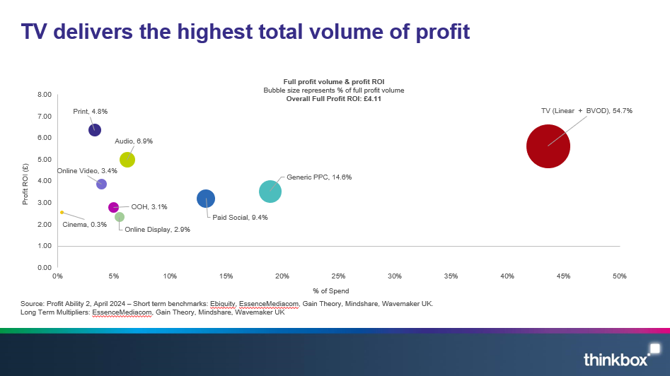
TV delivers the highest total volume of profit
Notes:
TV is also the #2 driver of immediate profit – second only to generic search – and generates 41.5% of all short-term media-driven profit. It works fast too.
But its sustained effects are how brands are built. Too much short-termism short-changes brand. Sustained advertising effects are crucial for creating and maintaining a brand's relevance and driving lasting profitability.

Slide 4
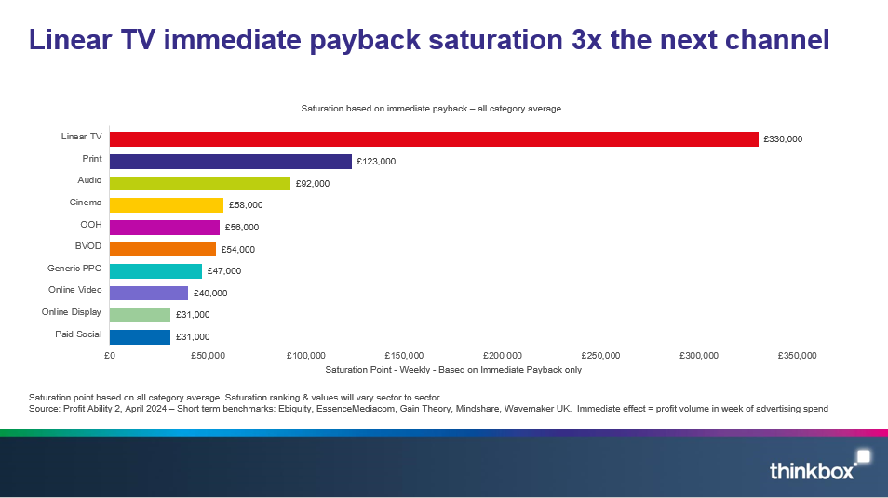
Linear TV immediate payback saturation 3x the next channel
Notes:
TV is also the #2 driver of immediate profit – second only to generic search – and generates 41.5% of all short-term media-driven profit. It works fast too.
But its sustained effects are how brands are built. Too much short-termism short-changes brand. Sustained advertising effects are crucial for creating and maintaining a brand's relevance and driving lasting profitability.

Slide 5

TV’s resilience:
TV Advertising Investment 2024
€293,000,405 was invested in TV advertising in Ireland in 2024. This is a total revenue figure, supplied by all broadcasters and includes spot, non-spot and VOD revenue.
This figure is up 5.3% on the 2023 figure

Slide 6
TV OFFERS VALUE TO SMALLER BRANDS
When you look at the make-up of TV advertisers in Ireland across 2024 in terms of spend, 32% fall within the <€25,000 spend bracket.
Source: Nielsen. AdIntel TV Spend Jan-Dec 2024 (spot only)by Advertiser. Please note, the Advertising Spend figures are not actual revenue figures. They are based on a defined methodology which is agreed and reviewed with key industry stakeholders)
Notes:
TV can be perceived as the exclusive domain of big brands with big budgets.
This is a myth, fuelled by the fact that just being on TV makes brands appear big.
When you look at the make-up of TV advertisers in Ireland across 2024 in terms of spend, 32% fall within the <€25,000 spend bracket.
Research from Thinkbox shows that for a small brand with <£50m brand value a £0.5m TV campaign can drive sales by 10%
TV is highly responsive across all brand sizes and can efficiently create sales uplifts at even low investment levels.
But TV has a stronger proportional effect for smaller brands – showing the power of TV to help build the brand. This is because small brands are working from a lower base and are often new brands where they are communicating new news.
TV efficiently creates sales uplifts even at low levels of investment

