Slide 1
TV SCREEN IS THE HOME OF HIGH-QUALITY CONTENT
Research from Thinkbox has shown that the TV screen drives the highest ad recall of all devices 34% more than ads seen on a computer and 60% more than a tablet or smartphone. This shows the likelihood of remembering an ad is greater when watched on a larger screen.
Ad recall is much higher from occasions involving professional content (vs. non-professional content) and the TV set remains the home for viewing to high-quality/professionally made content
Source: Thinkbox: Context Effects, Map The Territory & Tapestry Research, 2024

Slide 2
In Ireland, The TV set remains the home for viewing to high-quality/professionally made content
Source: TAM Ireland / Nielsen Media Ireland. Based on Total Video Panel, Average Minutes Per Person, Consolidated 7-Days Linear + Streaming, 2024, Mon-Sun 03:00-26:59Other Social Media/Video Sharing incorporates Meta, TicTok etc and smaller/niche platforms (ie Reddit, Spotify,) Adult content. Does not include other unidentified/unresolved streaming
Notes:
Looking at the breakdown of TV set viewing, to provide a bit more granularity, professionally produced content takes up the vast majority of time.

Slide 3
The TV set remains the home for viewing to high-quality/professionally made content (Ads 15-34)
Source: TAM Ireland / Nielsen Media Ireland. Based on Total Video Panel, Average Minutes Per Person, Consolidated 7-Days Linear + Streaming, 2024, Mon-Sun 03:00-26:59Other Social Media/Video Sharing incorporates Meta, TicTok etc and smaller/niche platforms (ie Reddit, Spotify,) Adult content, and other unidentified/unresolved streaming
Notes:
Looking at the breakdown of TV set viewing, to provide a bit more granularity, professionally produced content takes up the vast majority of time.

Slide 4
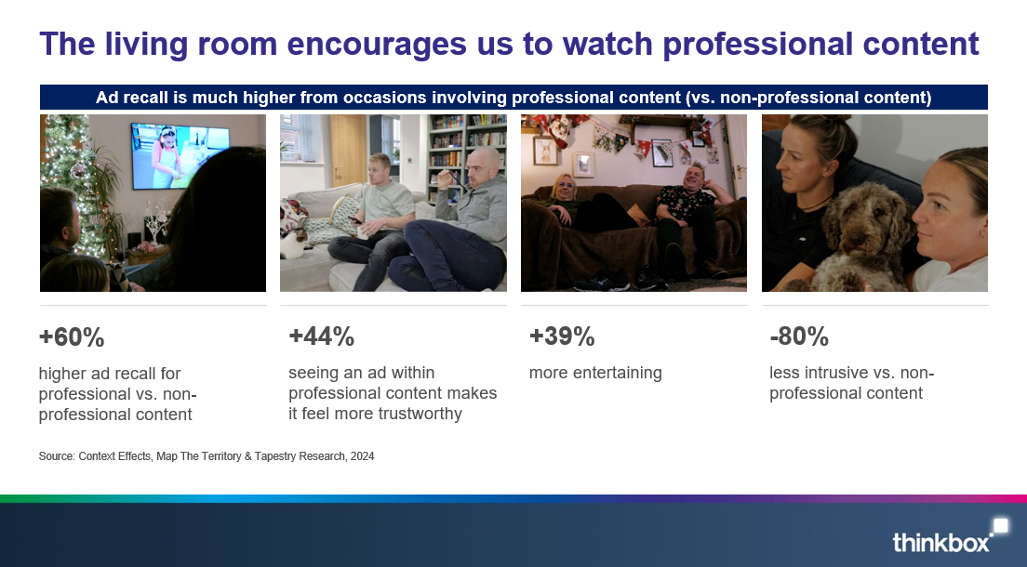
TV SCREEN DRIVES THE HIGHEST AD RECALL
Source: Thinkbox: Context Effects, Map The Territory & Tapestry Research, 2024

Slide 5
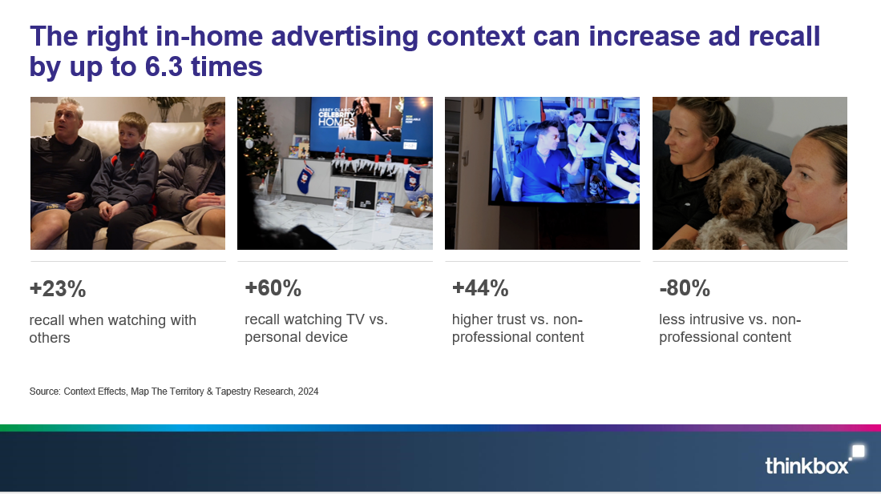
TV SCREEN DRIVES THE HIGHEST AD RECALL
Source: Thinkbox: Context Effects, Map The Territory & Tapestry Research, 2024

