Slide 1
TV is vital for long term success
TV’s scale, storytelling power, and emotional pull make it unmatched for building mental availability – the bedrock of lasting brand value.
TV turns products into brands. It creates meaning. It’s the antidote to commodification.
Every major study into advertising effectiveness – even those commissioned by rival media – agrees: if your brand needs growth, TV is the safest, smartest investment you can make.
Profit Ability 2 (2024) study from Thinkbox concluded that TV advertising is the most effective investment a business can make:
TV delivers the highest total volume of profit: Linear TV and BVOD account for 54.7% of advertising’s total payback, with a profit ROI of £5.61 (vs. a media average of £4.11).
58% of advertising’s effects arrive 6–24 months after airing – long-term value that short-term tactics miss.
Linear TV’s effects triple over two years; BVOD’s more than double.

Slide 2
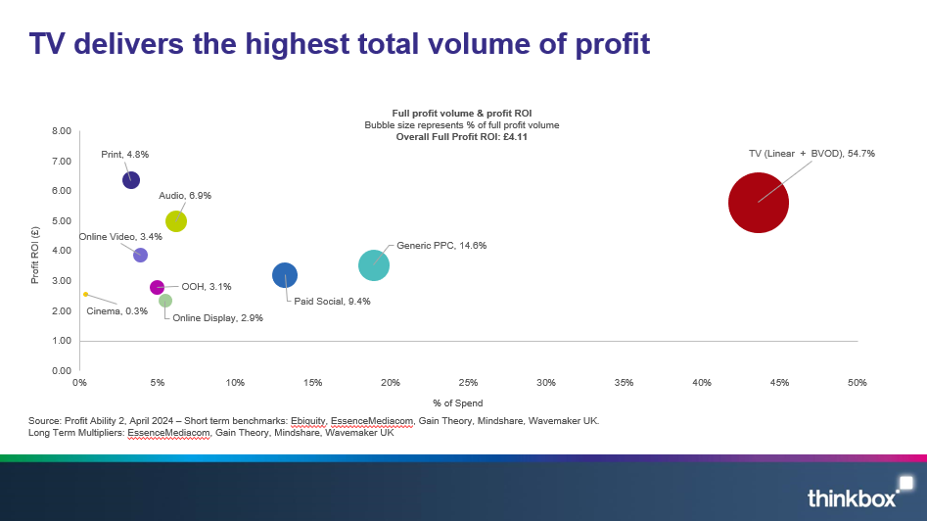
TV delivers the highest total volume of profit
Notes:
TV is also the #2 driver of immediate profit – second only to generic search – and generates 41.5% of all short-term media-driven profit. It works fast too.
But its sustained effects are how brands are built. Too much short-termism short-changes brand. Sustained advertising effects are crucial for creating and maintaining a brand's relevance and driving lasting profitability.

Slide 3
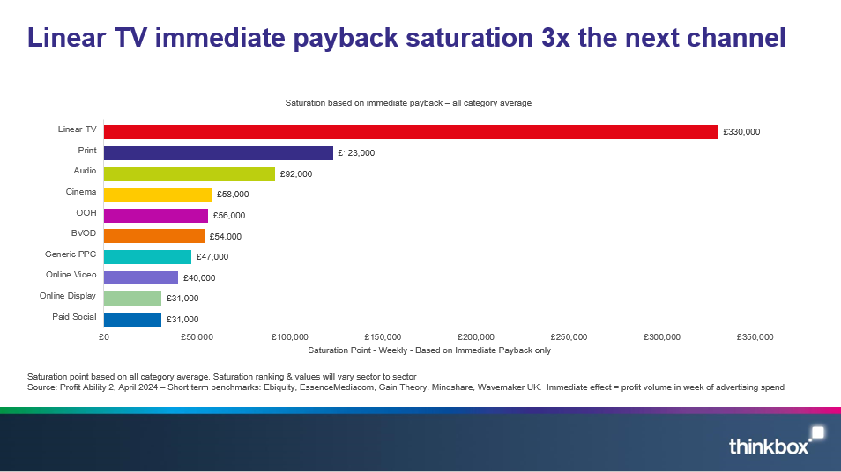
Linear TV immediate payback saturation 3x the next channel
Notes:
TV is also the #2 driver of immediate profit – second only to generic search – and generates 41.5% of all short-term media-driven profit. It works fast too.
But its sustained effects are how brands are built. Too much short-termism short-changes brand. Sustained advertising effects are crucial for creating and maintaining a brand's relevance and driving lasting profitability.

