Slide 1


December 2025
Viewing Trends Overview

Slide 2
AVERAGE WEEKLY REACH: December 2025

Slide 3
TOP 10 ADVERTISERS: December 2025
1: Procter & Gamble
2: Supervalu
3:Dunnes Stores
4: Aldi Ireland
05: McDonalds
10: Amazon
07: Vodafone Ireland
08: Lidl Ireland
09: Three Mobile
06: Allied Irish Banks

Slide 4
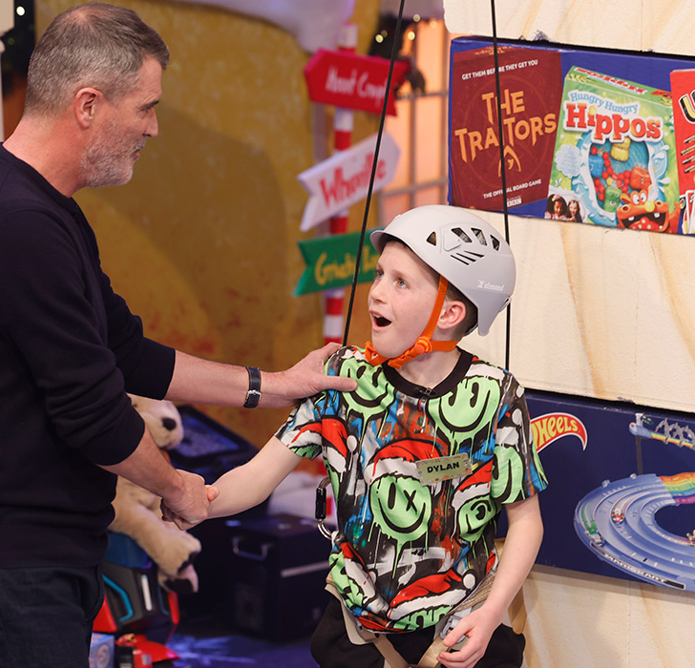
TOP 5 RTÉ PROGRAMMES
December 2025
1 The Late Late Toy Show 05-12-2025
2 RTÉ News: Nine O'Clock 05-12-2025
3 RTÉ News: Six One 09-12-2025
4 Mrs Brown's Boys 31-12-2025
The Late Late New Year's Eve Show
31-12-2025
The Great Pottery Throw Down, Channel 4
Top 5 programmes by station group
Notes:
Top 5 programmes – Channel 4

Slide 5

TOP 5 VIRGIN MEDIA
PROGRAMMES Dec 2025
I'm a Celebrity... Get Me Out Of Here!
07-12-2025
2 Coronation Street 15-12-2025
3 Emmerdale 09-12-2025
4 News at 5:30 09-12-2025
5 I'm a Celebrity... Get Me Out Of Here! Coming Out 13-12-2025
Top 5 programmes by station group.
Notes:
Top 5 programmes – Channel 4

Slide 6

TOP 5 SKY MEDIA
PROGRAMMES Dec 2025
UNITED RUGBY CHAMPIONSHIP 2025/26
27-12-2025
2 LIVE PL: MAN UTD V WEST HAM 04-12-2025
3 LIVE FNF: MAN UTD V NEWCASTLE 26-12-2025
4 LIVE PL: ASTON VILLA V MAN UTD 21-12-2025
5 PREMIER LEAGUE 2025/26 13-12-2025
Top 5 programmes by station group.
Notes:
Top 5 programmes – Channel 4

Slide 7

TOP 5 4 SALES
PROGRAMMES Nov 2025
1 THE BIG FAT QUIZ OF 2025 26-12-2025
2 SU2C 2025 - GOGGLEBOX SU2C SPECIAL 12-12-2025
CELEBRITY GOGGLEBOX SERIES 7
19-12-2025
4 FILM: HOME ALONE 2: LOST IN NEW YOR 25-12-2025
5 FILM: HOME ALONE (1990) 24-12-2025
Top 5 programmes by station group.
This Photo by Unknown Author is licensed under CC BY-SA-NC
Notes:
Top 5 programmes – Channel 4

Slide 8
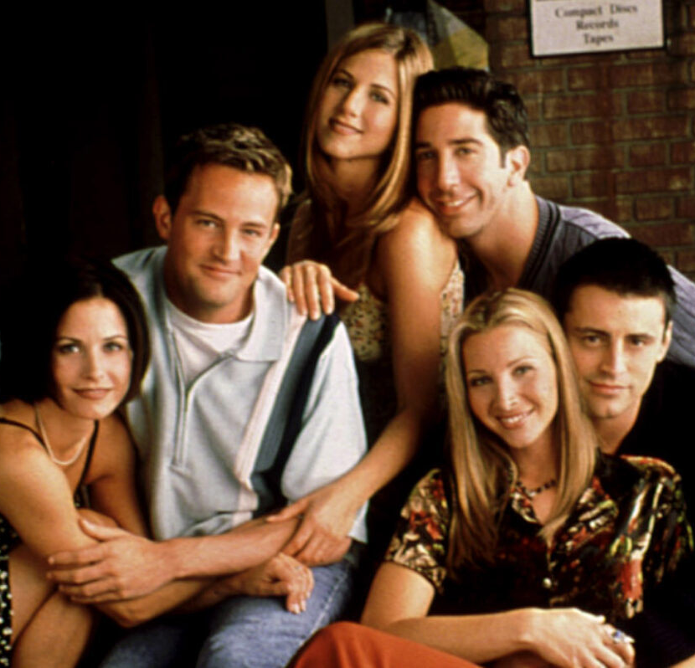
TOP 5 PARAMOUNT
PROGRAMMES Dec2025
BEN & HOLLY'S LITTLE KINGDOM
20-12-2025
2 MR. BEAN 26-12-2025
3 FRIENDS 04-12-2025
4 MICHAEL MCINTYRE'S VERY CHRISTMASSY CHRISTMAS SHOW 12-12-2025
5 FILM: HOOK (1991) 20-12-2025
Top 5 programmes by station group.
Notes:
Top 5 programmes – Channel 4

Slide 9

TOP 5 TG4 PROGRAMMES
Dec 2025
1 GAA BEO 2024 - 2025 21-12-2025
2 Mrs. Doubtfire 28-12-2025
3 Rugbaí Beo URC 2025 - 2026 19-12-2025
4 The Foster & Allen Show 3 23-12-2025
Mamma Mia - Here We Go Again!
26-12-2025
Top 5 programmes by station group
Notes:
Top 5 programmes – Channel 4

