Slide 1



Someone’s ad share just got cut
Notes:
I’m going to start with a line that sounds mildly threatening, but I promise it’s meant kindly: You might not be interested in econometrics, but econometrics is interested in you.
And the reason is simple. Somewhere in Ireland this week, a brand team is in a budget meeting, looking at a marketing report, and deciding what gets spent and what gets cut. It might be called Marketing Mix Modelling. It might be called econometrics. It might be called “the attribution dashboard the CFO trusts”. [CLICK]
But it amounts to the same thing. Someone’s ad share just got cut.
If a channel doesn’t show up properly in that system, it doesn’t have a pricing problem or a pitch problem. What it has is an attribution problem. And attribution problems turn into revenue problems remarkably quickly.

Slide 2

Everything should behave like PPC
Notes:
Now, here’s the awkward bit for offline media. We’re living through a shift in who sets the rules of measurement. The days when people started their media careers in local radio, newspapers, maybe even a TV station - that's over. For instance, my daughter started at Essence MediaCom in Manchester. She's twenty-four. She began her career planning paid search campaigns on Google's ad platform. That's normal now. That's where everybody starts.
And that rewires how an entire generation of media professionals has been trained to think about advertising. Everything should behave like PPC: Conversions. Immediate, measurable response. Digital levels of accountability. That's what they expect because that's what they've been taught advertising is.
So when young media professionals look at legacy channels like television, radio or outdoor, they're not thinking about reach and frequency. They're thinking: where's the return path? Where's the click trail? Show me the conversion.
And we can't. Not in the same way. Offline platforms don't have that click-based accountability. There’s no neat digital receipt that says “this TV spot caused that action”. We don't control the narrative any longer about what good attribution looks like. Which means we're being judged by rules we didn't write, in a game we didn't design.

Slide 3
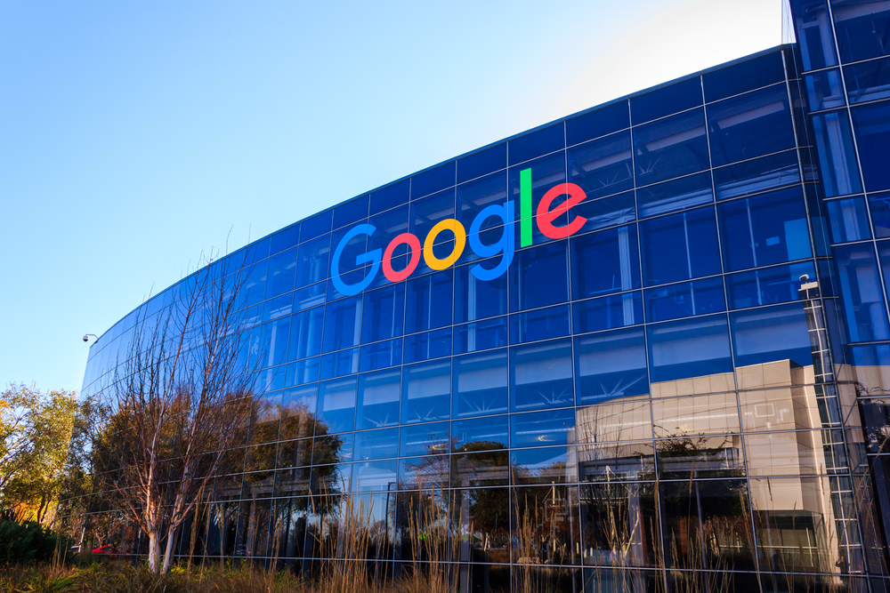
You get measured anyway
Notes:
So what happens? Well, you get measured anyway.
Because the brand still has to make a decision, and the agency still has to justify a plan, and the finance team still wants a number they can repeat in a board meeting. So if econometrics isn’t present, something else fills the vacuum.
And that “something else” is usually attribution. Now, attribution has its place. But it comes with a built-in bias: it was designed for clicks. It works best when the system can watch a person do a thing, immediately, and tag it.
But it's spectacularly bad at seeing how broadcast channels like television and radio actually work.

Slide 4
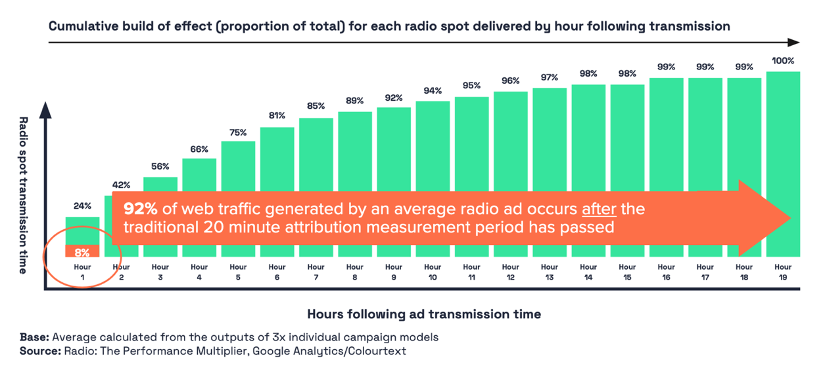


The offline attribution trap
Notes:
Let me give you a concrete example. I was looking at radio response measurement for Radiocentre in London. The question standard attribution tends to ask is basically this: does anything happen within a few minutes after a radio ad has played out? That could mean five minutes post transmission, perhaps twenty if you are feeling generous.
Radio was getting hammered by this approach. It looked weak. It looked disposable. It looked like the sort of budget line item you cut to fund more search ads.
Under those circumstances, the post-campaign review meeting almost writes itself. Search is driving results. Radio isn’t. It sounds empirical. It sounds like numbers. But it is the wrong data, produced by the wrong measurement approach.
When we modelled radio more carefully and allowed for delayed ad response, we found something significant. That short attribution window was capturing only about 8% of radio’s actual ad response. In other words, 92% of radio’s effect was happening outside the attribution window and getting credited to whatever was sitting closer to the conversion, which is usually paid search.
That is the problem in miniature. The attribution layer is not neutral. It systematically favours performance channels because those channels are structurally easier to measure in the short term.
It is not that broad reach media has stopped working. It is that attribution measurement has stopped seeing it. That’s the offline attribution trap.

Slide 5

Offline media needs to engage with modelling
Notes:
Now, I’m not here to tell you econometrics is the answer to all of life’s problems. I’ve seen enough regression models to know they too can lead us down the garden path.
But econometrics is one of the few tools we have that can do something attribution fundamentally cannot. It can capture carry-over. It can see delayed effects. It can separate baseline from uplift. It can estimate the long-memory effects that make TV, well…special.
If broad reach media does not engage with econometric modelling on its own terms, it will continue to be judged more harshly by methodologies designed for activation, not brand-building.
That’s what this session is about. So here's what I'm going to cover.

Slide 6
Coming up…
Data sources and econometric analysis approach
The Google Tax
The TV Persistence Dividend
Cut TV Once, Pay Twice: The Hidden Value of TV Advertising
Notes:
First, a brief word on the data we used and how we built the models. Then I'm going to show you that the attribution problem I've just described isn't abstract.
The first example is something the industry already has a name for: it's called The Google Tax.
From there, I'll show you what we've learnt about TV's powerful long term influence on brand memory. We've called this the TV Persistence Dividend.
We'll then move onto the headline finding that I want to leave you with. It's called 'Cut TV Once, Pay Twice'.
Let's start with the data.

Slide 7
Brand coverage
supermarkets
retail
online
insurance
x3 brands
x3 brands
x3 brands
x3 brands
€83m
€44m
€30m
€18m
TAM Ireland & Colourtext: The Google Tax 2026
Data Sources & Periods for Econometric Models: TAM Ireland, Similarweb, Nielsen Ad Intel | 31 Jul 2023 – 25 Aug 2025
Notes:
The analysis covers twelve Irish consumer brands across three broad sectors: supermarkets, retail and online services, plus three Insurance brands.
It's not our intention to expose any commercial sensitivities, or put any of you good people on the spot, so we'll maintain brand anonymity from here on in.
However, we made a choice to focus on some of the biggest and most well known brand advertisers in this market, that collectively invested approximately €150m of ad spend over the two year period we analysed.
This is a reasonably broad cross-section of Irish advertising, which will help us see how consistent the project findings are across different brand categories, consumer relationships and business models.

Slide 8


Data sources
Web & App Traffic
TV Impacts
Media Impacts
PPC Impressions
Notes:
Our goal is understand the relationship between advertising activity and brand outcomes. To run an econometric model you need to start with good data for campaign exposure.
TV audience impacts were supplied by TAM Ireland, the official TV ratings body for the Republic and, obviously, the sponsor of this research. These are audited, industry-standard figures, and they prove once again that official JIC data can significantly improve the quality of any modelling exercise.
Web traffic, app usage and paid search spend came from Similarweb. In my opinion it's the best available third-party source for estimating digital consumer behaviour at the brand level. If you've done any competitive digital analysis, you've probably used it.
We sourced channel advertising spend data from Nielsen Ad Intel. As we all know, Ad Intel reports media spend at rate card, and of course nobody actually pays rate card. But what Ad Intel does capture very well is relative channel investment activity - who's spending, when, and where - and that's genuinely what matters for the modelling.

Slide 9

We treat modelling like a search problem
Notes:
The modelling process itself was designed to be thorough. For each brand, we use an ‘ensemble’ modelling approach that generates hundreds of model variants, systematically, across media channels and brand outcomes, and we search for patterns that repeat: the effects that show up consistently, the ones that disappear and the ones that only appear in odd circumstances.
After sifting through the outputs from this process we identified a core group of models that showed a clear, robust and statistically credible relationship between television and the brand outcomes we were testing for.
OK, let’s move onto the findings.

Slide 10
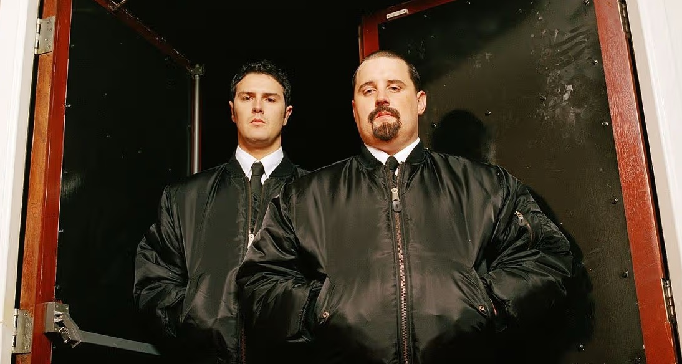
It’s called
The Google Tax
Notes:
We’re going to move from discussing the general attribution problem to a very specific one. This first effect is not theoretical. It already has a name in the industry. It’s called the Google Tax. The logic is simple enough.
Television does the hard bit. It builds familiarity. It puts the brand into people’s heads and nudges them closer to action. Then, later on, when those people finally get round to searching online, they type the brand name into Google, click a paid link, and the search platform sends a bill to the advertiser.
So in effect, the brand ends up paying twice. First for the TV advertising that created the interest. Then again for the paid click that captures it at the doorway. Television earned the visit. Paid search stood at the door and charged an entrance fee.

Slide 11

Distorting budget decisions over time
Notes:
Now, I should be careful here. I’m not saying paid search does nothing. PPC is a highly effective channel. It is very good at converting intent once intent exists.
The issue is what happens in the attribution report. That visit gets credited to PPC. Television gets nothing. And if that pattern repeats across enough consumer journeys, and across enough planning cycles, it quietly distorts every budget decision that follows.
That is not just a attribution quirk. It is a budget allocation problem. And in our study, we found four separate instances of the Google Tax across three brands.

Slide 12
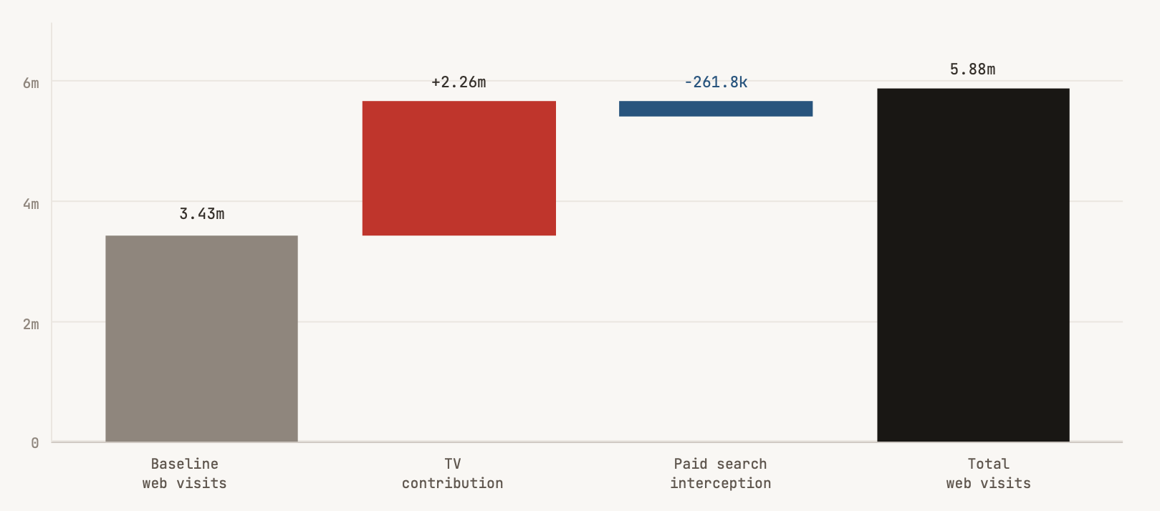
The Google Tax
A waterfall chart showing how baseline demand and TV advertising contribute towards website traffic for
Brand 2 (Insurance), and how paid search appears to capture part of that demand at the the point of click
90% of media uplift
PPC intercepted 11.6% of TV generated demand
TAM Ireland & Colourtext: The Google Tax 2026
Data Sources & Periods for Econometric Models: TAM Ireland, Similarweb, Nielsen Ad Intel | 31 Jul 2023 – 25 Aug 2025
Notes:
The clearest example came from the Total Web Visits model for Brand 2 (Insurance). Over the two-year period, television generated an estimated 2.25 million additive web visits, accounting for around 90% of all media-driven uplift in that model.
[CLICK]
Yet the model also indicates that paid search intercepted around 262,000 of those visits, or 12% of the web traffic TV had already created. Put bluntly, television appears to have built the demand, and paid search appears to have monetised a slice of it.

Slide 13
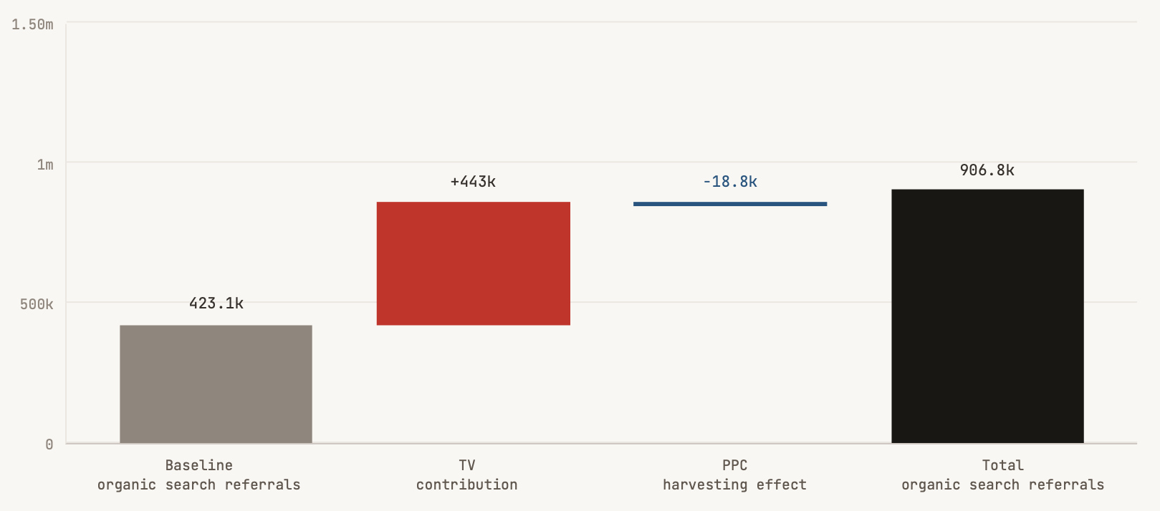
The Google Tax
A waterfall chart showing how baseline demand and TV advertising contribute towards organic search referrals for
Brand 2 (Insurance), and how paid search appears to capture part of that demand at the the point of click
92% of media uplift
PPC intercepted 4.2% of TV generated demand
TAM Ireland & Colourtext: The Google Tax 2026
Data Sources & Periods for Econometric Models: TAM Ireland, Similarweb, Nielsen Ad Intel | 31 Jul 2023 – 25 Aug 2025
Notes:
There was a second model for Brand 2 (Insurance) looking at organic search referrals, and it sharpens the picture further. Here the model estimates that television generated around 440,000 additional organic search referrals over the period. But when a paid listing sits above the free result, some people click the paid link instead of the organic one below it.
[CLICK]
The model suggests that about 19,000 organic referrals were diverted in this way, which is approximately 4% of the organic traffic TV had generated.

Slide 14
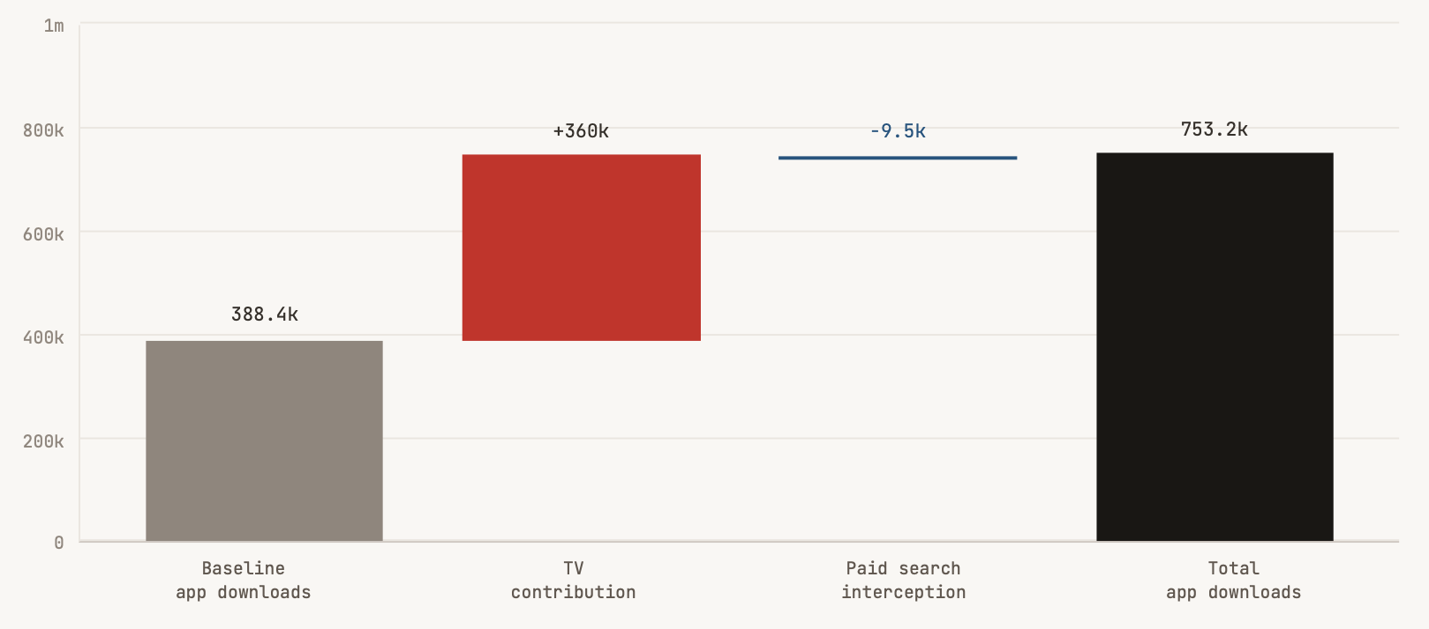
The Google Tax
A waterfall chart showing how baseline demand and TV advertising contribute towards Mobile App Downloads for
Brand 3 (Supermarket), and how paid search appears to capture part of that demand at the the point of click
PPC intercepted 2.7% of TV generated demand
TAM Ireland & Colourtext: The Google Tax 2026
Data Sources & Periods for Econometric Models: TAM Ireland, Similarweb, Nielsen Ad Intel | 31 Jul 2023 – 25 Aug 2025
Notes:
We saw the same pattern elsewhere. In the app downloads model for Brand 3 (Supermarket), paid search appears to have intercepted about 9,500 downloads, equal to 3% of the total downloads television had already stimulated.

Slide 15
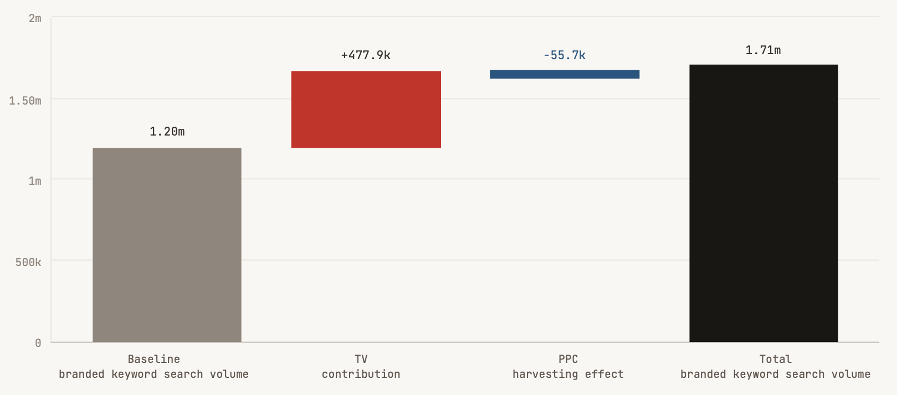
The Google Tax
A waterfall chart showing how baseline demand and TV advertising contribute towards Branded Keyword Search Volume for Brand 4 (Retail), and how paid search appears to capture part of that demand at the the point of click
PPC intercepted 11.7% of TV generated demand
TAM Ireland & Colourtext: The Google Tax 2026
Data Sources & Periods for Econometric Models: TAM Ireland, Similarweb, Nielsen Ad Intel | 31 Jul 2023 – 25 Aug 2025
Notes:
In the branded keyword search model for Brand 4 (Retail), paid search appears to have intercepted roughly 56,000 branded searches, or 12% of the total created by television. Different sectors, different consumer behaviours, same structural dynamic: TV is generating the demand, and paid search is collecting some of the credit and some of the money.
That, to my mind, is the key point. We are not looking at a few quirky brand cases with nothing in common. We are looking at a repeated pattern in which television’s upstream value leaks away to a channel that sits much closer to the point of conversion and is therefore much easier to measure.
Standard attribution then takes that easy-to-measure final step and quietly mistakes it for the whole journey.
The Google Tax is not just about marginal inefficiencies in media buying. It's about misreading where growth is coming from. To understand this better, we have to look more closely at one of television’s defining characteristics.
The influence of TV advertising does not vanish when the campaign stops. It lingers, accumulates and keeps shaping consumer behaviour long after the last spot has aired.

Slide 16

The TV Persistence Dividend:
TV builds a reservoir of brand memory
Notes:
That brings us to our next key finding: The TV Persistence Dividend, that reveals how television builds durable brand memory.
We’re drawing here from nine econometric models covering seven Irish consumer brands, selected because they illustrate one of television’s most important strengths as an advertising medium. TV can do more than generate an immediate ad response. In the models that illustrate this behaviour, TV is often building a reservoir of brand memory that carries value forward, week after week.
That matters commercially because it helps explain why television is so often under-credited in short-term attribution systems.
I used the word reservoir a moment ago, and I’ll come back to it shortly, because it is the single most useful way to think about what television does differently from performance media.

Slide 17


The TV Persistence Dividend
93%
of TV’s accumulated brand memory carried forward each week
Pay-Per-Click
Notes:
When you run a PPC campaign, the effect is essentially instantaneous. Someone searches, they click a link, and they convert, or they don’t. Turn off the spend, and the PPC effect stops. Compared with television, PPC usually behaves much more like a light switch. It tends to work on a much shorter time horizon, and PPC is very good at that.
[CLICK]
Television advertising doesn’t work like this. It behaves more like a slowly fading light bulb. You switch it off and the room doesn’t go dark immediately. The glow of TV’s brand memory lingers and only fades away slowly over weeks and months, rather than disappearing quickly in hours or days.
In econometric modelling, we measure this fade rate using something called an alpha decay parameter. Alpha is a number between zero and one. The closer it is to one, the slower the fade. In our study, the median alpha for television was 0.93.
[CLICK]
That means 93% of TV’s accumulated brand memory carries forward from one week to the next…
[CLICK]

Slide 18
The TV Persistence Dividend
Average TV half-life was
9 weeks
Pay-Per-Click
Notes:
…and it takes about nine weeks for half of that effect to drain away. That’s not a short campaign window, it's longer than two months.
What this tells us is that television’s influence on brand outcomes in these models does not evaporate at the end of a campaign flight. It lingers, compounds and it builds. And that has real commercial consequences.

Slide 19
TV’s brand memory half-life
Television’s influence on various brand outcomes in these models does not evaporate at the end of a campaign.
On average it takes about nine weeks for half of TV’s brand memory effect to fade away
9 week average half-life
(App downloads)
(Web visits)
(App sessions)
(App downloads)
(Organic search)
(App daily users)
(Organic search & branded keyword search)
(App downloads)
TV memory half-life in weeks
TAM Ireland & Colourtext: The Persistence Dividend 2026
Data Sources & Periods for Econometric Models: TAM Ireland, Similarweb, Nielsen Ad Intel | 31 Jul 2023 – 25 Aug 2025
Notes:
Across the set of nine models shown here, you can see how that effect plays out in practice. The half-life of television’s influence varies by brand and by outcome, but the pattern is consistent. [CLICK]
In several cases, the effect stretches well beyond the average half-life of nine weeks, and in two instances extends past fifty weeks. At the other end of the range, there are shorter-lived effects, but even these tend to persist for multiple weeks rather than days.
Now, here’s why this matters. If television’s effect on brand outcomes has a nine-week half-life, and you’re evaluating it over short term attribution window, you’re only seeing a fraction of what TV actually delivers. You’re looking at the early draw on TV's brand memory reservoir, not the full volume of value it goes on to release over time.

Slide 20

Draining the TV memory reservoir shows up slowly in lost brand performance
Pausing TV advertising is not a neutral act
50% of accumulated brand memory drains away after 9 weeks
TV’s value unfolds over longer horizons than measurement captures
This means it is routinely undervalued by short-term attribution systems
Notes:
And there’s a planning implication that follows directly from this. If TV is filling a reservoir of brand memory, then choosing to pause television in a budget meeting is not a neutral act. [CLICK]
It feels neutral at first. The brand memory reservoir is still there in week one, week two and week three. But it is draining. [CLICK]
At the median half-life in this study, which is nine weeks, a pause in TV activity of that duration will cost a brand half of its accumulated brand memory.
And by the time the loss of brand memory shows up in the performance of a paid search channel, any clear connection to the TV budget cut has often been lost. [CLICK]
When TV operates as a brand memory channel, it delivers value that unfolds over a far longer time horizon than standard attribution typically captures. [CLICK]
And that means it is routinely undervalued by the attribution systems that decide whether TV gets funded, or not.
This sets up our next headline finding.

Slide 21

Cut TV once, pay twice:
The hidden value of TV advertising
Notes:
Which is called, “Cut TV Once, Pay Twice: The Hidden Value of TV Advertising"
So the persistence dividend is not just a story about how long television’s own effect lasts. It is also a story about what that store of TV brand memory does to the channels around it.
In the Google Tax models, we saw one way that TV’s value can leak into paid search. But there is a second mechanism, and this one is even more important for budget planning. Sometimes television does not merely send demand in PPC’s direction. It makes PPC itself more productive.
The logic is straightforward. Television reaches people earlier, before they are ready to act. It builds familiarity, reduces uncertainty and makes the brand feel more recognisable when a buying moment eventually arrives. Later on, when consumers exposed to TV reach a search page, PPC is no longer addressing a cold audience. It is addressing people whose minds have already been warmed up by television. In those conditions, the paid listing carries more weight than it otherwise would. PPC is still doing useful work, but it is doing it with help.

Slide 22

Does PPC effectiveness change when TV is active?
Notes:
That is the part standard attribution usually misses.
To test for that effect properly, you need a different kind of model. A standard marketing mix model usually treats channels as independent. TV does its thing and PPC does something else. Add the two together and you have the answer.
An interaction model tests something more realistic. It asks whether PPC’s effectiveness changes when television activity is present. If the answer is yes, then television is not just making its own contribution to brand outcomes. It is also changing the return generated by search.
We found two clear and robust models where that positive boost effect showed up strongly and unambiguously.

Slide 23
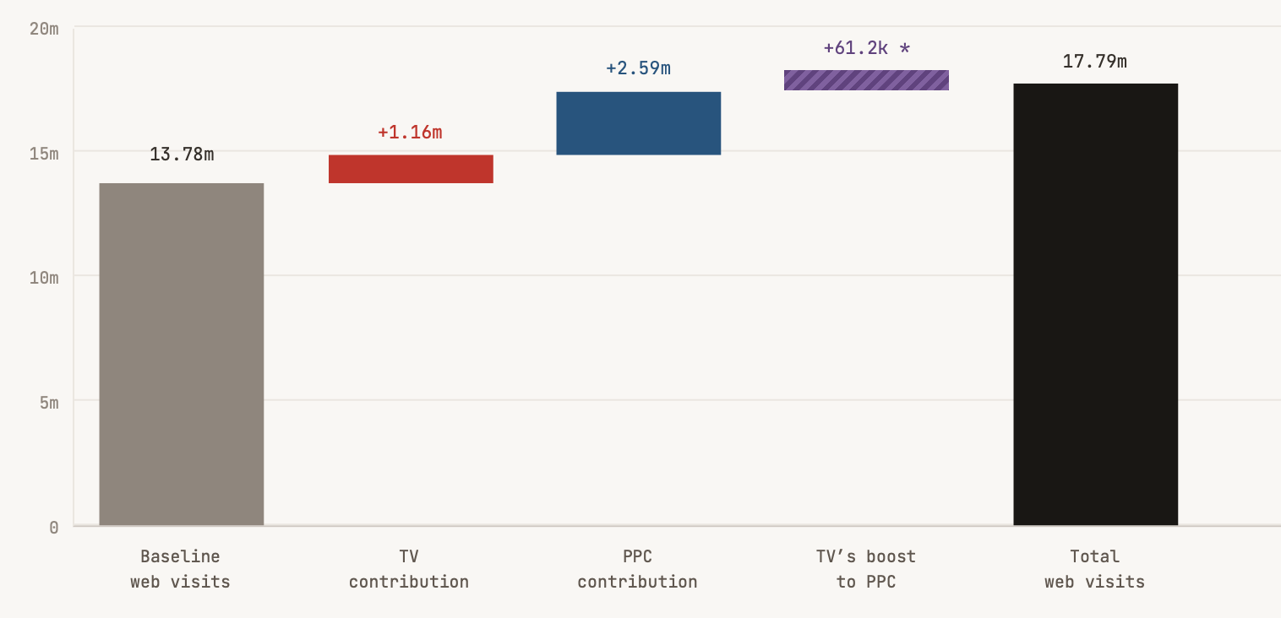
Last-click hands TV’s value to PPC
A waterfall chart showing how some of the Web Visits created by TV advertising for
Brand 11 (Online) are misattributed to PPC by last-click measurement
standard attribution hands 5% of TV’s total measured value to PPC
TAM Ireland & Colourtext: The Google Tax 2026
Data Sources & Periods for Econometric Models: TAM Ireland, Similarweb, Nielsen Ad Intel | 31 Jul 2023 – 25 Aug 2025
Notes:
So, here’s a waterfall chart showing how some of the Web Visits created by TV advertising for Brand 11 (Online) are miscredited to PPC by standard attribution measurement.
When this brand ran TV and paid search ads together, we discovered that standard attribution correctly credited TV with the 1million web visits it drove directly, which is the red bar in the chart here. [CLICK]
However, the interaction model found that the tally for PPC conversions (the blue bar) was getting boosted, incorrectly, by a further 61,000 visits that were actually generated by TV ads, and should have been added to television's account instead. Standard attribution will never produce that hidden number. [CLICK]
In this case, it hands 5.0% of the web visits that TV generated to paid search. This is a persistent structural miscount that, repeated across planning rounds, is another one of the mechanisms by which TV advertising leaks budget share to paid search.

Slide 24
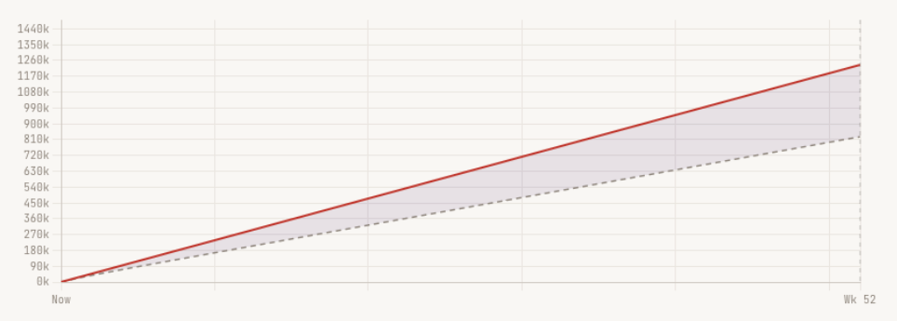
TV’s structural boost to PPC
Brand 11 (Online): What happens to the number of web visits PPC can convert one year after TV is cut
51%
Paid search converted around 51% more web visits when TV ads were running
PPC web visits with TV support
-33%
33%
If TV is cut to zero, PPC’s conversion rate would fall by 33% after 1 year
PPC web visits - zero TV support
Weeks after TV ended
TAM Ireland & Colourtext: The Google Tax 2026
Data Sources & Periods for Econometric Models: TAM Ireland, Similarweb, Nielsen Ad Intel | 31 Jul 2023 – 25 Aug 2025
Notes:
But the model picked up something else as well. We discovered that at typical levels of TV activity, paid search converted approximately 51% more web visits than it did without TV running. That means PPC was materially more productive because TV was active in the background. This led us to ask the model a very simple question: what happens to PPC productivity when TV ads stop? [CLICK]
The simulation we built estimated that if television were removed entirely from the advertising mix, PPC's conversion rate would fall by around 33% in the first year. [CLICK]
We can see what that looks like in this chart. It captures the full structural support that TV gives to PPC, a boost premium that is baked into everyday PPC attribution numbers that only becomes visible when TV is no longer there.

Slide 25
TV’s structural boost to PPC
Brand 11 (Online): What happens to the number of web visits PPC can convert one year after TV is cut
TV spend reduction | Year 1 fall in PPC conversion rate
10% budget cut | -3.3%
20% budget cut | -6.6%
40% budget cut | -13.2%
100% budget withdrawal | -33.1%
51%
Paid search converted around 51% more web visits when TV ads were running
33%
If TV is cut to zero, PPC’s conversion rate would fall by 33% after 1 year
TAM Ireland & Colourtext: The Google Tax 2026
Data Sources & Periods for Econometric Models: TAM Ireland, Similarweb, Nielsen Ad Intel | 31 Jul 2023 – 25 Aug 2025
Notes:
Admittedly, a complete withdrawal of TV spend is an extreme scenario, and a more realistic planning question would be what happens to paid search when TV investment is reduced incrementally.
The interaction model was able to forecast the drop in paid search conversion for a range of budget scenarios, which this table summarises.
A 10% cut in TV budget leads to a 3% drop in the effectiveness of paid search after 1 year,
A 20% cut to TV can be expected to lead to a 7% decline in PPC effectiveness,
And the model suggests a 40% cut in TV spend result in a 13% hit to PPC conversion rates after 12 months.

Slide 26
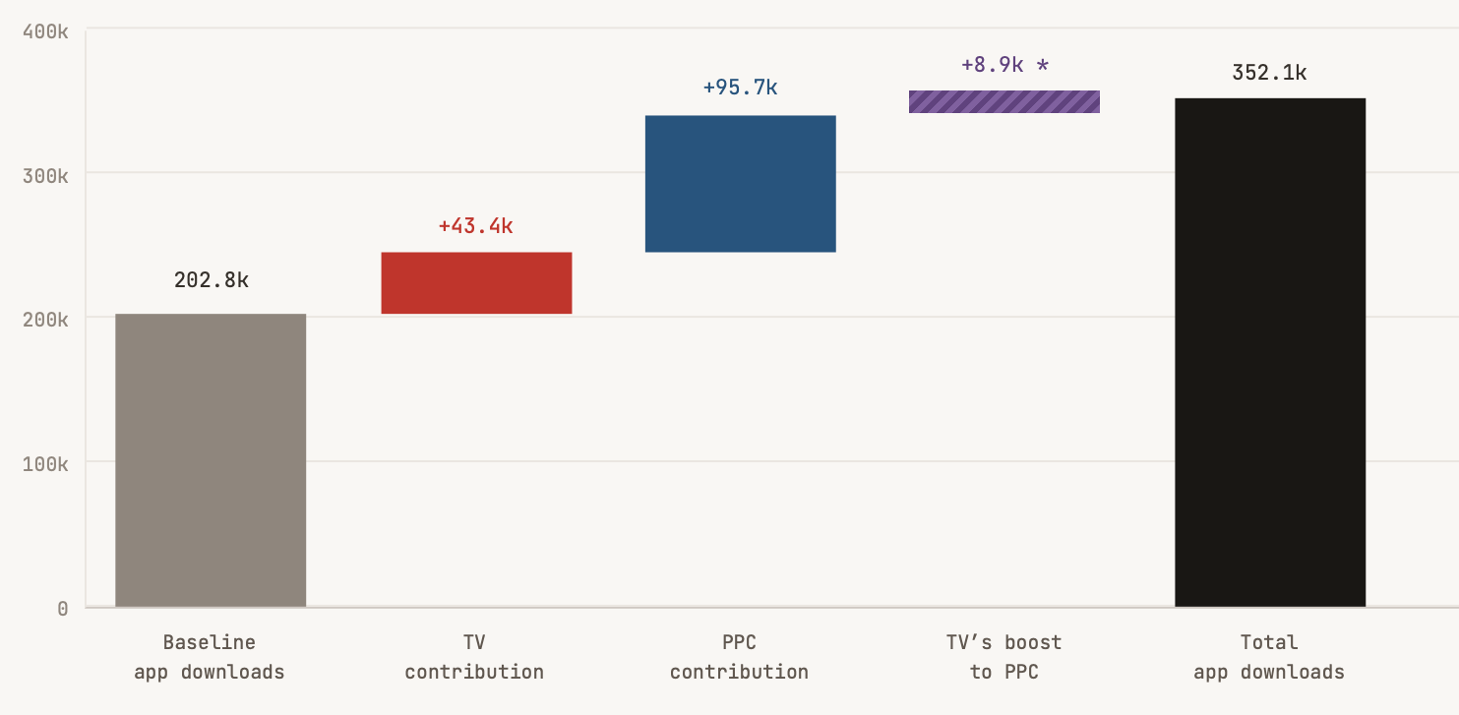
Last-click hands TV’s value to PPC
A waterfall chart showing how some of the mobile app downloads created by TV advertising for
Brand 10 (Insurance) are misattributed to PPC by last-click measurement
standard attribution hands 17% of TV’s total measured value to PPC
TAM Ireland & Colourtext: The Google Tax 2026
Data Sources & Periods for Econometric Models: TAM Ireland, Similarweb, Nielsen Ad Intel | 31 Jul 2023 – 25 Aug 2025
Notes:
Our second interaction model was for Brand 10 (Insurance), which tells a similar story, this time for Mobile App downloads. Standard attribution correctly credits TV with around 44,000 mobile app downloads, which is the red bar in the chart. [CLICK]
And as before, the interaction model found the tally for PPC conversions (the blue bar) was incorrectly boosted by an extra 9,000 downloads that should have been credited to television. [CLICK]
That suggests around 17% of the app downloads generated through TV’s priming effect are likely being misattributed to paid search by standard attribution systems.

Slide 27
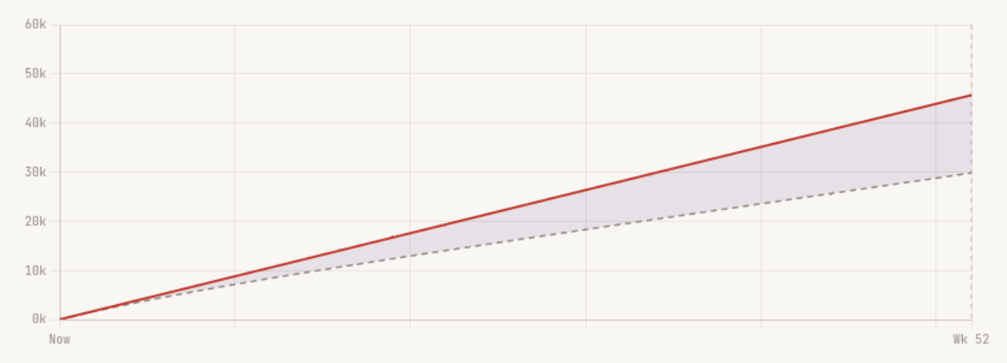
TV’s structural boost to PPC
Brand 10 (Insurance): What happens to the number of app downloads PPC can convert one year after TV is cut
69%
Paid search converted around 51% more app downloads when TV ads were running
PPC app downloads with TV support
-35%
35%
If TV is cut to zero, PPC’s conversion rate would fall by 33% after 1 year
PPC app downloads - zero TV support
Weeks after TV ended
TAM Ireland & Colourtext: The Google Tax 2026
Data Sources & Periods for Econometric Models: TAM Ireland, Similarweb, Nielsen Ad Intel | 31 Jul 2023 – 25 Aug 2025
Notes:
The interaction model also estimated that at typical levels of TV activity, paid search converted approximately 69% more mobile app downloads than it did without TV running. [CLICK]
When we asked the model what happens to PPC productivity when TV ads cease, the simulation estimated that if television was cut for a whole year, PPC's conversion rate would fall by around 35%.

Slide 28
TV’s structural boost to PPC
Brand 10 (Insurance): What happens to the number of app downloads PPC can convert one year after TV is cut
TV spend reduction | Year 1 fall in PPC conversion rate
10% budget cut | -3.5%
20% budget cut | -6.9%
40% budget cut | -13.9%
100% budget withdrawal | -34.7%
69%
Paid search converted around 51% more app downloads when TV ads were running
35%
If TV is cut to zero, PPC’s conversion rate would fall by 33% after 1 year
TAM Ireland & Colourtext: The Google Tax 2026
Data Sources & Periods for Econometric Models: TAM Ireland, Similarweb, Nielsen Ad Intel | 31 Jul 2023 – 25 Aug 2025
Notes:
And when we plug that into our life-like budget scenarios, the model predicted similar declines in PPC conversion rates.
So what these two cases tell us is that the attribution measurement problem is doing two things at once. It is overstating PPC’s independent performance, and it is hiding television’s indirect contribution.
And these figures refer only to the reduction in paid search performance. They actually sit on top of the direct losses the brand would suffer from cutting TV itself.
That is the logic behind the phrase Cut TV Once, Pay Twice.

Slide 29
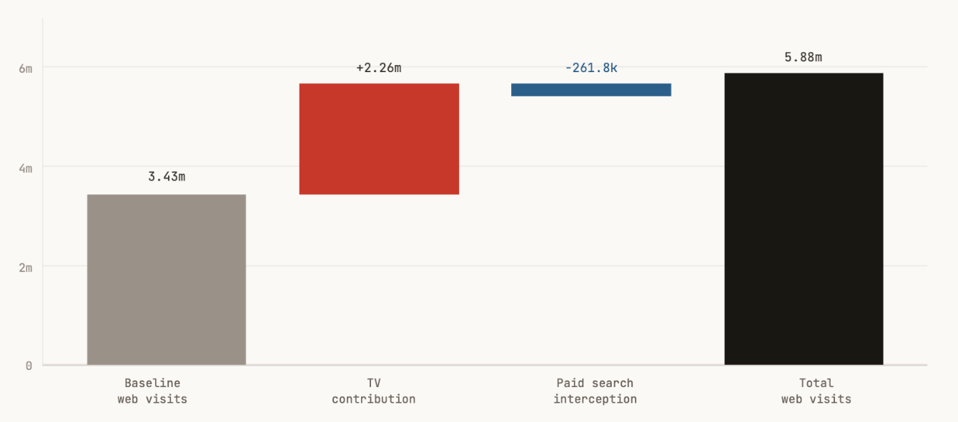
Cut TV once, take two hits
Brand 2 (Insurance): web visits
Cut TV and the first hit is obvious
You lose TV’s direct contribution to brand outcomes
e.g. TV delivered 90% of all media-generated uplift in mobile app downloads for Brand 2 (Insurance)
90% of media uplift
TAM Ireland & Colourtext: The Google Tax 2026
Data Sources & Periods for Econometric Models: TAM Ireland, Similarweb, Nielsen Ad Intel | 31 Jul 2023 – 25 Aug 2025
Notes:
when you cut television once, you risk taking two hits. The first hit is obvious. You lose television’s own direct contribution to web visits, app downloads or whatever outcome you are measuring.
We could see this clearly in The Google Tax models, like this one for Brand 2 (Insurance), where TV's direct contribution was measured at nearly 2.3 million web visits over two years.

Slide 30

The second hit is easier to miss
TV’s brand memory reservoir drains slowly
Search efficiency declines, CPA rates increase
PPC app downloads with TV support
-35%
PPC app downloads - zero TV support
Weeks after TV ended
TAM Ireland & Colourtext: The Google Tax 2026
Data Sources & Periods for Econometric Models: TAM Ireland, Similarweb, Nielsen Ad Intel | 31 Jul 2023 – 25 Aug 2025
Notes:
The second hit that follows a cut to TV is easier to miss. You also weaken the reservoir of consumer intent that had been making paid search work harder.
PPC becomes less productive, but the connection to the earlier TV budget cut is rarely visible in a standard attribution report. [CLICK]
We saw this really clearly through the interaction model for Brand 10 that we just looked at.
And because that brand memory reservoir drains gradually, the second hit often arrives slowly. It doesn't usually show up in the first week. It creeps in.
Search efficiency softens and Cost per acquisition rates starts to rise. Conversion performance looks a little less impressive than it did before.
The usual diagnosis is rising competition, higher keyword prices or tired creative. The possibility that paid search is underperforming because television support was reduced weeks or months earlier is not the sort of thing standard attribution is built to spot.

Slide 31

Shifting money in the wrong direction
Notes:
That is why I think this matters so much for budget allocation. If we attribute TV's contribution to brand outcomes badly, we don’t just misunderstand the past. We make worse decisions about the future.
As we have seen, standard attribution will often make TV look weaker than it is, and make performance channels look stronger than they actually are. [CLICK]
Automated optimisation tools are then using that distorted picture to shift money in the wrong direction. Rather than optimise brand communication, they are actually making it weaker by cutting support from the channel that was helping paid search investments perform.

Slide 32

Outcome > credit > money
Notes:
Let me end where I began. You might not be interested in econometrics, but econometrics is interested in you.
Because somewhere in a budget meeting, in an agency planning session, or in a boardroom review, somebody is deciding which channels created the outcome, which channels deserve the credit, and which channels deserve the money.
And if television does not show up properly in the attribution system used in that room, then television is not competing on fair terms.
That, really, is the central point of everything I’ve shown you today. The problem is not that TV has stopped working.
The problem is that too much of the work TV does happens earlier, lasts longer, and shows up in places that standard attribution systems are not built to recognise. That is why the attribution problem matters so much.

Slide 33
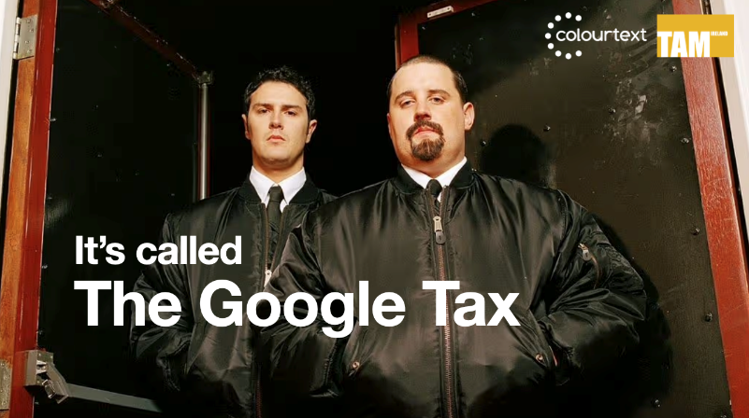
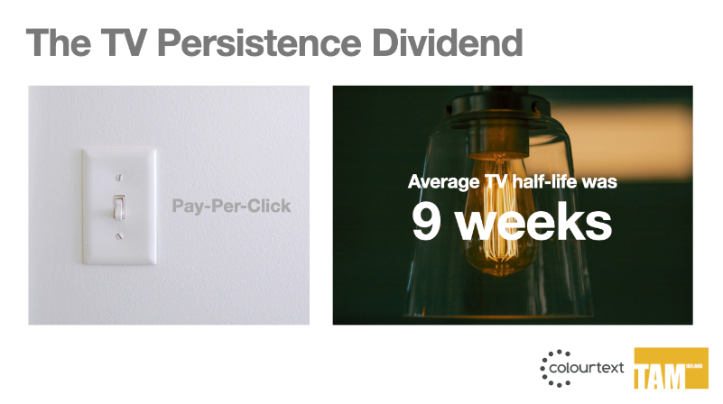

Summary conclusions
3 brands | 4 models
8 brands | 9 models
2 brands | 2 models
PPC intercepted between
2.7% - 11.7%
of demand generated by TV advertising that would otherwise have reached the brand organically
On average it took around
9 weeks
for half of TV’s brand memory effect to drain away
Paid Search was
51% & 69%
more productive when TV advertising ran at typical levels
Notes:
It is why the Google Tax matters. In 4 models across 3 brands, we saw PPC winning credit for something that it didn’t create by intercepting between 2.7% - 11.7% of demand generated by TV advertising that would otherwise have reached the brand organically, and for free. [CLICK]
It is why the Persistence Dividend matters. Across 9 models for 8 brands we found it took on average 9 weeks for half of TV's brand memory effect to drain away, demonstrating how Television builds a reservoir of brand memory that carries value forward week after week. [CLICK]
And it is why Cut TV Once, Pay Twice matters. We found two robust example where Paid Search was 51% and 69% more productive when TV advertising ran at typical levels. This demonstrates that when a brand cuts television, it may not just lose TV’s own direct contribution. It may also weaken the productivity of paid search that television had been quietly supporting in the background.

Slide 34

TV does more work than the numbers give it credit for
It’s building demand
It’s sustaining demand
It’s feeding channels that appear to outperform it
Notes:
The usual story says television is hard to account for, while performance channels are clean, efficient and measurable. Our evidence suggests the truth is more complicated, and rather more interesting. Television is often doing more work than the standard attribution give it credit for. [CLICK]
It is building demand. [CLICK]
It is sustaining demand. [CLICK]
It is sometimes feeding the very channels that appear to outperform it. [CLICK]
So I hope the main takeaway from this project is not simply that TV deserves a bit more appreciation. It is that TV deserves to be measured properly.
A channel that works over months should not be judged by an attribution window of just hours or days. A channel that builds demand should not be undervalued because another channel captures that demand later on.
And a channel that can raise the productivity of paid search should not be treated as though it sits outside the performance marketing story.

Slide 35

When we do bad attribution for TV
We make worse decisions about the future
Shift money in the wrong direction
Weaken the reservoir of brand memory
Make paid search look stronger than it is
When PPC conversions soften, we don’t link it to the original attribution mistake
Notes:
When we do bad attribution measurement for TV, we don’t just misunderstand the past. [CLICK]
We make worse decisions about the future. [CLICK]
We shift money in the wrong direction. [CLICK]
We weaken the reservoir of brand memory. [CLICK]
We make PPC look stronger than it really is, and TV look weaker than it really is. [CLICK]
Then, when the productivity of performance channels starts to soften, we tend to blame the market, the season, the competition, almost anything except perhaps the original attribution mistake.

Slide 36

Final thoughts
TV behaves more like a durable brand asset
It keeps working after the spot has aired
It creates value over longer horizons that attribution sees
When cut, the loss arrives later and proves larger & harder to see
Notes:
So the final thoughts I’ll leave you with are this. Television is not just another media line on a spreadsheet. [CLICK]
In the right conditions, it behaves much more like a durable brand asset. [CLICK]
It keeps working after the spot has aired. [CLICK]
It creates value that unfolds over longer horizons than standard attribution usually sees. [CLICK]
And when it is cut, the loss to a brand often arrives later, proves larger and is harder to see than the efficiency gains promised by an attribution dashboard.
That is why this matters. And that is why television’s commercial story, when measured properly, is stronger than the market has recently been encouraged to believe.

