Slide 1


May 2026
Viewing Trends

Slide 2
AVERAGE WEEKLY REACH: May 2026

Slide 3
TOP 10 ADVERTISERS: May 2026
1: Procter & Gamble
2: Vodafone Ireland
3: McDonalds
4: Dunnes Stores
05: Aldi
10: Heineken
07: Lidl
08: Supervalu
09: Reckitt Benckiser
06: OUTsurance

Slide 4

TOP 5 RTÉ PROGRAMMES
May 2026
Top 5 programmes by station group
Champions League Live - PSG v Arsenal:Live Sat 30-05-2026 17:02 - 19:59
2) RTÉ News: Nine O'Clock Sun 10-05-2026 21:00 - 21:22
3) RTÉ News: Six One Tue 19-05-2026 18:01 - 18:53
4) Cheap Irish Homes Tue 19-05-2026 19:00 - 19:25
5) The Late Late Show Fri 01-05-2026 21:35 - 23:03
Notes:
Top 5 programmes – Channel 4

Slide 5

TOP 5 VIRGIN MEDIA PROGRAMMES
May 2026
Top 5 programmes by station group.
1) Coronation Street Tue 12-05-2026 20:30 - 20:56
2) Emmerdale Tue 12-05-2026 20:00 - 20:26
3) News at 5:30 Mon 04-05-2026 17:30 - 17:53
4) Britain's Got Talent S19 Sat 02-05-2026 18:59 - 21:04
5) The 1% Club S3 Sat 16-05-2026 21:03 - 21:56
Notes:
Top 5 programmes – Channel 4

Slide 6
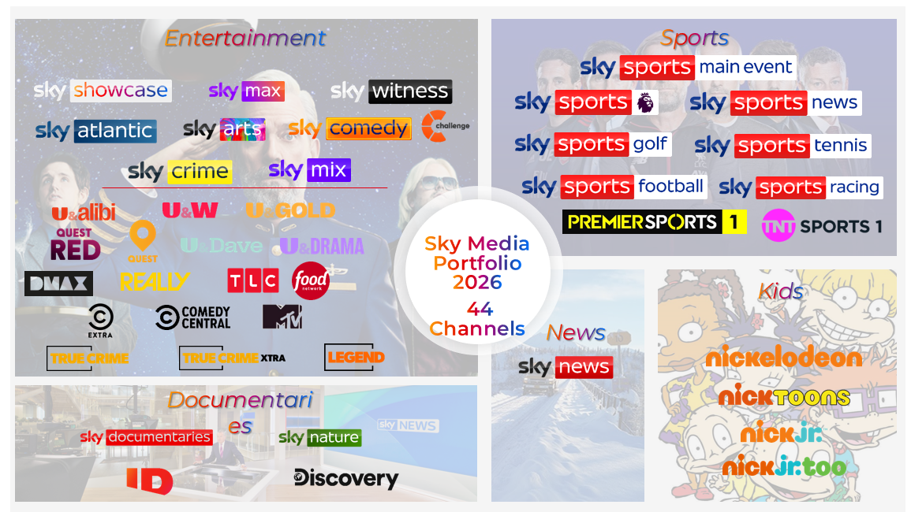
TOP 5 SKY MEDIA PROGRAMMES
May 2026
Top 5 programmes by station group.
1) LIVE PL: MAN UTD V NOTT'M FOREST Sun 17-05-2026 12:00 - 14:30
2) LIVE PL: MAN UTD V LIVERPOOL Sun 03-05-2026 14:02 - 17:55
3) LIVE PL: WEST HAM V ARSENAL Sun 10-05-2026 16:03 - 20:03
4) LIVERPOOL V CHELSEA Sat 09-05-2026 11:00 - 14:49
5) INVESTEC CHAMPIONS CUP 2025/26 Sat 02-05-2026 14:00 - 17:11
Notes:
Top 5 programmes – Channel 4

Slide 7

TOP 5 4 SALES PROGRAMMES
May 2026
Top 5 programmes by station group.
1) GOGGLEBOX Fri 22-05-2026 21:01 - 21:58
2) FALLING Tue 19-05-2026 21:01 - 22:02
3) MARRIED AT FIRST SIGHT AUSTRALIA Thu 07-05-2026 19:29 - 21:05
4) TIP TOE Sun 31-05-2026 21:02 - 21:59
5) LOCATION LOCATION LOCATION S45 Wed 20-05-2026 19:59 - 20:57
Notes:
Top 5 programmes – Channel 4

Slide 8
TOP 5 PARAMOUNT PROGRAMMES
May 2026
Top 5 programmes by station group.
1) BEN & HOLLY'S LITTLE KINGDOM Wed 27-05-2026 19:45 - 19:55
2) FRIENDS Sat 23-05-2026 19:32 - 19:58
3) MICHAEL MCINTYRE'S THE WHEEL Sat 23-05-2026 19:59 - 20:58
4) FILM: THE WATERBOY (1998) Tue 26-05-2026 21:00 - 22:41
5) THE THUNDERMANS: UNDERCOVER Sat 09-05-2026 19:00 - 19:25
Notes:
Top 5 programmes – Channel 4

Slide 9

TOP 5 TG4 PROGRAMMES
May 2025
1) GAA BEO 2026 Sun 31-05-2026 13:30 - 16:00
2) Rugbaí Beo URC 2025 - 2026 Fri 15-05-2026 19:40 - 21:42
3) Glór Tíre - Athghearradh Sraith 17 Tue 05-05-2026 22:01 - 22:27
4) Unforgiven Fri 08-05-2026 22:22 - 24:38
5) Viva Ceol Tíre 3 Tue 05-05-2026 21:31 - 21:57
Top 5 programmes by station group
Notes:
Top 5 programmes – Channel 4

